Slide 1
01-1
This work is licensed under a Creative Commons Attribution-ShareAlike 4.0 International License.
Please add this statement to all the videos you create.
English Bible quotes are from the World English Bible US, which is in the public domain.

Slide 2
Creation –
Genesis 1

Slide 3
Creation –
Genesis 1
བཀོད་པ 1
འཛམ་གླིང་བཀོད་པ།

Slide 4
Creation –
Genesis 1

Slide 5
1In the beginning, God created the heavens and the earth.

Slide 6
Genesis 1:1,2

Slide 7
2The earth was formless and empty. Darkness was on the surface of the deep and God’s Spirit was hovering over the surface of the waters.

Slide 8
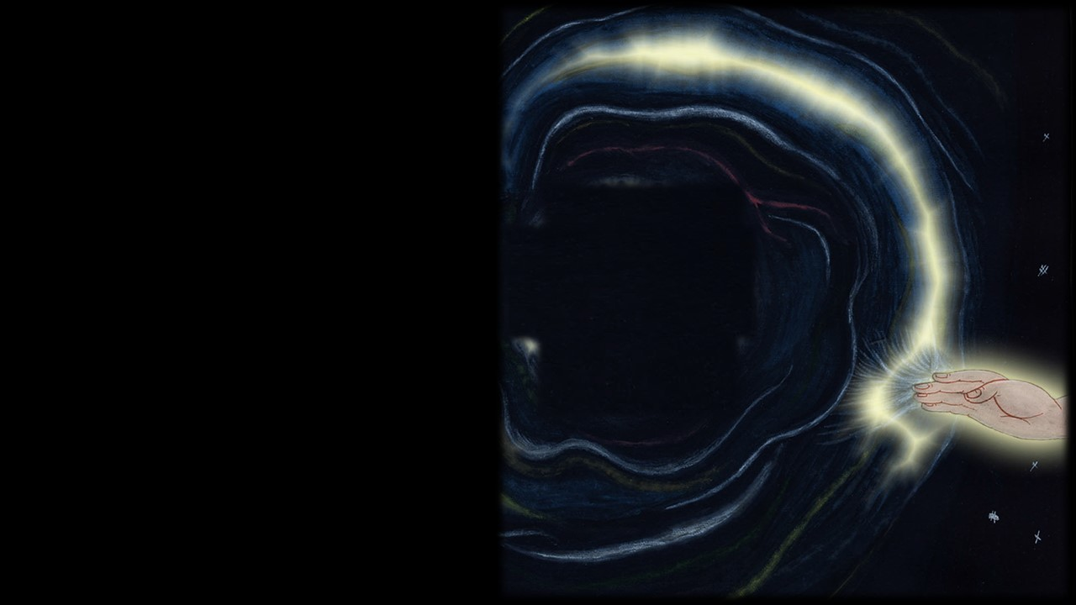
Genesis 1:3

Slide 9
3God said, “Let there be light,” and there was light.

Slide 10
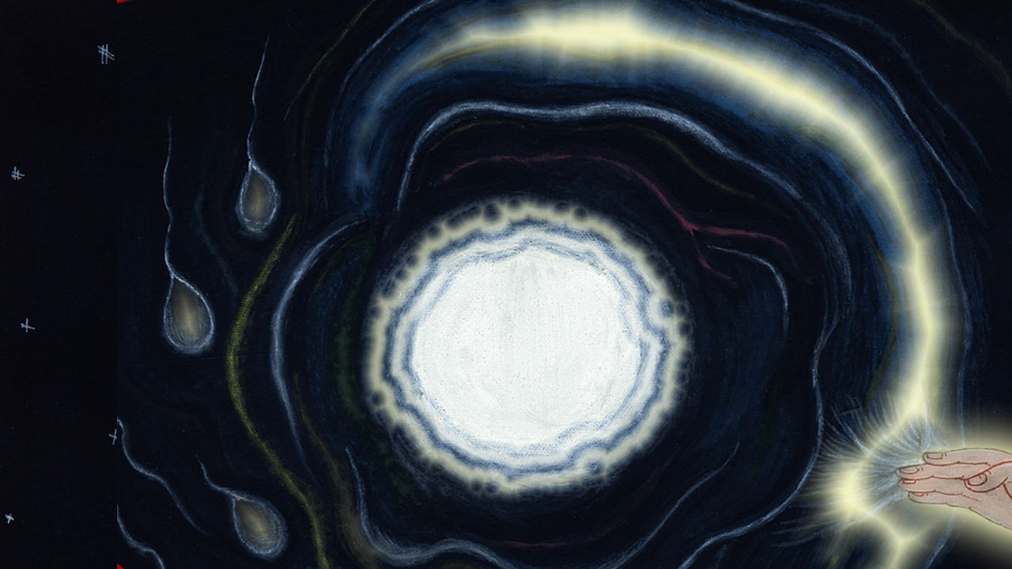
Genesis 1:3

Slide 11
4God saw the light, and saw that it was good. God divided the light from the darkness.

Slide 12
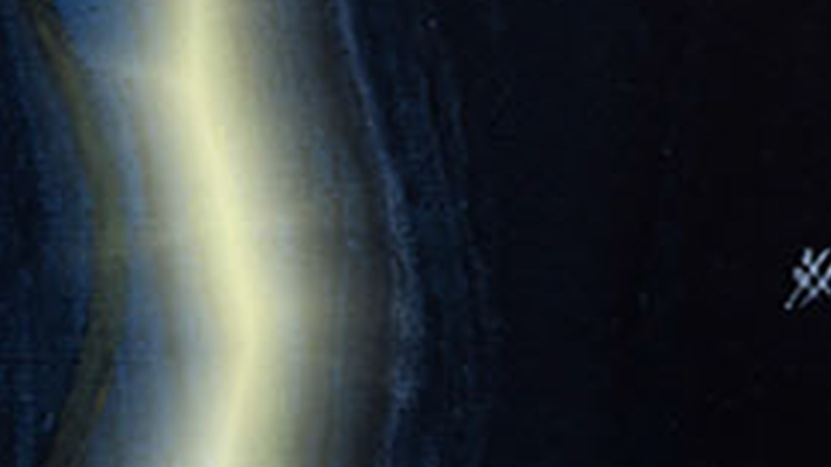
Genesis 1:4

Slide 13
5God called the light “day”, and the darkness he called “night”. There was evening and there was morning, the first day.

Slide 14
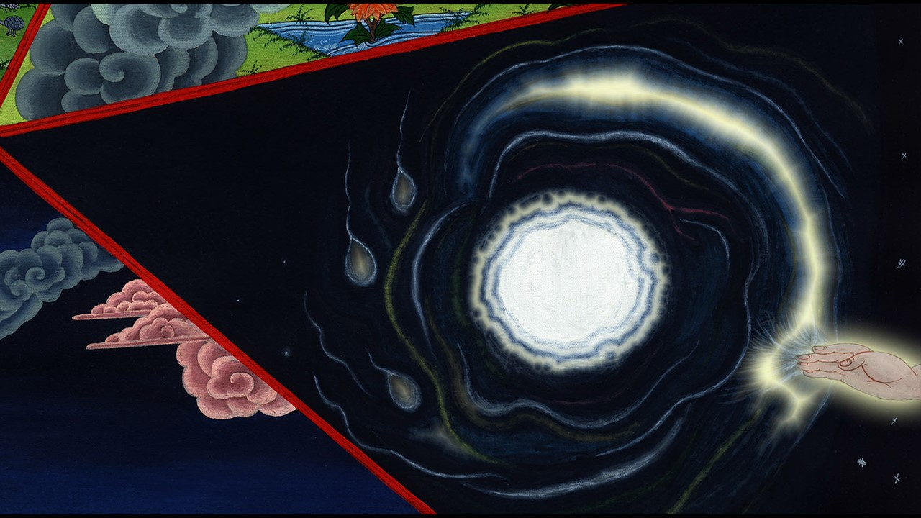
Genesis 1:5

Slide 15
6God said, “Let there be an expanse in the middle of the waters, and let it divide the waters from the waters.”

Slide 16
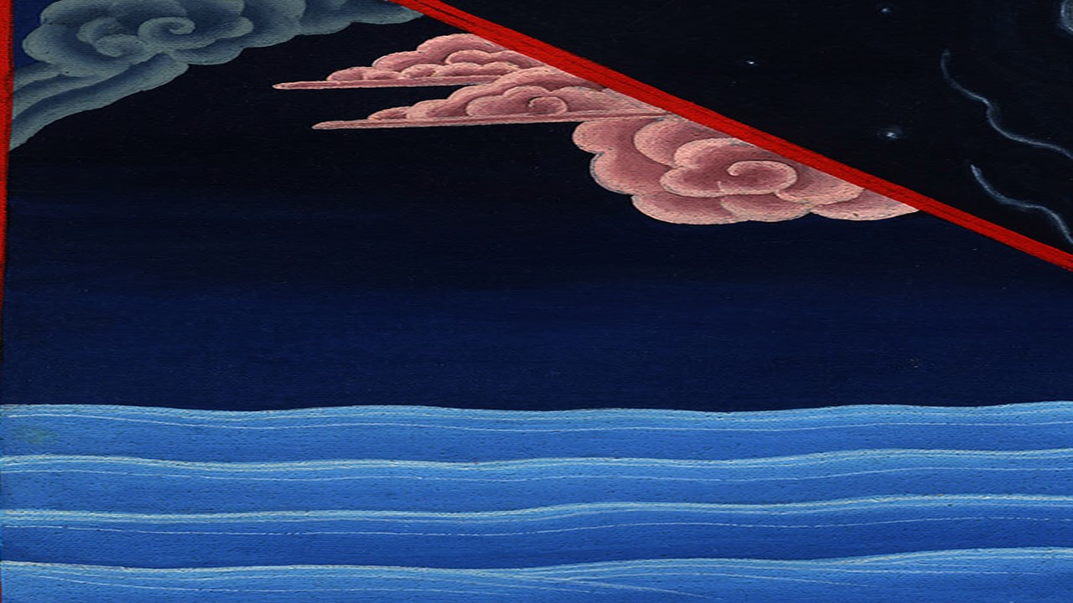
Genesis 1:6

Slide 17
7God made the expanse, and divided the waters which were under the expanse from the waters which were above the expanse; and it was so.

Slide 18
Genesis 1:7

Slide 19
8God called the expanse “sky”. There was evening and there was morning, a second day.

Slide 20
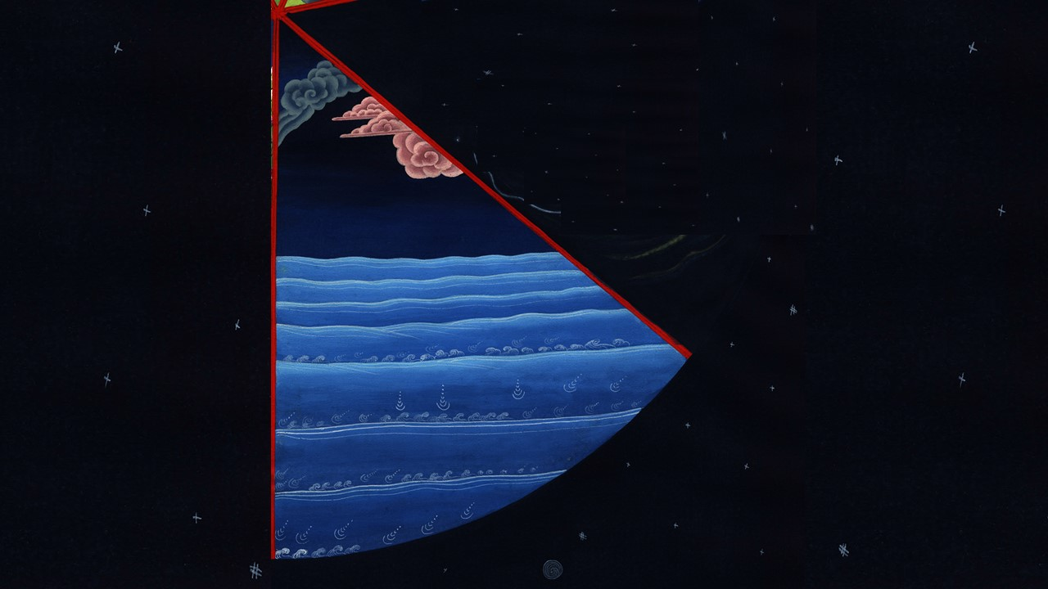
Genesis 1:8

Slide 21
9God said, “Let the waters under the sky be gathered together to one place, and let the dry land appear;” and it was so.

Slide 22
Genesis 1:9

Slide 23
10God called the dry land “earth”, and the gathering together of the waters he called “seas”. God saw that it was good.

Slide 24
Genesis 1:10

Slide 25
11God said, “Let the earth yield grass, herbs yielding seeds, and fruit trees bearing fruit after their kind, with their seeds in it, on the earth;” and it was so.

Slide 26
Genesis 1:11

Slide 27
12The earth yielded grass, herbs yielding seed after their kind, and trees bearing fruit, with their seeds in it, after their kind; and God saw that it was good. 13There was evening and there was morning, a third day.

Slide 28
Genesis 1:12,13

Slide 29
14God said, “Let there be lights in the expanse of the sky to divide the day from the night; and let them be for signs to mark seasons, days, and years;

Slide 30
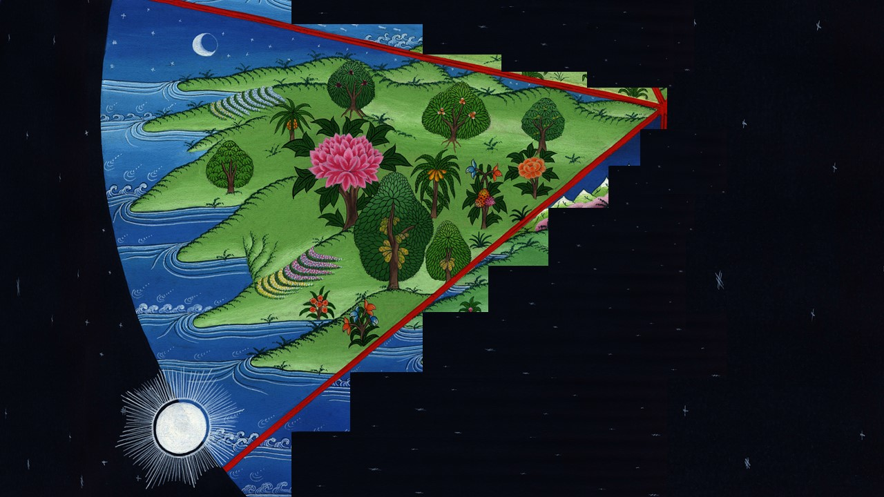
Genesis 1:14

Slide 31
15and let them be for lights in the expanse of the sky to give light on the earth;” and it was so.

Slide 32
Genesis 1:15

Slide 33
16God made the two great lights: the greater light to rule the day, and the lesser light to rule the night. He also made the stars.

Slide 34
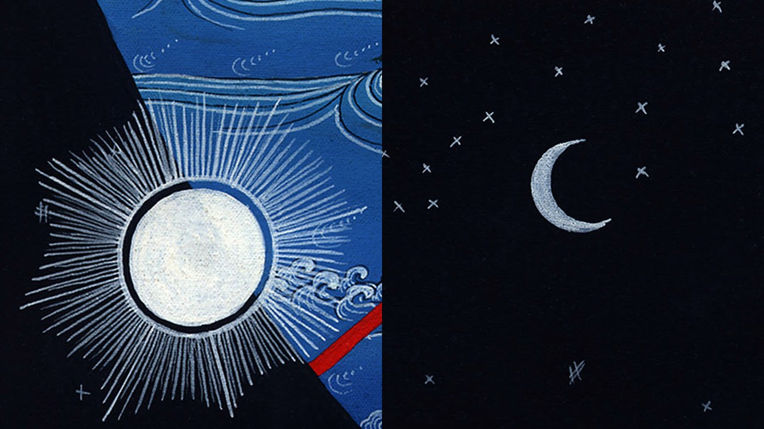
Genesis 1:16

Slide 35
17God set them in the expanse of the sky to give light to the earth, 18and to rule over the day and over the night, and to divide the light from the darkness. God saw that it was good.

Slide 36
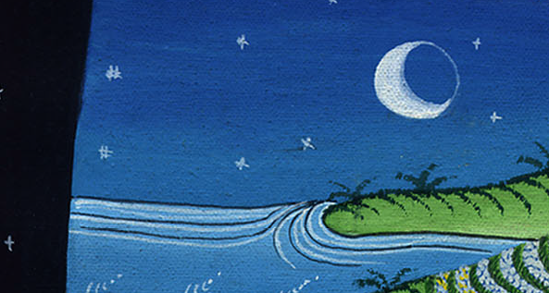
Genesis 1:17,18

Slide 37
19There was evening and there was morning, a fourth day.

Slide 38
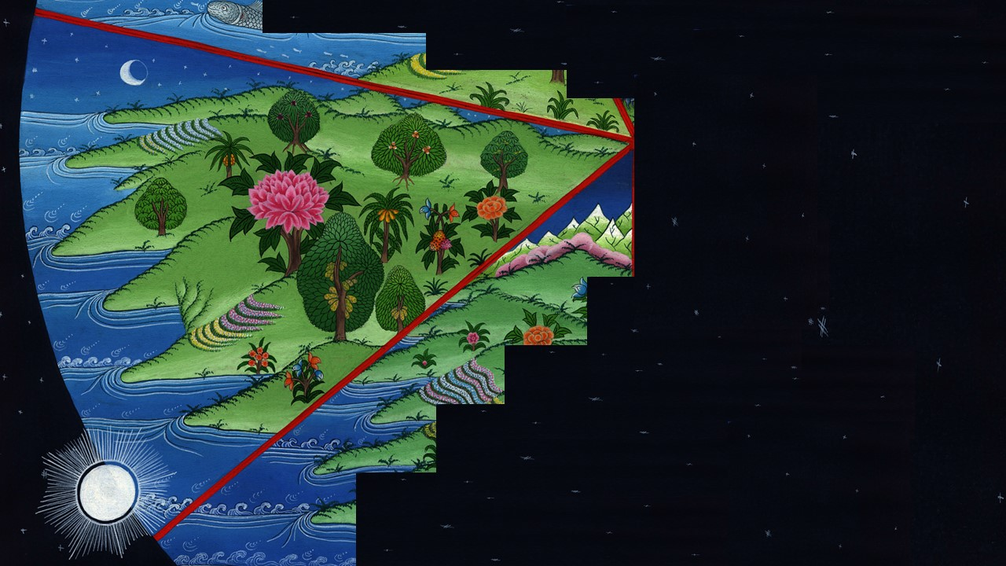
Genesis 1:19

Slide 39
20God said, “Let the waters abound with living creatures, and let birds fly above the earth in the open expanse of the sky.”

Slide 40
Genesis 1:20

Slide 41
21God created the large sea creatures and every living creature that moves, with which the waters swarmed, after their kind, and every winged bird after its kind. God saw that it was good.

Slide 42
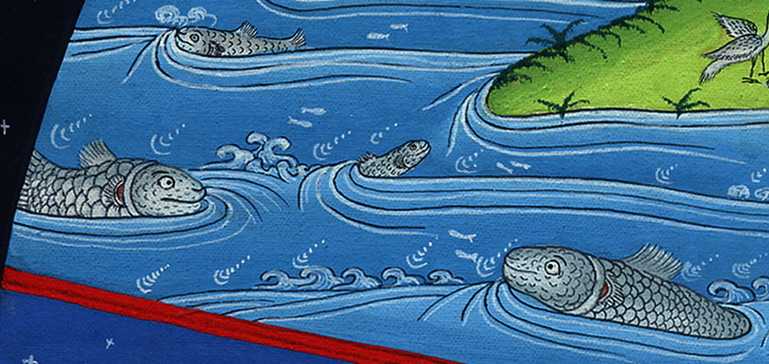
Genesis 1:21

Slide 43
22God blessed them, saying, “Be fruitful, and multiply, and fill the waters in the seas, and let birds multiply on the earth.”

Slide 44
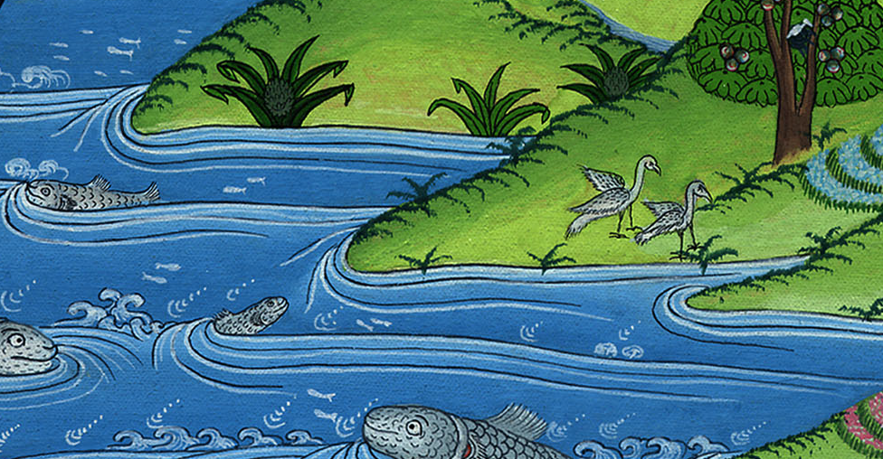
Genesis 1:22

Slide 45
23There was evening and there was morning, a fifth day.

Slide 46
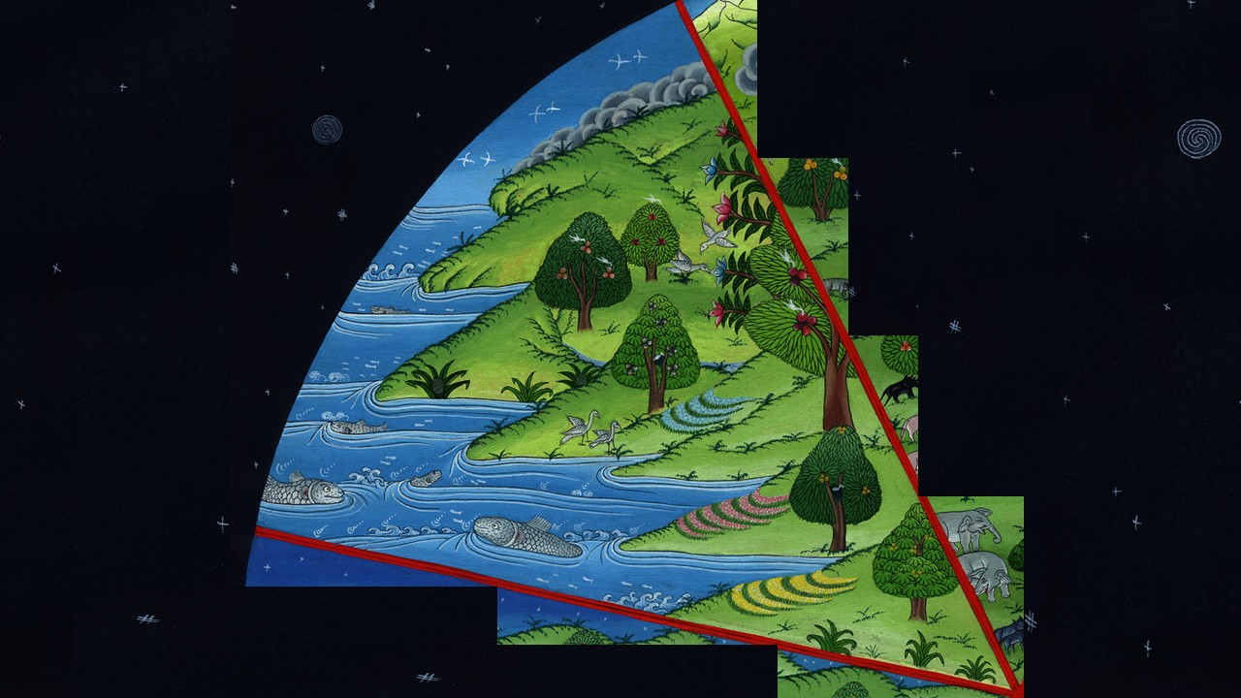
Genesis 1:23

Slide 47
24God said, “Let the earth produce living creatures after their kind, livestock, creeping things, and animals of the earth after their kind;” and it was so.

Slide 48
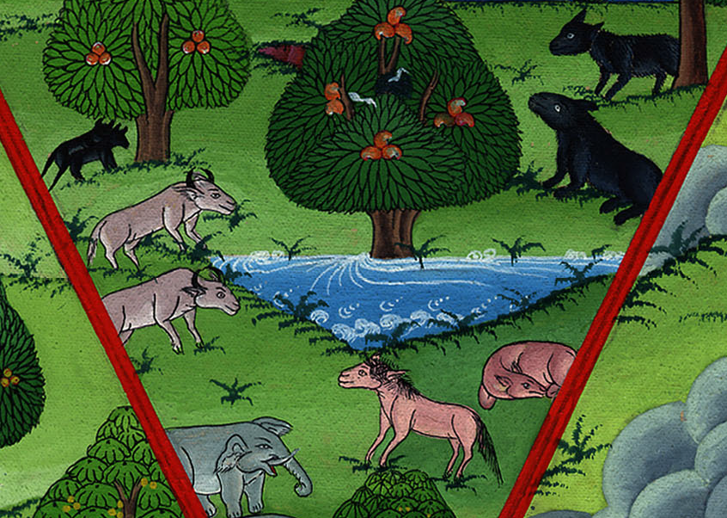
Genesis 1:24

Slide 49
25God made the animals of the earth after their kind, and the livestock after their kind, and everything that creeps on the ground after its kind. God saw that it was good.

Slide 50
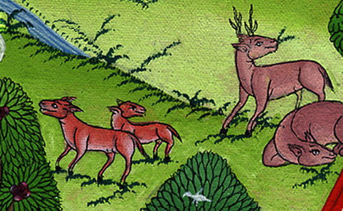
Genesis 1:25

Slide 51
26God said, “Let’s make man in our image, after our likeness. Let them have dominion over the fish of the sea, and over the birds of the sky, and over the livestock, and over all the earth, and over every creeping thing that creeps on the earth.”

Slide 52
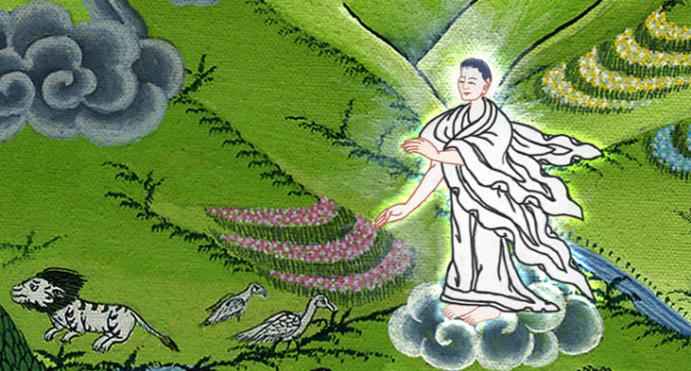
Genesis 1:26

Slide 53
27God created man in his own image. In God’s image he created him; male and female he created them.

Slide 54
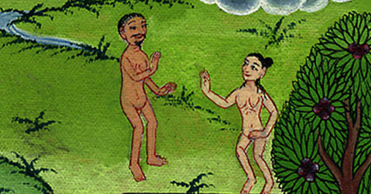
Genesis 1:27

Slide 55
28God blessed them. God said to them, “Be fruitful, multiply, fill the earth, and subdue it. Have dominion over the fish of the sea, over the birds of the sky, and over every living thing that moves on the earth.”

Slide 56
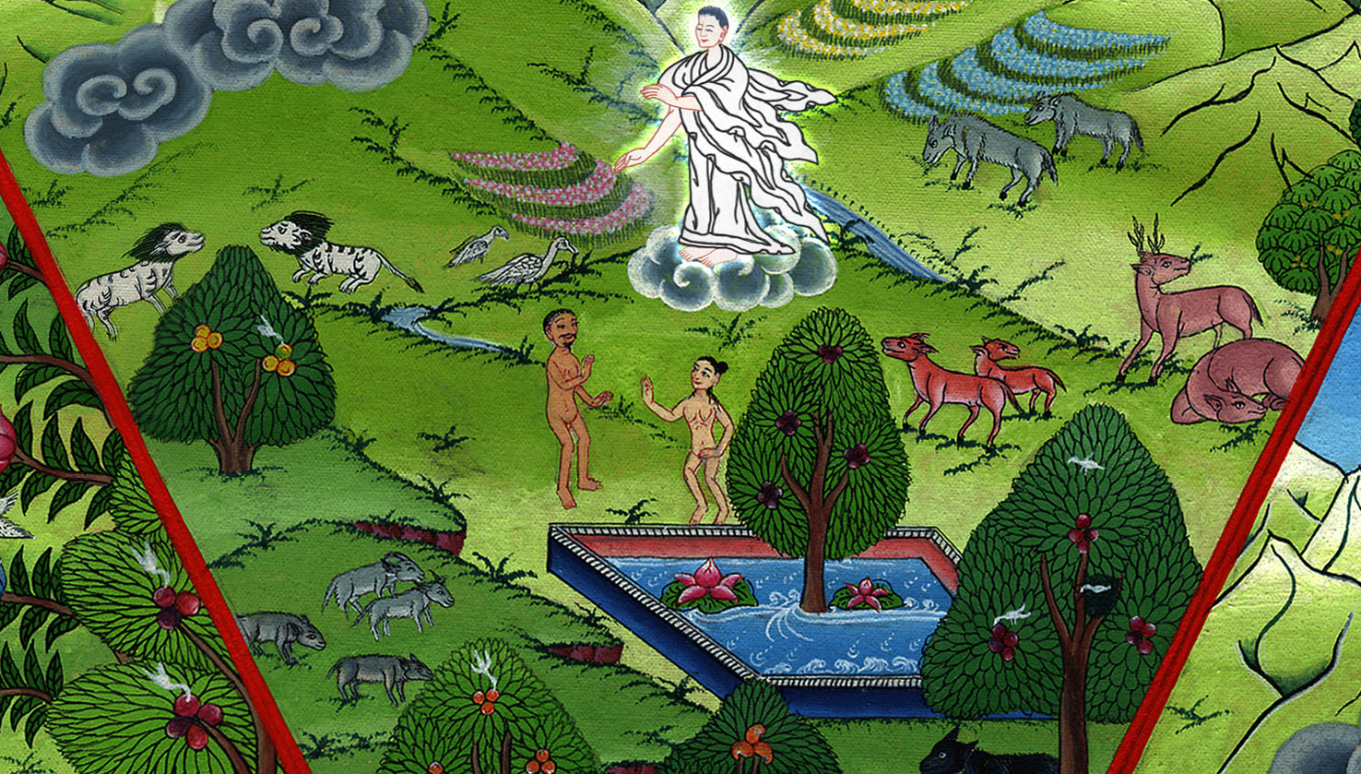
Genesis 1:28

Slide 57
29God said, “Behold, I have given you every herb yielding seed, which is on the surface of all the earth, and every tree, which bears fruit yielding seed. It will be your food.

Slide 58
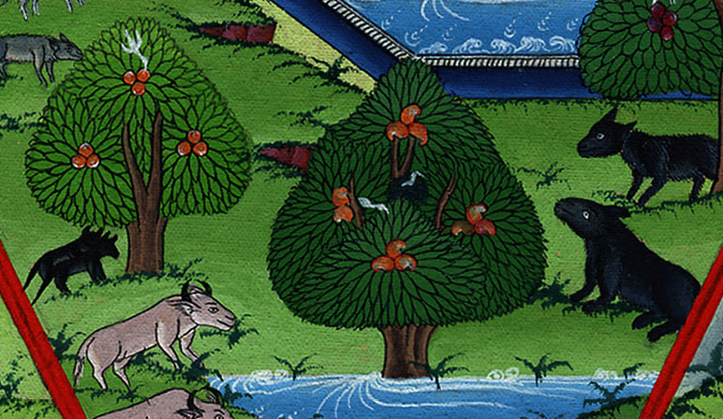
Genesis 1:29

Slide 59
30To every animal of the earth, and to every bird of the sky, and to everything that creeps on the earth, in which there is life, I have given every green herb for food;” and it was so.

Slide 60
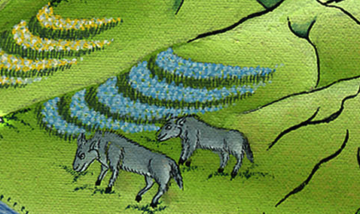
Genesis 1:30

Slide 61
31God saw everything that he had made, and, behold, it was very good.

Slide 62
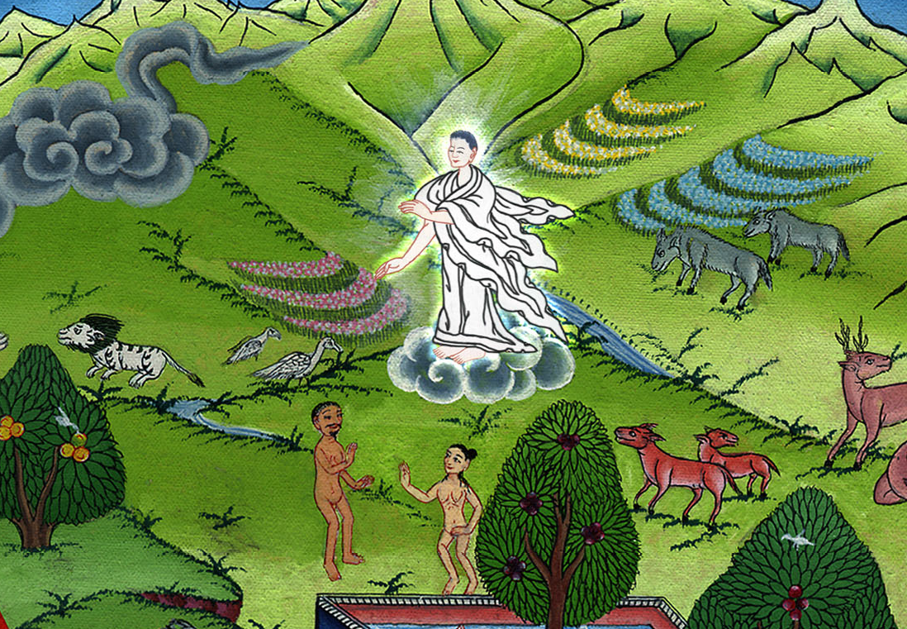
Genesis 1:31

Slide 63
…There was evening and there was morning, a sixth day. 2:1The heavens, the earth, and all their vast array were finished.

Slide 64
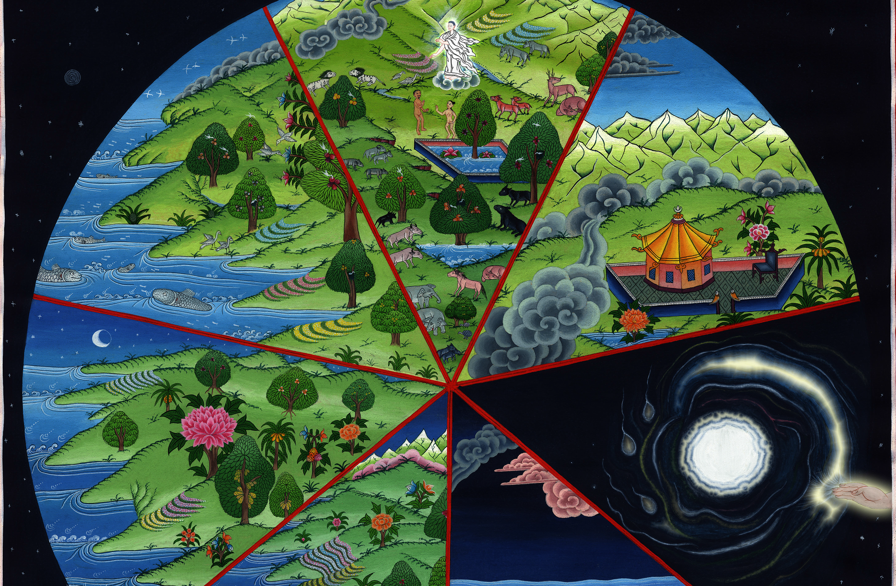
Genesis 2:1

Slide 65
2On the seventh day God finished his work which he had done; and he rested on the seventh day from all his work which he had done.

Slide 66
Genesis 2:2

Slide 67
3God blessed the seventh day, and made it holy, because he rested in it from all his work of creation which he had done.

Slide 68
Genesis 2:3

Slide 69
4This is the history of the generations of the heavens and of the earth when they were created, in the day that Yahweh God made the earth and the heavens.

Slide 70
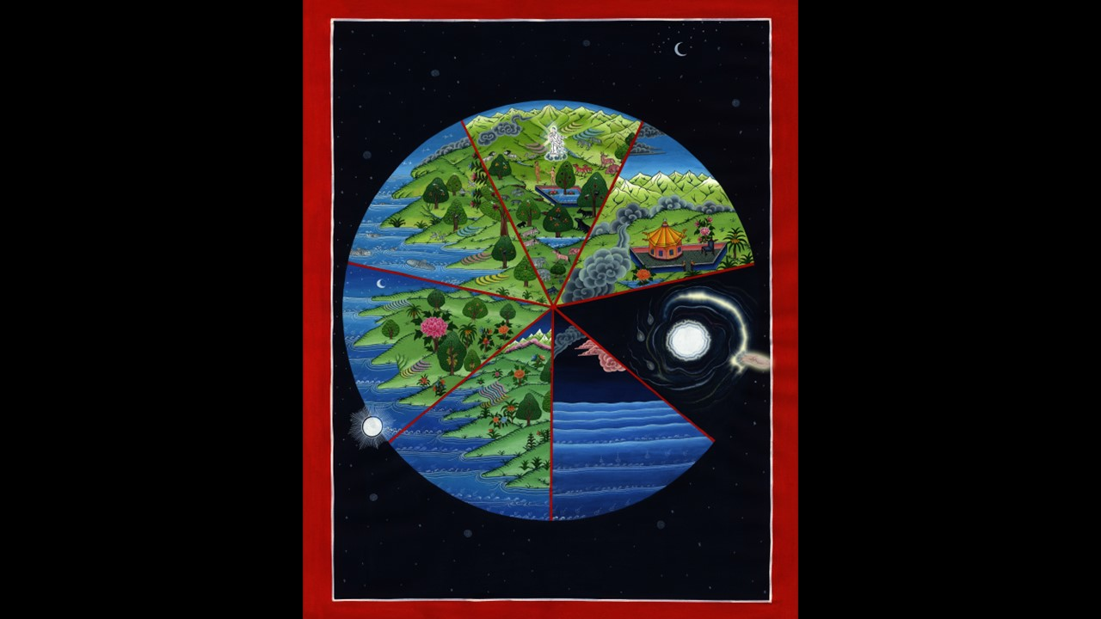
Genesis 2:4

