Slide 1
02-2
This work is licensed under a Creative Commons Attribution-ShareAlike 4.0 International License.
Please add this statement to all the videos you create.
English Bible quotes are from the World English Bible US, which is in the public domain.

Slide 2
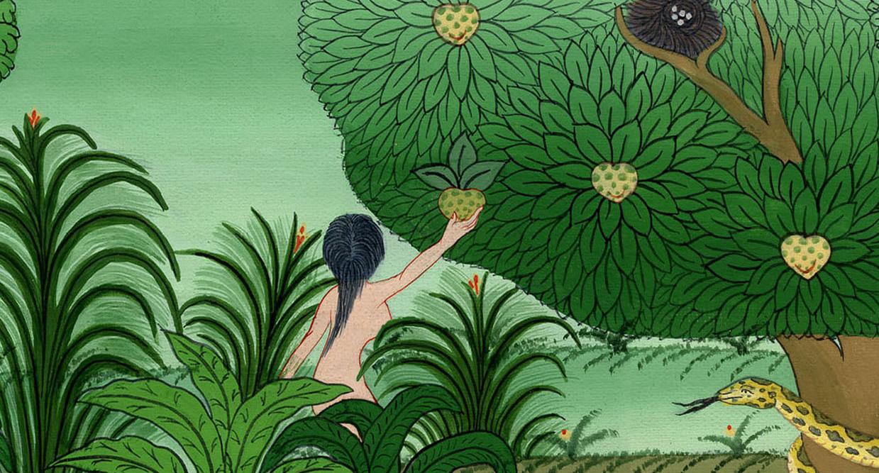
Satan tempts Eve - Genesis 3:1-6

Slide 3
Satan tempts Eve - Genesis 3:1-6

Slide 4
Satan tempts Eve - Genesis 3:1-6
Notes:
Serpent tempts Eve - Gen 3:1-5

Slide 5
2:15Yahweh God took the man, and put him into the garden of Eden to cultivate and keep it. 16Yahweh God commanded the man, saying, “You may freely eat of every tree of the garden; 17but you shall not eat of the tree of the knowledge of good and evil; for in the day that you eat of it, you will surely die.”

Slide 6
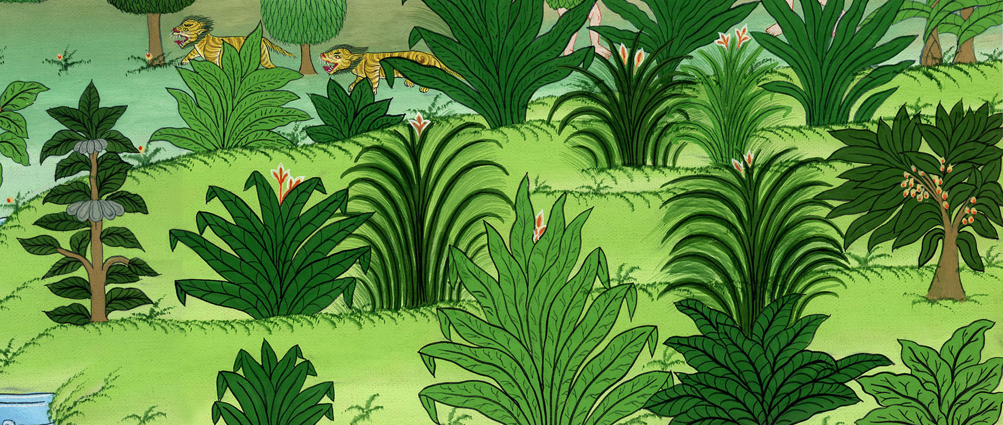
Genesis 2:15-17
Notes:
GEN 2:15¹⁵ The Lord God put the man in the Garden of Eden. He put him there to farm its land and take care of it. ¹⁶ The Lord God gave the man a command. He said, “You may eat fruit from any tree in the garden. ¹⁷ But you must not eat the fruit from the tree of the knowledge of good and evil. If you do, you will certainly die.”

Slide 7
1Now the serpent was more subtle than any animal of the field which Yahweh God had made. He said to the woman, “Has God really said, ‘You shall not eat of any tree of the garden’?”

Slide 8
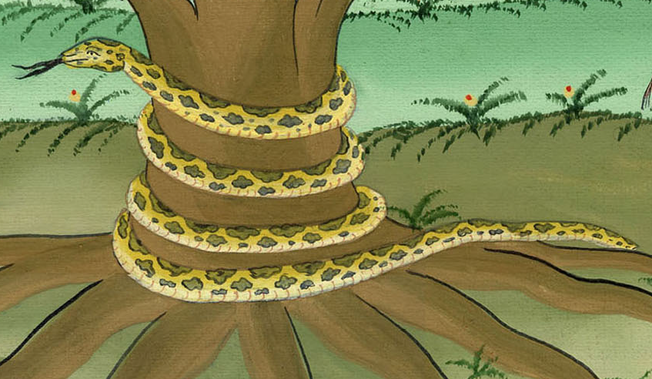
Genesis 3:1
Notes:
3 The serpent was more clever than any of the wild animals the Lord God had made. The serpent said to the woman, “Did God really say, ‘You must not eat fruit from any tree in the garden’?”

Slide 9
2The woman said to the serpent, “We may eat fruit from the trees of the garden,

Slide 10
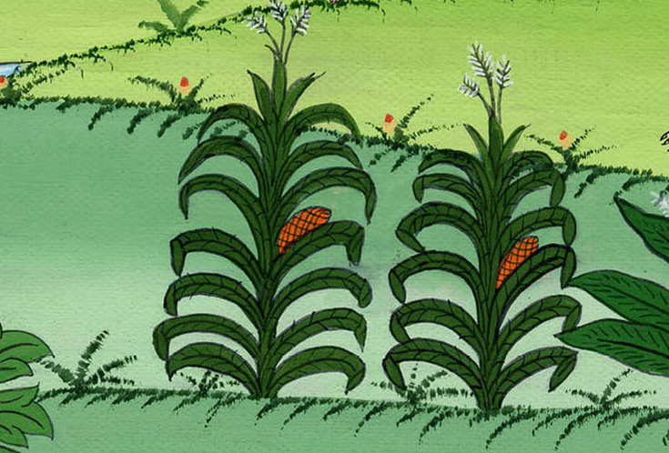
Genesis 3:2
Notes:
² The woman said to the serpent, “We may eat fruit from the trees in the garden

Slide 11
3but not the fruit of the tree which is in the middle of the garden. God has said, ‘You shall not eat of it. You shall not touch it, lest you die.’”

Slide 12
Genesis 3:3
Notes:
. ³ But God did say, ‘You must not eat the fruit from the tree in the middle of the garden. Do not even touch it. If you do, you will die.’ ”

Slide 13
4The serpent said to the woman, “You won’t really die,

Slide 14
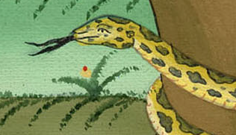
Genesis 3:4
Notes:
⁴ “You will certainly not die,” the serpent said to the woman.

Slide 15
5for God knows that in the day you eat it, your eyes will be opened, and you will be like God, knowing good and evil.”

Slide 16
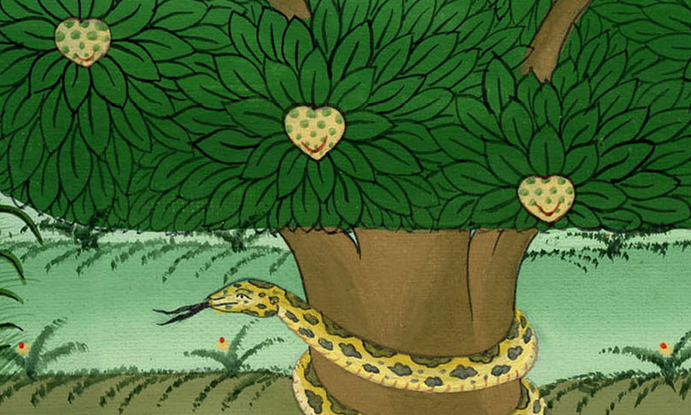
Genesis 3:5
Notes:
. ⁵ “God knows that when you eat fruit from that tree, you will know things you have never known before. Like God, you will be able to tell the difference between good and evil.”

Slide 17
6When the woman saw that the tree was good for food, and that it was a delight to the eyes, and that the tree was to be desired to make one wise,

Slide 18
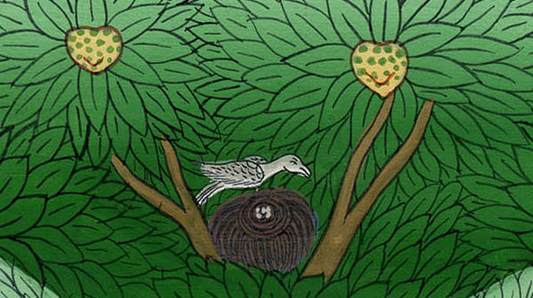
Genesis 3:6
Notes:
⁶ The woman saw that the tree’s fruit was good to eat and pleasing to look at. She also saw that it would make a person wise

Slide 19
6….she took some of its fruit, and ate.

Slide 20
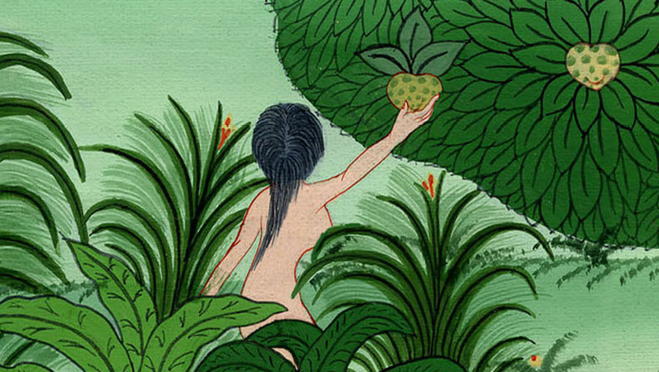
Genesis 3:6
Notes:
. So she took some of the fruit and ate it

Slide 21
6…Then she gave some to her husband with her, and he ate it, too.

Slide 22
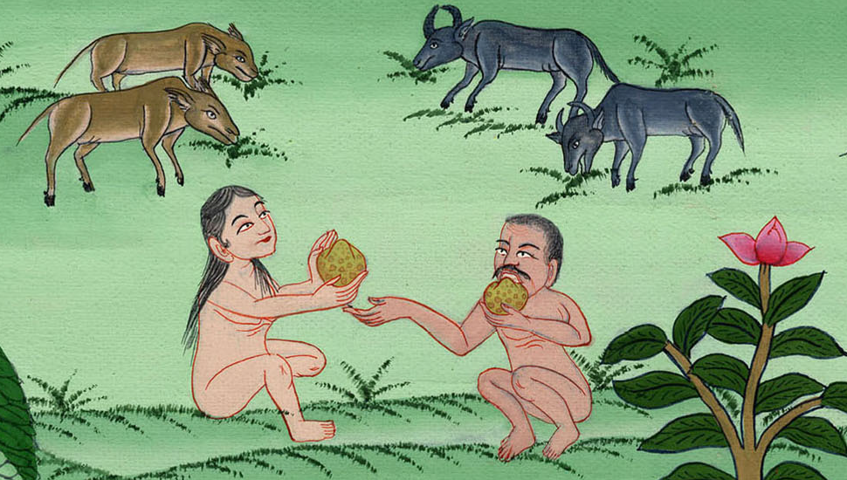
Genesis 3:6
Notes:
She also gave some to her husband, who was with her. And he ate it. ⁷ Then both of them knew things they had never known before. They realized they were naked.

Slide 23
7Their eyes were opened, and they both knew that they were naked. They sewed fig leaves together, and made coverings for themselves.

Slide 24
Genesis 3:7

Slide 25
This was the first sin that people committed. God gave a command, and they chose to disobey it.

Slide 26
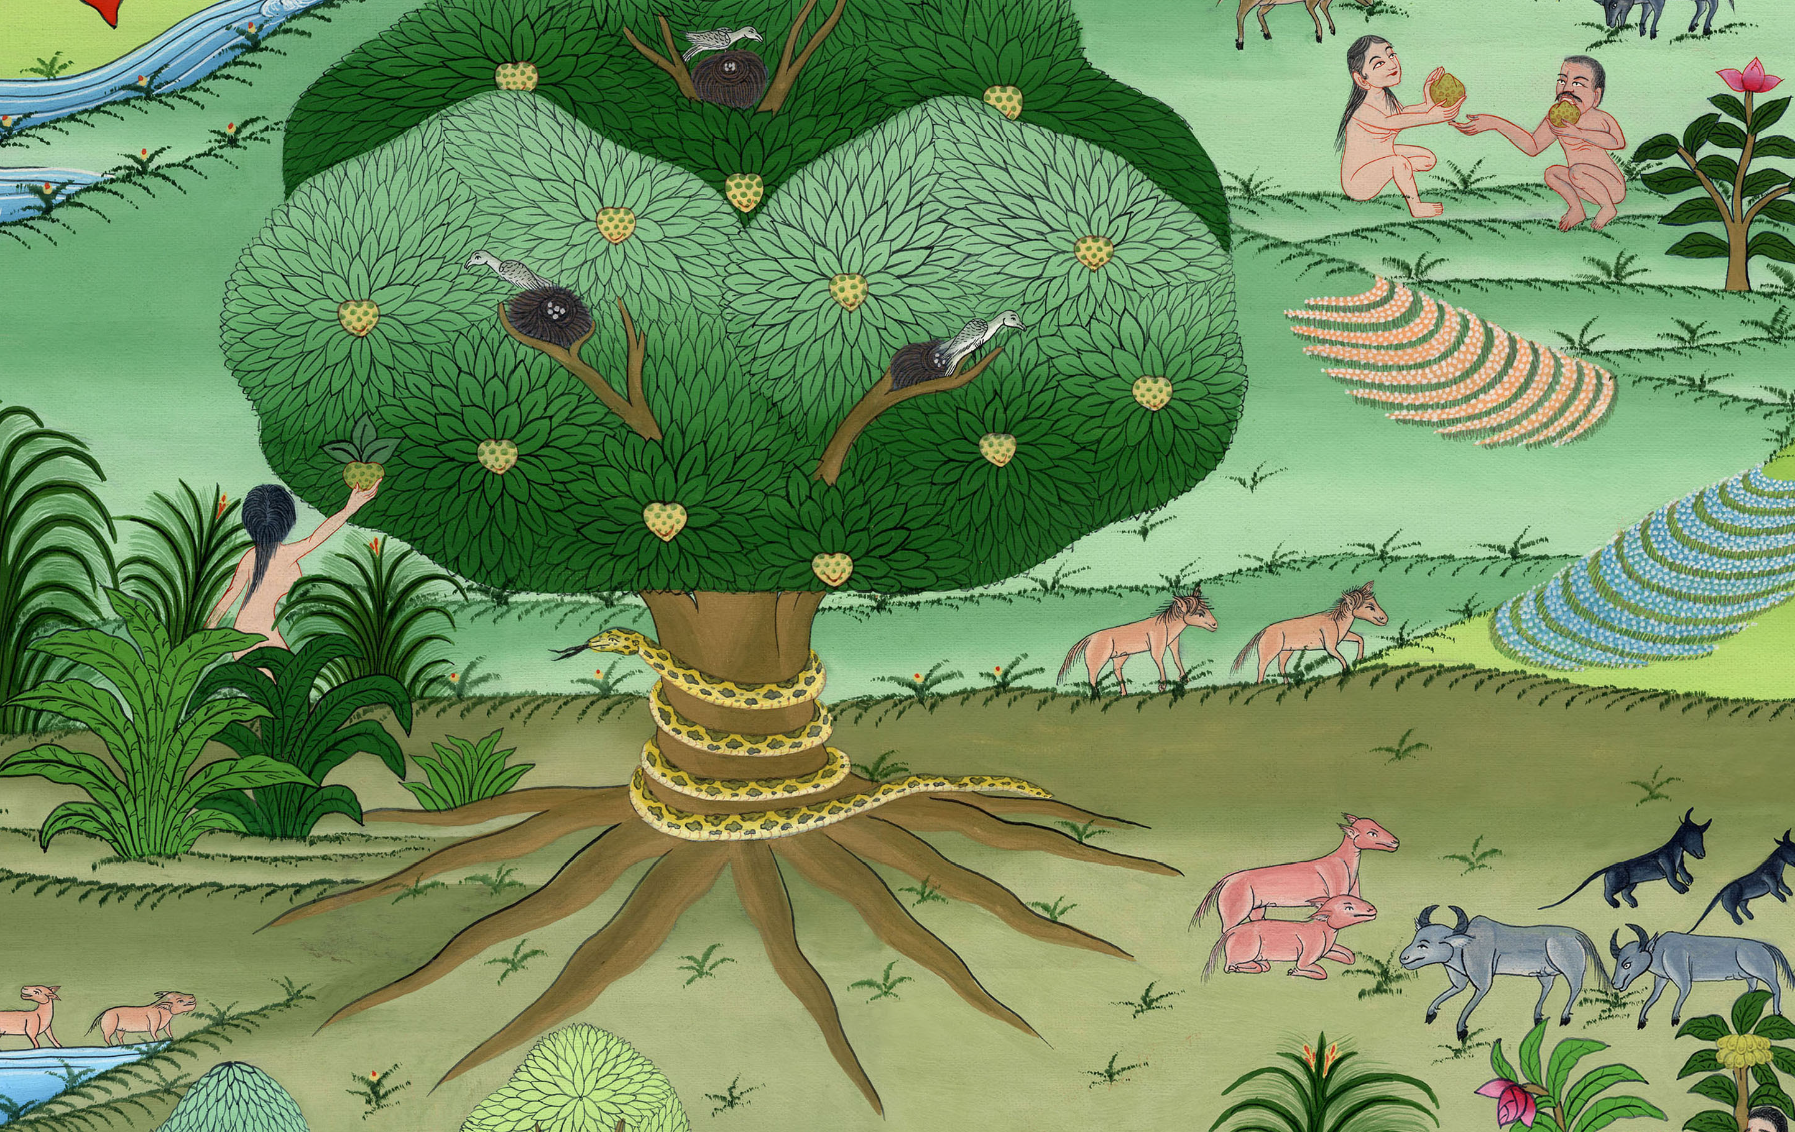
Notes:
This was the first sin that people committed. God gave a command, and they chose to disobey it.

