Slide 1
02-4
This work is licensed under a Creative Commons Attribution-ShareAlike 4.0 International License.
Please add this statement to all the videos you create.
English Bible quotes are from the World English Bible US, which is in the public domain.

Slide 2
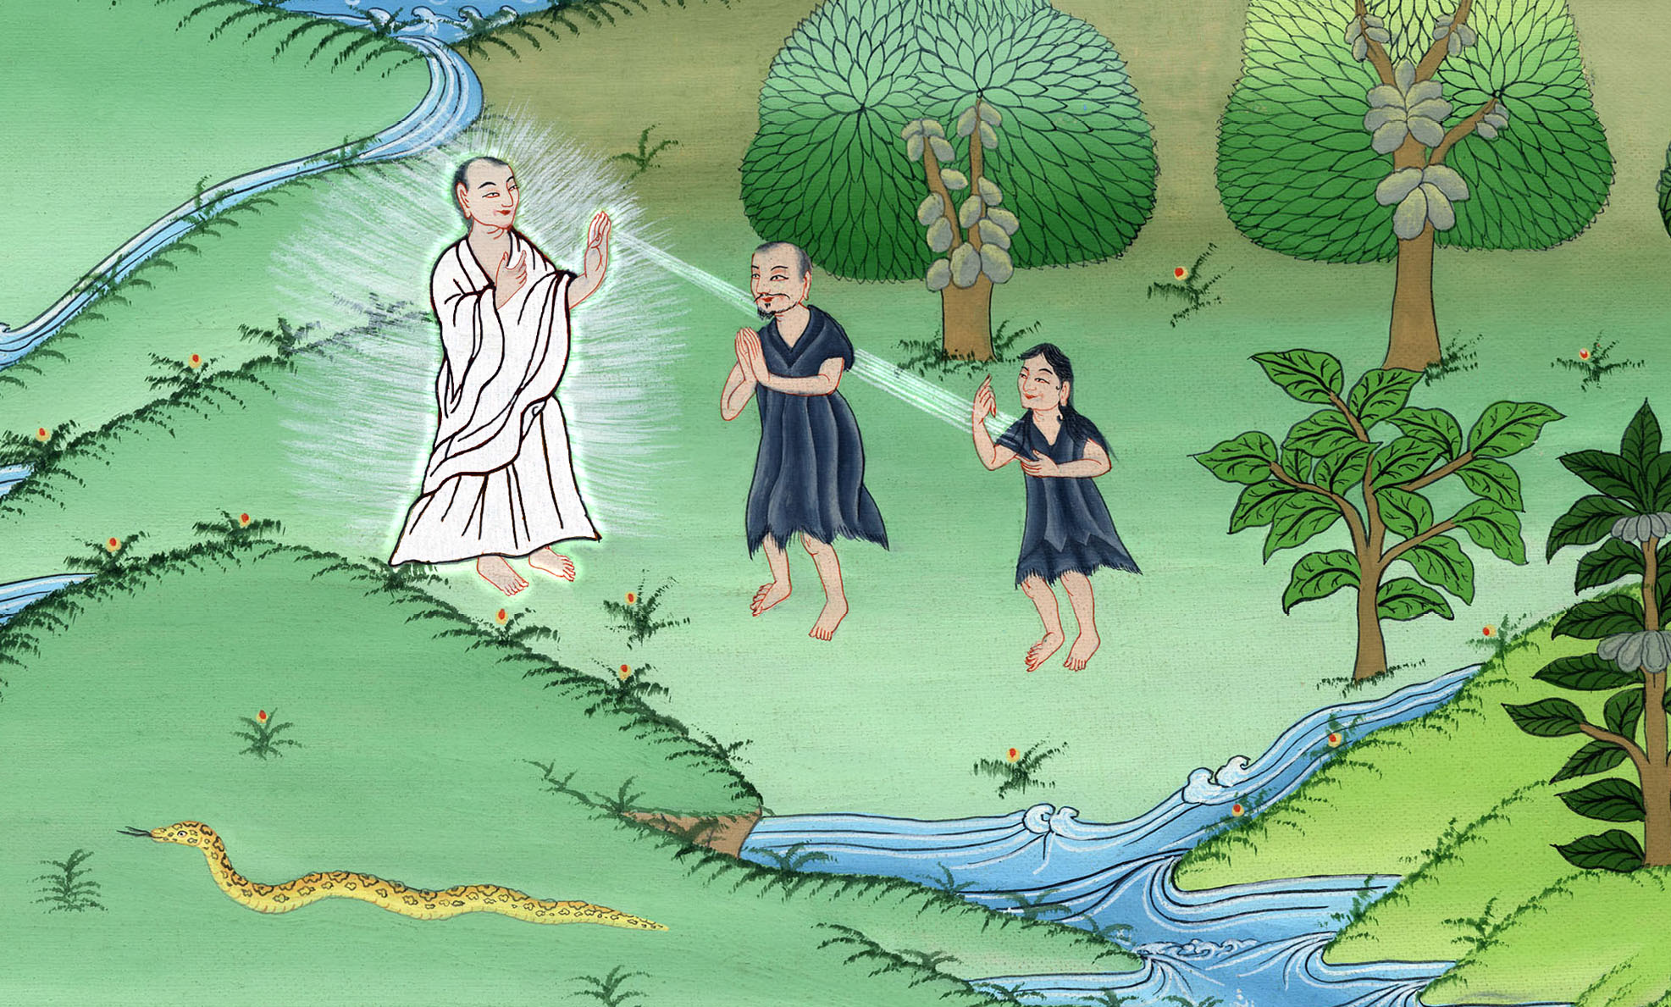
God punishes Adam and Eve –
Genesis 3:14-21

Slide 3
God punishes Adam and Eve – Genesis 3:14-21

Slide 4
God punishes Adam and Eve –
Genesis 3:14-21
Notes:
The Fall
1. Fall of Satan - Ezekiel 28:11-19; Isaiah 14:12-15 (Top)
2. Serpent tempts Eve - Gen 3:1-5 (Center)
3. Eve gives to Adam - Gen 3:6 (Right Center)
4. They hide from God - Gen 3:7-13 (Right Bottom)
5. God punishes their sin but also clothes them – Gen 3:14-21 (Left Bottom)
6. Cast out – Gen 3:22-24 (Left Center)

Slide 5
14Yahweh God said to the serpent,
“Because you have done this,
you are cursed above all livestock,
and above every animal of the field.

Slide 6
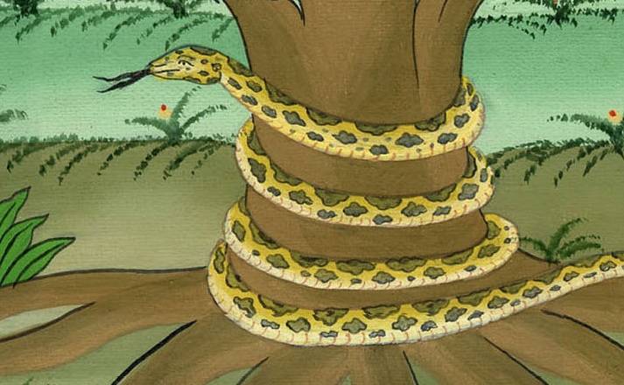
Genesis 3:14

Slide 7
You shall go on your belly
and you shall eat dust all the days of your life.

Slide 8
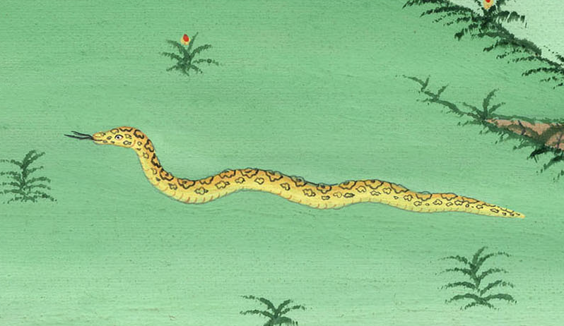
Genesis 3:14

Slide 9
15I will put hostility between you and the woman,
and between your offspring and her offspring.
He will bruise your head,
and you will bruise his heel.”

Slide 10
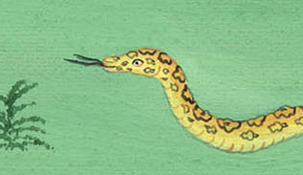
Genesis 3:15

Slide 11
16To the woman he said,
“I will greatly multiply your pain in childbirth.
You will bear children in pain.
Your desire will be for your husband,
and he will rule over you.”

Slide 12
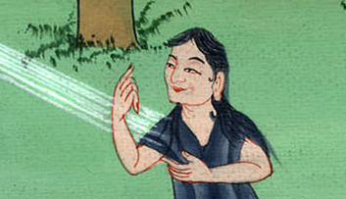
Genesis 3:16

Slide 13
17To Adam he said,
“Because you have listened to your wife’s voice,
and have eaten from the tree,
about which I commanded you, saying, ‘You shall not eat of it,’

Slide 14
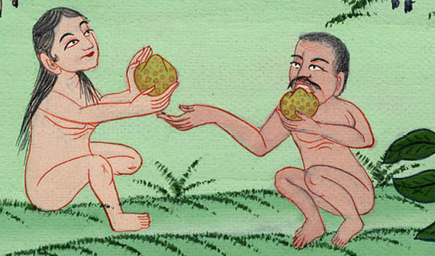
Genesis 3:17

Slide 15
the ground is cursed for your sake.
You will eat from it with much labor all the days of your life.

Slide 16
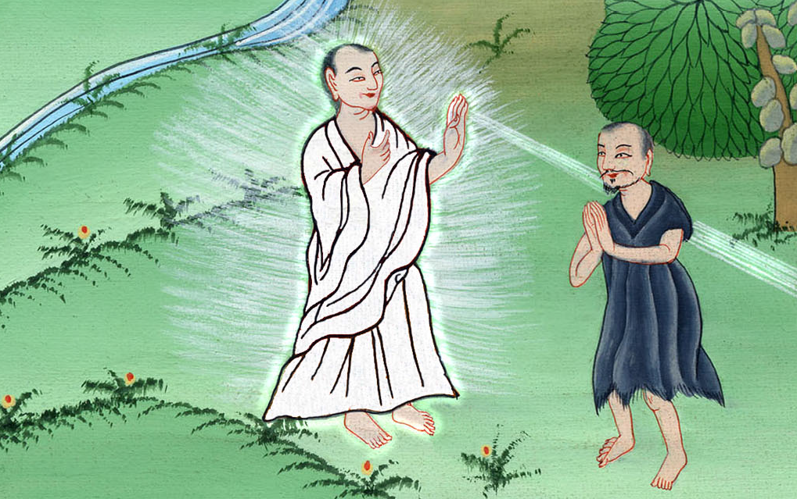
Genesis 3:17

Slide 17
18It will yield thorns and thistles to you;
and you will eat the herb of the field.

Slide 18
Genesis 3:18

Slide 19
19You will eat bread by the sweat of your face until you return to the ground,

Slide 20
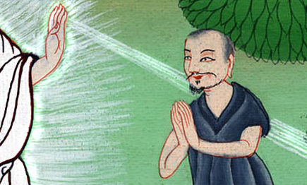
Genesis 3:19

Slide 21
for you were taken out of it.
For you are dust,
and you shall return to dust.”

Slide 22
Genesis 3:19

Slide 23
20The man called his wife Eve because she would be the mother of all the living.

Slide 24
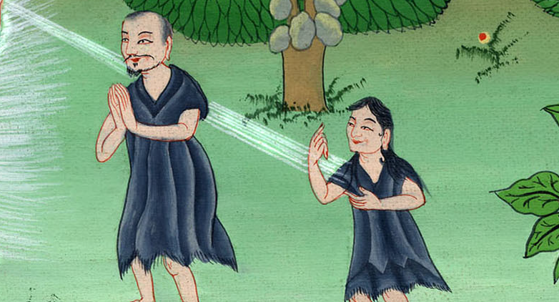
བཀོད་པ 3:20

Slide 25
21Yahweh God made garments of animal skins for Adam and for his wife, and clothed them.

Slide 26
Genesis 3:21

Slide 27
22Yahweh God said, “Behold, the man has become like one of us, knowing good and evil. Now, lest he reach out his hand, and also take of the tree of life, and eat, and live forever—”

Slide 28
Genesis 3:22

Slide 29
23Therefore Yahweh God sent him out from the garden of Eden, to till the ground from which he was taken.

Slide 30
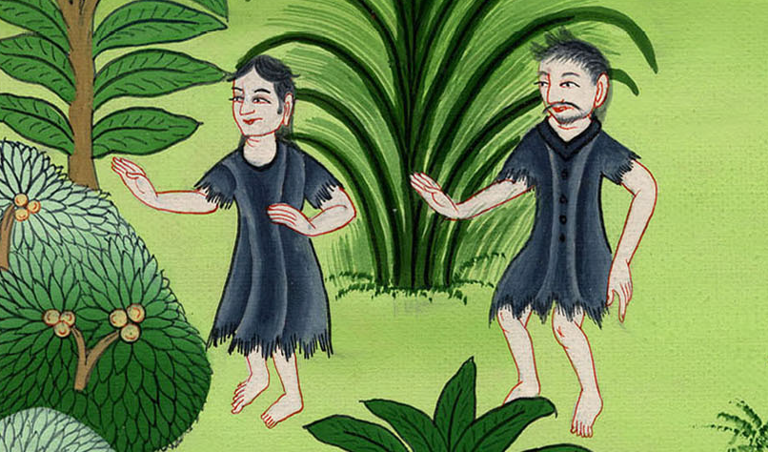
Genesis 3:23

Slide 31
24So he drove out the man; and he placed cherubim at the east of the garden of Eden, and a flaming sword which turned every way, to guard the way to the tree of life.

Slide 32
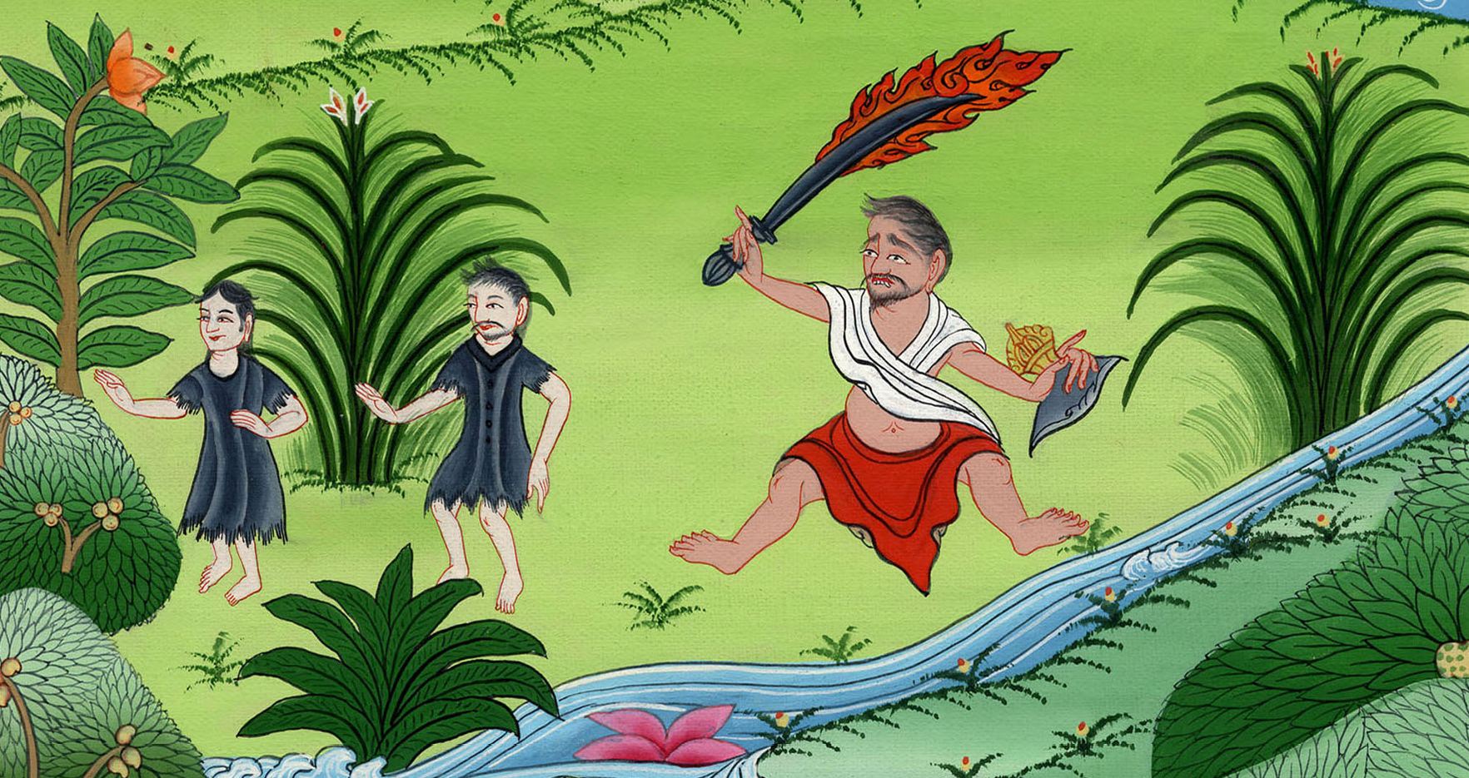
Genesis 3:24

