Slide 1
03-2
This work is licensed under a Creative Commons Attribution-ShareAlike 4.0 International License.
Please add this statement to all the videos you create.
English Bible quotes are from the World English Bible US, which is in the public domain.
Notes:
03 Sin Continues – Gen 4-9
1) Cain & Able – Gen 4:1-15 (Left Top)
2) Corruption of Mankind – Gen 6:1-7 (Center Top)
3) Noah found favor – Gen 6:8-12 (Right Top)
4) Noah builds the Arc – Gen 6:13-22 (Right 2nd)
5) Animals board the Arc – Gen 7:1-10 (Right Bottom)
6) Floods come – Gen 7:11-16 (Left Bottom)
7) Flood waters cover the earth – Gen 7:17-8:12 (Center)
8) Floods dry up – Gen 8:13-19 (Left 2nd from Bottom)
9) Rainbow – Gen 8:20-9:17 (Left 3rd from Bottom)

Slide 2
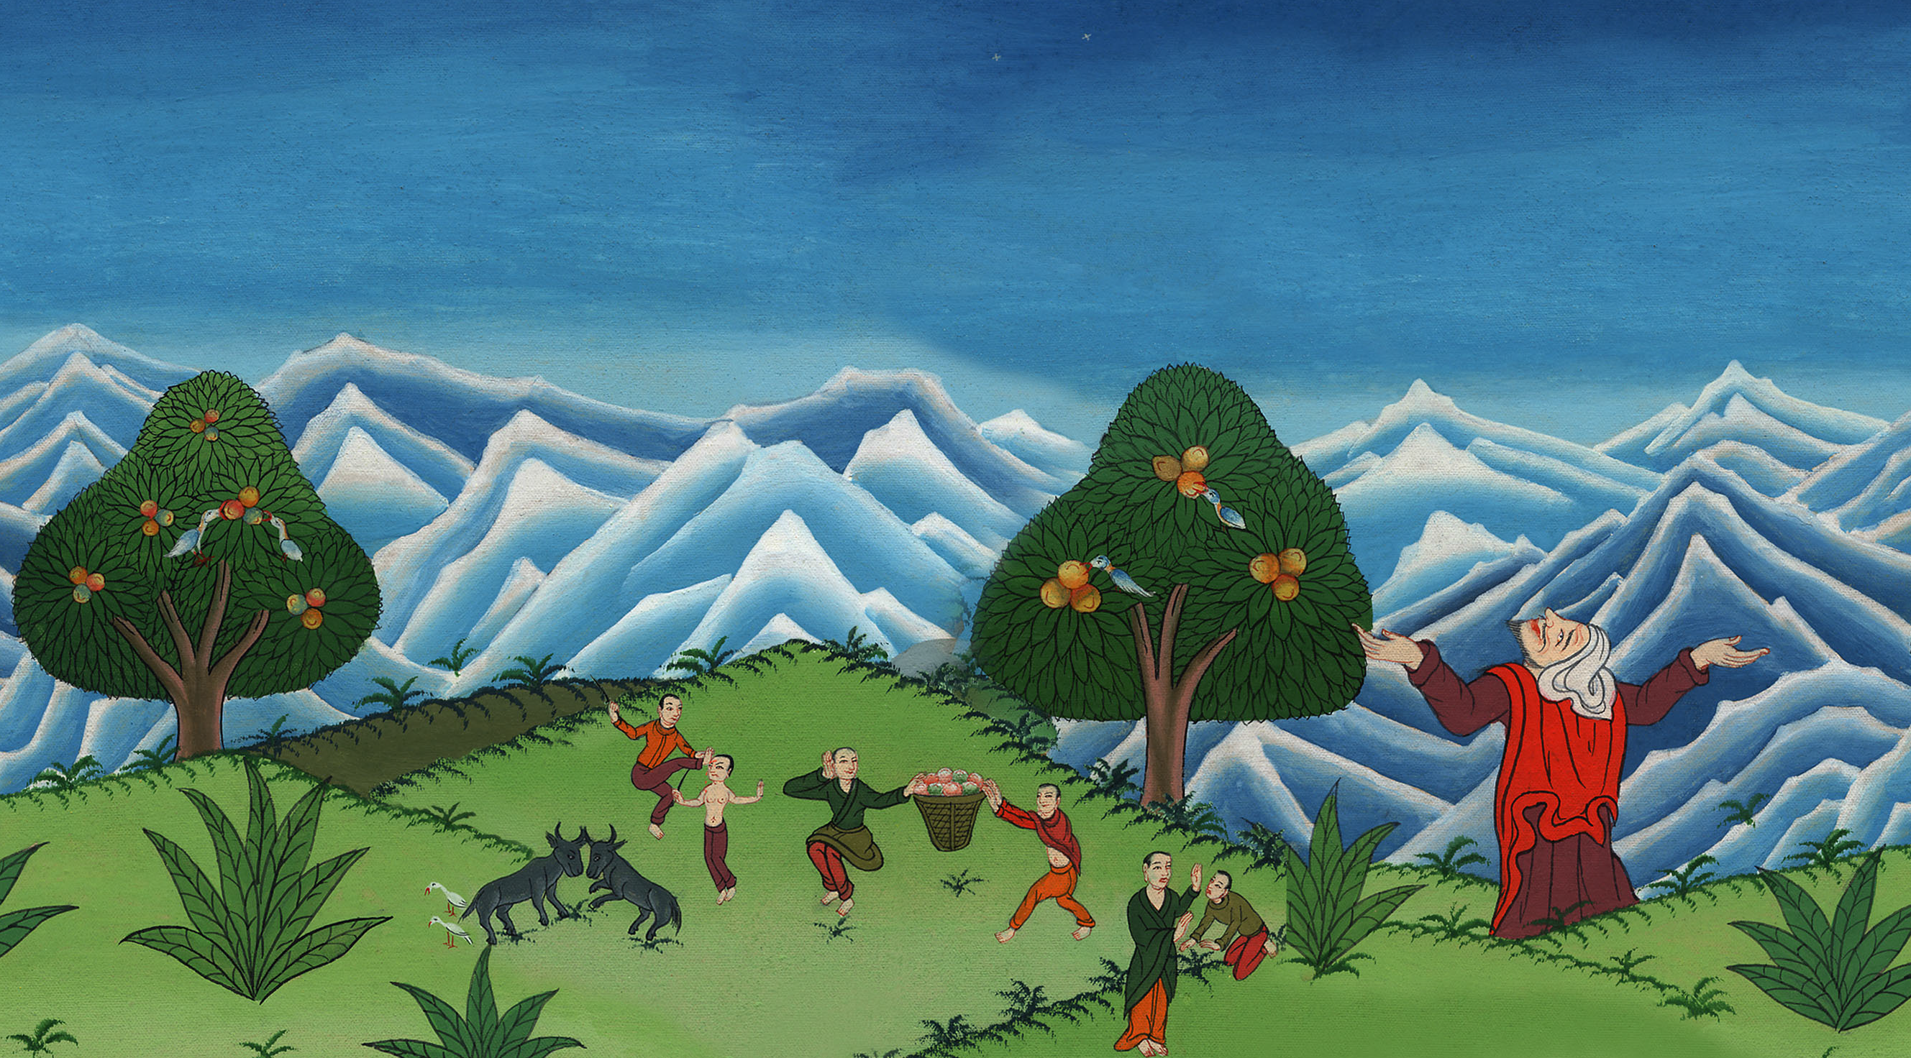
Corruption of Mankind –
Genesis 6:1-7

Slide 3
Corruption of Mankind – Genesis 6:1-7
མི་རིགས་རྣམས་ཀྱི་ལས་ངན། བཀོད་པ 6:1-7

Slide 4
Corruption of Mankind –
Genesis 6:1-7

Slide 5
1When men began to multiply on the surface of the ground, and daughters were born to them,

Slide 6
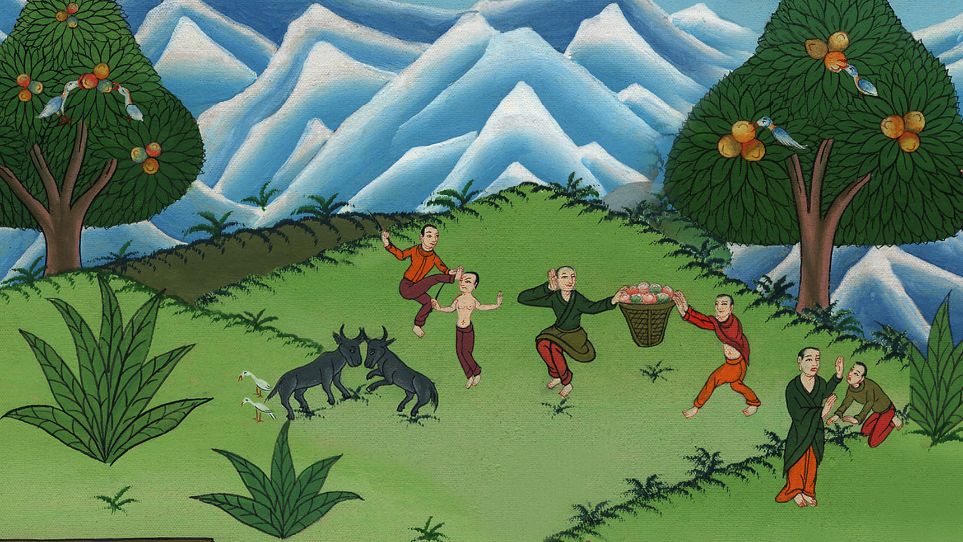
Genesis 6:1

Slide 7
5Yahweh saw that the wickedness of man was great in the earth, and that every imagination of the thoughts of man’s heart was continually only evil.

Slide 8
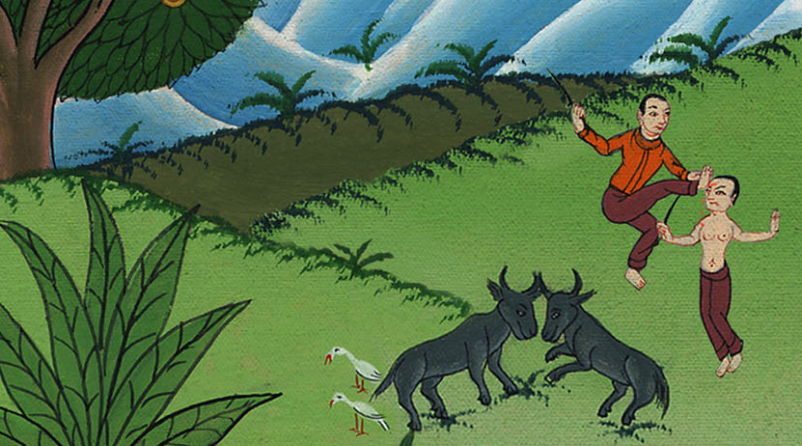
Genesis 6:5

Slide 9
6Yahweh was sorry that he had made man on the earth, and it grieved him in his heart.

Slide 10
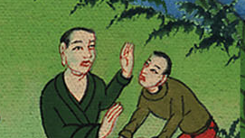
Genesis 6:6

Slide 11
7Yahweh said, “I will destroy man whom I have created from the surface of the ground—man, along with animals, creeping things, and birds of the sky—for I am sorry that I have made them.”

Slide 12
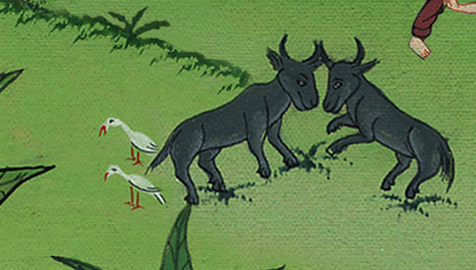
Genesis 6:7

Slide 13
8But Noah found favor in Yahweh’s eyes.

Slide 14
Genesis 6:8

Slide 15
9This is the history of the generations of Noah: Noah was a righteous man, blameless among the people of his time. Noah walked with God.

Slide 16
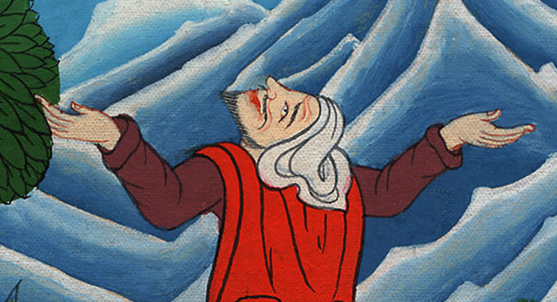
Genesis 6:9

Slide 17
10Noah became the father of three sons: Shem, Ham, and Japheth.

Slide 18
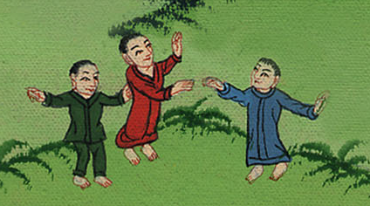
Genesis 6:10

Slide 19
11The earth was corrupt before God, and the earth was filled with violence.

Slide 20
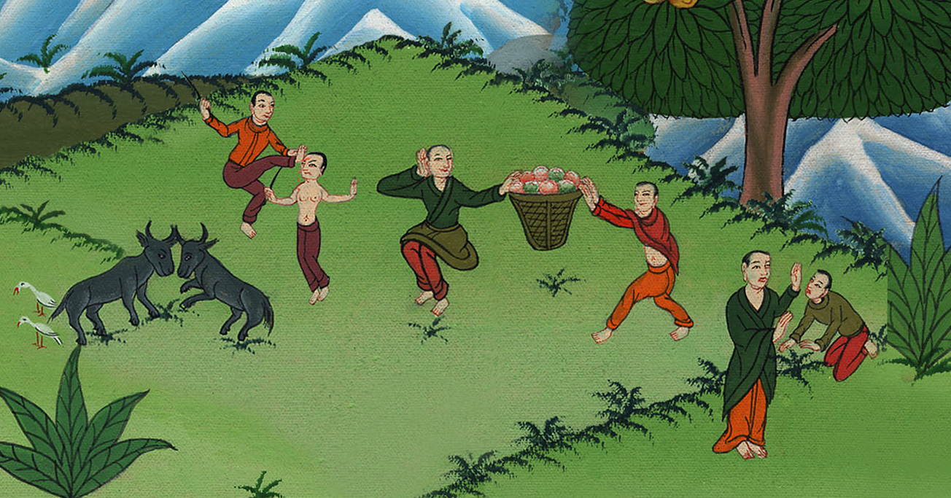
Genesis 6:11
Notes:
.

