Slide 1
03-3
This work is licensed under a Creative Commons Attribution-ShareAlike 4.0 International License.
Please add this statement to all the videos you create.
English Bible quotes are from the World English Bible US, which is in the public domain.
Notes:
03 Sin Continues – Gen 4-9
1) Cain & Able – Gen 4:1-15 (Left Top)
2) Corruption of Mankind – Gen 6:1-7 (Center Top)
3) Noah found favor – Gen 6:8-12 (Right Top)
4) Noah builds the Arc – Gen 6:13-22 (Right 2nd)
5) Animals board the Arc – Gen 7:1-10 (Right Bottom)
6) Floods come – Gen 7:11-16 (Left Bottom)
7) Flood waters cover the earth – Gen 7:17-8:12 (Center)
8) Floods dry up – Gen 8:13-19 (Left 2nd from Bottom)
9) Rainbow – Gen 8:20-9:17 (Left 3rd from Bottom)

Slide 2
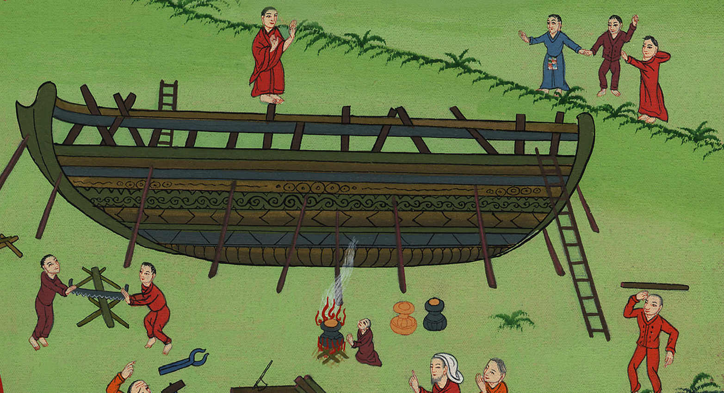
Noah builds
the Ark –
Genesis 6:12-22

Slide 3
Noah builds the Ark – Genesis 6:12-22

Slide 4
Noah builds
the Ark –
Genesis 6:12-22

Slide 5
12God saw the earth, and saw that it was corrupt, for all flesh had corrupted their way on the earth.

Slide 6
Genesis 6:12
Notes:
.

Slide 7
13God said to Noah, “I will bring an end to all flesh, for the earth is filled with violence through them. Behold, I will destroy them and the earth.

Slide 8
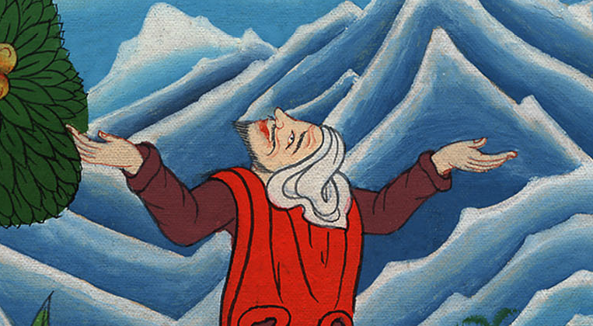
Genesis 6:13

Slide 9
14Make a ship of gopher wood. You shall make rooms in the ship, and shall seal it inside and outside with pitch.

Slide 10
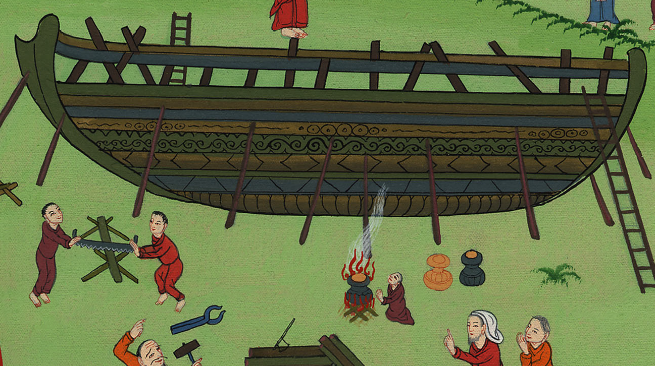
Genesis 6:14

Slide 11
15Here is how I want you to build it. The ark has to be 450 feet long. It has to be 75 feet wide and 45 feet high. (nirv)

Slide 12
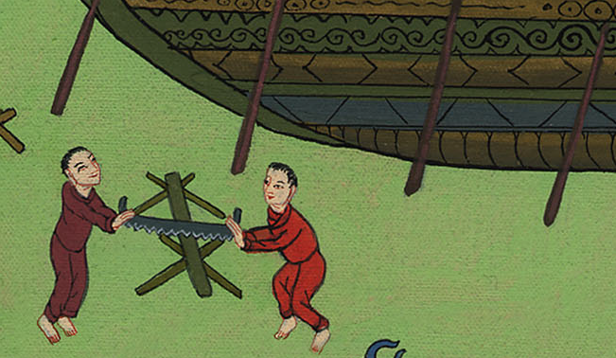
Genesis 6:15

Slide 13
16You shall make a roof in the ship, and you shall finish it to a cubit upward. You shall set the door of the ship in its side. You shall make it with lower, second, and third levels.

Slide 14
Genesis 6:16

Slide 15
17I, even I, will bring the flood of waters on this earth, to destroy all flesh having the breath of life from under the sky. Everything that is in the earth will die.

Slide 16
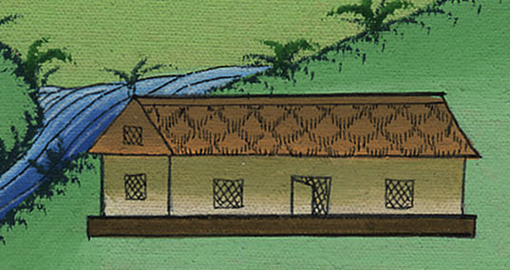
Genesis 6:17

Slide 17
18But I will establish my covenant with you. You shall come into the ship, you, your sons, your wife, and your sons’ wives with you.

Slide 18
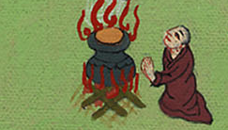
Genesis 6:18

Slide 19
19Of every living thing of all flesh, you shall bring two of every sort into the ship, to keep them alive with you. They shall be male and female.

Slide 20
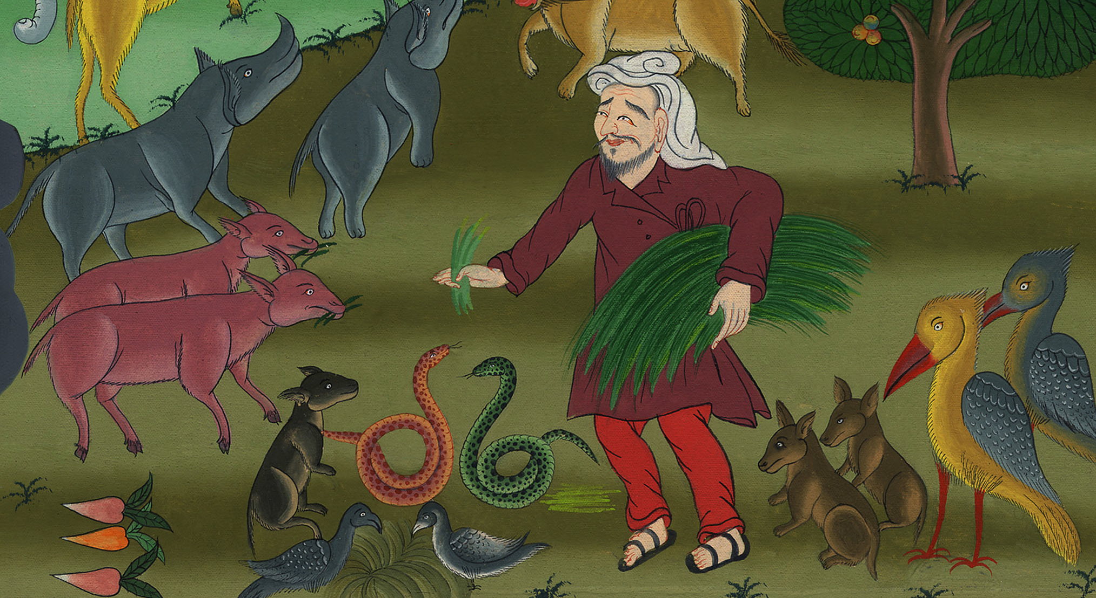
Genesis 6:19

Slide 21
0Of the birds after their kind, of the livestock after their kind, of every creeping thing of the ground after its kind, two of every sort will come to you, to keep them alive.

Slide 22
བཀོད་པ 6:19,20
Notes:
19Bring a male and a female of every living thing into the ark. They will be kept alive with you. 20Two of every kind of bird will come to you. Two of every kind of animal will also come to you. And so will two of every kind of creature that moves along the ground. All of them will be kept alive with you.

Slide 23
21Take with you some of all food that is eaten, and gather it to yourself; and it will be for food for you, and for them.”

Slide 24
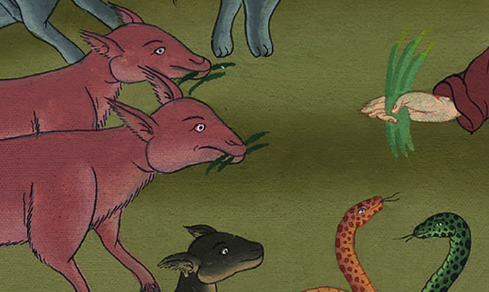
བཀོད་པ 6:21

Slide 25
22Thus Noah did. He did all that God commanded him.

Slide 26
བཀོད་པ 6:22

