Slide 1
03-4
This work is licensed under a Creative Commons Attribution-ShareAlike 4.0 International License.
Please add this statement to all the videos you create.
English Bible quotes are from the World English Bible US, which is in the public domain.

Slide 2
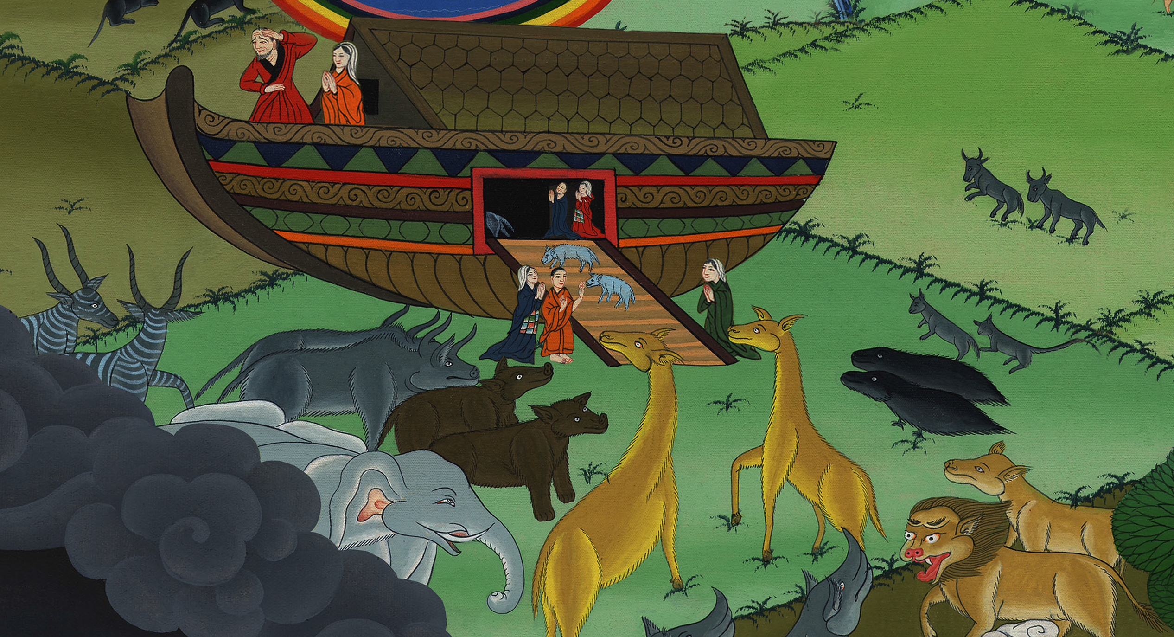
Animals enter the Ark – Genesis 7:1-16

Slide 3
Animals enter the Ark – Genesis 7:1-16

Slide 4
Animals enter the Ark – Genesis 7:1-16

Slide 5
1Yahweh said to Noah, “Come with all of your household into the ship, for I have seen your righteousness before me in this generation.

Slide 6
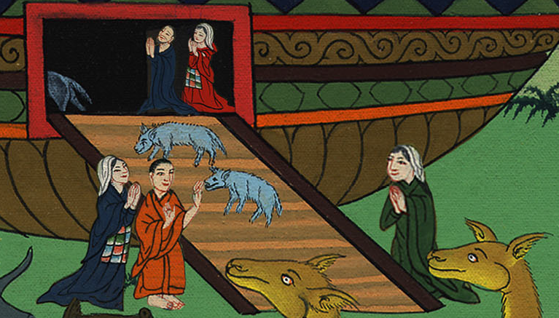
Genesis 7:1

Slide 7
2You shall take seven pairs of every clean animal with you, the male and his female. Of the animals that are not clean, take two, the male and his female.

Slide 8
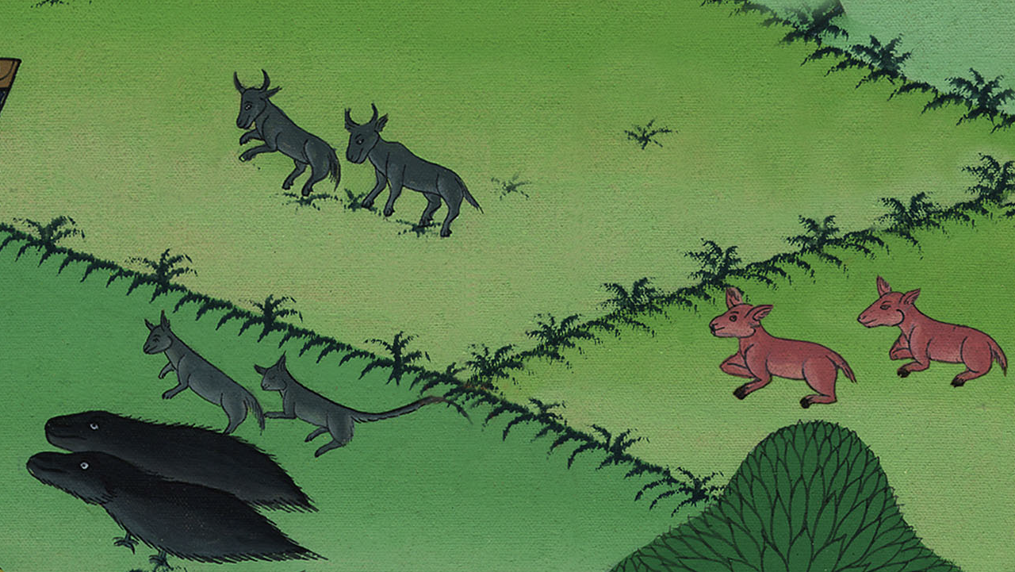
Genesis 7:2

Slide 9
3Also of the birds of the sky, seven and seven, male and female, to keep seed alive on the surface of all the earth.

Slide 10
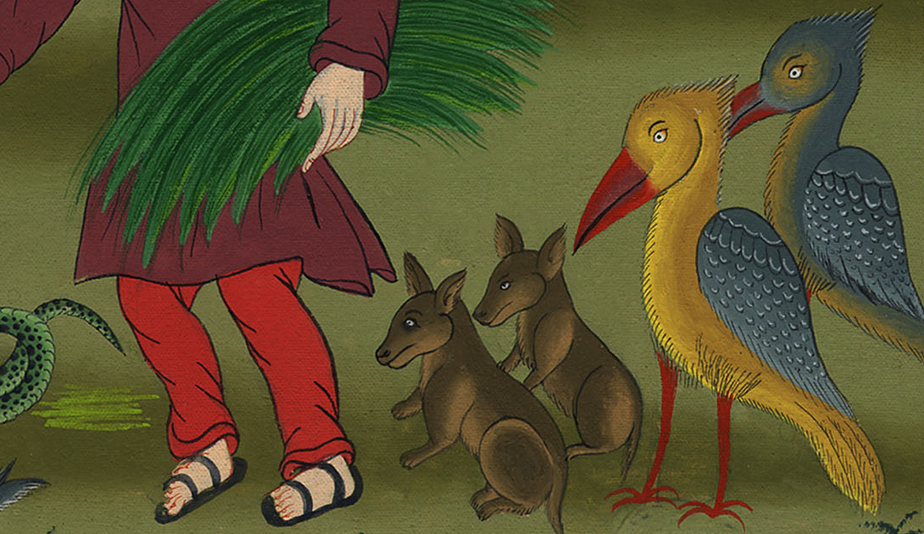
Genesis 7:3

Slide 11
4In seven days, I will cause it to rain on the earth for forty days and forty nights. I will destroy every living thing that I have made from the surface of the ground.”

Slide 12
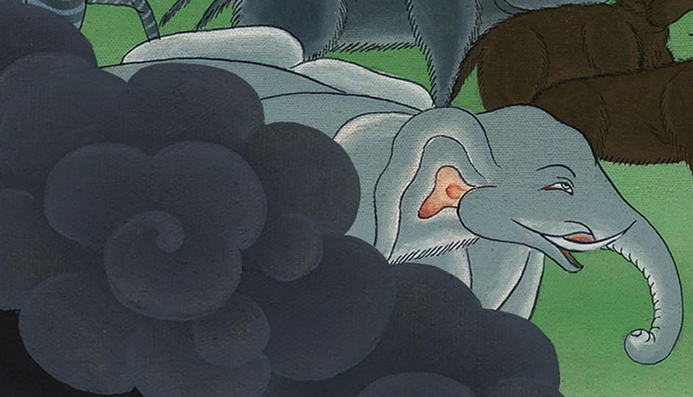
Genesis 7:4

Slide 13
5Noah did everything that Yahweh commanded him.

Slide 14
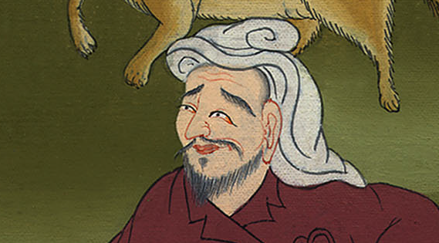
Genesis 7:5
Notes:
6Noah was 600 years old when the flood came on the earth.

Slide 15
7Noah went into the ship with his sons, his wife, and his sons’ wives, because of the floodwaters.

Slide 16
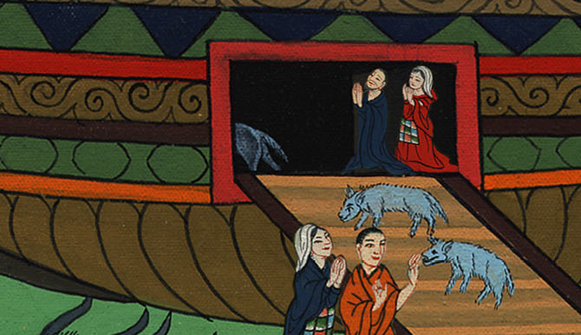
Genesis 7:7

Slide 17
14they, and every animal after its kind, all the livestock after their kind, every creeping thing that creeps on the earth after its kind, and every bird after its kind, every bird of every sort.

Slide 18
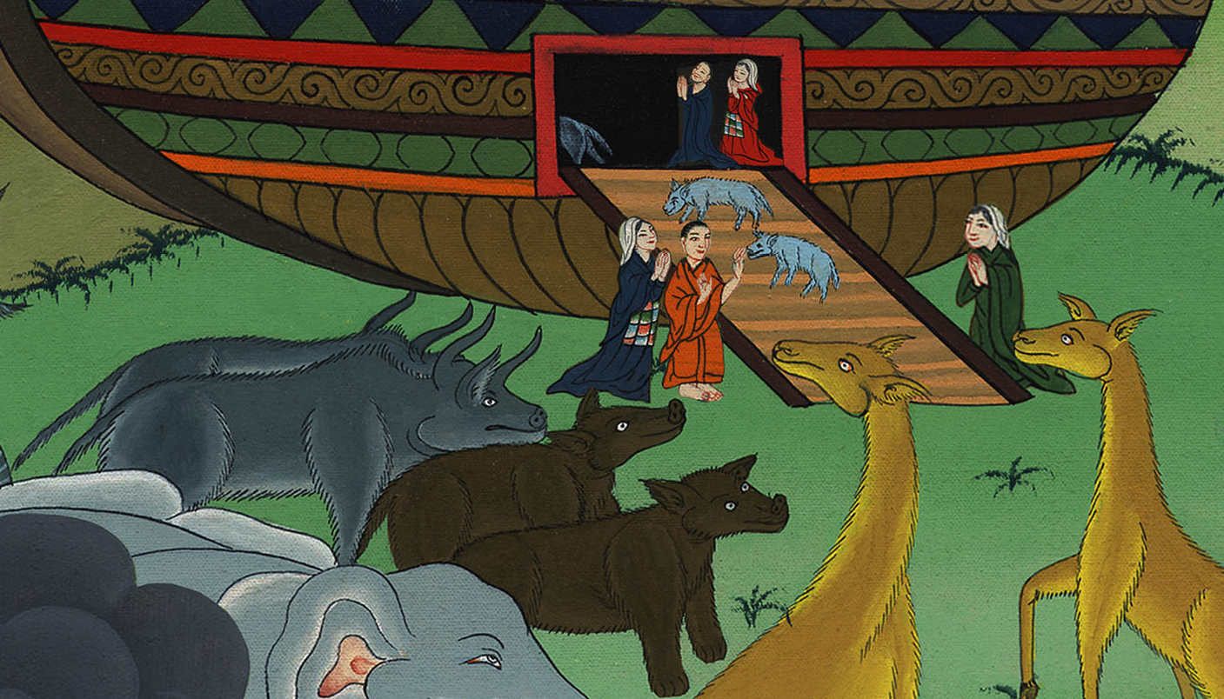
Genesis 7:14

Slide 19
15Pairs from all flesh with the breath of life in them went into the ship to Noah. 16Those who went in, went in male and female of all flesh, as God commanded him; then Yahweh shut him in.

Slide 20
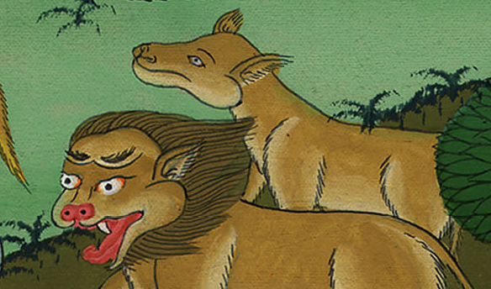
Genesis 7:15

Slide 21
Everything happened just as God had commanded Noah. Then the Lord shut him in.

Slide 22
