Slide 1
03-5
This work is licensed under a Creative Commons Attribution-ShareAlike 4.0 International License.
Please add this statement to all the videos you create.
English Bible quotes are from the World English Bible US, which is in the public domain.

Slide 2
Flood waters cover the earth – Genesis 7:17-8:12

Slide 3
Flood waters cover the earth – Genesis 7:17-8:12

Slide 4
Flood waters cover the earth – Genesis 7:17-8:12

Slide 5
17The flood was forty days on the earth. The waters increased, and lifted up the ship, and it was lifted up above the earth.

Slide 6
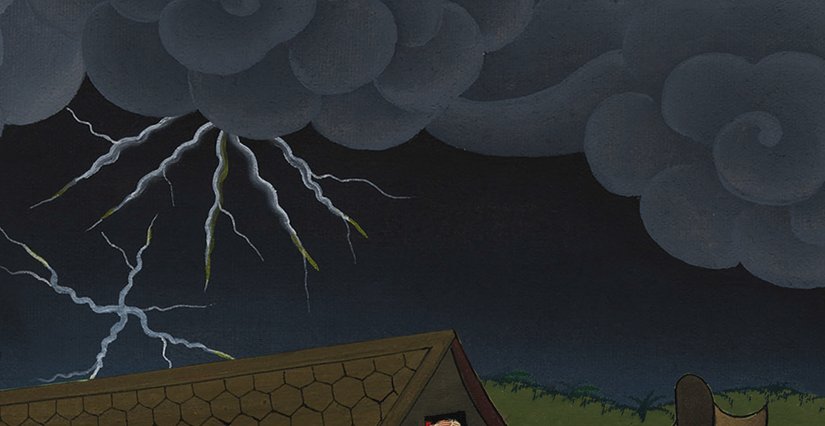
Genesis 7:17

Slide 7
18The waters rose, and increased greatly on the earth; and the ship floated on the surface of the waters.

Slide 8
Genesis 7:18

Slide 9
19The waters rose very high on the earth. All the high mountains that were under the whole sky were covered.

Slide 10
Genesis 7:19

Slide 11
20The waters rose fifteen cubits higher (20 feet.), and the mountains were covered.

Slide 12
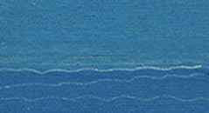
Genesis 7:20

Slide 13
21All flesh died that moved on the earth, including birds, livestock, animals, every creeping thing that creeps on the earth, and every man.

Slide 14
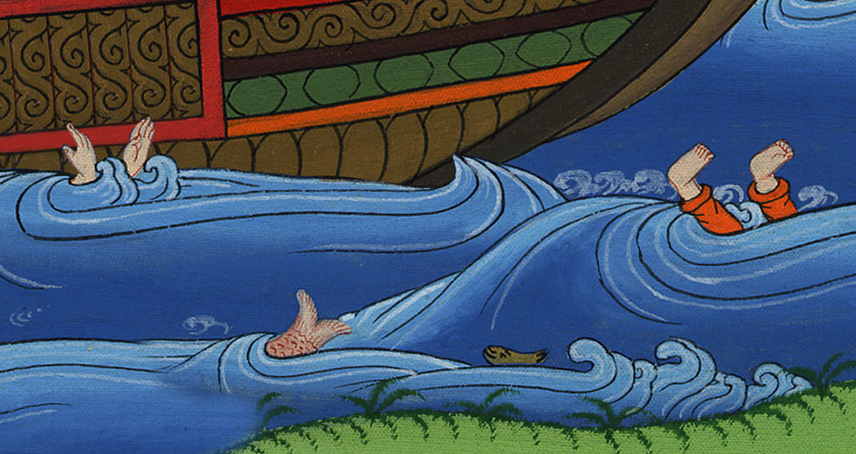
Genesis 7:21

Slide 15
22All on the dry land, in whose nostrils was the breath of the spirit of life, died.

Slide 16
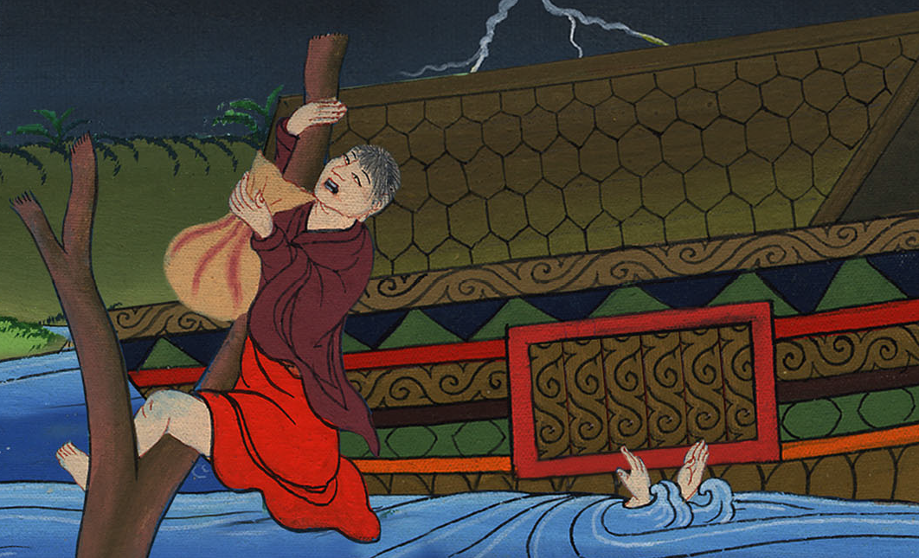
Genesis 7:22

Slide 17
23Every living thing was destroyed that was on the surface of the ground, including man, livestock, creeping things, and birds of the sky. They were destroyed from the earth. Only Noah was left, and those who were with him in the ship.

Slide 18
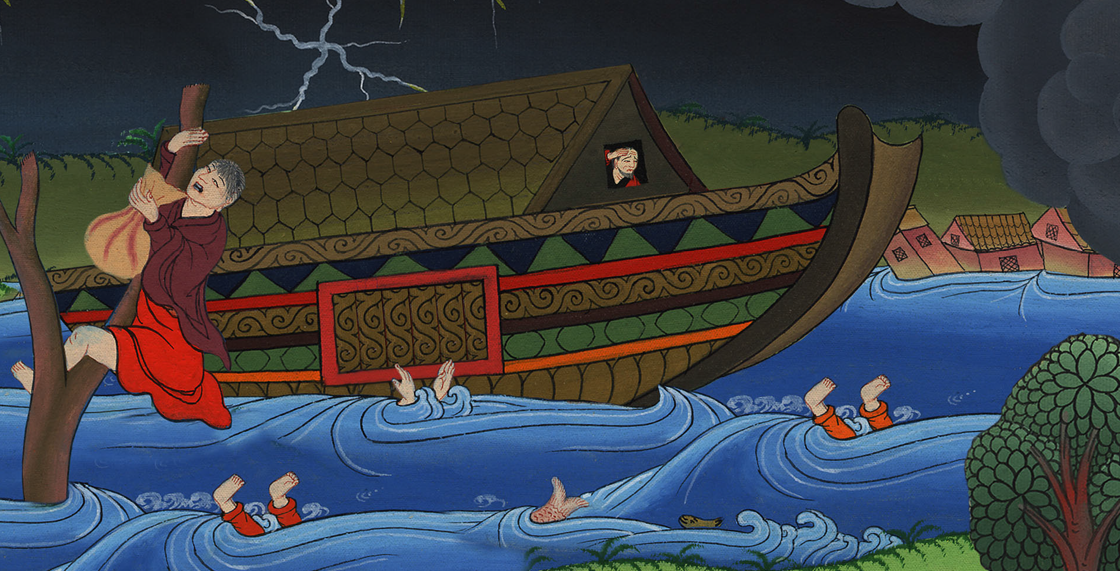
Genesis 7:23

Slide 19
24The waters flooded the earth one hundred fifty days.

Slide 20
Genesis 7:24

Slide 21
8: 1God remembered Noah, all the animals, and all the livestock that were with him in the ship; and God made a wind to pass over the earth. The waters subsided.

Slide 22
Genesis 8:1

Slide 23
2The deep’s fountains and the sky’s windows were also stopped, and the rain from the sky was restrained.

Slide 24
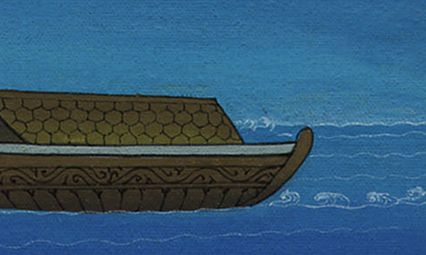
Genesis 8:2

Slide 25
3The waters continually receded from the earth. After the end of one hundred fifty days the waters receded.

Slide 26
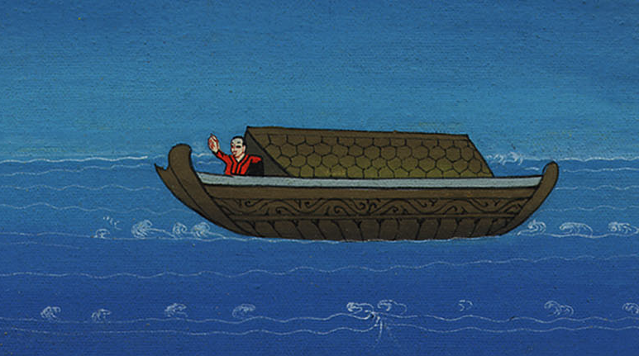
Genesis 8:3

Slide 27
4The ship rested in the seventh month, on the seventeenth day of the month, on Ararat’s mountains.

Slide 28
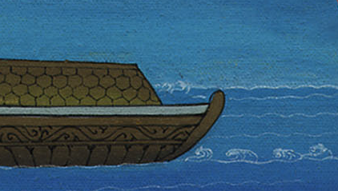
Genesis 8:4

Slide 29
5The waters receded continually until the tenth month. In the tenth month, on the first day of the month, the tops of the mountains were visible.

Slide 30
Genesis 8:5

Slide 31
6At the end of forty days, Noah opened the window of the ship which he had made, 7and he sent out a raven. It went back and forth, until the waters were dried up from the earth.

Slide 32
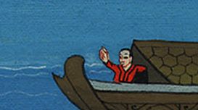
Genesis 8:6,7

Slide 33
8He himself sent out a dove to see if the waters were abated from the surface of the ground,

Slide 34
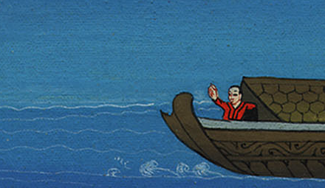
Genesis 8:8

Slide 35
9but the dove found no place to rest her foot, and she returned into the ship to him, for the waters were on the surface of the whole earth. He put out his hand, and took her, and brought her to him into the ship.

Slide 36
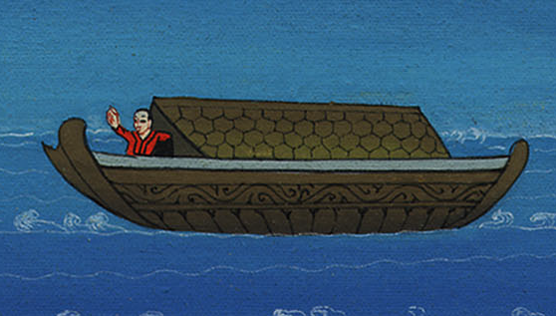
Genesis 8:9
Notes:
9

Slide 37
10He waited yet another seven days; and again he sent the dove out of the ship.

Slide 38
Genesis 8:10

Slide 39
11The dove came back to him at evening and, behold, in her mouth was a freshly plucked olive leaf. So Noah knew that the waters were abated from the earth.

Slide 40
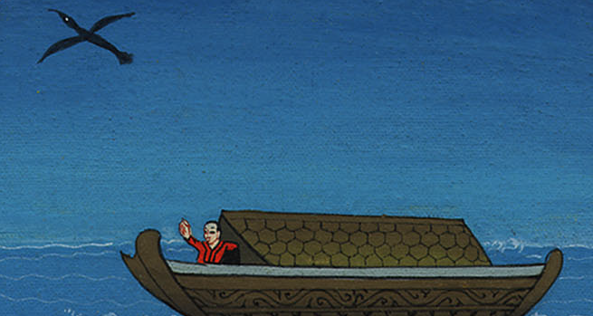
Genesis 8:11

Slide 41
12He waited yet another seven days, and sent out the dove; and she didn’t return to him any more.

Slide 42
Genesis 8:12

