Slide 1
03-6
This work is licensed under a Creative Commons Attribution-ShareAlike 4.0 International License.
Please add this statement to all the videos you create.
English Bible quotes are from the World English Bible US, which is in the public domain.

Slide 2
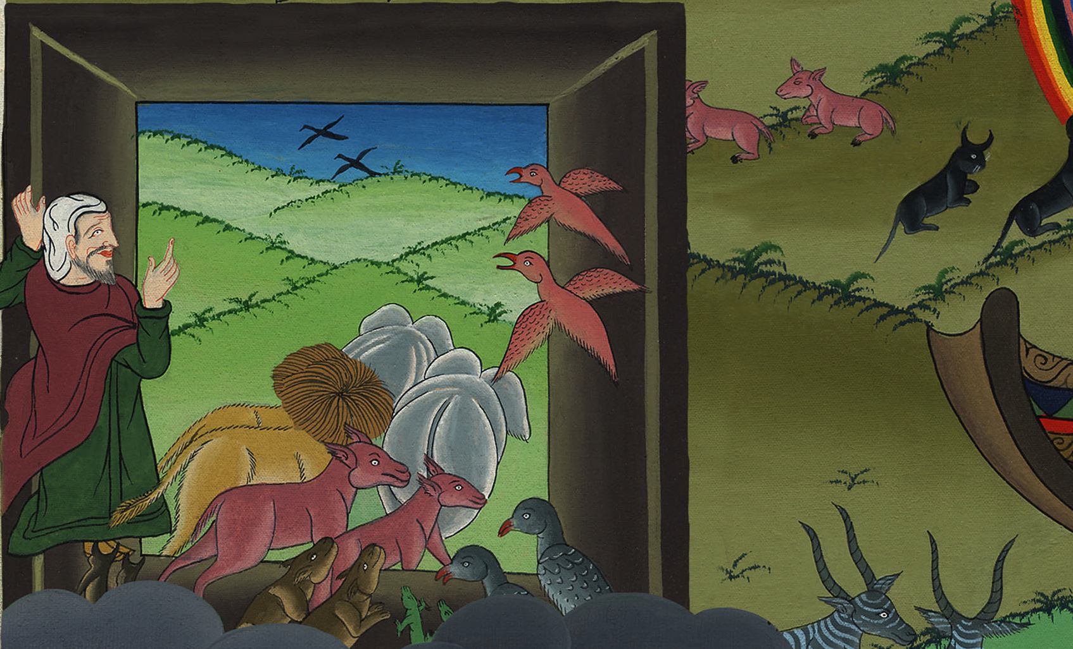
Floods dry up – Genesis 8:13-19

Slide 3
Floods dry up – Genesis 8:13-19

Slide 4
Floods dry up – Genesis 8:13-19

Slide 5
13In the six hundred first year, in the first month, the first day of the month, the waters were dried up from the earth. Noah removed the covering of the ship, and looked. He saw that the surface of the ground was dry.

Slide 6
Genesis 8:13

Slide 7
14In the second month, on the twenty-seventh day of the month, the earth was dry.

Slide 8
Genesis 8:14
Notes:
14By the 27th day of the second month the earth was completely dry.

Slide 9
15God spoke to Noah, saying, 16“Go out of the ship, you, your wife, your sons, and your sons’ wives with you.

Slide 10
Genesis 8:15,16

Slide 11
17Bring out with you every living thing that is with you of all flesh, including birds, livestock, and every creeping thing that creeps on the earth, that they may breed abundantly in the earth, and be fruitful, and multiply on the earth.”

Slide 12
Genesis 8:17

Slide 13
18Noah went out, with his sons, his wife, and his sons’ wives with him.

Slide 14
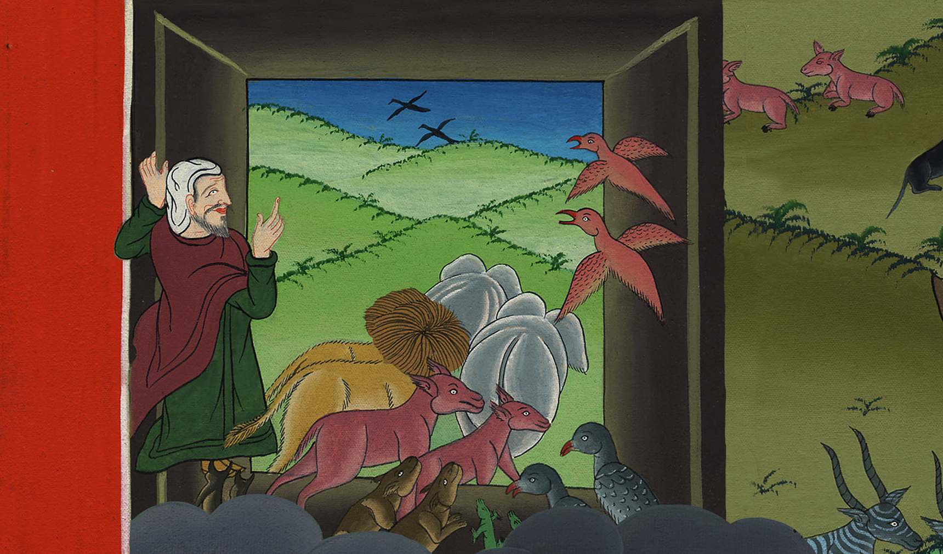
Genesis 8:18

Slide 15
19Every animal, every creeping thing, and every bird, whatever moves on the earth, after their families, went out of the ship.

Slide 16
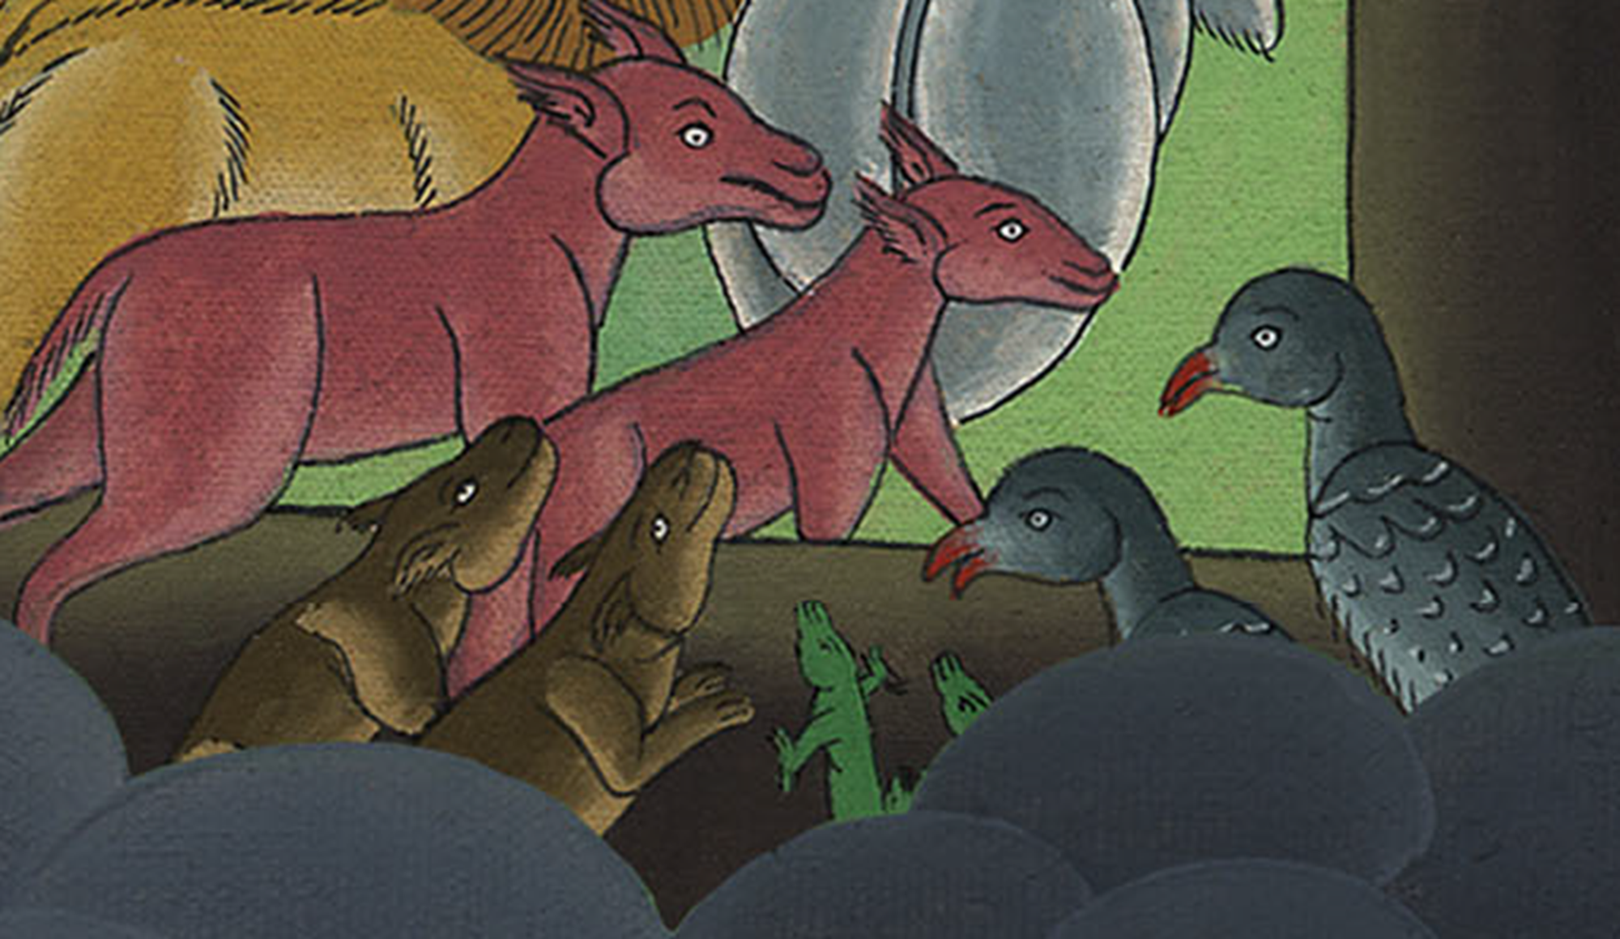
Genesis 8:19

