Slide 1
03-7
This work is licensed under a Creative Commons Attribution-ShareAlike 4.0 International License.
Please add this statement to all the videos you create.
English Bible quotes are from the World English Bible US, which is in the public domain.

Slide 2
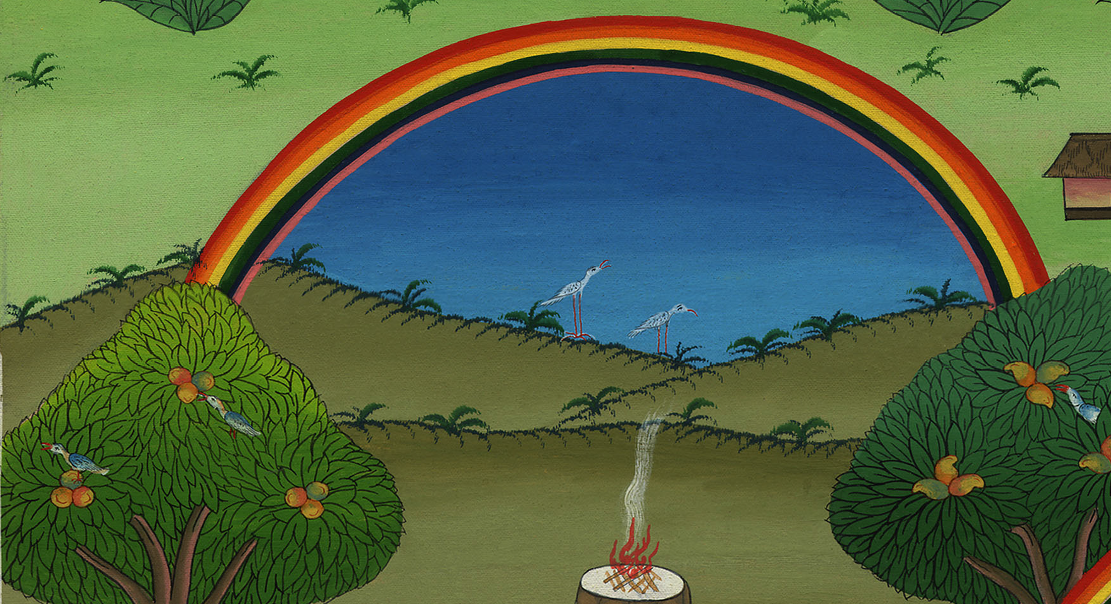
God Makes a Covenant With Noah –
Genesis 8:20-9:17

Slide 3
God Makes a Covenant With Noah – Genesis 8:20-9:17

Slide 4
God Makes a Covenant With Noah –
Genesis 8:20-9:17

Slide 5
20Noah built an altar to Yahweh, and took of every clean animal, and of every clean bird, and offered burnt offerings on the altar.

Slide 6
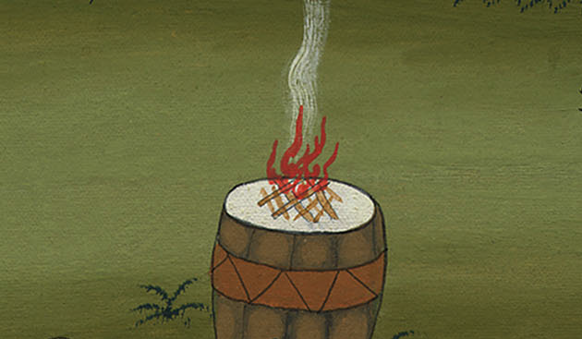
Genesis 8:20

Slide 7
21Yahweh smelled the pleasant aroma. Yahweh said in his heart,

Slide 8
Genesis 8:21

Slide 9
“I will not again curse the ground any more for man’s sake because the imagination of man’s heart is evil from his youth. I will never again strike every living thing, as I have done.

Slide 10
Genesis 8:21

Slide 11
22While the earth remains, seed time and harvest, and cold and heat, and summer and winter, and day and night will not cease.”

Slide 12
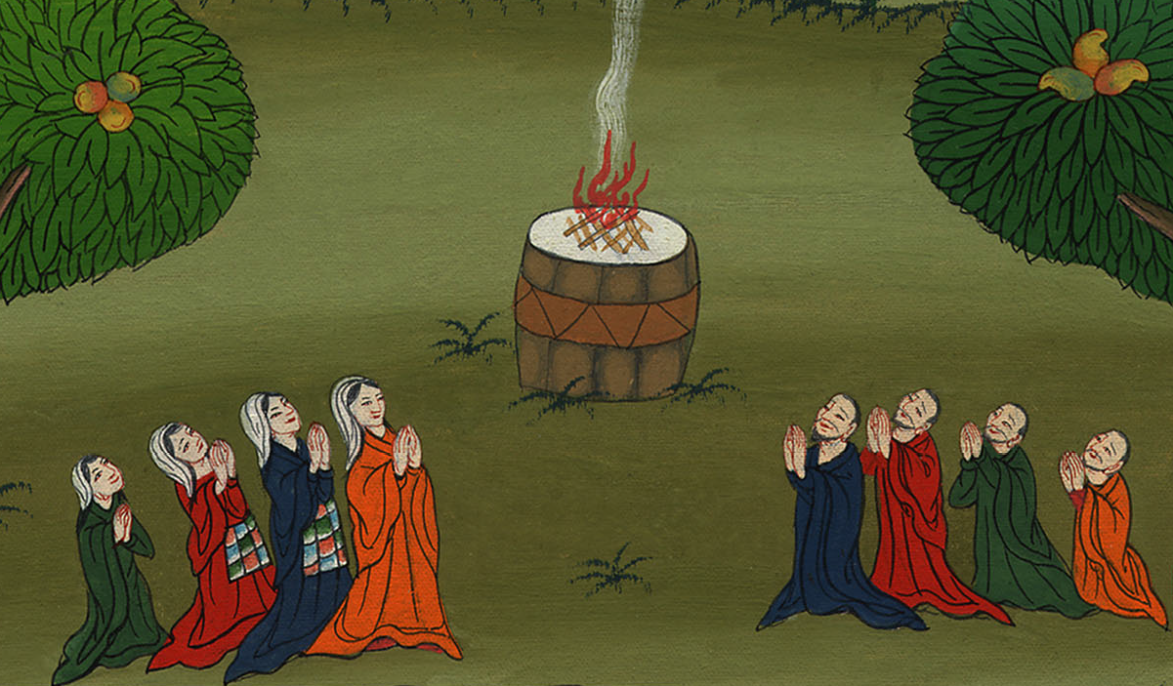
Genesis 8:22

Slide 13
1God blessed Noah and his sons, and said to them, “Be fruitful, multiply, and replenish the earth.

Slide 14
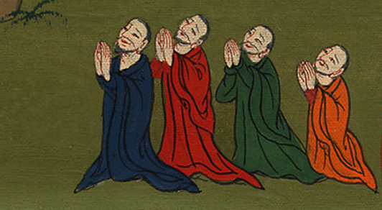
Genesis 9:1
Notes:
1

Slide 15
2The fear of you and the dread of you will be on every animal of the earth, and on every bird of the sky. Everything that moves along the ground, and all the fish of the sea, are delivered into your hand.

Slide 16
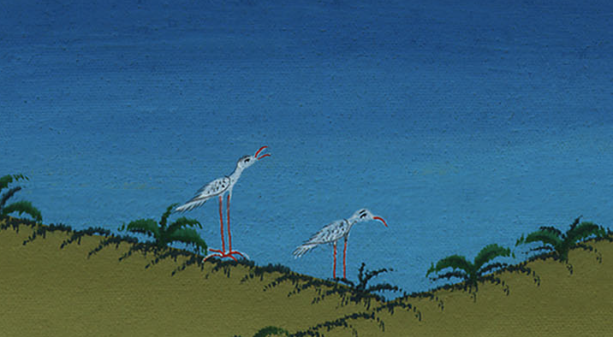
Genesis 9:2

Slide 17
3Every moving thing that lives will be food for you. As I gave you the green herb, I have given everything to you.

Slide 18
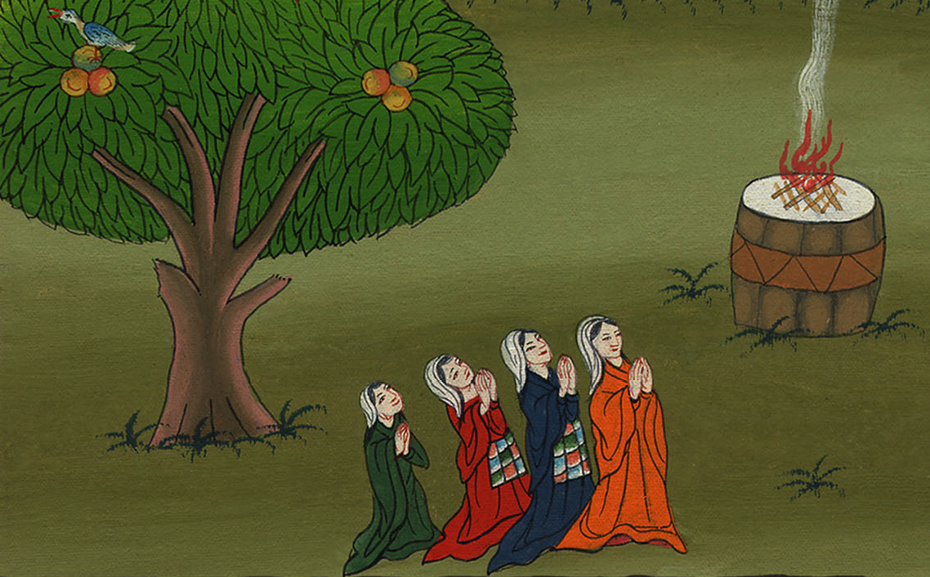
Genesis 9:3

Slide 19
4But flesh with its life, that is, its blood, you shall not eat.

Slide 20
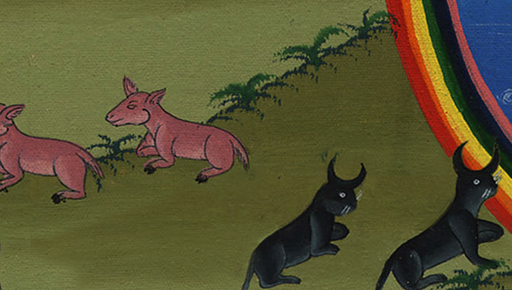
Genesis 9:4

Slide 21
5I will surely require accounting for your life’s blood. At the hand of every animal I will require it. At the hand of man, even at the hand of every man’s brother, I will require the life of man.

Slide 22
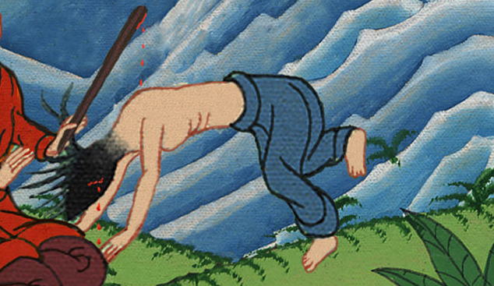
Genesis 9:5

Slide 23
6Whoever sheds man’s blood, his blood will be shed by man, for God made man in his own image.

Slide 24
Genesis 9:6

Slide 25
8God spoke to Noah and to his sons with him, saying, 9“As for me, behold, I establish my covenant with you, and with your offspring after you, 10and with every living creature that is with you: the birds, the livestock, and every animal of the earth with you, of all that go out of the ship, even every animal of the earth.

Slide 26
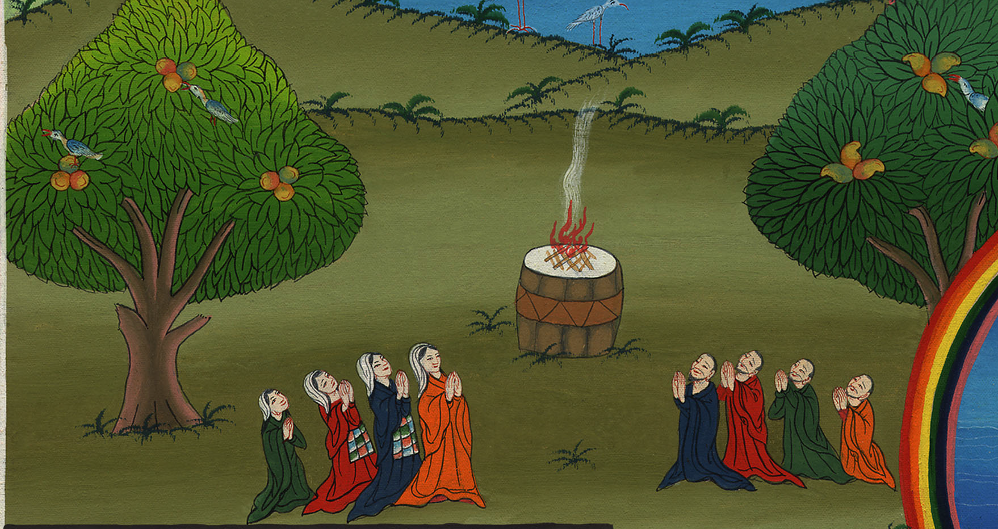
Genesis 9:8,9,10

Slide 27
11I will establish my covenant with you: All flesh will not be cut off any more by the waters of the flood. There will never again be a flood to destroy the earth.”

Slide 28
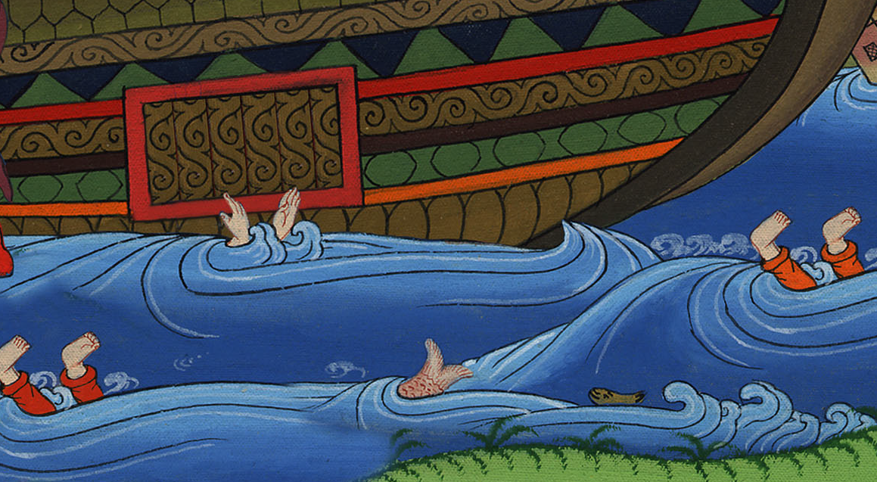
Genesis 9:11

Slide 29
12God said, “This is the token of the covenant which I make between me and you and every living creature that is with you, for perpetual generations:

Slide 30
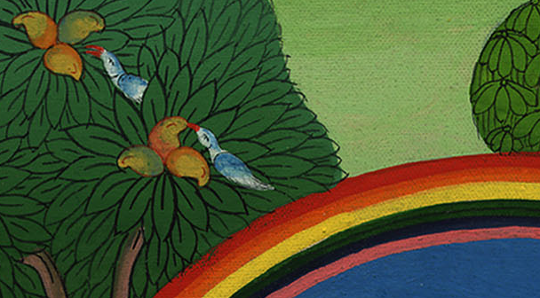
Genesis 9:12

Slide 31
13I set my rainbow in the cloud, and it will be a sign of a covenant between me and the earth.

Slide 32
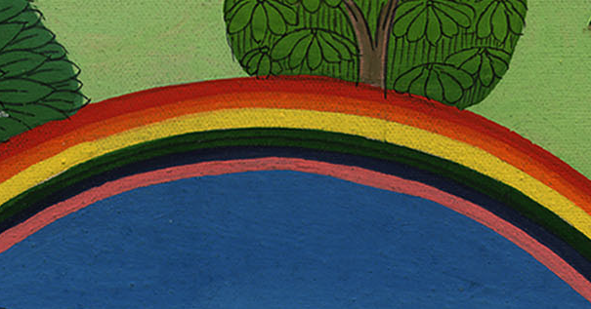
Genesis 9:13

Slide 33
14When I bring a cloud over the earth, that the rainbow will be seen in the cloud,

Slide 34
Genesis 9:14

Slide 35
15I will remember my covenant, which is between me and you and every living creature of all flesh, and the waters will no more become a flood to destroy all flesh.

Slide 36
Genesis 9:15

Slide 37
17God said to Noah, “This is the token of the covenant which I have established between me and all flesh that is on the earth.”

Slide 38
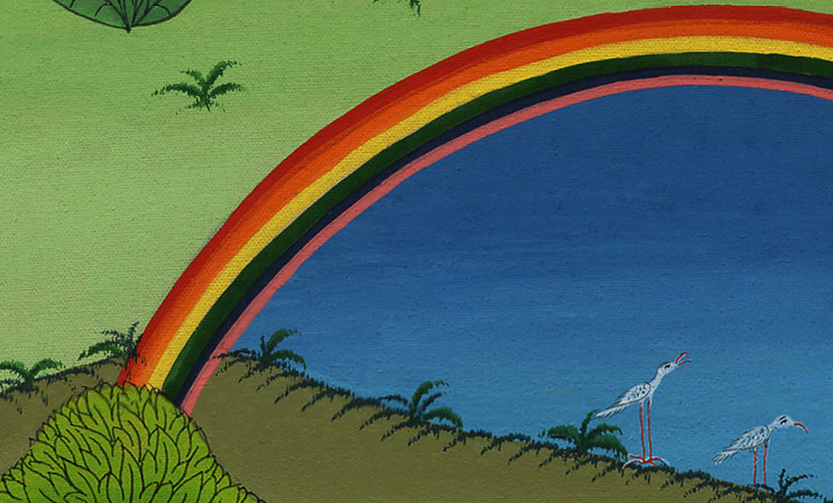
Genesis 9:17

Slide 39
Summary

Slide 40
