Slide 1
04-
This work is licensed under a Creative Commons Attribution-ShareAlike 4.0 International License.
Please add this statement to all the videos you create.
English Bible quotes are from the World English Bible US, which is in the public domain.

Slide 2
The Tower of Babel
Genesis 11

Slide 3
The Tower of Babel
Genesis 11

Slide 4
The Tower of Babel
Genesis 11
Notes:
The Tower of Babel

Slide 5
1The whole earth was of one language and of one speech.

Slide 6
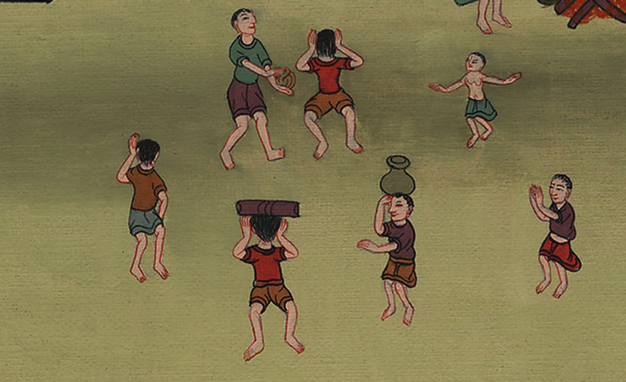
Genesis 11:1

Slide 7
2As they traveled east, they found a plain in the land of Shinar, and they lived there.

Slide 8
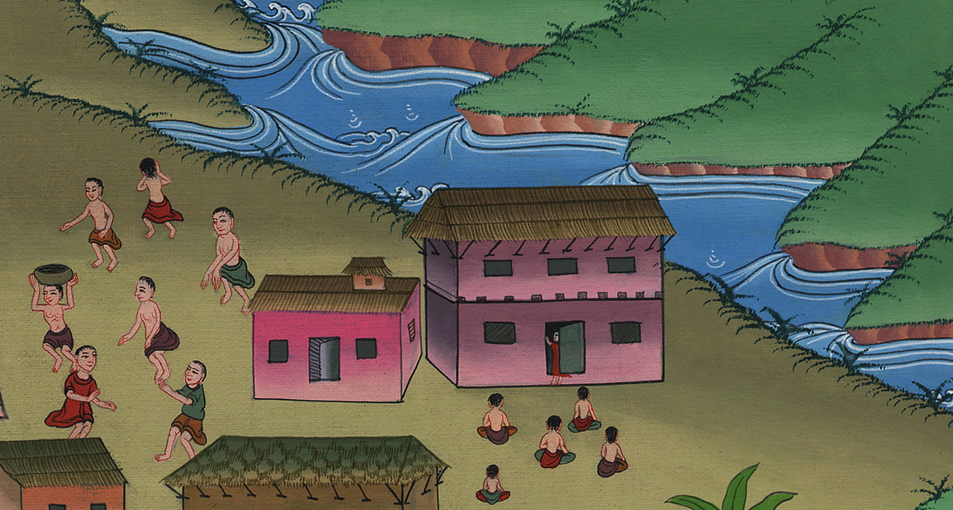
Genesis 11:2
Notes:
.

Slide 9
3They said to one another, “Come, let’s make bricks, and burn them thoroughly.” They had brick for stone, and they used tar for mortar.

Slide 10
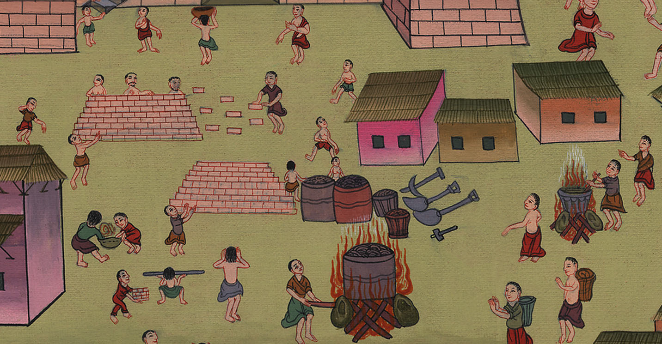
Genesis 11:3

Slide 11
4They said, “Come, let’s build ourselves a city, and a tower whose top reaches to the sky, and let’s make a name for ourselves, lest we be scattered abroad on the surface of the whole earth.”

Slide 12
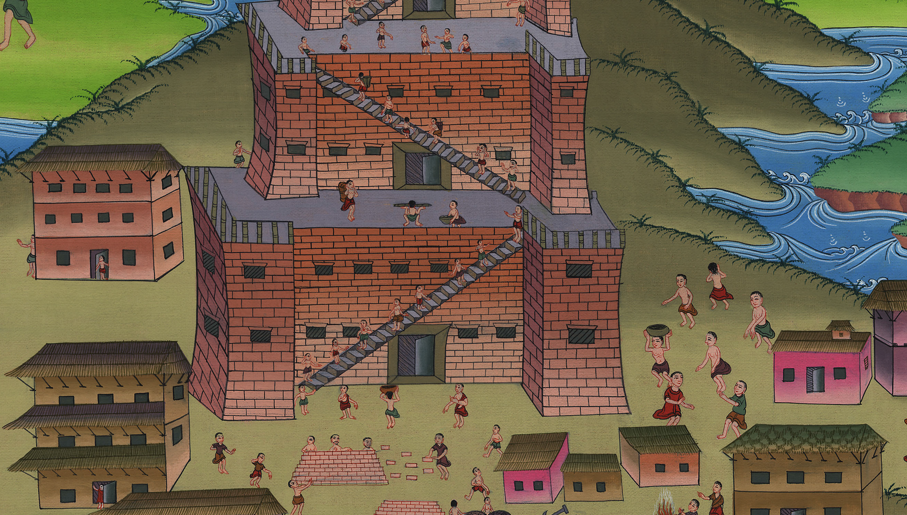
Genesis 11:4
Notes:
.

Slide 13
5Yahweh came down to see the city and the tower, which the children of men built.

Slide 14
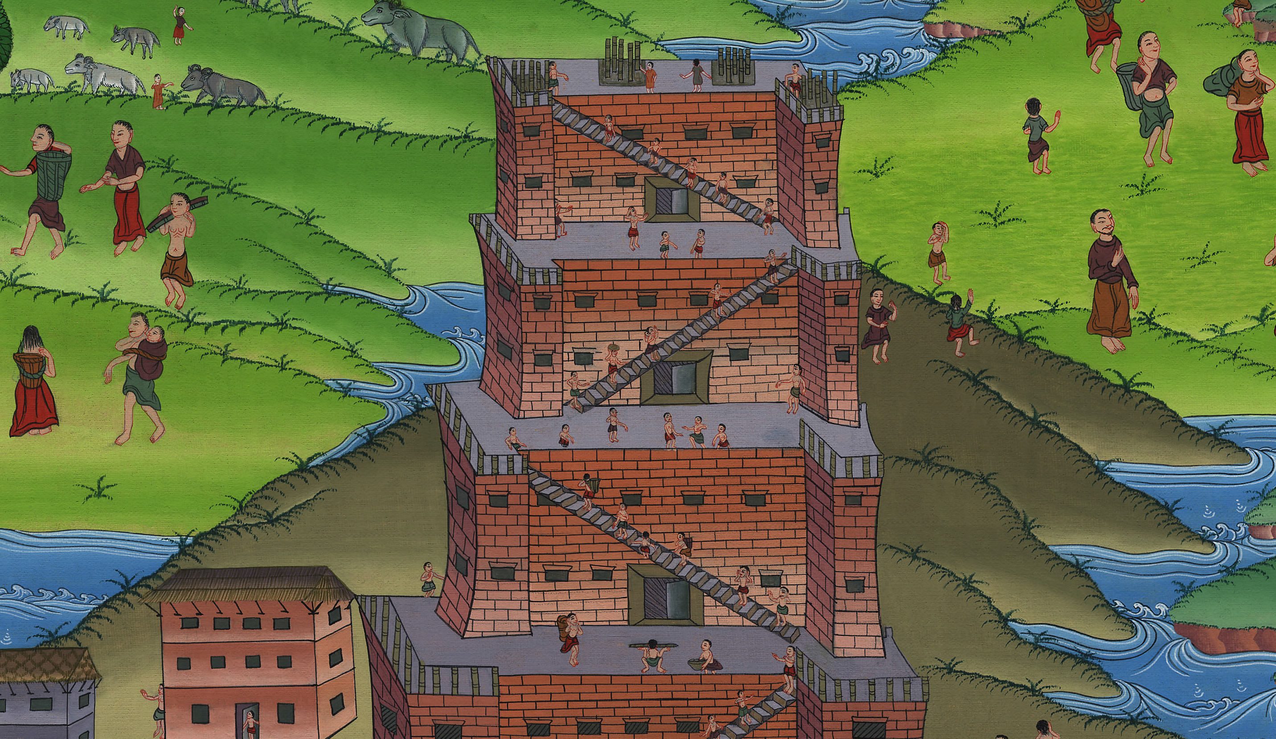
Genesis 11:5

Slide 15
6Yahweh said, “Behold, they are one people, and they all have one language, and this is what they begin to do. Now nothing will be withheld from them, which they intend to do.

Slide 16
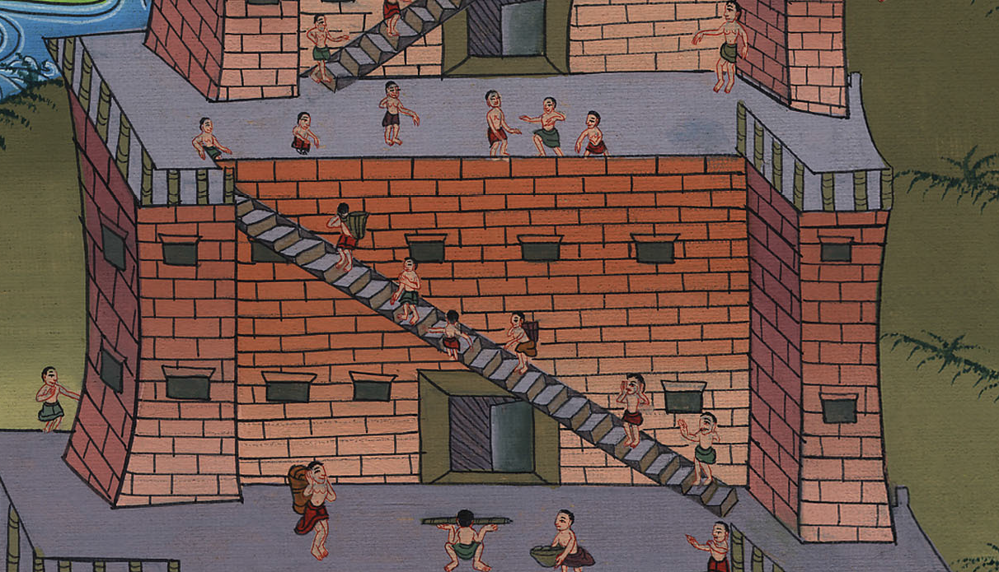
Genesis 11:6
Notes:
.

Slide 17
7Come, let’s go down, and there confuse their language, that they may not understand one another’s speech.”

Slide 18
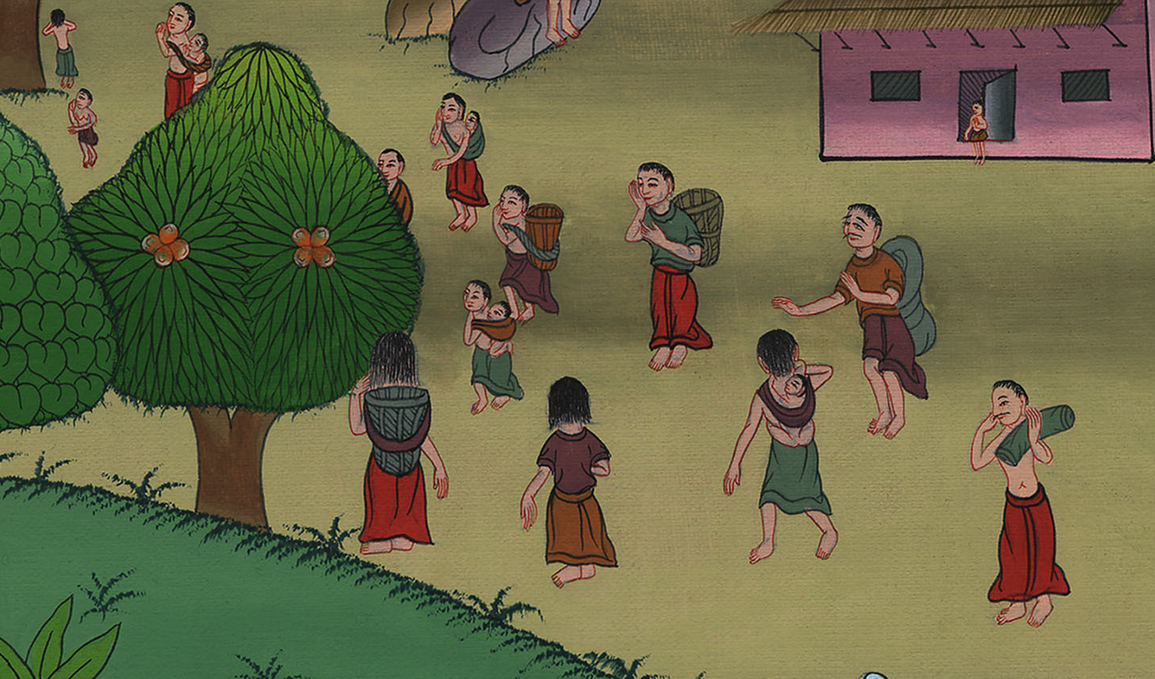
Genesis 11:7
Notes:
.

Slide 19
8So Yahweh scattered them abroad from there on the surface of all the earth. They stopped building the city.

Slide 20
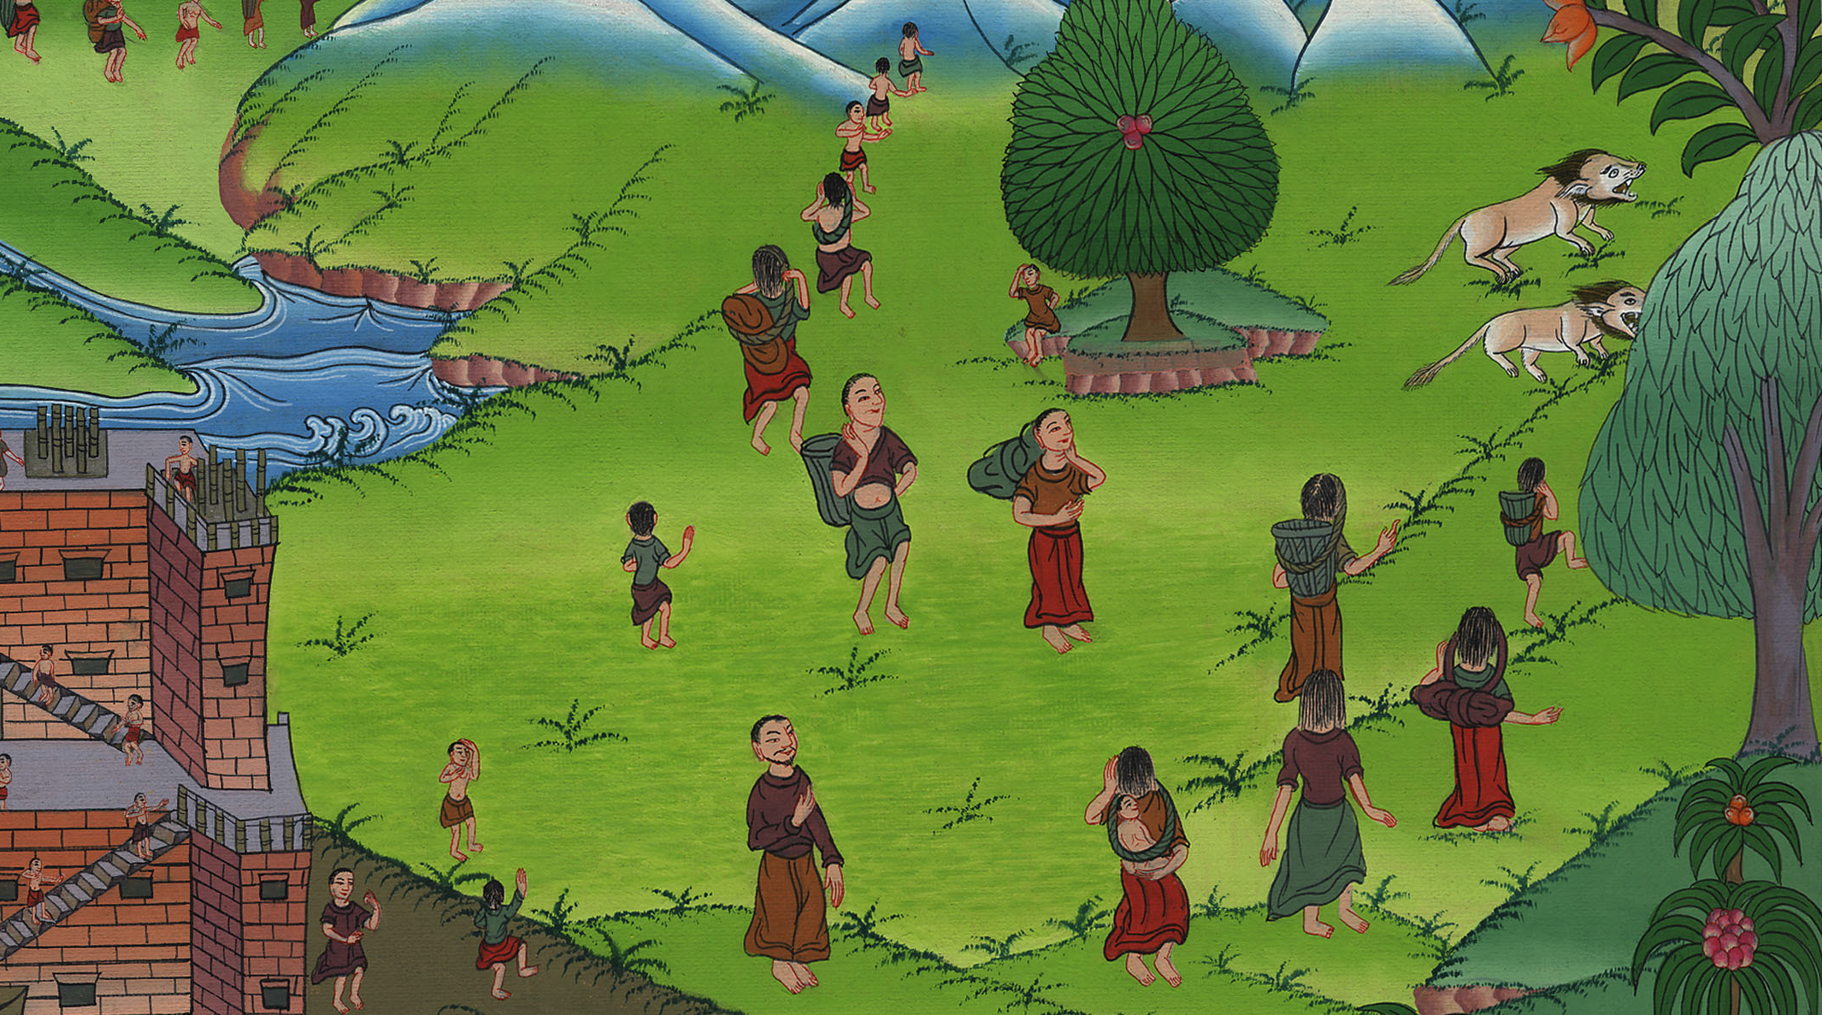
Genesis 11:8

Slide 21
9Therefore its name was called Babel, because there Yahweh confused the language of all the earth. From there, Yahweh scattered them abroad on the surface of all the earth.

Slide 22
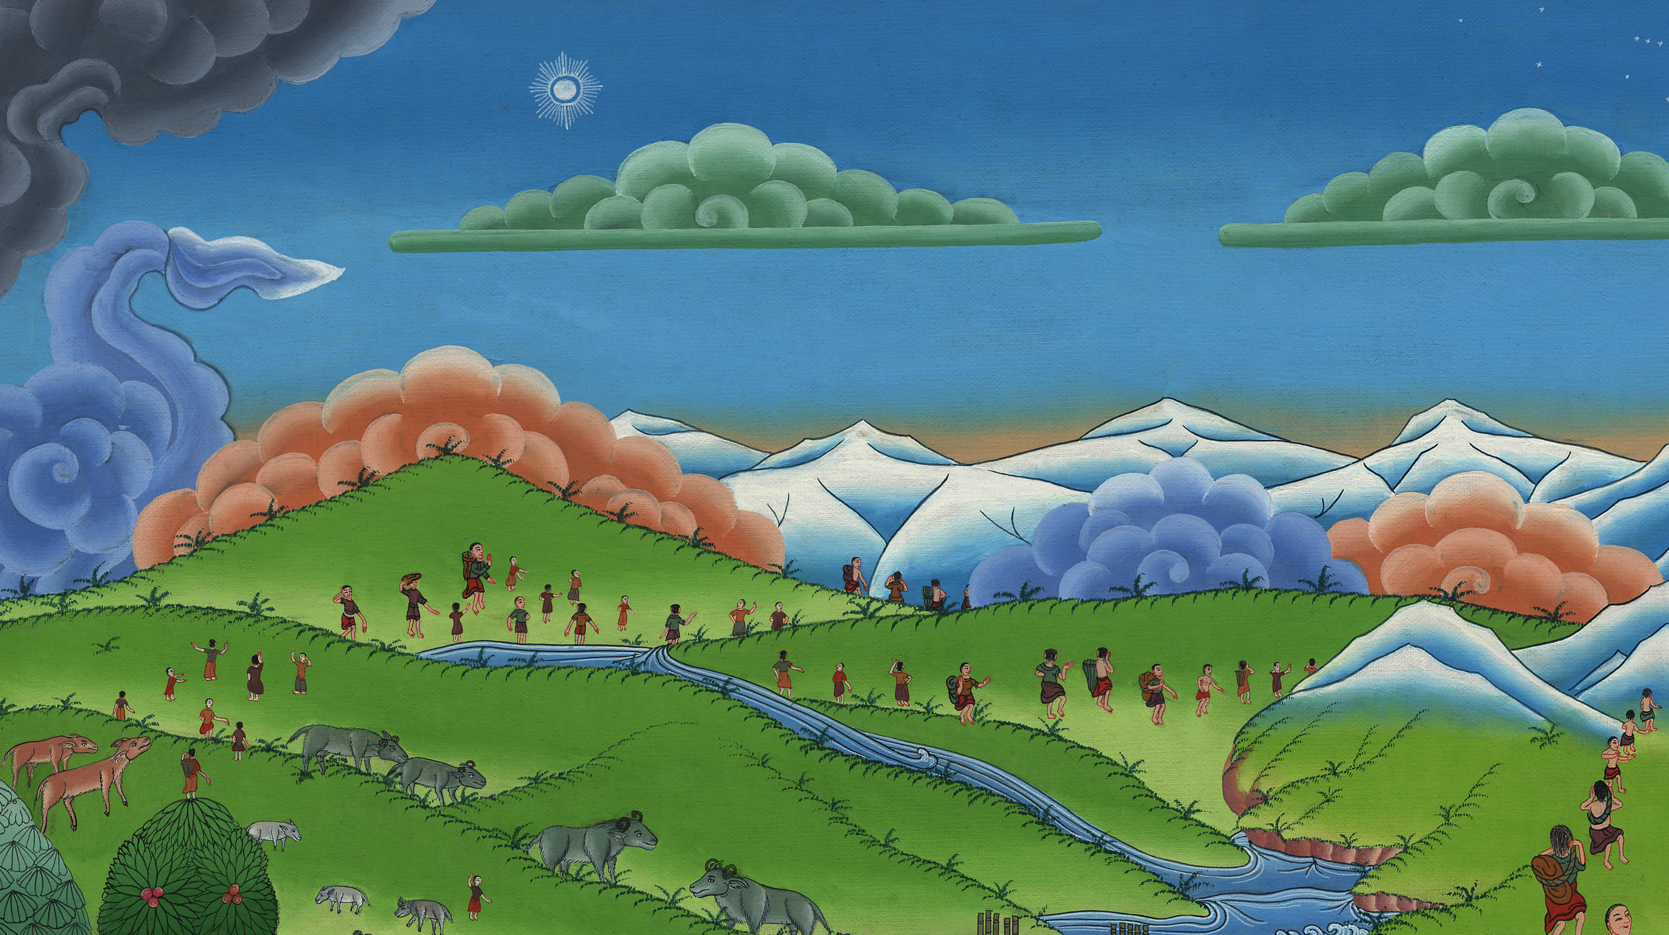
Genesis 11:9
Notes:
.

