Slide 1
05-10
This work is licensed under a Creative Commons Attribution-ShareAlike 4.0 International License.
Please add this statement to all the videos you create.
English Bible quotes are from the World English Bible US, which is in the public domain.

Slide 2
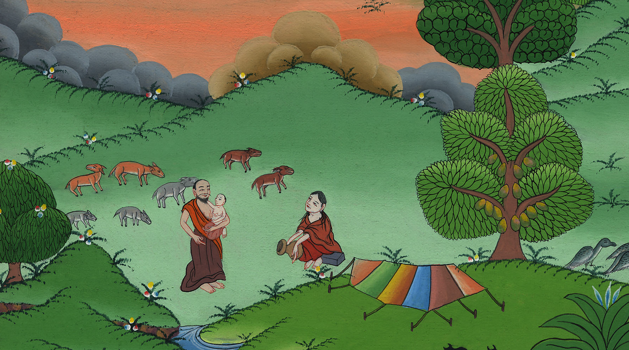
10
The Birth of Isaac – Genesis 21:1-8

Slide 3
The Birth of Isaac – Genesis 21:1-8

Slide 4
The Birth of Isaac – Genesis 21:1-8
Notes:
10 Isaac Born – Gen 21:1-8 (Left 3rd) ཨི་སཱག་སྐྱེས་པ།
Introduction:
After the destruction of Sodom, Abraham decides to move to a new place. He leads his growing clan to the Negev region, near the dessert.

Slide 5
After the destruction of Sodom, Abraham decides to move to a new place. He leads his growing clan to the Negev region, near the dessert.

Slide 6
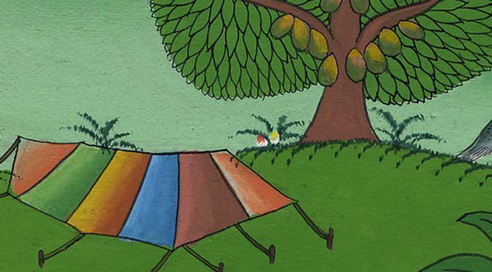

Slide 7
1Yahweh visited Sarah as he had said, and Yahweh did to Sarah as he had spoken.

Slide 8
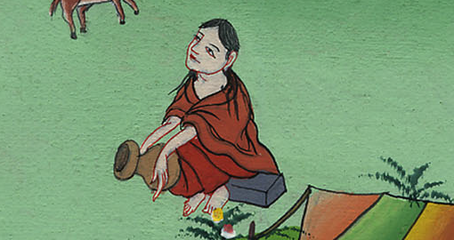
Genesis 21:1
Notes:
The Lord was gracious to Sarah, just as he had said he would be. The Lord did for Sarah what he had promised to do.
1དཀོན་མཆོག་གིས་དམ་བཅའ་གནང་བ་བཞིན་ས་རཱ་ལ་བྱིན་རླབས་གནང་ཞིང་།

Slide 9
2Sarah conceived, and bore Abraham a son in his old age, at the set time of which God had spoken to him.

Slide 10
Genesis
Notes:
² Sarah became pregnant. She had a son by Abraham when he was old. The child was born at the exact time God had promised.
2ས་རཱ་མངལ་དང་ལྡན་པར་འགྱུར་ནས། ཨབ་ར་ཧམ་རྒས་པའི་ཚེ་མོ་ལ་བུ་ཞིག་སྐྱེས་སོ། བུ་དེ་ནི་དཀོན་མཆོག་གིས་སྐྱེས་ཡོང་གསུངས་པའི་དུས་ཚོད་དེ་རང་ལ་སྐྱེས་སོ།

Slide 11
3Abraham called his son who was born to him, whom Sarah bore to him, Isaac.

Slide 12
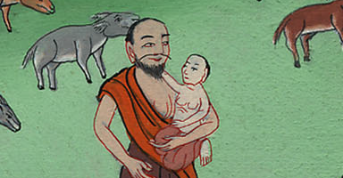
Genesis 21:3
Notes:
³ Abraham gave the name Isaac to the son Sarah had by him.
3ཨབ་ར་ཧམ་གྱིས་བུ་དེའི་མིང་ཨི་སཱག་ཞེས་བཏགས་སོ།

Slide 13
4Abraham circumcised his son, Isaac, when he was eight days old, as God had commanded him.

Slide 14
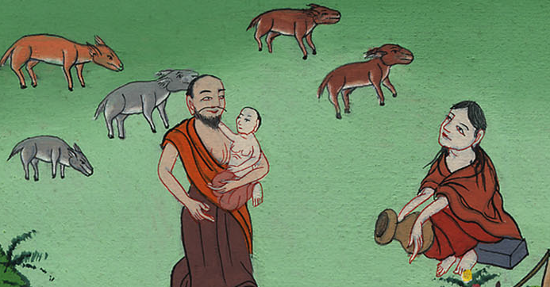
Genesis 21:4
Notes:
⁴ When his son Isaac was eight days old, Abraham circumcised him. He did it exactly as God had commanded him.
4དཀོན་མཆོག་གིས་བཀའ་གནང་བ་བཞིན་ཨི་སཱག་སྐྱེས་ནས་ཉི་མ་བརྒྱད་ལོན་པའི་རྗེས་སུ་ཨབ་ར་ཧམ་གྱིས་ཁོའི་མདུན་ལྤགས་བཅད་དོ།

Slide 15
5Abraham was one hundred years old when his son, Isaac, was born to him.

Slide 16
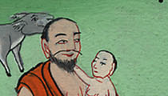
Genesis 21:5
Notes:
⁵ Abraham was 100 years old when his son Isaac was born to him.
5ཨི་སཱག་སྐྱེས་པའི་ཚེ་ཨབ་ར་ཧམ་ལོ་ ༡༠༠ ལོན་ཡོད་པ་དང་།

Slide 17
6Sarah said, “God has made me laugh. Everyone who hears will laugh with me.”

Slide 18
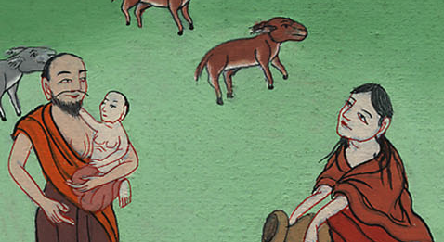
Genesis 21:6
Notes:
⁶ Sarah said, “God has given laughter to me. Everyone who hears about this will laugh with me.”
6ས་རཱས། ཕྲུ་གུ་འདི་སྐྱེས་པའི་སྒོ་ནས་དཀོན་མཆོག་གིས་ང་ལ་དགའ་བ་དང་། གད་མོ་གནང་བས། བྱ་བ་དེའི་སྐོར་ཐོས་མཁན་རྣམས་ཀྱིས་ཀྱང་ང་དང་མཉམ་དུ་གད་མོ་བགད་ཡོང།

