Slide 1
05-3
This work is licensed under a Creative Commons Attribution-ShareAlike 4.0 International License.
Please add this statement to all the videos you create.
English Bible quotes are from the World English Bible US, which is in the public domain.

Slide 2
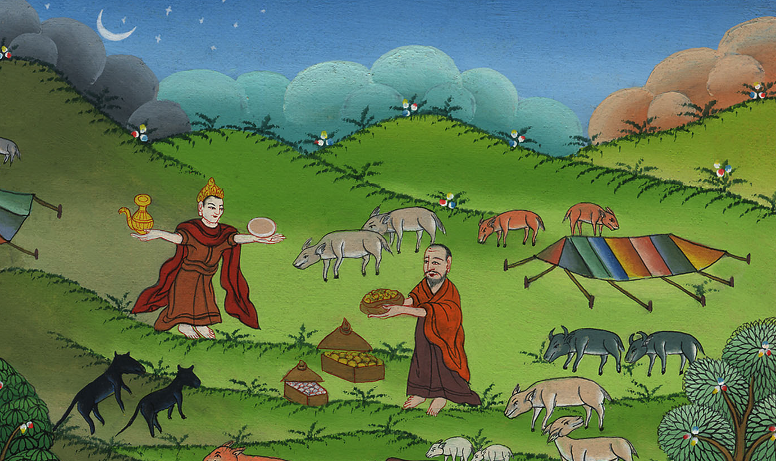
3
Abram rescues Lot and meets Melchizedek
Genesis 14:1-24

Slide 3
Abram rescues Lot and meets Melchizedek Genesis 14:1-24

Slide 4
Abram rescues Lot and meets Melchizedek
Genesis 14:1-24

Slide 5
At this time there was a war between the kings of this area.
8 …. and they set the battle in array against them in the valley of Siddim

Slide 6
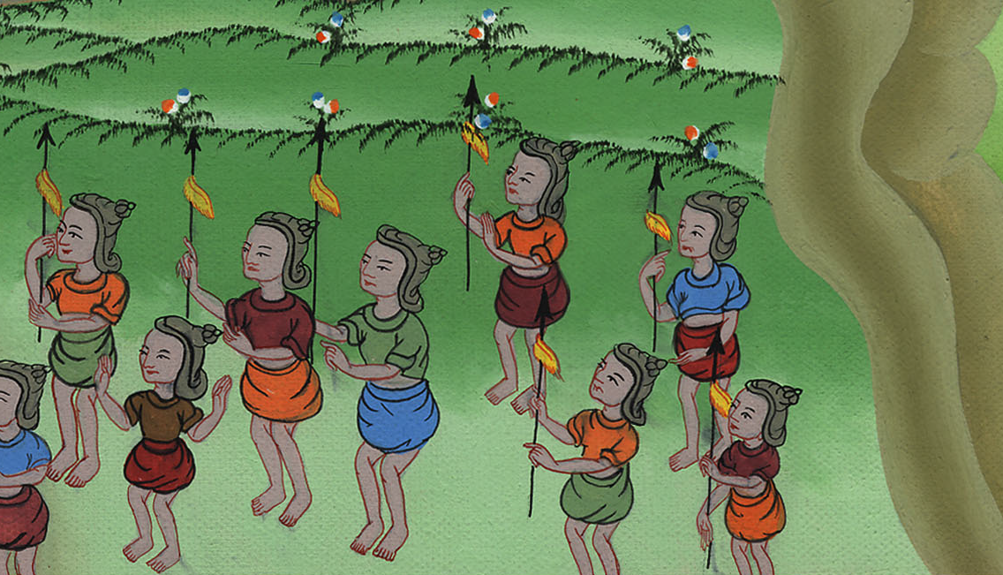
Genesis 14:8

Slide 7
9. There were four kings against five.
10 …and the kings of Sodom and Gomorrah fled, and some fell there. Those who remained fled to the hills.

Slide 8
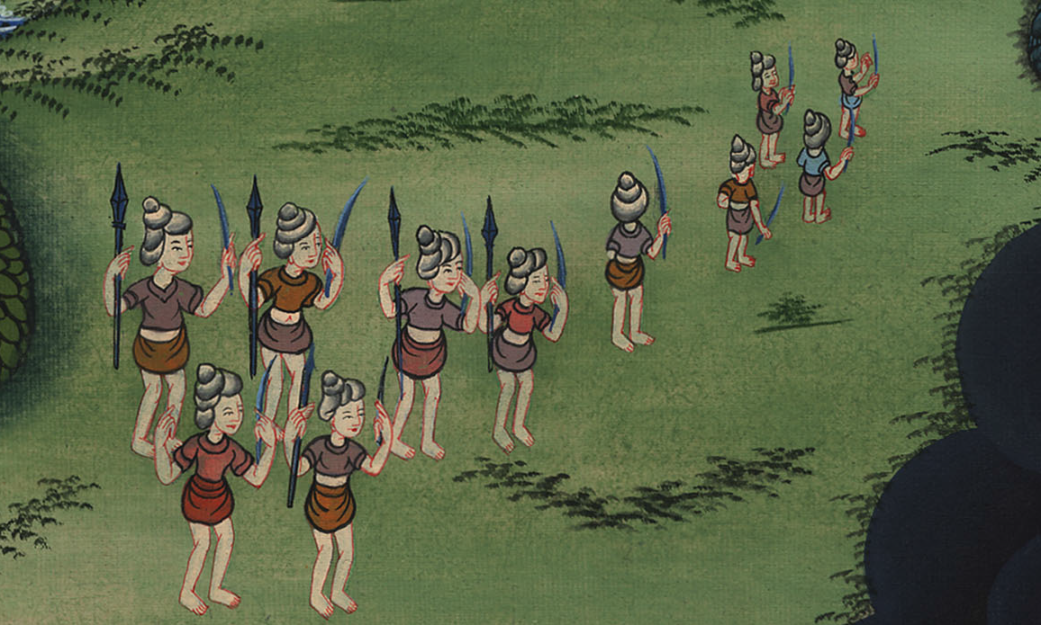
Genesis 14:9,10

Slide 9
11They took all the goods of Sodom and Gomorrah, and all their food, and went their way. 12They took Lot, Abram’s brother’s son, who lived in Sodom, and his goods, and departed.

Slide 10
Genesis 14:11,12

Slide 11
13A man escaped and came to report everything to Abram.
14Abram heard that Lot had been captured. So he called out his 318 trained men.

Slide 12
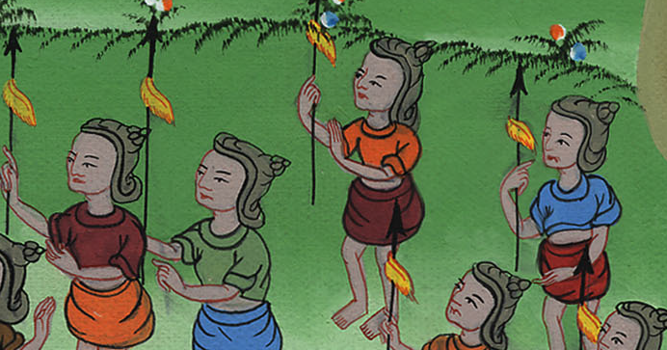
Genesis 14:13,14

Slide 13
17The king of Sodom went out to meet him after his return from the slaughter of Chedorlaomer and the kings who were with him, at the valley of Shaveh (that is, the King’s Valley).

Slide 14
Genesis 14:17

Slide 15
After winning the battle, Abraham went to Jerusalem

Slide 16
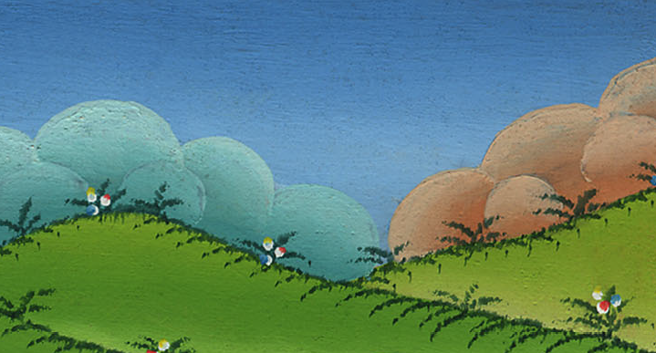
Genesis 14:18

Slide 17
18Melchizedek king of Salem brought out bread and wine. He was priest of God Most High.

Slide 18
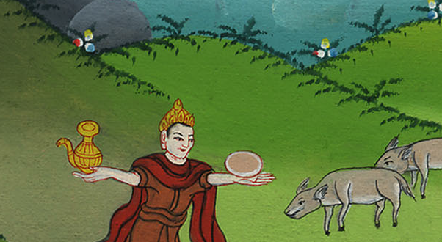
Genesis 14:18
Notes:
18

Slide 19
19He blessed him, and said, “Blessed be Abram of God Most High, possessor of heaven and earth.

Slide 20
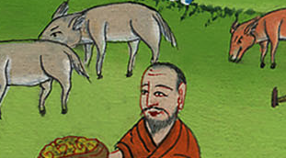
Genesis 14:19

Slide 21
20Blessed be God Most High, who has delivered your enemies into your hand.”

Slide 22
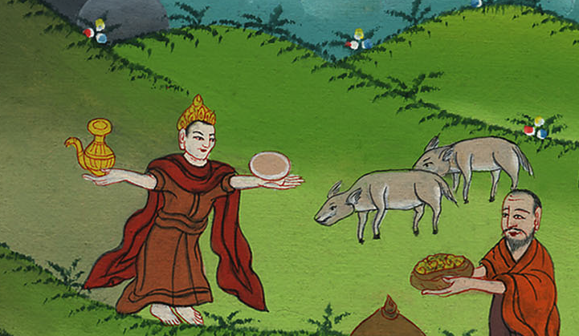
Genesis 14:20

Slide 23
Abram gave him a tenth of all.

Slide 24
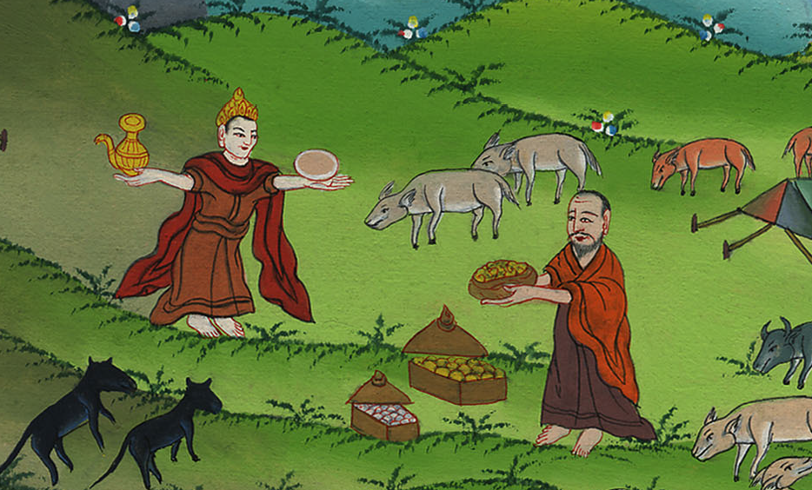
Genesis 14:20

