Slide 1
06-1
This work is licensed under a Creative Commons Attribution-ShareAlike 4.0 International License.
Please add this statement to all the videos you create.
English Bible quotes are from the World English Bible US, which is in the public domain.

Slide 2
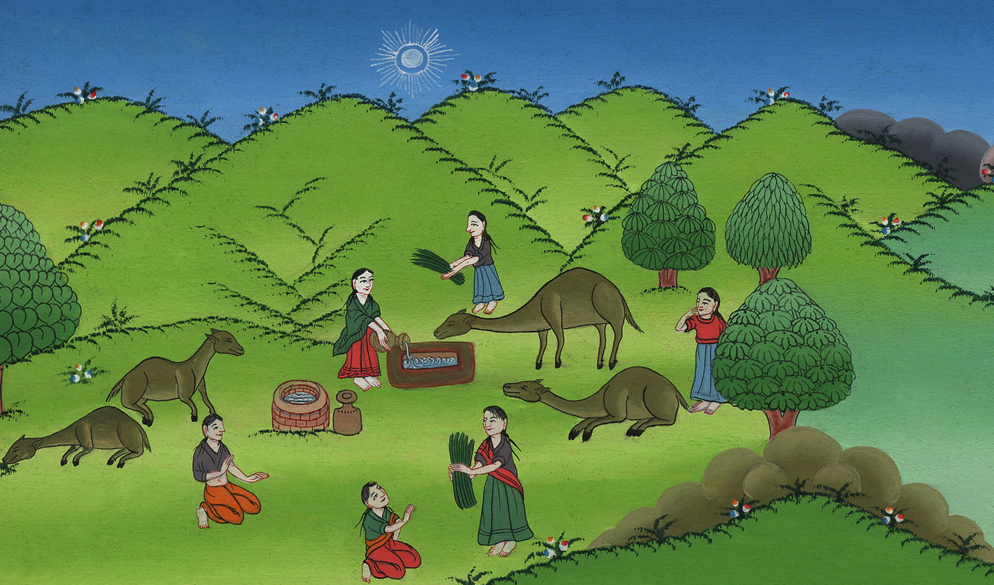
A wife for Isaac – Genesis 24:1-61
Notes:
Checked

Slide 3
A wife for Isaac – Genesis 24:1-61

Slide 4
A wife for Isaac – Genesis 24:1-61
Notes:
Abraham sends his servant to find a wife for Isaac – Gen 24:1-61

Slide 5
24:1 1Abraham was old, and well advanced in age. Yahweh had blessed Abraham in all things.

Slide 6
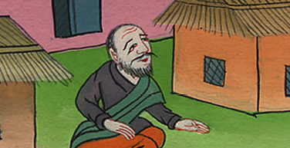
Genesis 24:1
Notes:
24:1 By that time Abraham was very old. The Lord had blessed Abraham in every way

Slide 7
2Abraham said to his servant, the elder of his house, who ruled over all that he had, “Please put your hand under my thigh.

Slide 8
Genesis 24:2
Notes:
. ² The best servant in his house was in charge of everything Abraham had. Abraham said to him, “

Slide 9
3I will make you swear by Yahweh, the God of heaven and the God of the earth, that you shall not take a wife for my son of the daughters of the Canaanites, among whom I live.

Slide 10
Genesis 24:3
Notes:
³ The Lord is the God of heaven and the God of earth. I want you to make a promise to me in his name. I’m living among the people of Canaan. But I want you to promise me that you won’t get a wife for my son from their daughters.

Slide 11
4But you shall go to my country, and to my relatives, and take a wife for my son Isaac.”

Slide 12
Genesis 24:4
Notes:
⁴ Instead, promise me that you will go to my country and to my own relatives. Get a wife for my son Isaac from there.”

Slide 13
10The servant took ten of his master’s camels, and departed, having a variety of good things of his master’s with him. He arose, and went to Mesopotamia, to the city of Nahor.

Slide 14
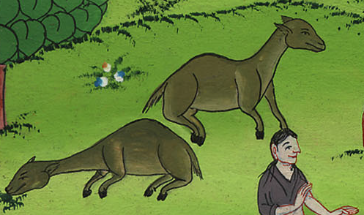
Genesis 24:10
Notes:
¹⁰ The servant chose ten of his master’s camels and left. He loaded the camels with all kinds of good things from his master. He started out for Aram Naharaim and made his way to the town of Nahor.

Slide 15
11He made the camels kneel down outside the city by the well of water at the time of evening, the time that women go out to draw water.

Slide 16
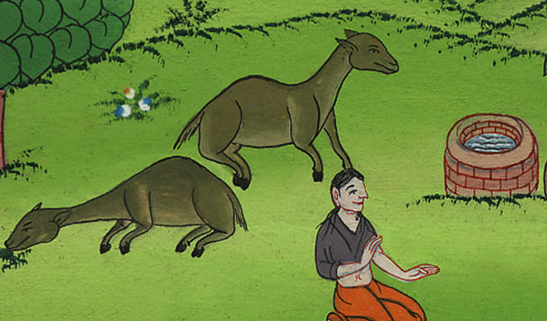
Genesis 24:11
Notes:
¹¹ He stopped near the well outside the town. There he made the camels get down on their knees. It was almost evening, the time when women go out to get water.

Slide 17
12He said, “Yahweh, the God of my master Abraham, please give me success today, and show kindness to my master Abraham.

Slide 18
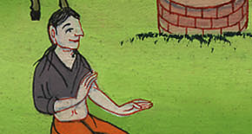
Genesis 24:12
Notes:
¹² Then he prayed, “Lord, you are the God of my master Abraham. Make me successful today. Be kind to my master Abraham.

Slide 19
13Behold, I am standing by the spring of water. The daughters of the men of the city are coming out to draw water.

Slide 20
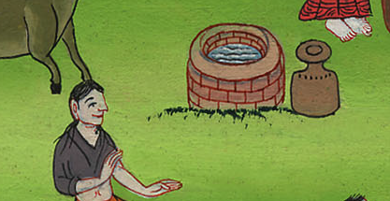
Genesis 24:13
Notes:
¹³ I’m standing beside this spring. The daughters of the people who live in the town are coming out here to get water.

Slide 21
14Let it happen, that the young lady to whom I will say, ‘Please let down your pitcher, that I may drink,’ then she says, ‘Drink, and I will also give your camels a drink,’—let her be the one you have appointed for your servant Isaac. By this I will know that you have shown kindness to my master.”

Slide 22
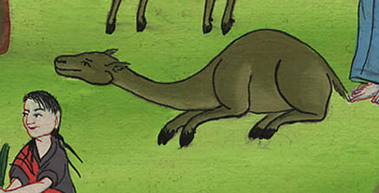
Genesis 24:14
Notes:
¹⁴ I will speak to a young woman. I’ll say to her, ‘Please lower your jar so I can have a drink.’ Suppose she says, ‘Have a drink of water, and I’ll get some for your camels too.’ Then let her be the one you have chosen for your servant Isaac. That’s how I’ll know you have been kind to my master.”

Slide 23
15Before he had finished speaking, behold, Rebekah came out, who was born to Bethuel the son of Milcah, the wife of Nahor, Abraham’s brother, with her pitcher on her shoulder.

Slide 24
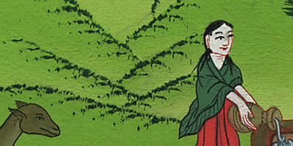
Genesis 24:15
Notes:
¹⁵ Before he had finished praying, Rebekah came out. She was carrying a jar on her shoulder.

Slide 25
16The young lady was very beautiful to look at, a virgin. No man had known her. She went down to the spring, filled her pitcher, and came up.

Slide 26
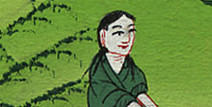
Genesis 24:16
Notes:
¹⁶ The young woman was very beautiful. No man had ever slept with her. She went down to the spring. She filled her jar and came up again.

Slide 27
17The servant ran to meet her, and said, “Please give me a drink, a little water from your pitcher.”

Slide 28
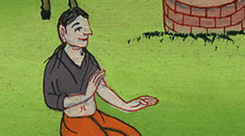
Genesis 24:17
Notes:
¹⁷ The servant hurried to meet her. He said, “Please give me a little water from your jar.”

Slide 29
18She said, “Drink, my lord.” She hurried, and let down her pitcher on her hand, and gave him a drink.

Slide 30
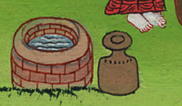
Genesis 24:18
Notes:
¹⁸ “Have a drink, sir,” she said. She quickly lowered the jar to her hands and gave him a drink.

Slide 31
19When she had finished giving him a drink, she said, “I will also draw for your camels, until they have finished drinking.”

Slide 32
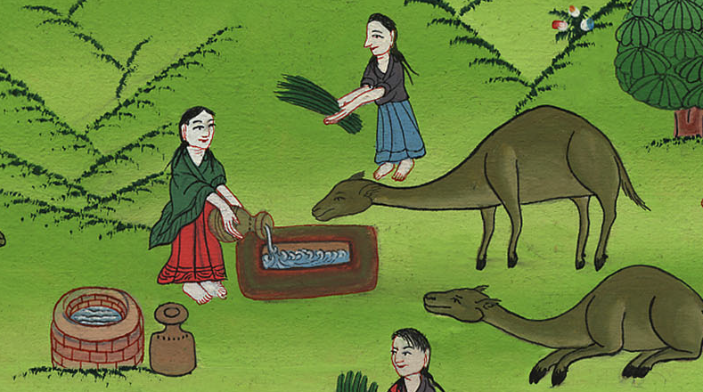
Genesis 24:19
Notes:
¹⁹ After she had given him a drink, she said, “I’ll get water for your camels too. I’ll keep doing it until they have had enough to drink.”

Slide 33
20She hurried, and emptied her pitcher into the trough, and ran again to the well to draw, and drew for all his camels.

Slide 34
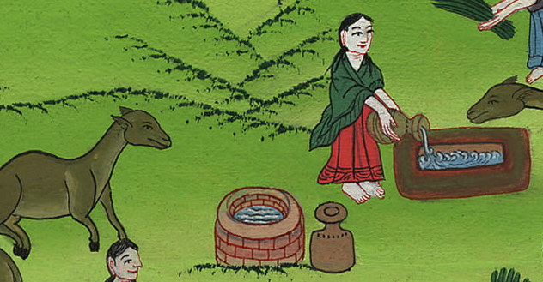
Genesis 24:20
Notes:
²⁰ So she quickly emptied her jar into the stone tub. Then she ran back to the well to get more water. She got enough for all his camels

Slide 35
22As the camels had done drinking, the man took a golden ring of half a shekel weight, and two bracelets for her hands of ten shekels weight of gold,

Slide 36
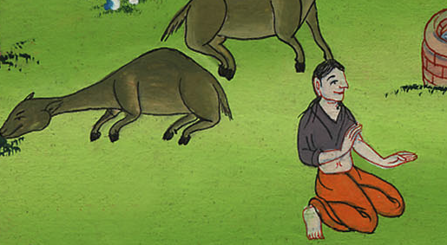
Genesis 24:22
Notes:
²² The camels finished drinking. Then the man took out a gold nose ring. It weighed about a fifth of an ounce. He also took out two gold bracelets. They weighed about four ounces.

Slide 37
23and said, “Whose daughter are you? Please tell me. Is there room in your father’s house for us to stay?”

Slide 38
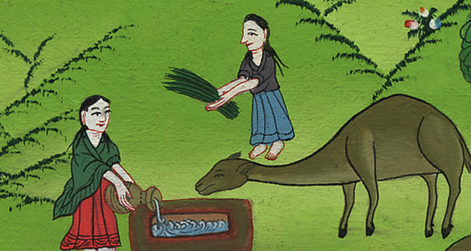
Genesis 24:23
Notes:
²³ Then he asked, “Whose daughter are you? And please tell me something else. Is there room in your father’s house for us? Can we spend the night there?”

Slide 39
24She said to him, “I am the daughter of Bethuel the son of Milcah, whom she bore to Nahor.”

Slide 40
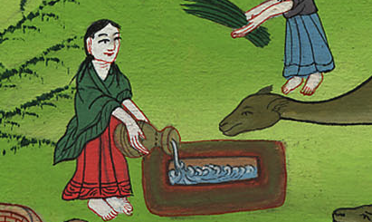
Genesis 24:24
Notes:
²⁴ She answered, “I’m the daughter of Bethuel. He’s the son Milkah had by Nahor.”

Slide 41
25She said moreover to him, “We have both straw and feed enough, and room to lodge in.”

Slide 42
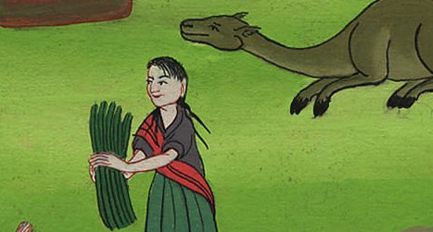
Genesis 24:25
Notes:
²⁵ She continued, “We have plenty of straw and feed for your camels. We also have room for you to spend the night.”

Slide 43
26The man bowed his head, and worshiped Yahweh. 27He said, “Blessed be Yahweh, the God of my master Abraham, who has not forsaken his loving kindness and his truth toward my master. As for me, Yahweh has led me on the way to the house of my master’s relatives.”

Slide 44
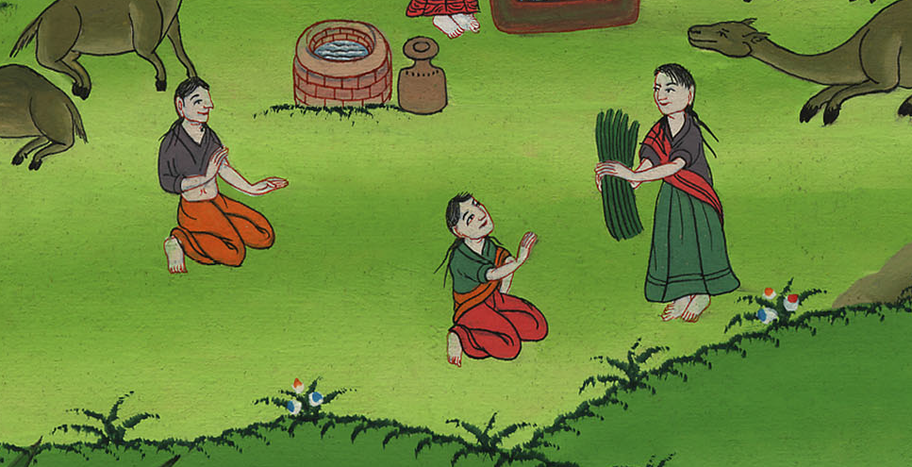
Genesis 24:26
Notes:
²⁶ Then the man bowed down and worshiped the Lord. ²⁷ He said, “I praise the Lord, the God of my master Abraham. The Lord hasn’t stopped being kind and faithful to my master. The Lord has led me on this journey. He has brought me to the house of my master’s relatives.”

Slide 45
28The young lady ran, and told her mother’s house about these words.

Slide 46
Genesis 24:28
Notes:
²⁸ The young woman ran home. She told her mother’s family what had happened.

Slide 47
(The servant went to Rebekha’s house and met her family. He told them everything.)

Slide 48
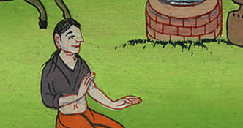
Notes:
The servant went to Rebekha’s house and met her family. He told them everything.

Slide 49
59They sent away Rebekah, their sister, with her nurse, Abraham’s servant, and his men.

Slide 50
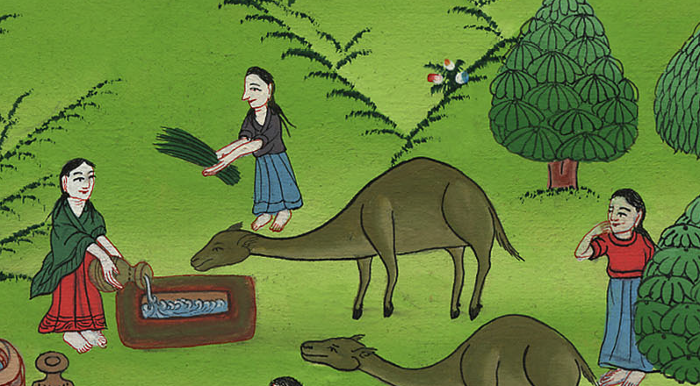
Genesis 24:59
Notes:
⁵⁹ So they sent their sister Rebekah on her way with Abraham’s servant and his men. They also sent Rebekah’s servant with her.

Slide 51
60They blessed Rebekah, and said to her, “Our sister, may you be the mother of thousands of ten thousands, and let your offspring possess the gate of those who hate them.”
61Rebekah arose with her ladies. They rode on the camels, and followed the man. The servant took Rebekah, and went his way.

Slide 52
བཀོད་པ 24:61
Genesis 24:60,61
Notes:
⁶¹ Then Rebekah and her female servants got ready. They got on their camels to go back with the man. So Abraham’s servant took Rebekah and left.

