Slide 1
07-1
This work is licensed under a Creative Commons Attribution-ShareAlike 4.0 International License.
Please add this statement to all the videos you create.
English Bible quotes are from the World English Bible US, which is in the public domain.

Slide 2
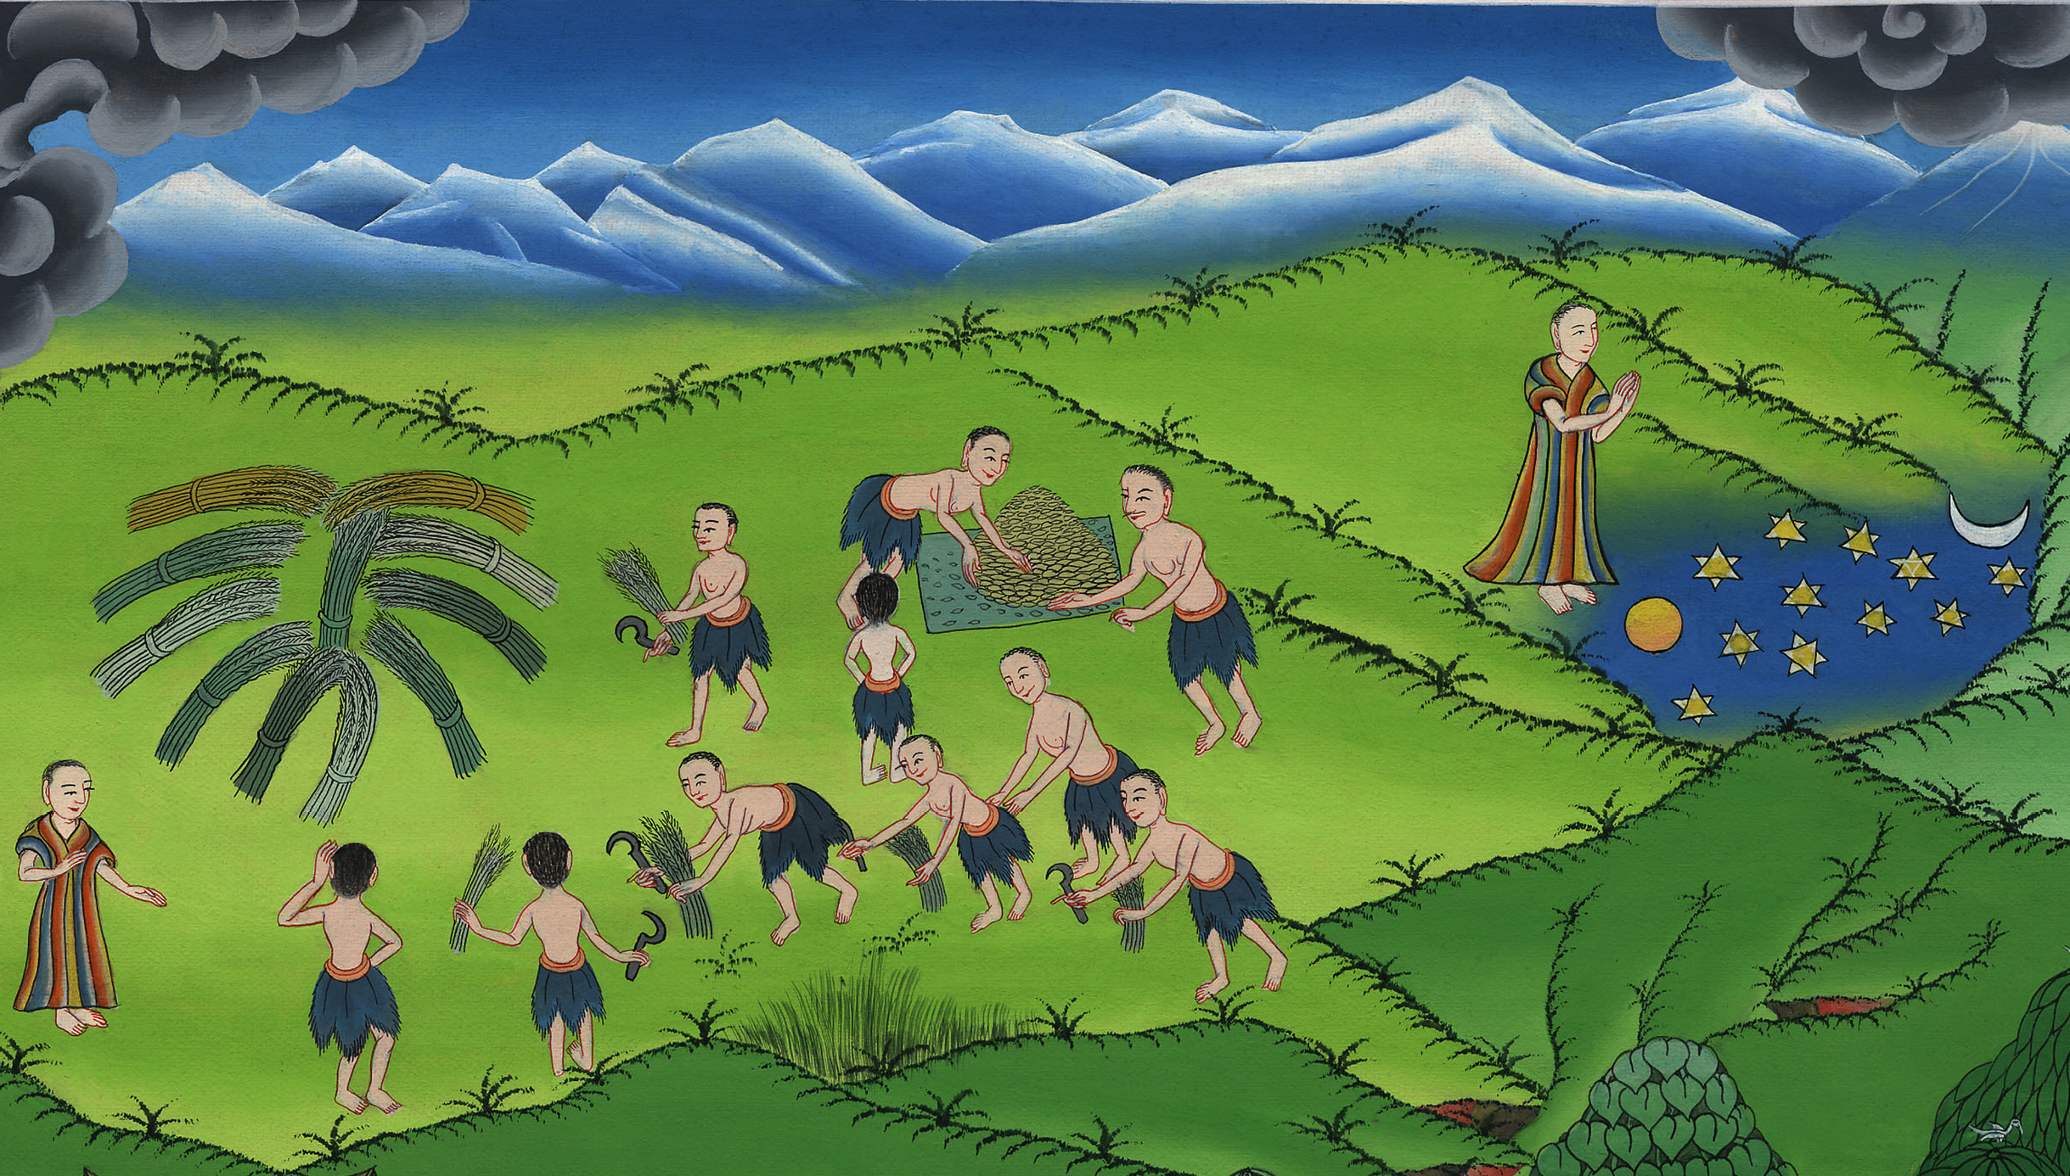
Joseph’s dreams
Genesis 37:1-11
Notes:
checked

Slide 3
Joseph’s dreams
Genesis 37:1-11
Notes:
1) Joseph’s first dream – Gen 37:1-8 (Left Top)

Slide 4
Joseph’s dreams
Genesis 37:1-11

Slide 5
1Jacob lived in the land of his father’s travels, in the land of Canaan.
Notes:
1) Joseph’s first dream – Gen 37:1-8 (Left Top)

Slide 6
Genesis 37:1

Slide 7
2This is the history of the generations of Jacob. Joseph, being seventeen years old, was feeding the flock with his brothers.
Notes:
1) Joseph’s first dream – Gen 37:1-8 (Left Top)

Slide 8
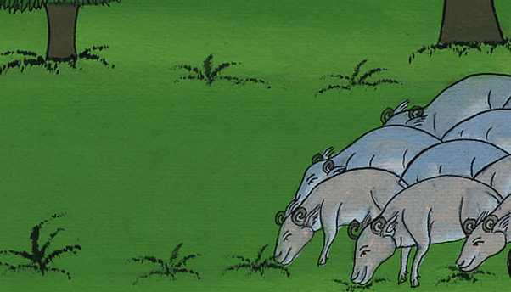
Genesis 37:2

Slide 9
He was a boy with the sons of Bilhah and Zilpah, his father’s wives. Joseph brought an evil report of them to their father.
Notes:
1) Joseph’s first dream – Gen 37:1-8 (Left Top)

Slide 10
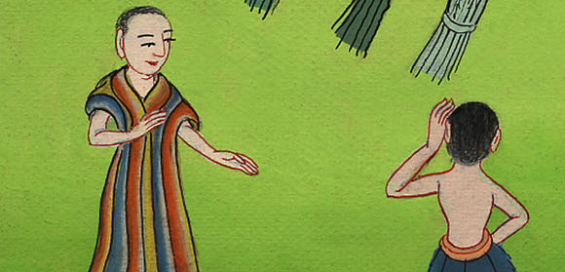
Genesis 37:2

Slide 11
3Now Israel loved Joseph more than all his children, because he was the son of his old age, and he made him a tunic of many colors
Notes:
1) Joseph’s first dream – Gen 37:1-8 (Left Top)

Slide 12
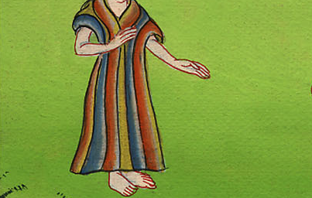
Genesis 37:3

Slide 13
4His brothers saw that their father loved him more than all his brothers, and they hated him, and couldn’t speak peaceably to him.
Notes:
1) Joseph’s first dream – Gen 37:1-8 (Left Top)

Slide 14
Genesis 37:4

Slide 15
5Joseph dreamed a dream, and he told it to his brothers, and they hated him all the more.
Notes:
1) Joseph’s first dream – Gen 37:1-8 (Left Top)

Slide 16
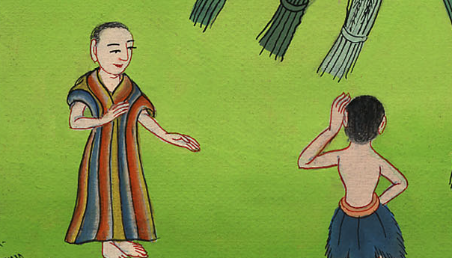
Genesis 37:5

Slide 17
6He said to them, “Please hear this dream which I have dreamed:
Notes:
1) Joseph’s first dream – Gen 37:1-8 (Left Top)

Slide 18
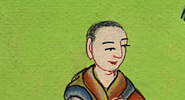
Genesis 37:6

Slide 19
7for behold, we were binding sheaves in the field, and behold, my sheaf arose and also stood upright; and behold, your sheaves came around, and bowed down to my sheaf.”
Notes:
1) Joseph’s first dream – Gen 37:1-8 (Left Top)

Slide 20
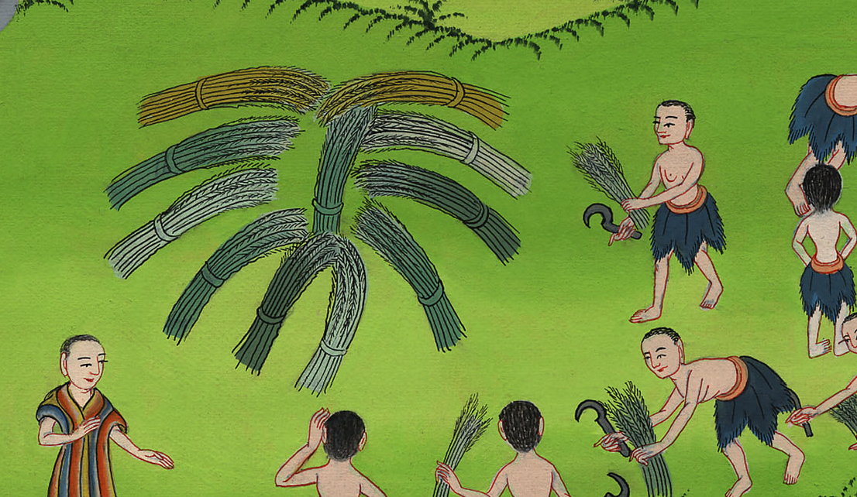
Genesis 37:7

Slide 21
8His brothers asked him, “Will you indeed reign over us? Will you indeed have dominion over us?” They hated him all the more for his dreams and for his words.
Notes:
1) Joseph’s first dream – Gen 37:1-8 (Left Top)

Slide 22
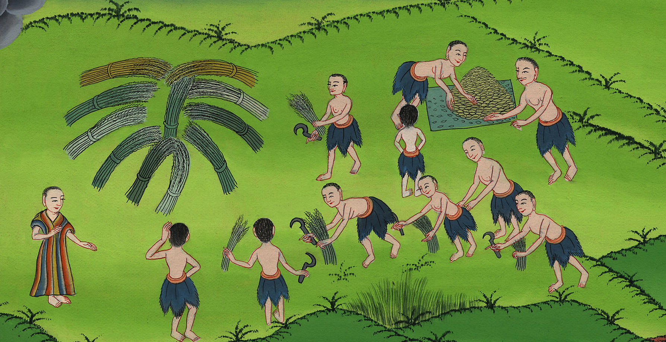
Genesis 37:8

Slide 23
9He dreamed yet another dream, and told it to his brothers, and said, “Behold, I have dreamed yet another dream: and behold, the sun and the moon and eleven stars bowed down to me.”
Notes:
1) Joseph’s first dream – Gen 37:1-8 (Left Top)

Slide 24
Genesis 37:9

Slide 25
10He told it to his father and to his brothers. His father rebuked him, and said to him, “What is this dream that you have dreamed? Will I and your mother and your brothers indeed come to bow ourselves down to the earth before you?”
Notes:
1) Joseph’s first dream – Gen 37:1-8 (Left Top)

Slide 26
Genesis 37:10

Slide 27
11His brothers envied him, but his father kept this saying in mind.
Notes:
1) Joseph’s first dream – Gen 37:1-8 (Left Top)

Slide 28
Genesis 37:11

