Slide 1
07-11
This work is licensed under a Creative Commons Attribution-ShareAlike 4.0 International License.
Please add this statement to all the videos you create.
English Bible quotes are from the World English Bible US, which is in the public domain.

Slide 2
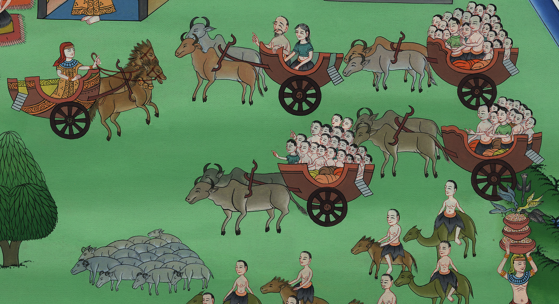
07-11
Joseph’s family comes to Egypt – Genesis 45:9 – 47:28
Notes:
Checked

Slide 3
Joseph’s family comes to Egypt – Genesis 45:9 – 47:28

Slide 4
Joseph’s family comes to Egypt – Genesis 45:9 – 47:28

Slide 5
9Now hurry back to my father. Say to him, ‘Your son Joseph says, “God has made me master of the whole land of Egypt. Come down to me. Don’t waste any time.

Slide 6
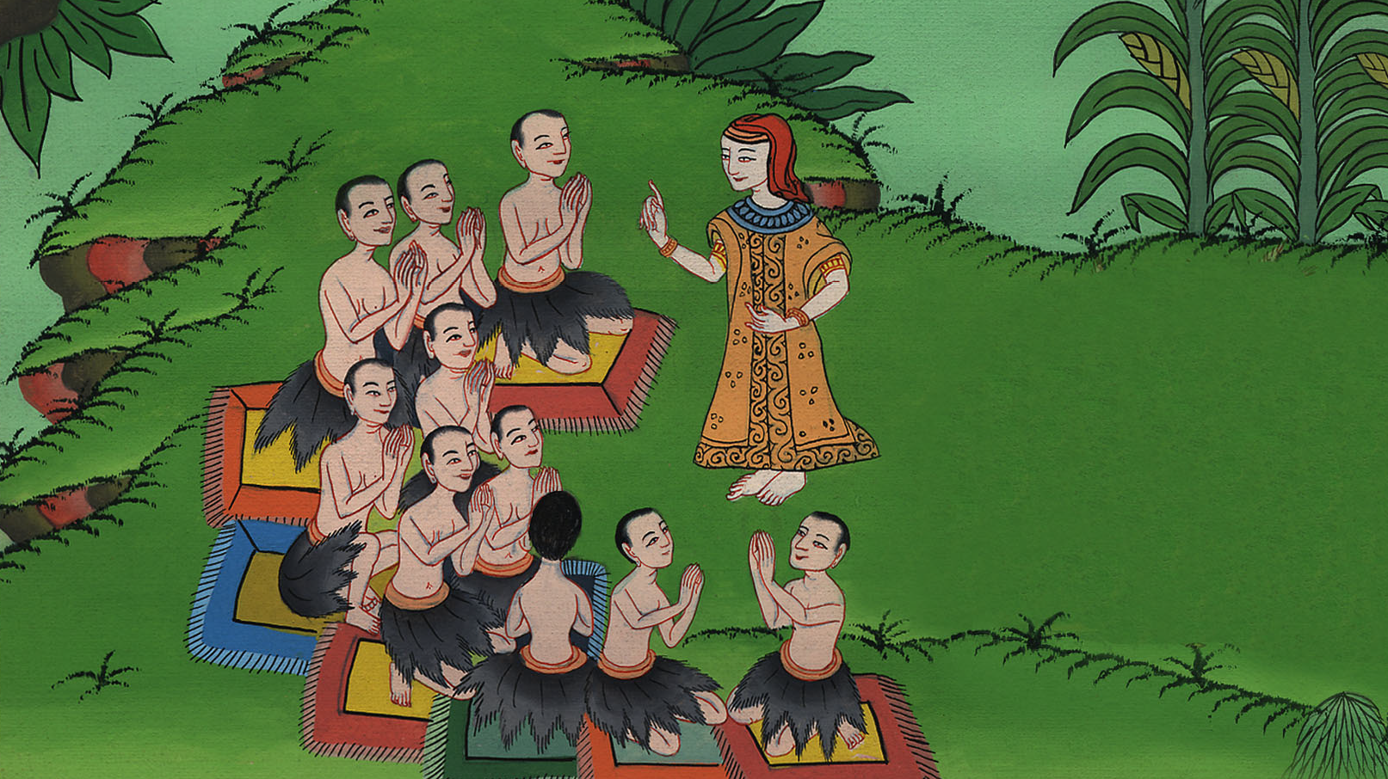
Genesis 45:9

Slide 7
10You shall dwell in the land of Goshen, and you will be near to me, you, your children, your children’s children, your flocks, your herds, and all that you have.

Slide 8
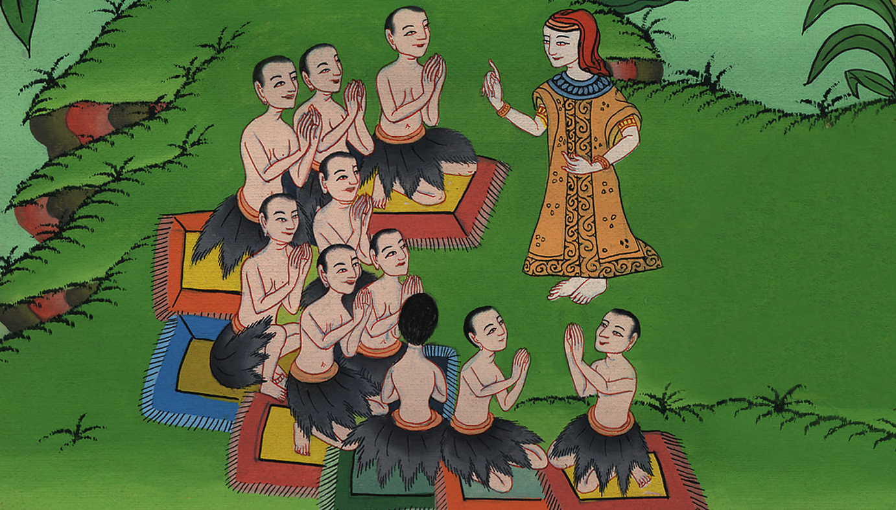
Genesis 45:10

Slide 9
11There I will provide for you; for there are yet five years of famine; lest you come to poverty, you, and your household, and all that you have.”’

Slide 10
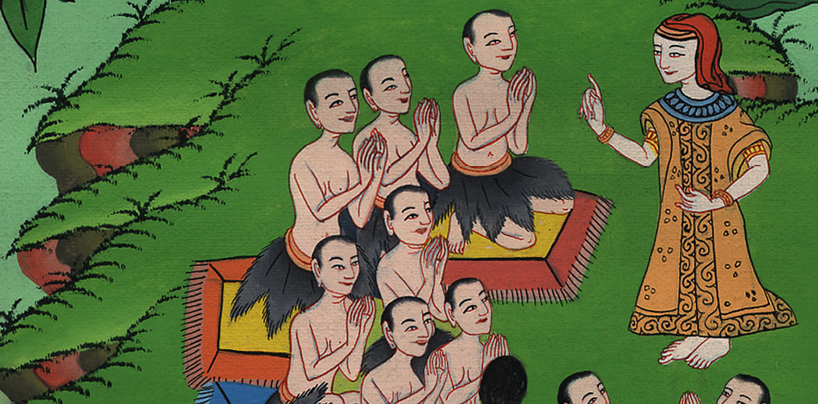
Genesis 45:11

Slide 11
12Behold, your eyes see, and the eyes of my brother Benjamin, that it is my mouth that speaks to you.

Slide 12
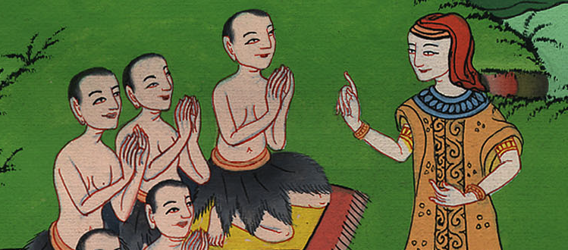
Genesis 45:12

Slide 13
13You shall tell my father of all my glory in Egypt, and of all that you have seen. You shall hurry and bring my father down here.”

Slide 14
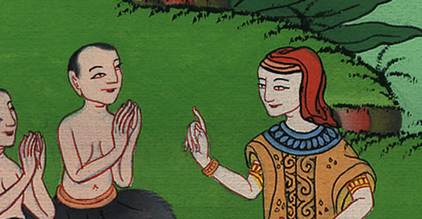
Genesis 45:13

Slide 15
14He fell on his brother Benjamin’s neck and wept, and Benjamin wept on his neck.

Slide 16
Genesis 45:14

Slide 17
15He kissed all his brothers, and wept on them. After that his brothers talked with him.

Slide 18
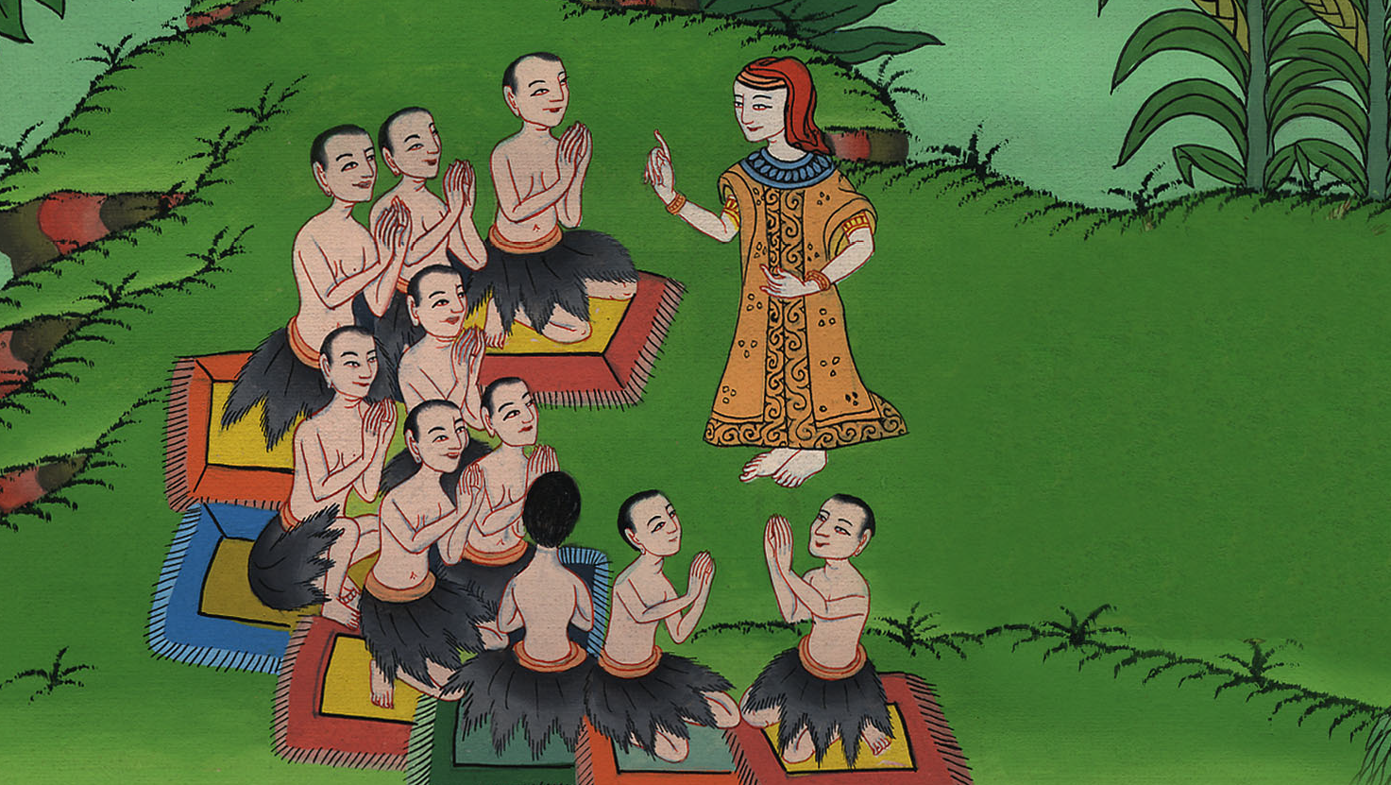
Genesis 45:15

Slide 19
16The report of it was heard in Pharaoh’s house, saying, “Joseph’s brothers have come.” It pleased Pharaoh well, and his servants.

Slide 20
Genesis 45:16

Slide 21
17Pharaoh said to Joseph, “Tell your brothers, ‘Do this: Load your animals, and go, travel to the land of Canaan.

Slide 22
Genesis 45:17

Slide 23
18Take your father and your households, and come to me, and I will give you the good of the land of Egypt, and you will eat the fat of the land.’

Slide 24
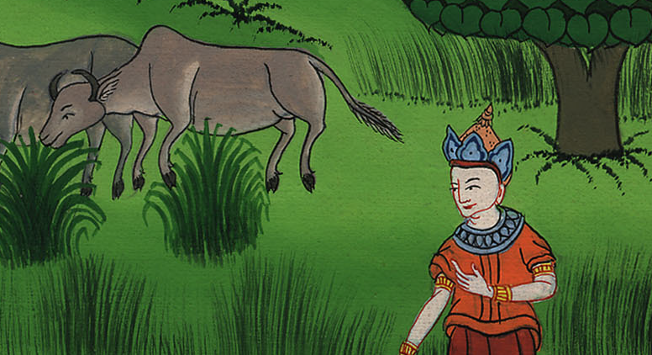
Genesis 45:18

Slide 25
19Now you are commanded to do this: Take wagons out of the land of Egypt for your little ones, and for your wives, and bring your father, and come.

Slide 26
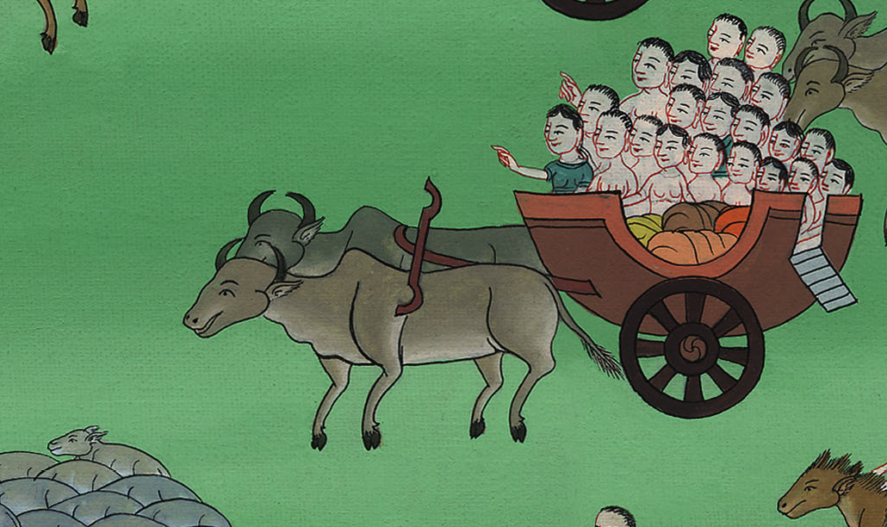
Genesis 45:19

Slide 27
20Also, don’t concern yourselves about your belongings, for the good of all the land of Egypt is yours.”

Slide 28
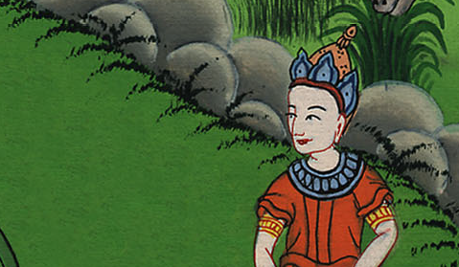
Genesis 45:20

Slide 29
25They went up out of Egypt, and came into the land of Canaan, to Jacob their father.

Slide 30
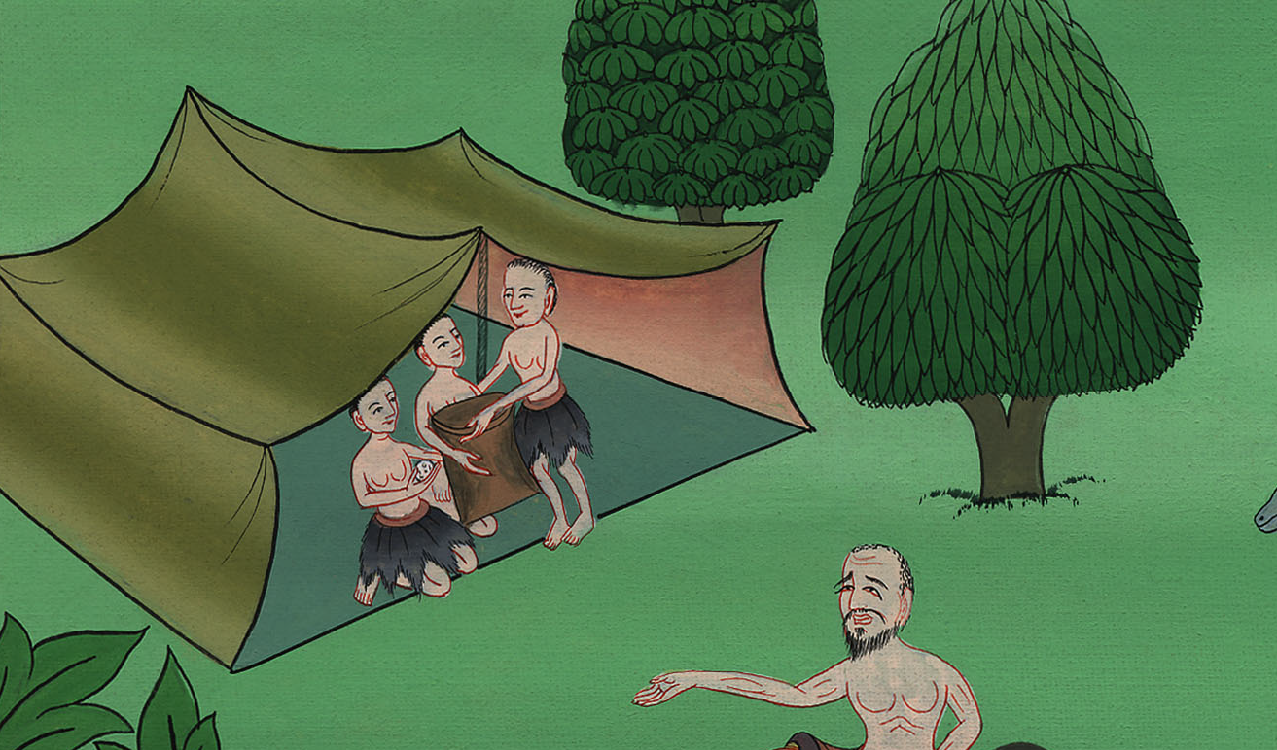
Genesis 45:25

Slide 31
26They told him, saying, “Joseph is still alive, and he is ruler over all the land of Egypt.” His heart fainted, for he didn’t believe them.

Slide 32
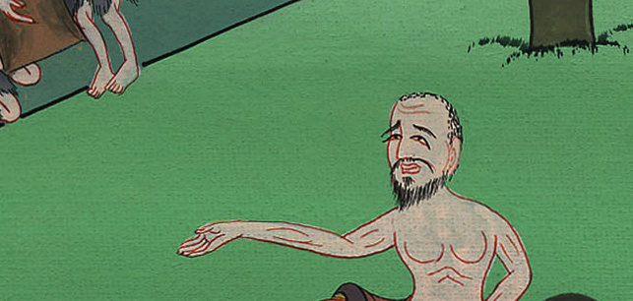
Genesis 45:26

Slide 33
27They told him all the words of Joseph, which he had said to them. When he saw the wagons which Joseph had sent to carry him, the spirit of Jacob, their father, revived.

Slide 34
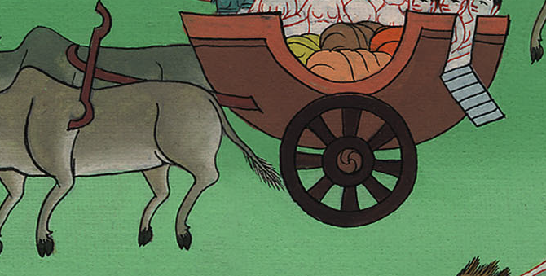
Genesis 45:27

Slide 35
28Israel said, “It is enough. Joseph my son is still alive. I will go and see him before I die.”

Slide 36
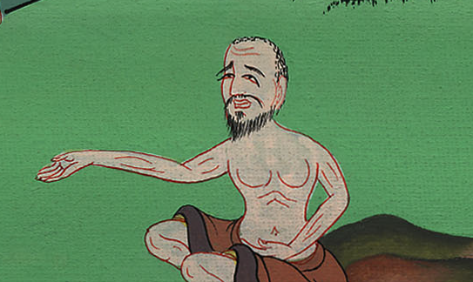
Genesis 45:28

Slide 37
1Israel traveled with all that he had, and came to Beersheba, and offered sacrifices to the God of his father, Isaac.

Slide 38
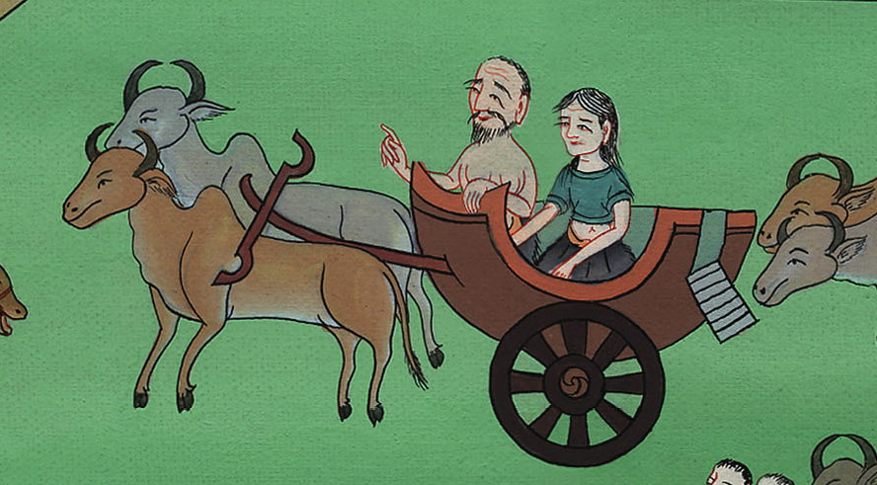
Genesis 46:1

Slide 39
2God spoke to Israel in the visions of the night, and said, “Jacob, Jacob!”
He said, “Here I am.”

Slide 40
Genesis 46:2

Slide 41
3He said, “I am God, the God of your father. Don’t be afraid to go down into Egypt, for there I will make of you a great nation.

Slide 42
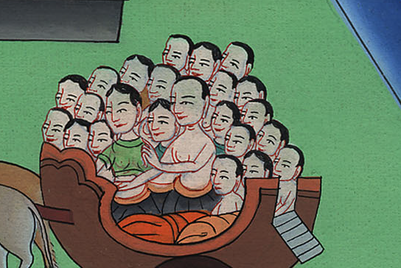
Genesis 46:3

Slide 43
4I will go down with you into Egypt. I will also surely bring you up again. Joseph’s hand will close your eyes.”

Slide 44
Genesis 46:4

Slide 45
6They took their livestock, and their goods, which they had gotten in the land of Canaan, and came into Egypt—Jacob, and all his offspring with him,

Slide 46
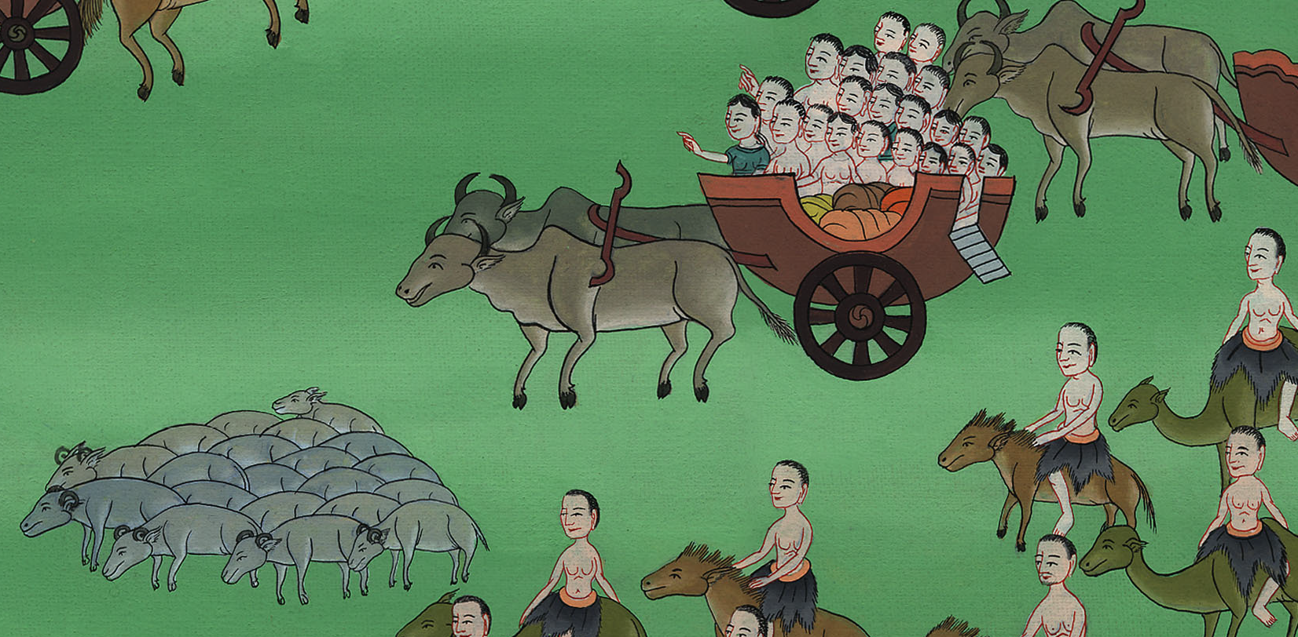
Genesis 46:6

Slide 47
27The sons of Joseph, who were born to him in Egypt, were two souls. All the souls of the house of Jacob, who came into Egypt, were seventy.

Slide 48
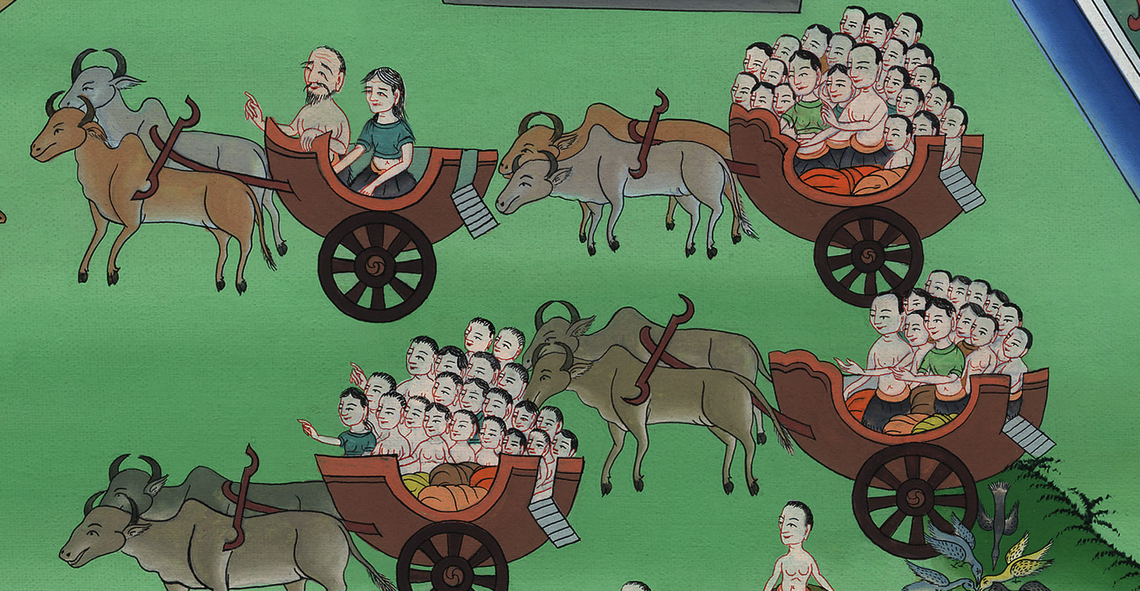
Genesis 46:27

Slide 49
47:5Pharaoh spoke to Joseph, saying, “Your father and your brothers have come to you.

Slide 50
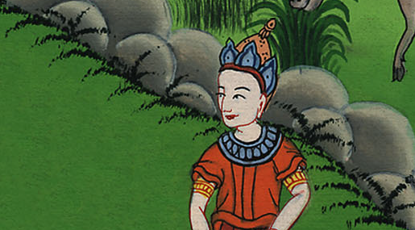
Genesis 47:5

Slide 51
6The land of Egypt is before you. Make your father and your brothers dwell in the best of the land. Let them dwell in the land of Goshen. If you know any able men among them, then put them in charge of my livestock.”

Slide 52
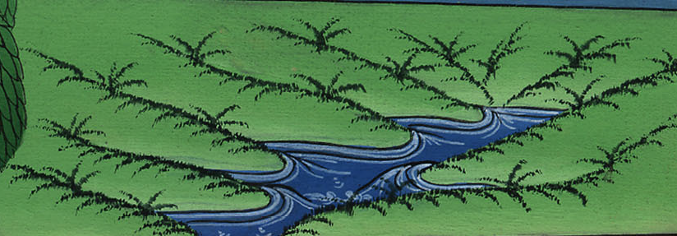
Genesis 47:6

Slide 53
27Israel lived in the land of Egypt, in the land of Goshen; and they got themselves possessions therein, and were fruitful, and multiplied exceedingly.

Slide 54
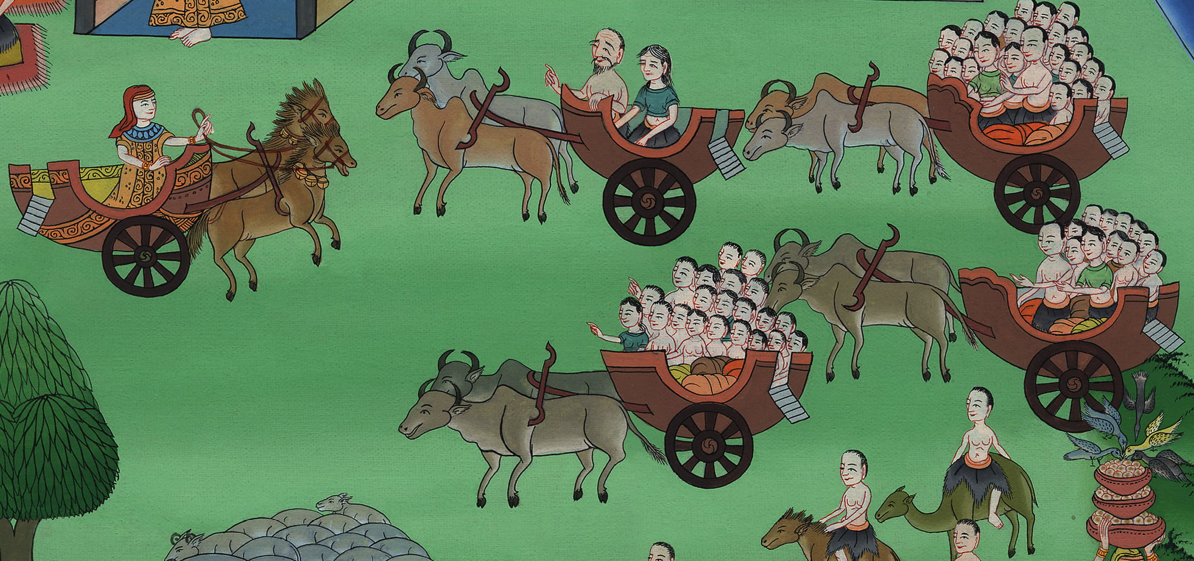
Genesis 47:27

