Slide 1
07-2
This work is licensed under a Creative Commons Attribution-ShareAlike 4.0 International License.
Please add this statement to all the videos you create.
English Bible quotes are from the World English Bible US, which is in the public domain.

Slide 2
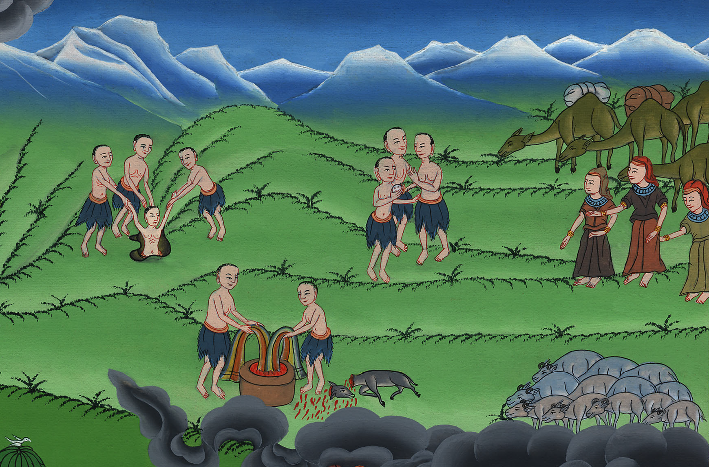
Brothers sell Joseph
Genesis 37:12-35
ཡོ་སེབ་ལ་བཙོང་ནས་ཨི་ཇིབ་ཡུལ་དུ་འཁྲིད་པ།
Genesis37:12-35
Notes:
checked

Slide 3
3) Brothers sell Joseph – Gen 37:12-35 (Right Top)

Slide 4
Brothers sell Joseph
Genesis 37:12-35

Slide 5
12His brothers went to feed their father’s flock in Shechem.

Slide 6
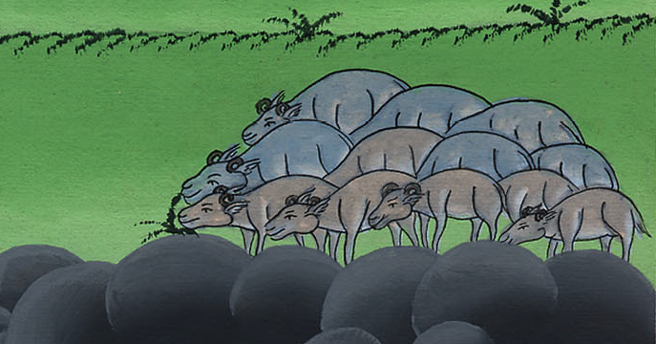
Genesis 37:12

Slide 7
13Jacob said to Joseph, “As you know, your brothers are taking care of the flocks near Shechem. Come. I’m going to send you to them.”
“All right,” Joseph replied.

Slide 8
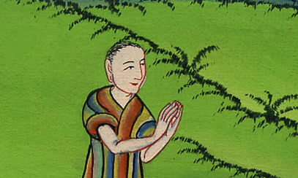
Genesis 37:13

Slide 9
13Israel said to Joseph, “Aren’t your brothers feeding the flock in Shechem? Come, and I will send you to them.” He said to him, “Here I am.”

Slide 10
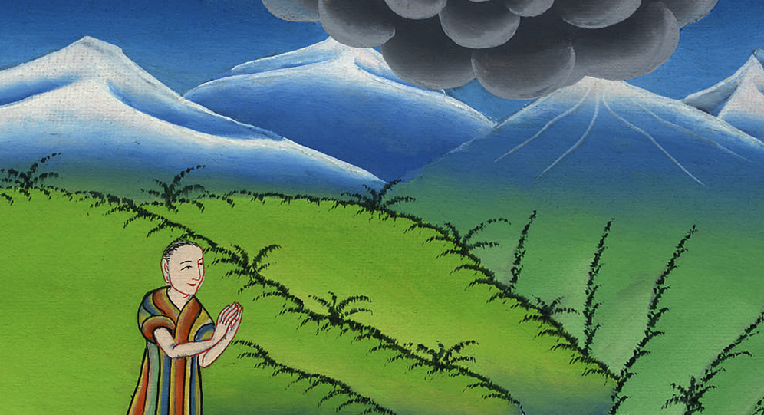
Genesis 37:14

Slide 11
18They saw him afar off, and before he came near to them, they conspired against him to kill him.

Slide 12
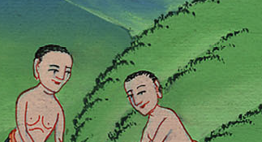
Genesis 37:18

Slide 13
19They said to one another, “Behold, this dreamer comes.

Slide 14
Genesis 37:19

Slide 15
20Come now therefore, and let’s kill him, and cast him into one of the pits, and we will say, ‘An evil animal has devoured him.’ We will see what will become of his dreams.”

Slide 16
Genesis 37:20

Slide 17
23When Joseph came to his brothers, they stripped Joseph of his tunic, the tunic of many colors that was on him;

Slide 18
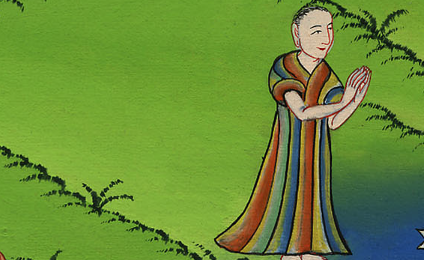
Genesis 37:23

Slide 19
24and they took him, and threw him into the pit. The pit was empty. There was no water in it..

Slide 20
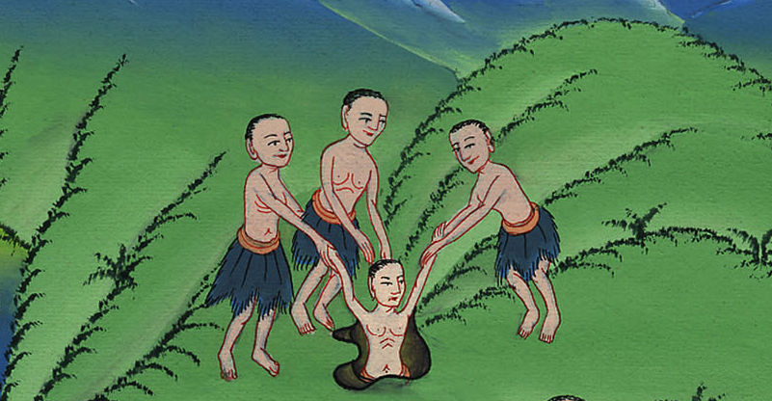
Genesis 37:24

Slide 21
25They sat down to eat bread, and they lifted up their eyes and looked, and saw a caravan of Ishmaelites was coming from Gilead, with their camels bearing spices and balm and myrrh, going to carry it down to Egypt.

Slide 22
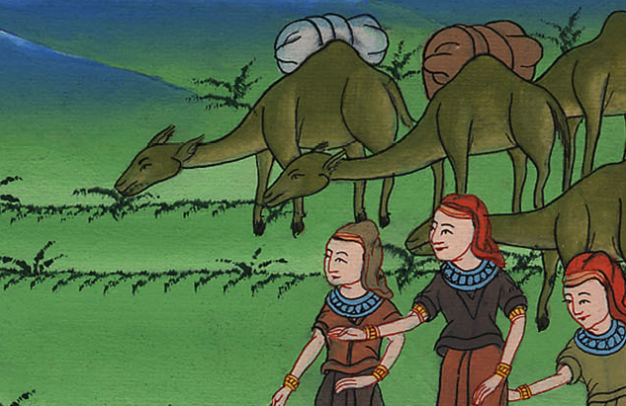
Genesis 37:25

Slide 23
26Judah said to his brothers, “What profit is it if we kill our brother and conceal his blood?

Slide 24
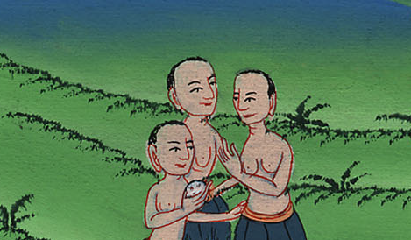
Genesis 37:26

Slide 25
27Come, and let’s sell him to the Ishmaelites, and not let our hand be on him; for he is our brother, our flesh.” His brothers listened to him.

Slide 26
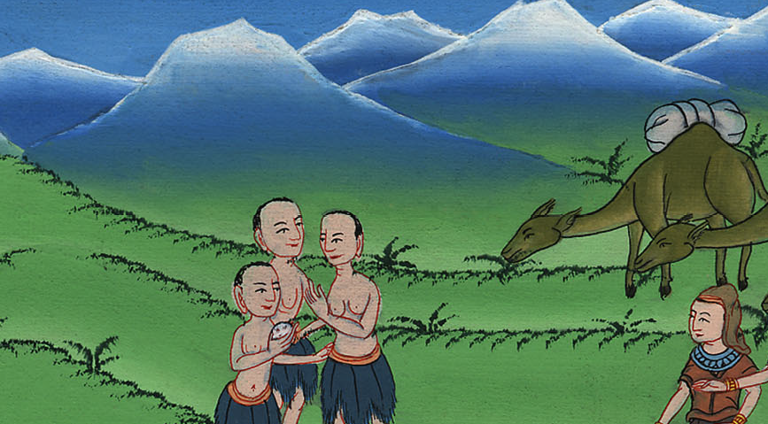
Genesis 37:27

Slide 27
28Midianites who were merchants passed by, and they drew and lifted up Joseph out of the pit, and sold Joseph to the Ishmaelites for twenty pieces of silver. The merchants brought Joseph into Egypt.

Slide 28
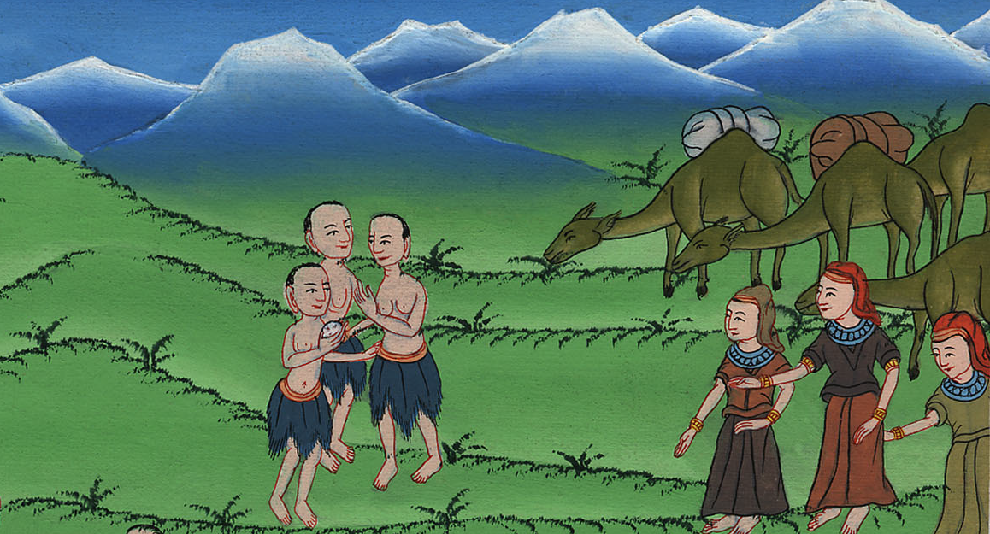
Genesis 37:28

Slide 29
31They took Joseph’s tunic, and killed a male goat, and dipped the tunic in the blood.

Slide 30
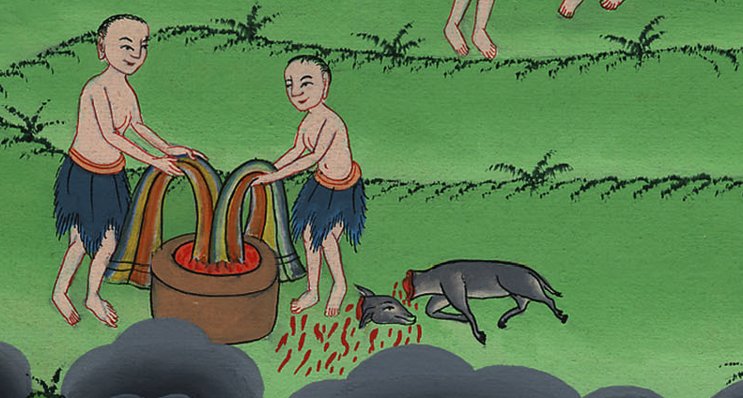
Genesis 37:31

Slide 31
32They took the tunic of many colors, and they brought it to their father, and said, “We have found this. Examine it, now, and see if it is your son’s tunic or not.”

Slide 32
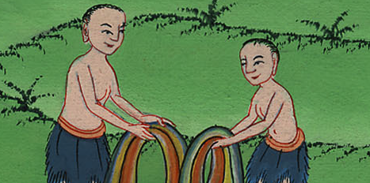
Genesis 37:32

Slide 33
33He recognized it, and said, “It is my son’s tunic. An evil animal has devoured him. Joseph is without doubt torn in pieces.”

Slide 34
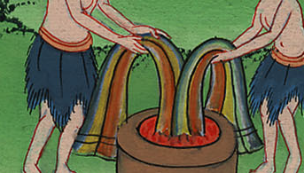
Genesis 37:33

Slide 35
34Jacob tore his clothes, and put sackcloth on his waist, and mourned for his son many days.

Slide 36
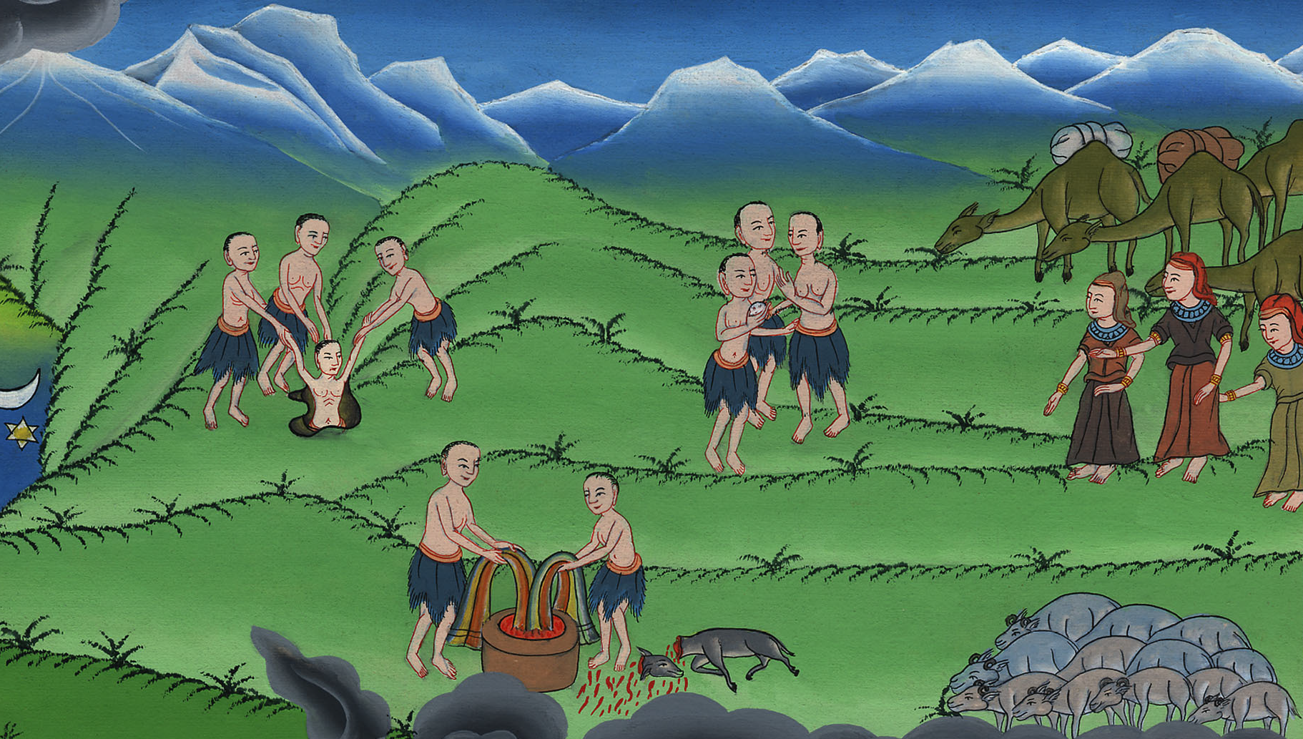
Genesis 37:34

