Slide 1
7-3
This work is licensed under a Creative Commons Attribution-ShareAlike 4.0 International License.
Please add this statement to all the videos you create.
English Bible quotes are from the World English Bible US, which is in the public domain.

Slide 2
In Potiphar’s house
Genesis 37:36; 39:1-20
Notes:
checked

Slide 3
4) In Potiphar’s house – Gen 37:36; 39:1-20 (Right 2nd)

Slide 4
In Potiphar’s house
Genesis 37:36; 39:1-20

Slide 5
36The Midianites sold him into Egypt to Potiphar, an officer of Pharaoh’s, the captain of the guard.

Slide 6
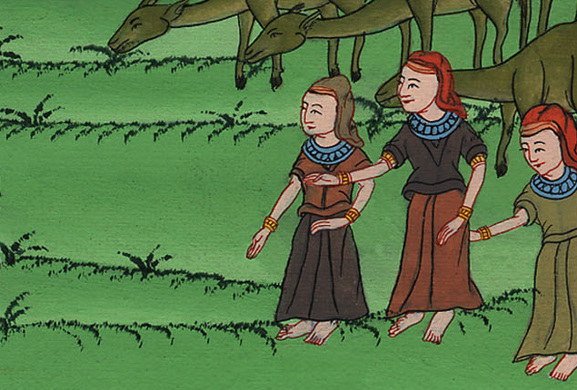
Genesis 37:36

Slide 7
2Yahweh was with Joseph, and he was a prosperous man. He was in the house of his master the Egyptian.

Slide 8
Genesis 39:2

Slide 9
3His master saw that Yahweh was with him, and that Yahweh made all that he did prosper in his hand.

Slide 10
Genesis 39:3

Slide 11
4Joseph found favor in his sight. He ministered to him, and Potiphar made him overseer over his house, and all that he had he put into his hand.

Slide 12
Genesis 39:4

Slide 13
6He left all that he had in Joseph’s hand. He didn’t concern himself with anything, except for the food which he ate.
Joseph was well-built and handsome.

Slide 14
Genesis 39:6

Slide 15
7After these things, his master’s wife set her eyes on Joseph; and she said, “Lie with me.”

Slide 16
Genesis 39:7

Slide 17
8But he refused, and said to his master’s wife, “Behold, my master doesn’t know what is with me in the house, and he has put all that he has into my hand.

Slide 18
Genesis 39:8

Slide 19
10As she spoke to Joseph day by day, he didn’t listen to her, to lie by her, or to be with her.

Slide 20
Genesis 39:10

Slide 21
11About this time, he went into the house to do his work, and there were none of the men of the house inside.

Slide 22
Genesis 39:11

Slide 23
12She caught him by his garment, saying, “Lie with me!”
He left his garment in her hand, and ran outside.

Slide 24
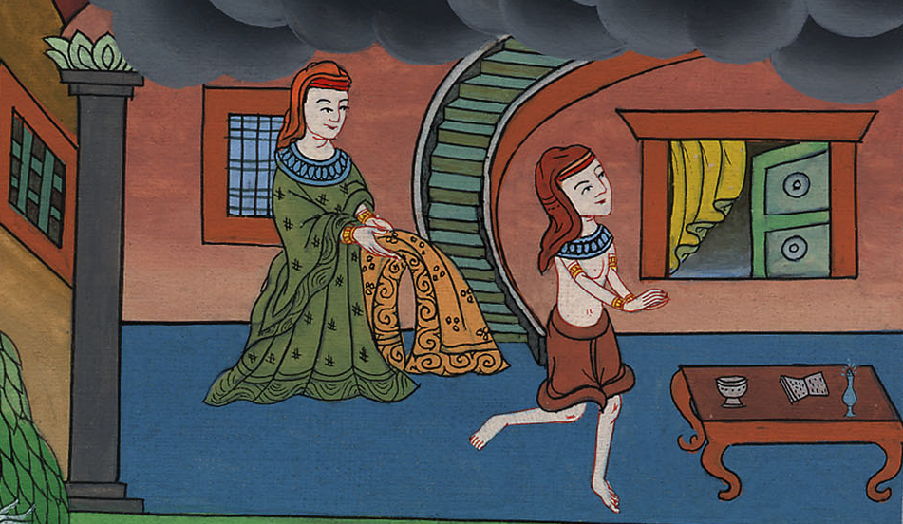
Genesis 39:12

Slide 25
16She laid up his garment by her, until his master came home.

Slide 26
Genesis 39:16

Slide 27
17She spoke to him according to these words, saying, “The Hebrew servant, whom you have brought to us, came in to me to mock me,

Slide 28
Genesis 39:17

Slide 29
18and as I lifted up my voice and cried, he left his garment by me, and ran outside.”

Slide 30
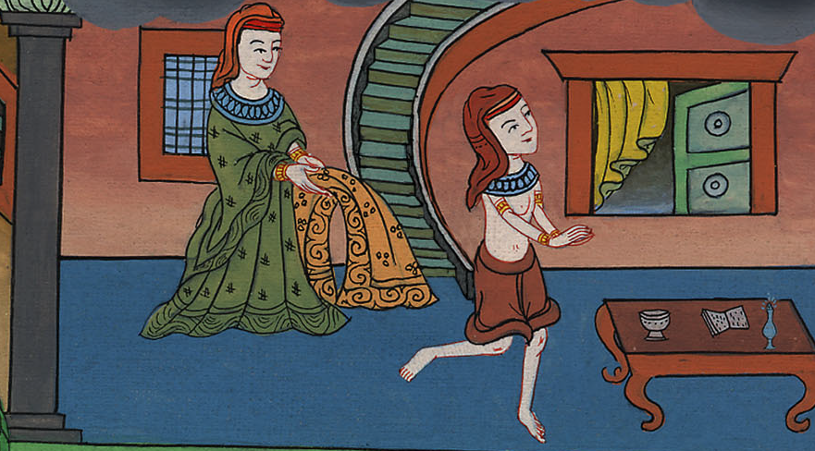
Genesis 39:18

Slide 31
19When his master heard the words of his wife, which she spoke to him, saying, “This is what your servant did to me,” his wrath was kindled.

Slide 32
Genesis 39:19

Slide 33
20Joseph’s master took him, and put him into the prison, the place where the king’s prisoners were bound, and he was there in custody.

Slide 34
Genesis 39:20

