Slide 1
7-4
This work is licensed under a Creative Commons Attribution-ShareAlike 4.0 International License.
Please add this statement to all the videos you create.
English Bible quotes are from the World English Bible US, which is in the public domain.

Slide 2
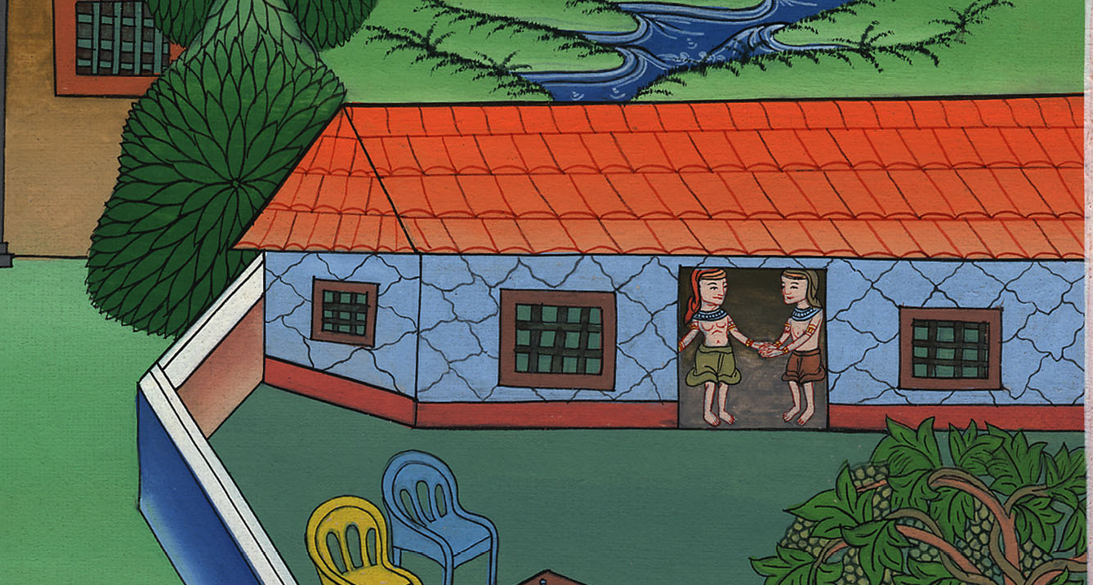
In Jail
Genesis 39:21 – 40:23
Notes:
Checked

Slide 3
5) In Jail – Gen 39:21 – 40:23 (Right 3rd)

Slide 4
In Jail
Genesis 39:21 – 40:23

Slide 5
21But Yahweh was with Joseph, and showed kindness to him, and gave him favor in the sight of the keeper of the prison.

Slide 6
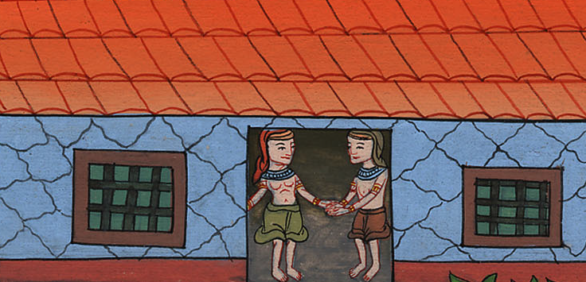
Genesis 39:21

Slide 7
22The keeper of the prison committed to Joseph’s hand all the prisoners who were in the prison. Whatever they did there, he was responsible for it.

Slide 8
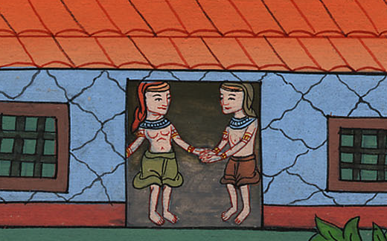
Genesis 39:22

Slide 9
1After these things, the butler of the king of Egypt and his baker offended their lord, the king of Egypt.

Slide 10
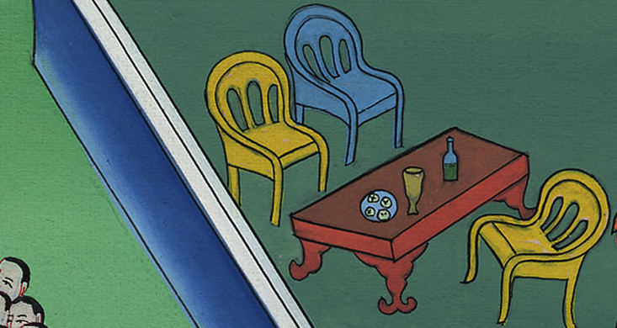
Genesis 40:1

Slide 11
2Pharaoh was angry with his two officers, the chief cup bearer and the chief baker. 3He put them in custody in the house of the captain of the guard, into the prison, the place where Joseph was bound. 4The captain of the guard assigned them to Joseph, and he took care of them. They stayed in prison many days.

Slide 12
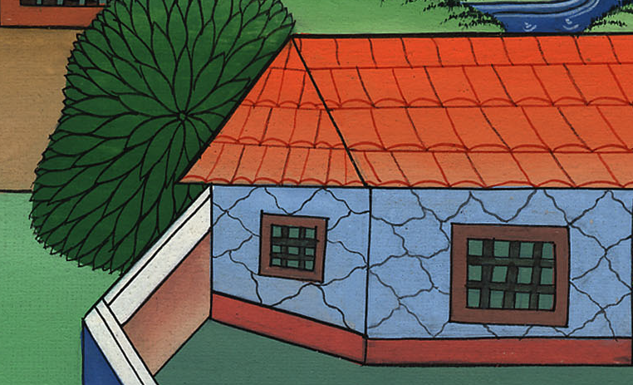
Genesis 40:2

Slide 13
5They both dreamed a dream, each man his dream, in one night, each man according to the interpretation of his dream, the cup bearer and the baker of the king of Egypt, who were bound in the prison.

Slide 14
Genesis 40:5

Slide 15
6Joseph came in to them in the morning, and saw them, and saw that they were sad. 7He asked Pharaoh’s officers who were with him in custody in his master’s house, saying, “Why do you look so sad today?”

Slide 16
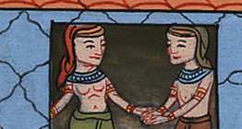
Genesis 40:6,7

Slide 17
8They said to him, “We have dreamed a dream, and there is no one who can interpret it.”
Joseph said to them, “Don’t interpretations belong to God? Please tell it to me.”

Slide 18
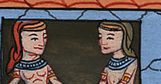
Genesis 40:8

Slide 19
9The chief cup bearer told his dream to Joseph, and said to him, “In my dream, behold, a vine was in front of me,

Slide 20
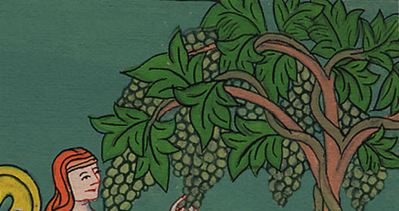
Genesis 40:9

Slide 21
10and in the vine were three branches. It was as though it budded, it blossomed, and its clusters produced ripe grapes.

Slide 22
Genesis 40:10

Slide 23
11Pharaoh’s cup was in my hand; and I took the grapes, and pressed them into Pharaoh’s cup, and I gave the cup into Pharaoh’s hand.”

Slide 24
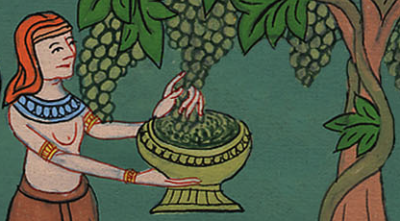
Genesis 40:11

Slide 25
12Joseph said to him, “This is its interpretation: the three branches are three days.

Slide 26
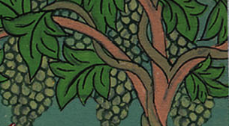
Genesis 40:12

Slide 27
13Within three more days, Pharaoh will lift up your head, and restore you to your office. You will give Pharaoh’s cup into his hand, the way you did when you were his cup bearer.

Slide 28
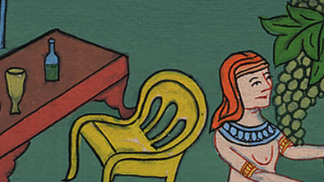
Genesis 40:13

Slide 29
14But remember me when it is well with you. Please show kindness to me, and make mention of me to Pharaoh, and bring me out of this house.

Slide 30
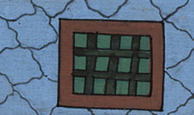
Genesis 40:14

Slide 31
15For indeed, I was stolen away out of the land of the Hebrews, and here also I have done nothing that they should put me into the dungeon.”

Slide 32
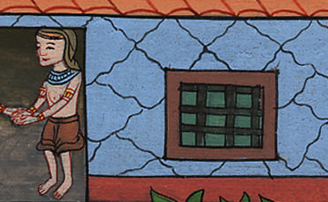
Genesis 40:15

Slide 33
16The chief baker saw that Joseph had given a positive meaning to the wine taster’s dream. So he said to Joseph, “I had a dream too. There were three baskets of bread on my head.

Slide 34
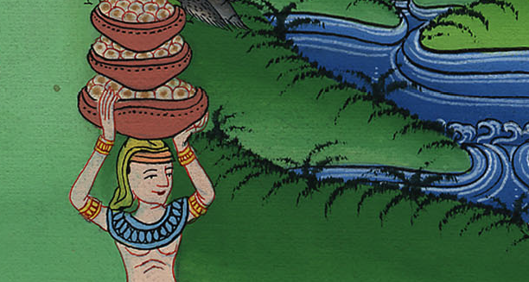
Genesis 40:16

Slide 35
17In the uppermost basket there were all kinds of baked food for Pharaoh, and the birds ate them out of the basket on my head.”

Slide 36
Genesis 40:17

Slide 37
18Joseph answered, “This is its interpretation. The three baskets are three days.

Slide 38
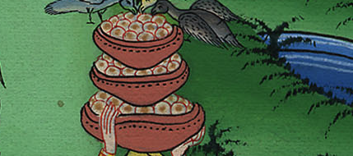
Genesis 40:18

Slide 39
19Within three more days, Pharaoh will lift up your head from off you, and will hang you on a tree; and the birds will eat your flesh from off you.”

Slide 40
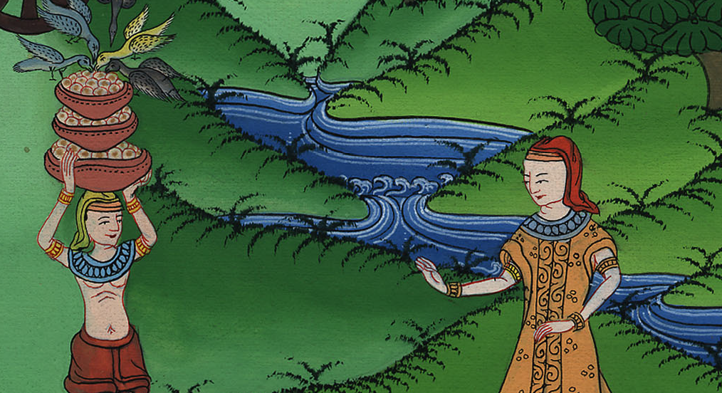
Genesis 40:19

Slide 41
20On the third day, which was Pharaoh’s birthday, he made a feast for all his servants, and he lifted up the head of the chief cup bearer and the head of the chief baker among his servants.

Slide 42
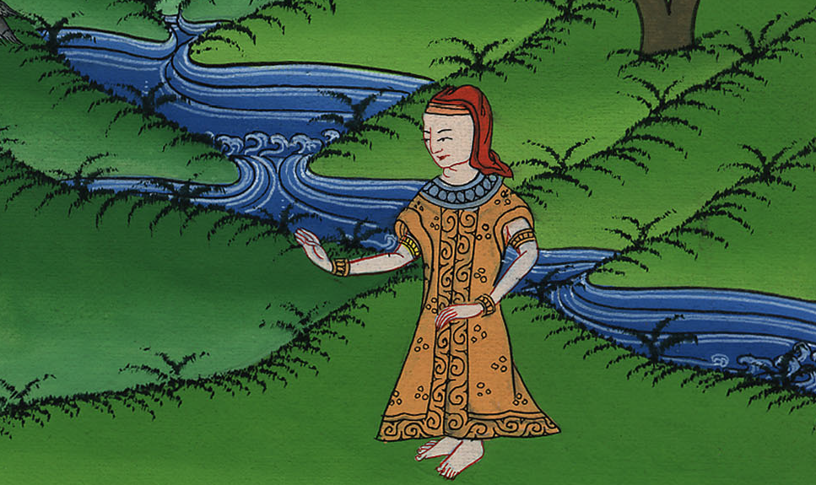
Genesis 40:20

Slide 43
21He restored the chief cup bearer to his position again, and he gave the cup into Pharaoh’s hand;

Slide 44
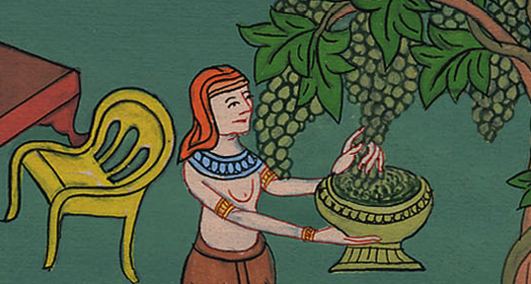
Genesis 40:21

Slide 45
22but he hanged the chief baker, as Joseph had interpreted to them.

Slide 46
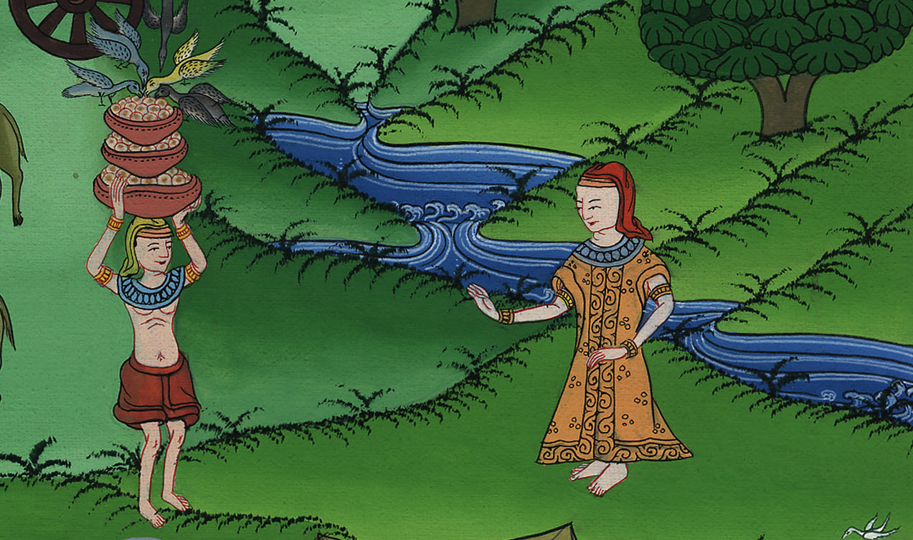
Genesis 40:22

Slide 47
23Yet the chief cup bearer didn’t remember Joseph, but forgot him.

Slide 48
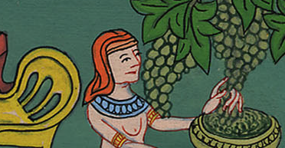
Genesis 40:23

