Slide 1
7-5
This work is licensed under a Creative Commons Attribution-ShareAlike 4.0 International License.
Please add this statement to all the videos you create.
English Bible quotes are from the World English Bible US, which is in the public domain.

Slide 2
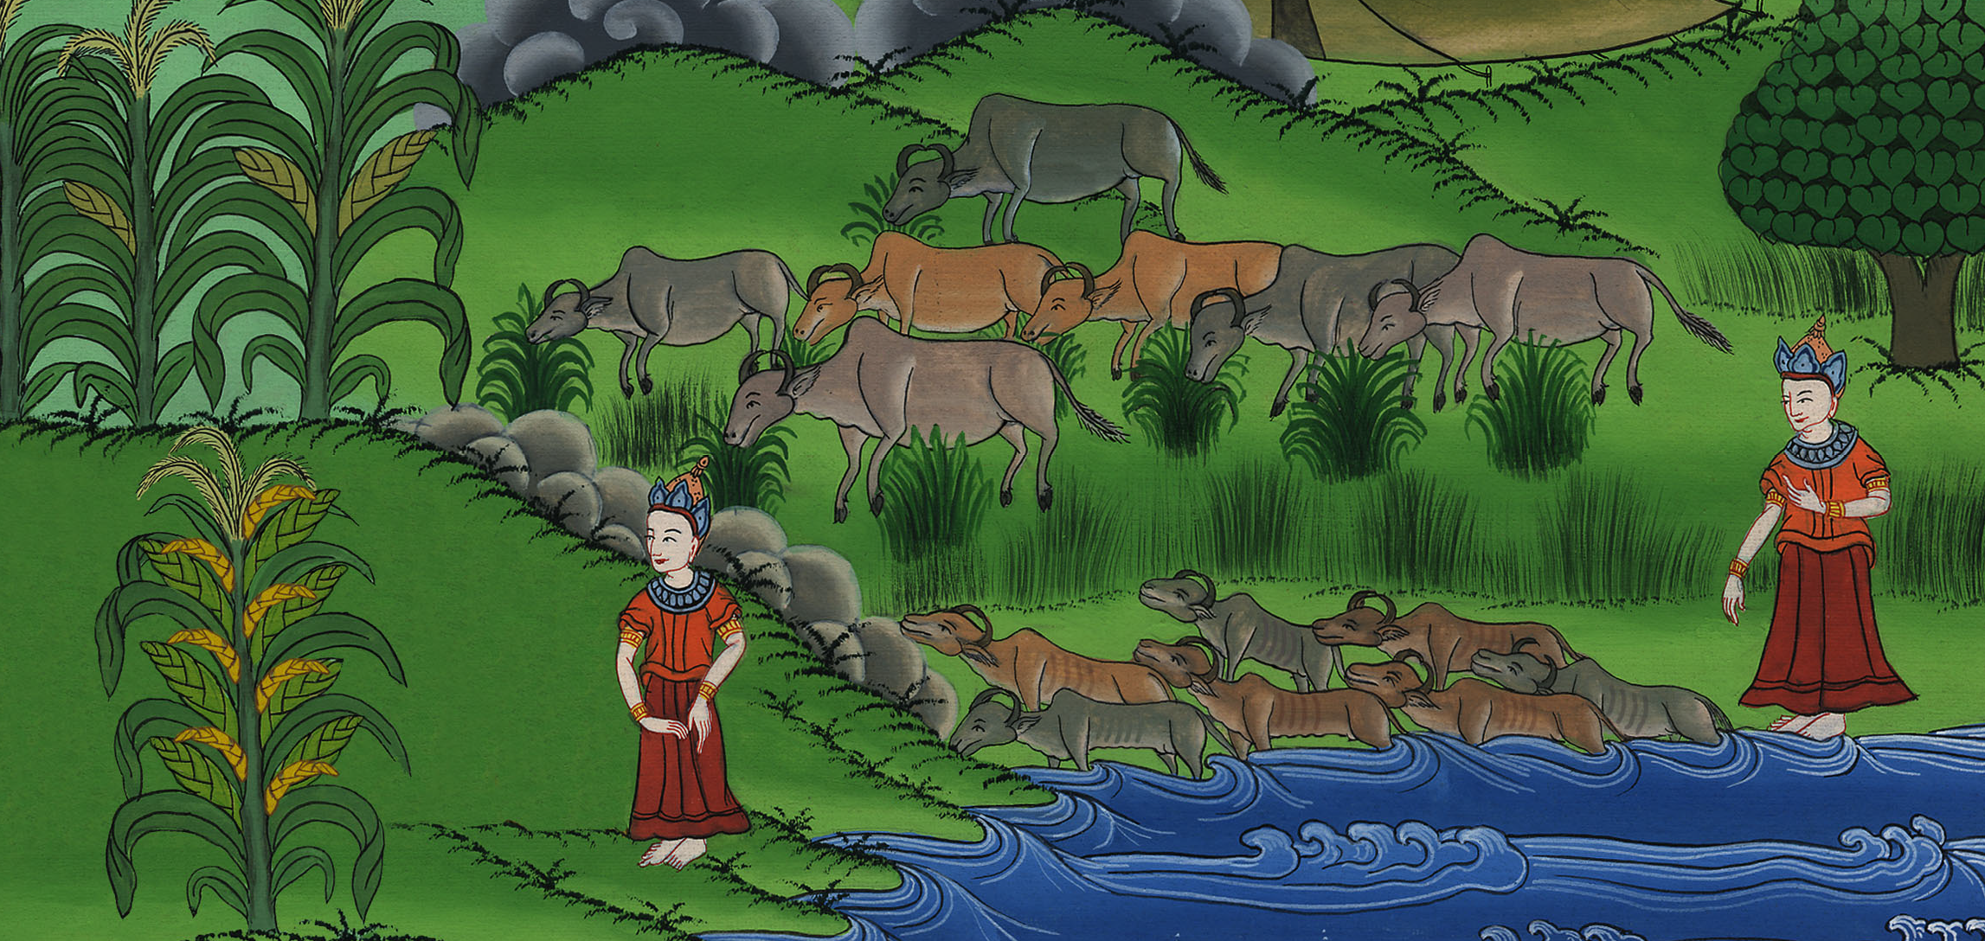
Joseph interprets Pharaoh’s dreams
Genesis 41

Slide 3
6) Joseph interprets Pharaoh’s dreams and becomes leader of Egypt – Gen 41 (Right
and Center Bottom)

Slide 4
Joseph interprets Pharaoh’s dreams
Genesis 41

Slide 5
1At the end of two full years, Pharaoh dreamed, and behold, he stood by the river.

Slide 6
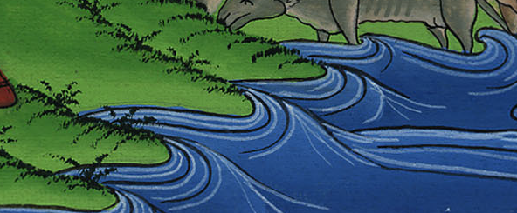
Genesis 41:1

Slide 7
2Behold, seven cattle came up out of the river. They were sleek and fat, and they fed in the marsh grass.

Slide 8
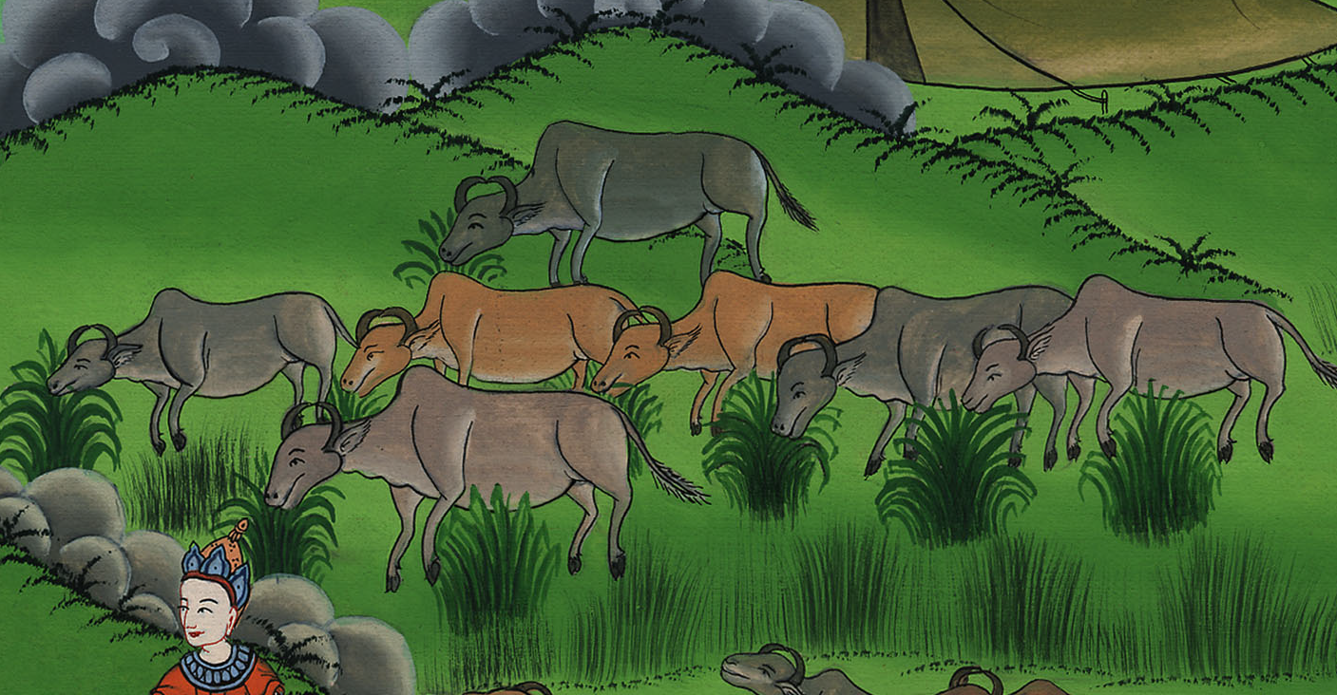
Genesis 41:2

Slide 9
3Behold, seven other cattle came up after them out of the river, ugly and thin, and stood by the other cattle on the brink of the river.

Slide 10
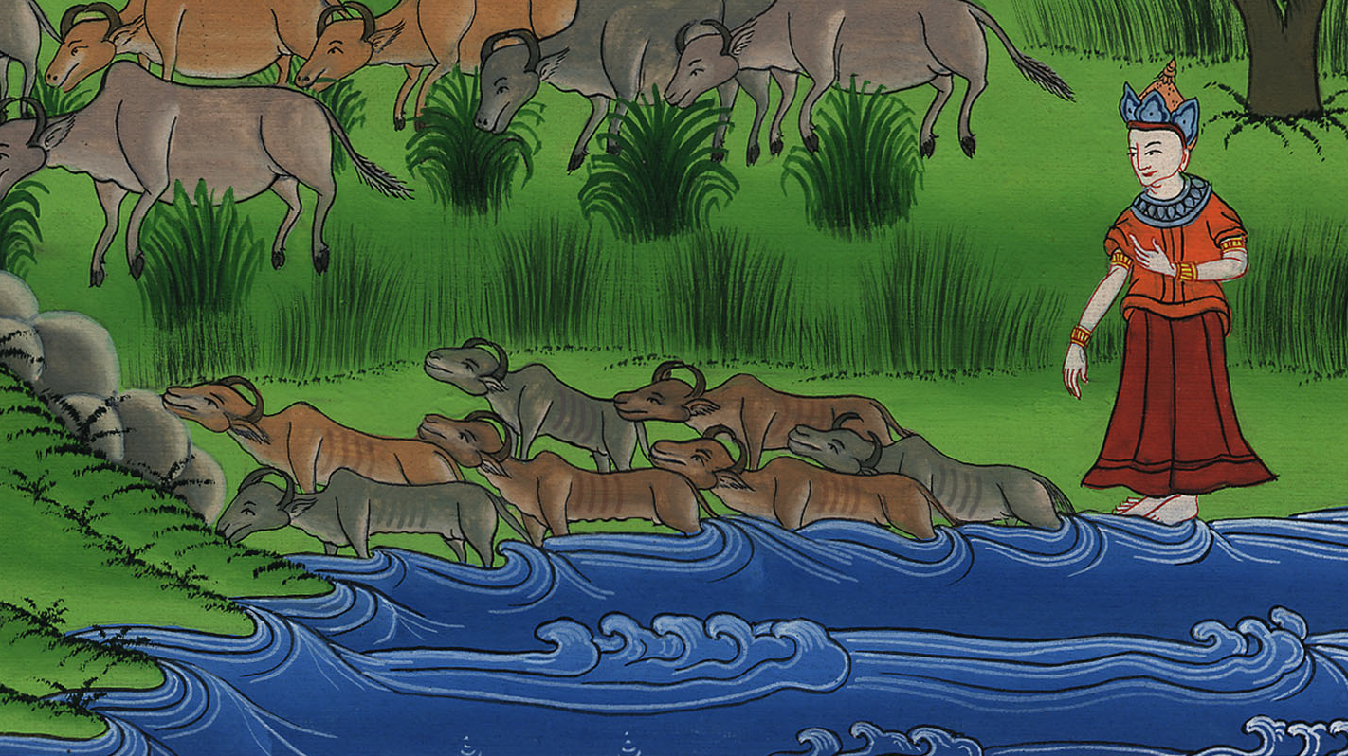
Genesis 41:3

Slide 11
4The ugly and thin cattle ate up the seven sleek and fat cattle. So Pharaoh awoke.

Slide 12
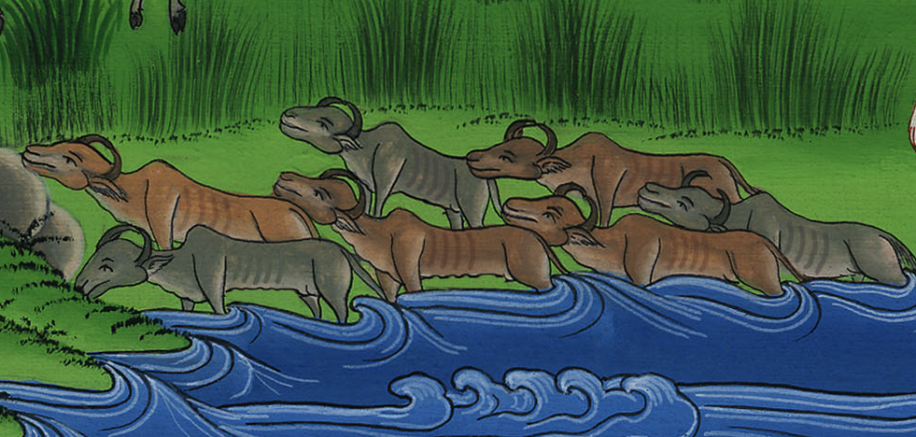
Genesis 41:4

Slide 13
5He slept and dreamed a second time; and behold, seven heads of grain came up on one stalk, healthy and good.

Slide 14
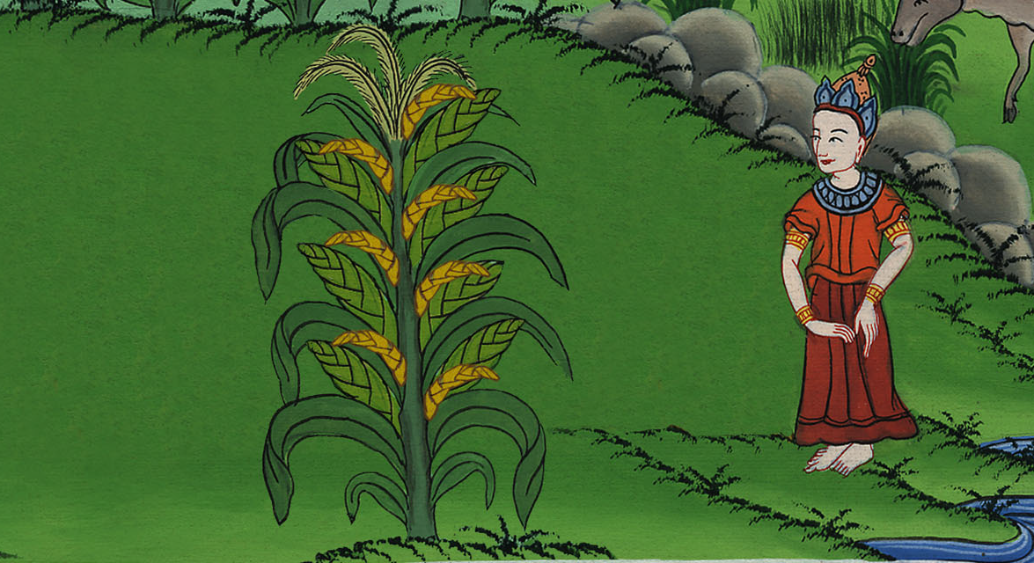
Genesis 41:5

Slide 15
6Behold, seven heads of grain, thin and blasted with the east wind, sprung up after them.

Slide 16
Genesis 41:6

Slide 17
7The thin heads of grain swallowed up the seven healthy and full ears. Pharaoh awoke, and behold, it was a dream.

Slide 18
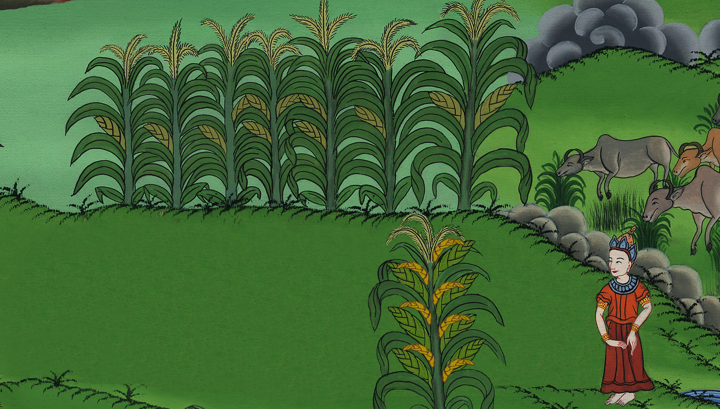
Genesis 41:7

Slide 19
8In the morning, his spirit was troubled, and he sent and called for all of Egypt’s magicians and wise men. Pharaoh told them his dreams, but there was no one who could interpret them to Pharaoh.

Slide 20
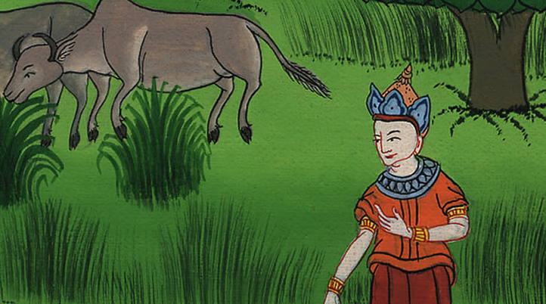
Genesis 41:8

Slide 21
9Then the chief cup bearer spoke to Pharaoh, saying, “I remember my faults today.

Slide 22
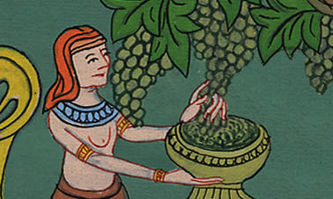
Genesis 41:9

Slide 23
10Pharaoh was angry with his servants, and put me in custody in the house of the captain of the guard, with the chief baker.

Slide 24
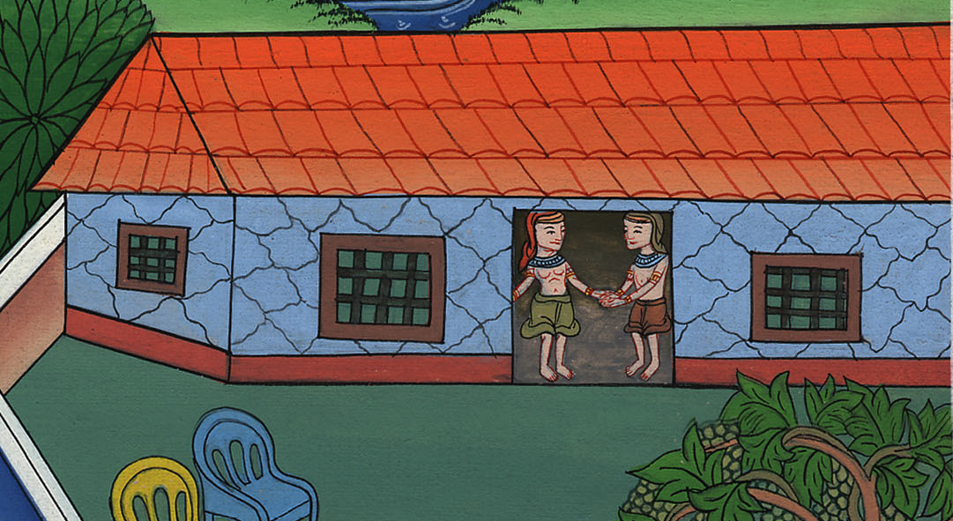
Genesis 41:10

Slide 25
11We dreamed a dream in one night, he and I. Each man dreamed according to the interpretation of his dream.

Slide 26
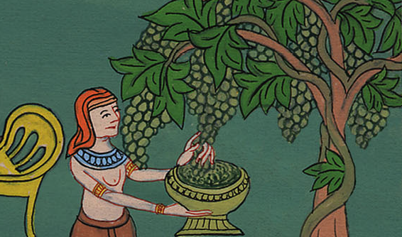
Genesis 41:11

Slide 27
12There was with us there a young man, a Hebrew, servant to the captain of the guard, and we told him, and he interpreted to us our dreams. He interpreted to each man according to his dream.

Slide 28
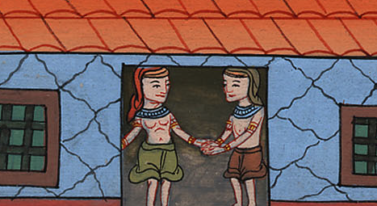
Genesis 41:12

Slide 29
13As he interpreted to us, so it was. He restored me to my office, and he hanged him.”

Slide 30
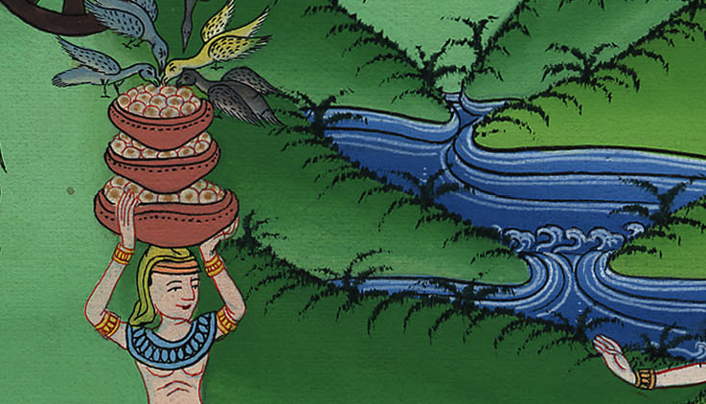
Genesis 41:13
Notes:
checked

Slide 31
14Then Pharaoh sent and called Joseph, and they brought him hastily out of the dungeon. He shaved himself, changed his clothing, and came in to Pharaoh.

Slide 32
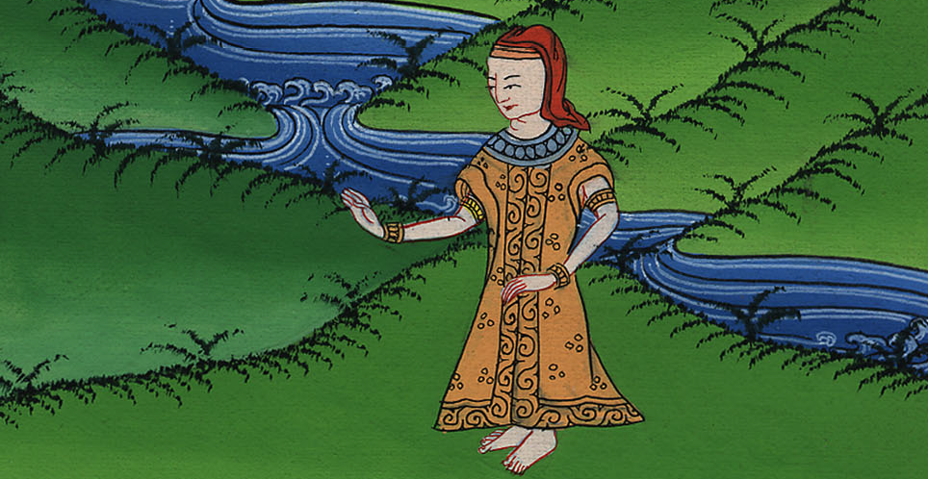
Genesis 41:14

Slide 33
15Pharaoh said to Joseph, “I have dreamed a dream, and there is no one who can interpret it. I have heard it said of you, that when you hear a dream you can interpret it.”

Slide 34
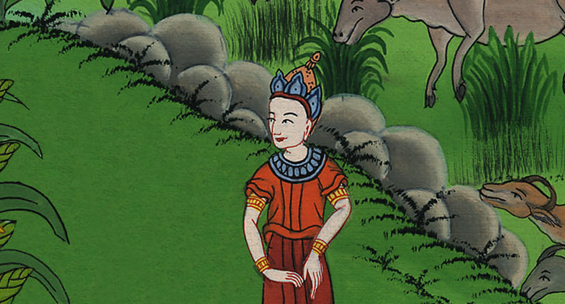
Genesis 41:15

Slide 35
16Joseph answered Pharaoh, saying, “It isn’t in me. God will give Pharaoh an answer of peace.”

Slide 36
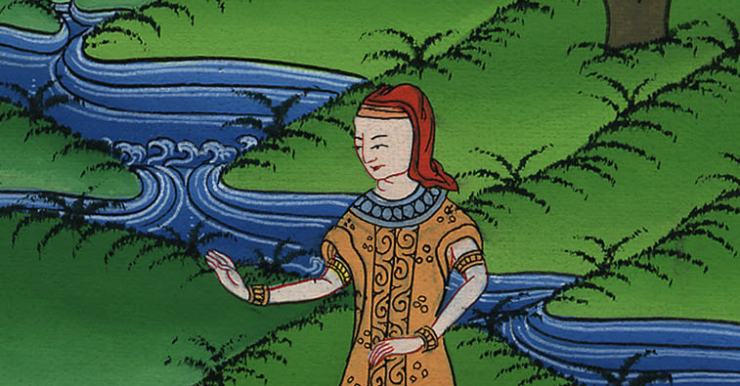
Genesis 41:16

Slide 37
17Pharaoh spoke to Joseph, “In my dream, behold, I stood on the brink of the river; 18and behold, seven fat and sleek cattle came up out of the river. They fed in the marsh grass; 19and behold, seven other cattle came up after them, poor and very ugly and thin, such as I never saw in all the land of Egypt for ugliness. 20The thin and ugly cattle ate up the first seven fat cattle; 21and when they had eaten them up, it couldn’t be known that they had eaten them, but they were still ugly, as at the beginning. So I awoke. 22I saw in my dream, and behold, seven heads of grain came up on one stalk, full and good; 23and behold, seven heads of grain, withered, thin, and blasted with the east wind, sprung up after them. 24The thin heads of grain swallowed up the seven good heads of grain. I told it to the magicians, but there was no one who could explain it to me.”

Slide 38
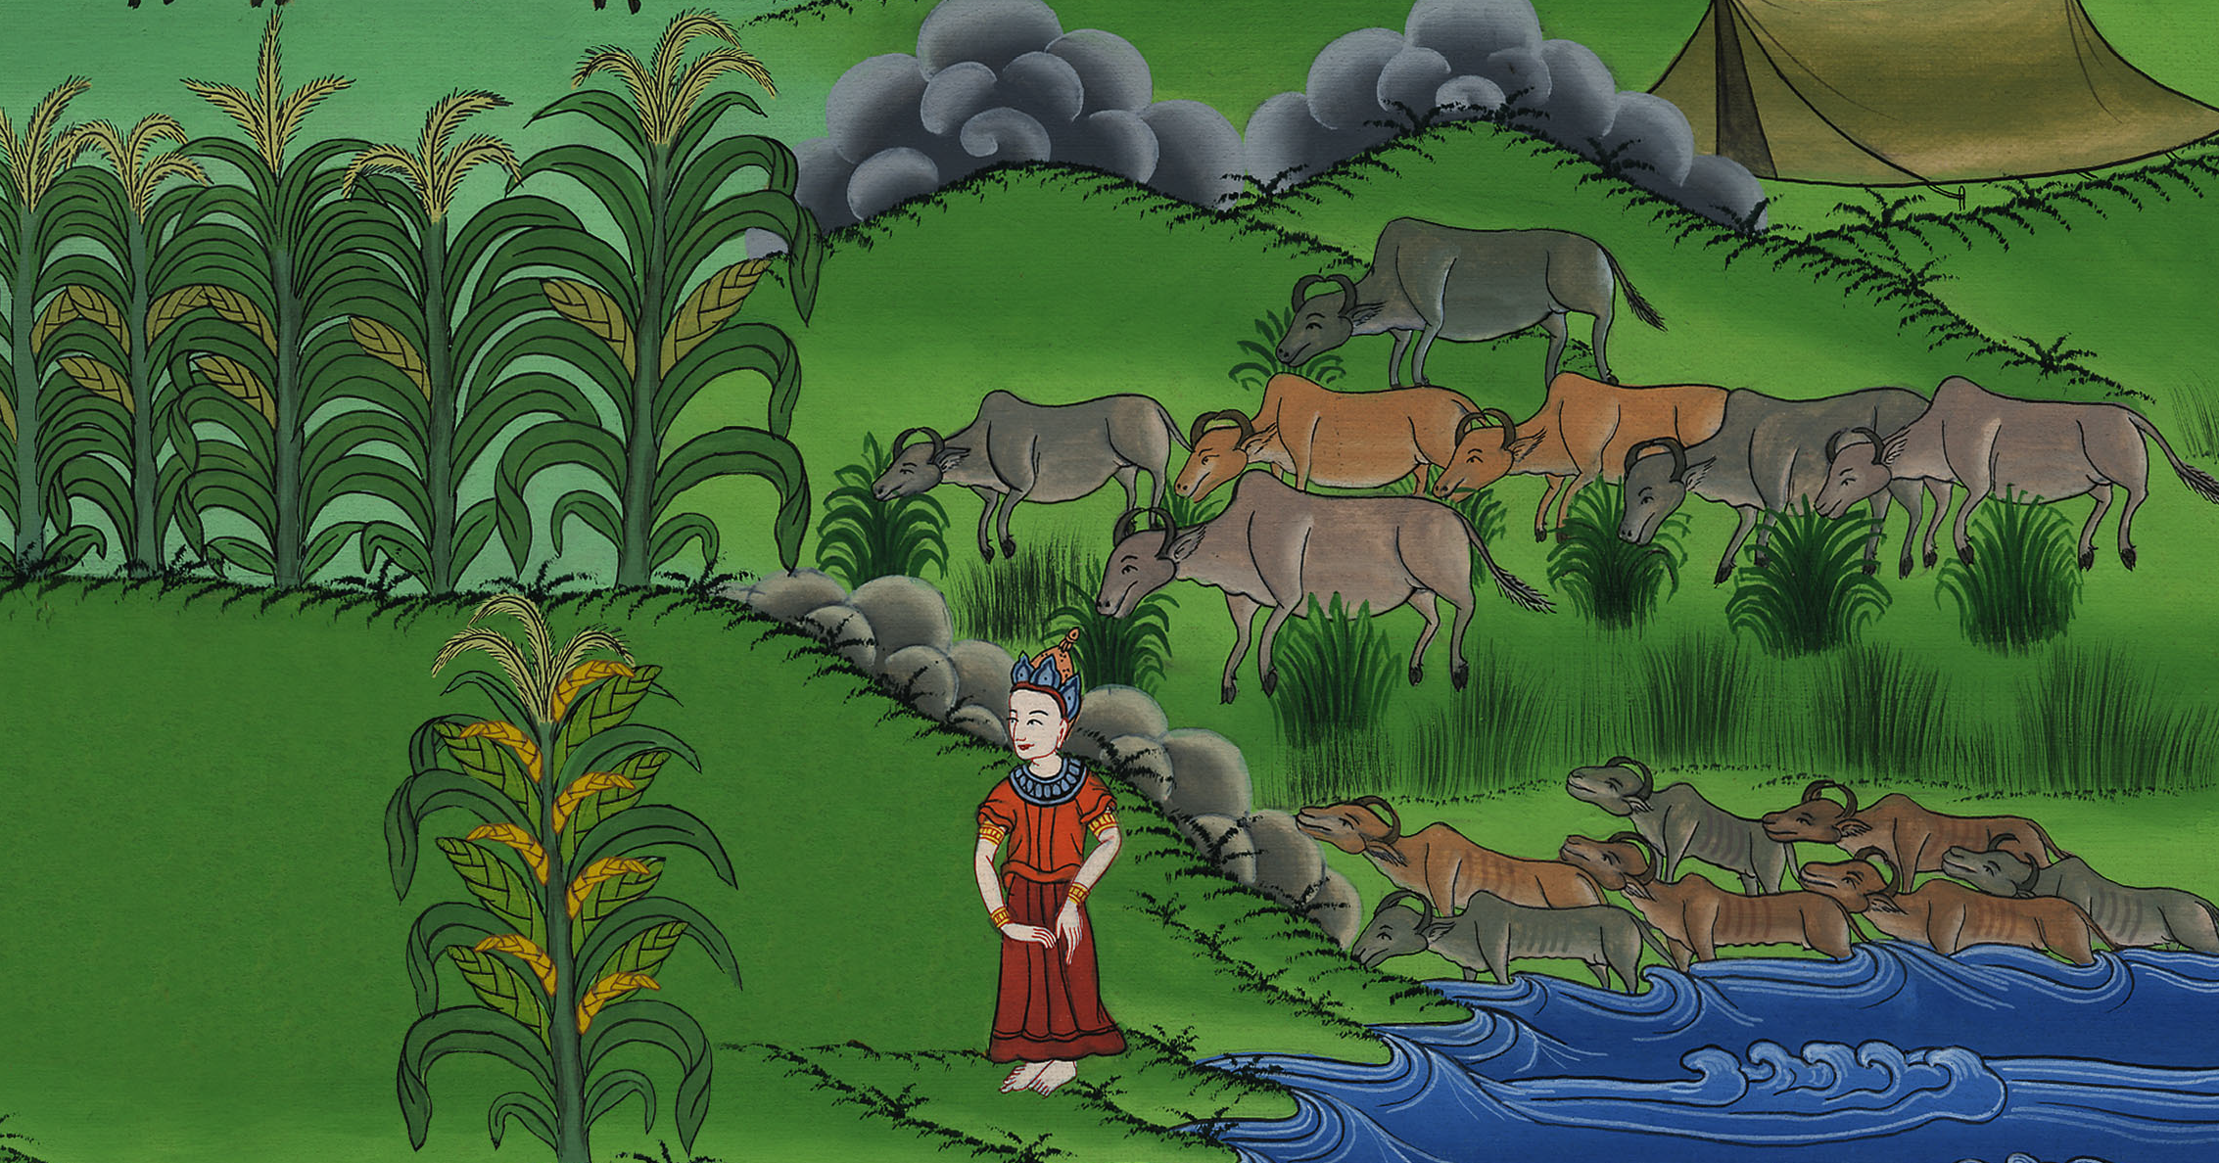
Genesis 41:17

Slide 39
25Joseph said to Pharaoh, “The dream of Pharaoh is one. What God is about to do he has declared to Pharaoh.

Slide 40
Genesis 41:25

Slide 41
6The seven good cattle are seven years; and the seven good heads of grain are seven years. The dream is one.

Slide 42
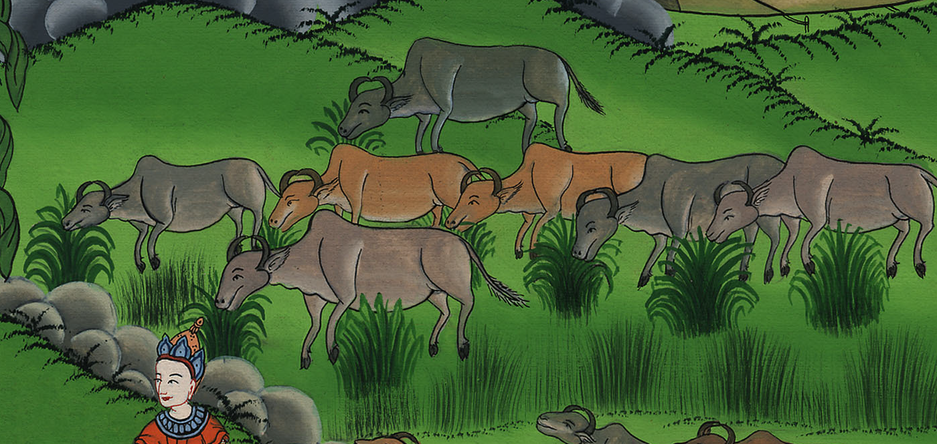
Genesis 41:26

Slide 43
27The seven thin and ugly cattle that came up after them are seven years, and also the seven empty heads of grain blasted with the east wind; they will be seven years of famine.

Slide 44
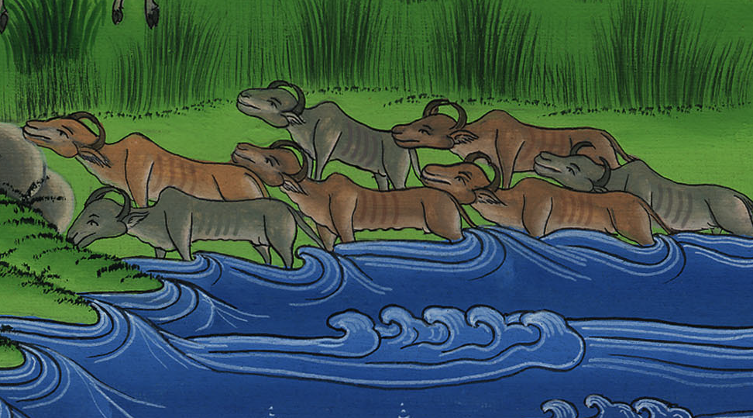
Genesis 41:27

Slide 45
28That is the thing which I have spoken to Pharaoh. God has shown Pharaoh what he is about to do.

Slide 46
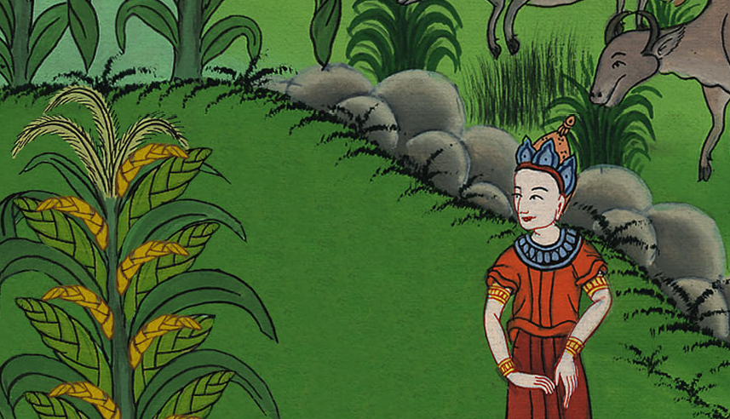
Genesis 41:28

Slide 47
29Behold, seven years of great plenty throughout all the land of Egypt are coming.

Slide 48
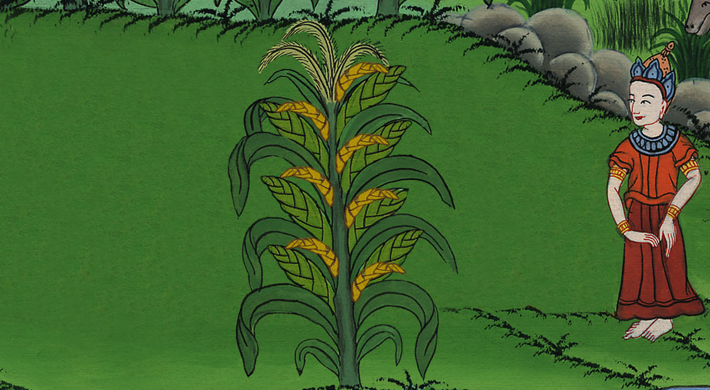
Genesis 41:29

Slide 49
30Seven years of famine will arise after them, and all the plenty will be forgotten in the land of Egypt. The famine will consume the land,

Slide 50
Genesis 41:30

Slide 51
33“Now therefore let Pharaoh look for a discreet and wise man, and set him over the land of Egypt.

Slide 52
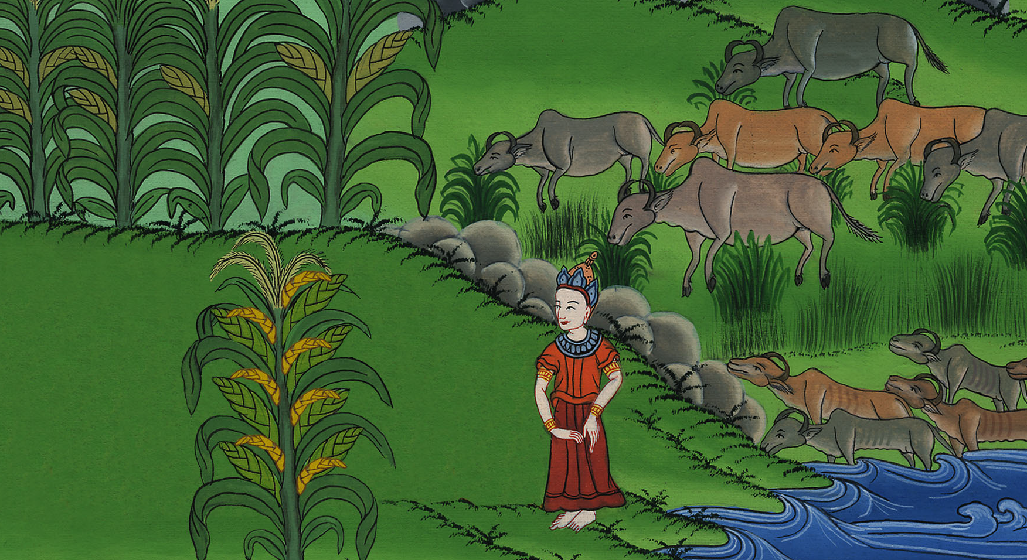
Genesis 41:33

Slide 53
39Pharaoh said to Joseph, “Because God has shown you all of this, there is no one so discreet and wise as you.

Slide 54
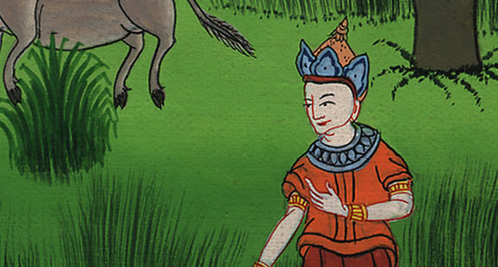
Genesis 41:39

Slide 55
41Pharaoh said to Joseph, “Behold, I have set you over all the land of Egypt.”

Slide 56
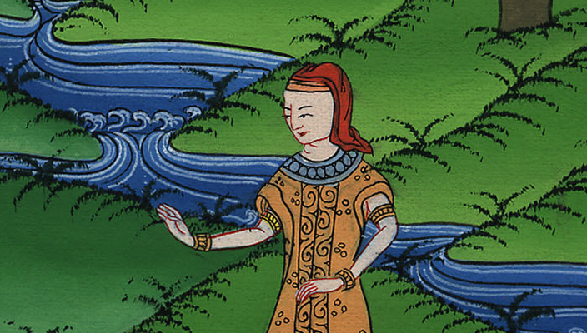
Genesis 41:41

Slide 57
42Pharaoh took off his signet ring from his hand, and put it on Joseph’s hand, and arrayed him in robes of fine linen, and put a gold chain about his neck.

Slide 58
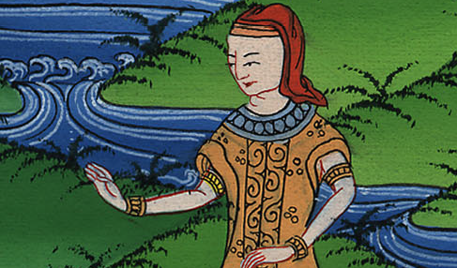
Genesis 41:42

Slide 59
47In the seven plenteous years the earth produced abundantly.

Slide 60
Genesis 41:47

Slide 61
48He gathered up all the food of the seven years which were in the land of Egypt, and laid up the food in the cities. He stored food in each city from the fields around that city.

Slide 62
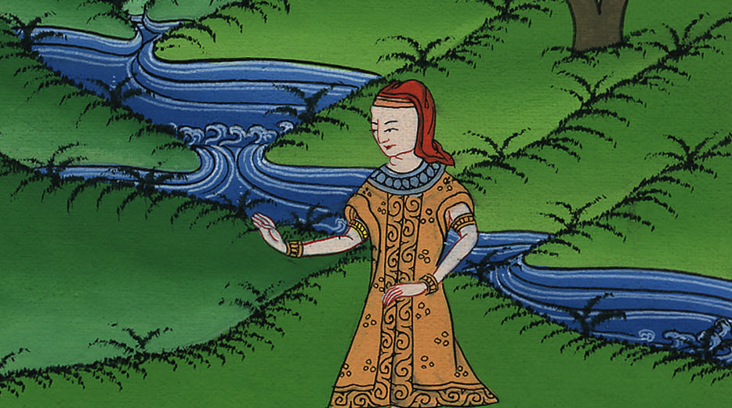
Genesis 41:48

Slide 63
53The seven years of plenty, that were in the land of Egypt, came to an end.

Slide 64
Genesis 41:53

Slide 65
54The seven years of famine began to come, just as Joseph had said. There was famine in all lands, but in all the land of Egypt there was bread.

Slide 66
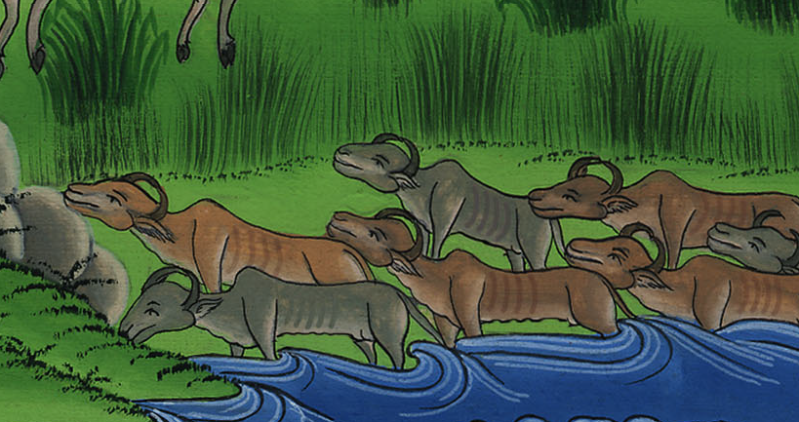
Genesis 41:54

Slide 67
55When all the land of Egypt was famished, the people cried to Pharaoh for bread, and Pharaoh said to all the Egyptians, “Go to Joseph. What he says to you, do.”

Slide 68
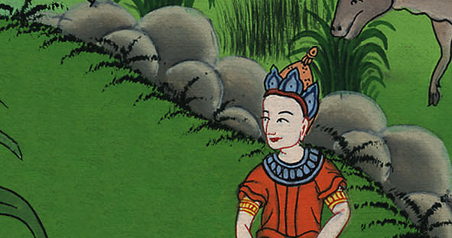
Genesis 41:55

Slide 69
57All countries came into Egypt, to Joseph, to buy grain, because the famine was severe in all the earth.

Slide 70
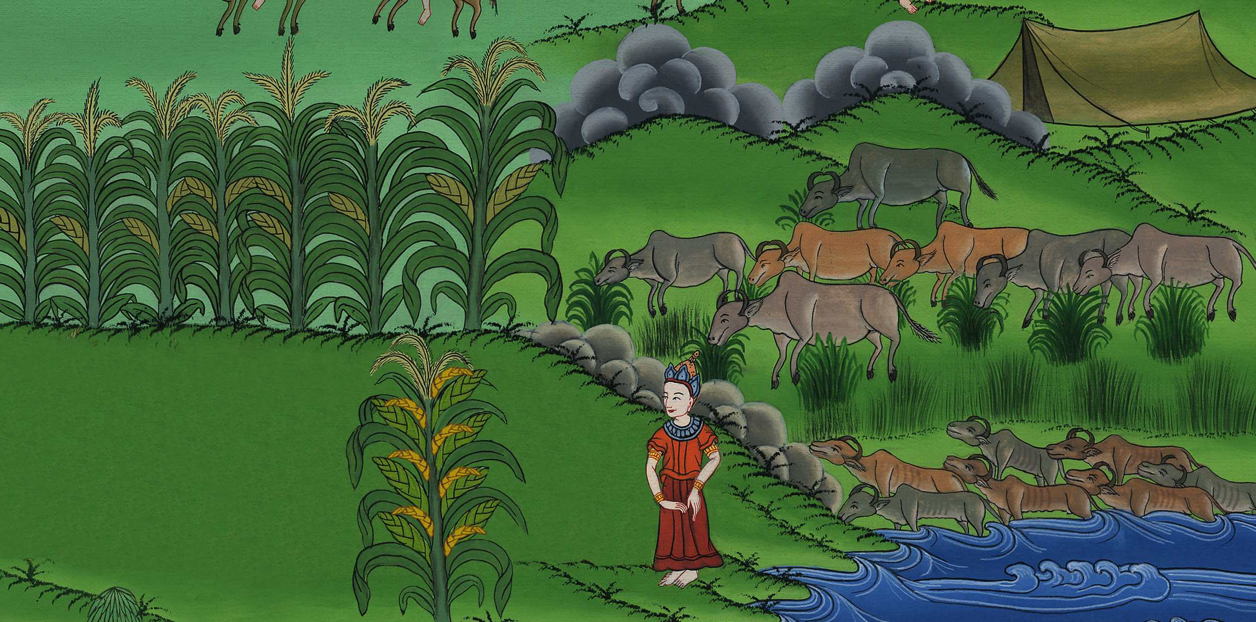
Genesis 41:57

