Slide 1
7-6
This work is licensed under a Creative Commons Attribution-ShareAlike 4.0 International License.
Please add this statement to all the videos you create.
English Bible quotes are from the World English Bible US, which is in the public domain.

Slide 2
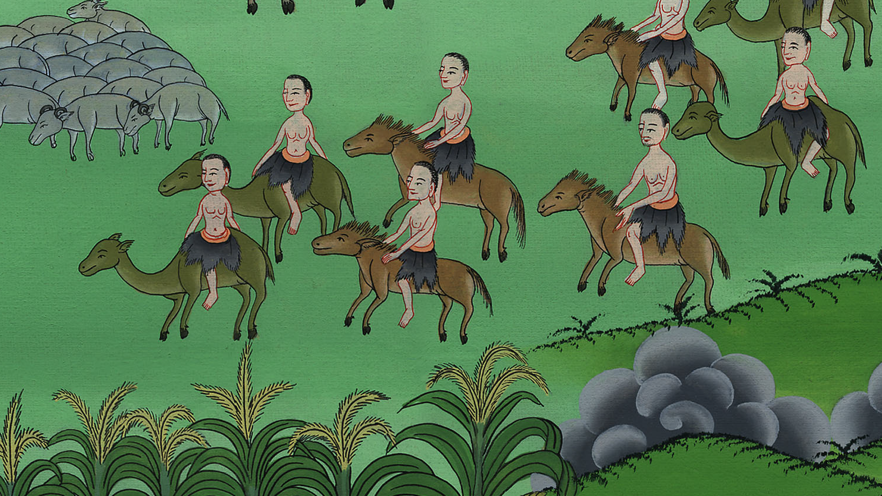
6
Joseph’s brothers come for grain
Genesis 42:1-26

Slide 3
6) Joseph’s brothers come for grain – Gen 42:1-26 (Left Bottom)

Slide 4
Joseph’s brothers come for grain
Genesis 42:1-26

Slide 5
1Now Jacob saw that there was grain in Egypt, and Jacob said to his sons, “Why do you look at one another?”

Slide 6
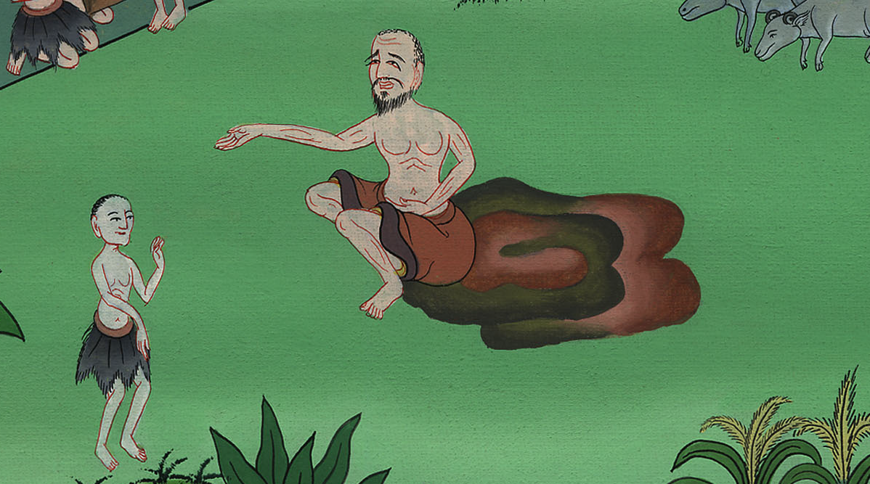
Genesis 42:1

Slide 7
2He said, “Behold, I have heard that there is grain in Egypt. Go down there, and buy for us from there, so that we may live, and not die.”

Slide 8
Genesis 42:2

Slide 9
3Joseph’s ten brothers went down to buy grain from Egypt.

Slide 10
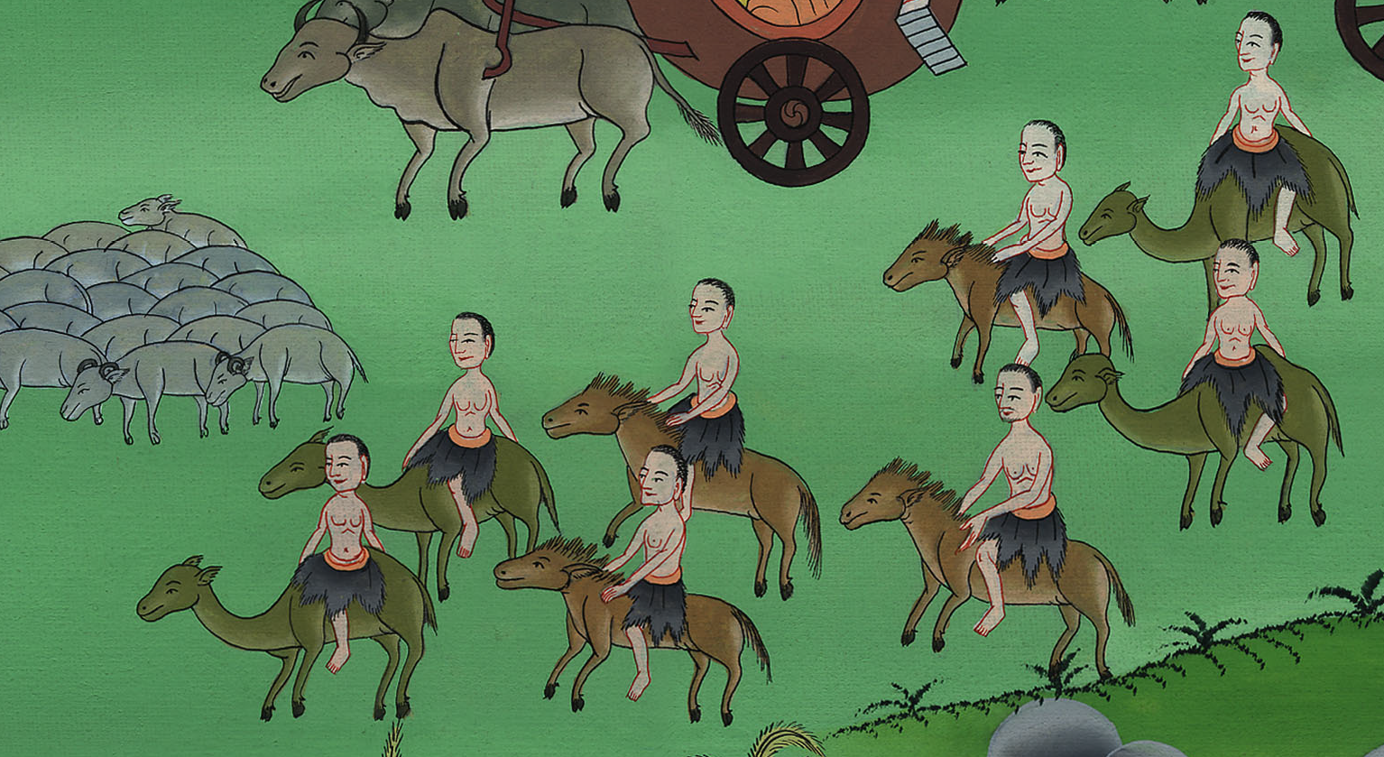
Genesis 42:3

Slide 11
4But Jacob didn’t send Benjamin, Joseph’s brother, with his brothers; for he said, “Lest perhaps harm happen to him.”

Slide 12
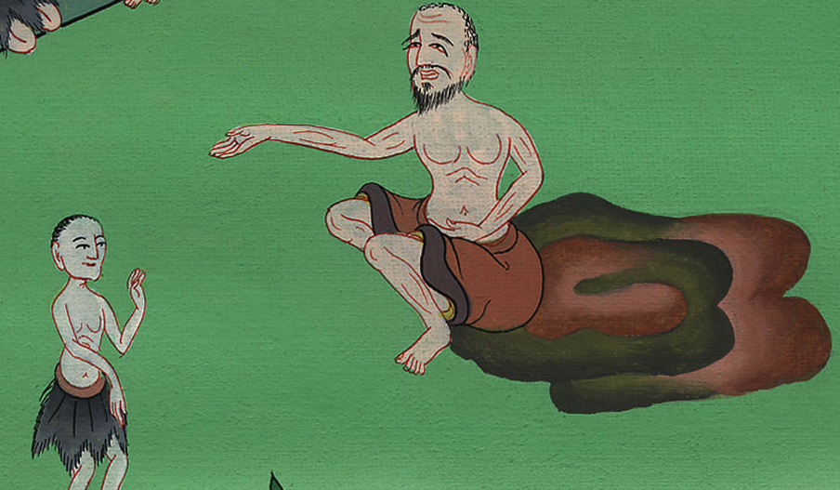
Genesis 42:4

Slide 13
6Joseph was the governor over the land. It was he who sold to all the people of the land. Joseph’s brothers came, and bowed themselves down to him with their faces to the earth.

Slide 14
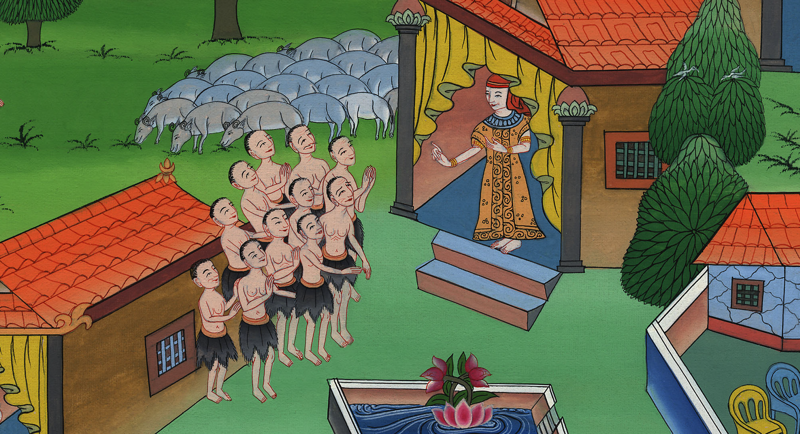
Genesis 42:6

Slide 15
7Joseph saw his brothers, and he recognized them, but acted like a stranger to them, and spoke roughly with them. He said to them, “Where did you come from?”
They said, “From the land of Canaan, to buy food.”

Slide 16
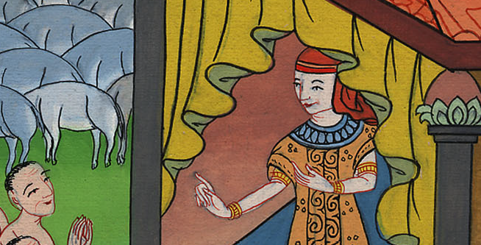
Genesis 42:7

Slide 17
8Joseph recognized his brothers, but they didn’t recognize him.

Slide 18
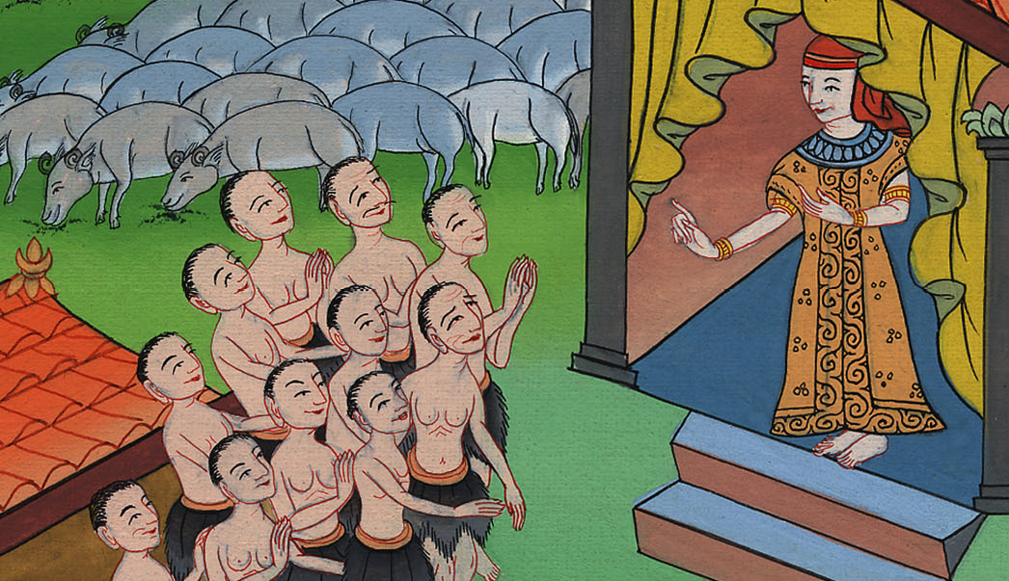
Genesis 42:8

Slide 19
9Joseph remembered the dreams which he dreamed about them, and said to them, “You are spies! You have come to see the nakedness of the land.”

Slide 20
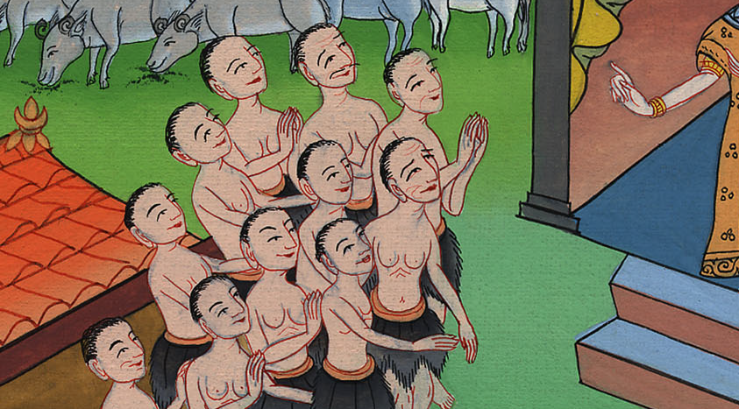
Genesis 42:9

Slide 21
13They said, “We, your servants, are twelve brothers, the sons of one man in the land of Canaan; and behold, the youngest is today with our father, and one is no more.”

Slide 22
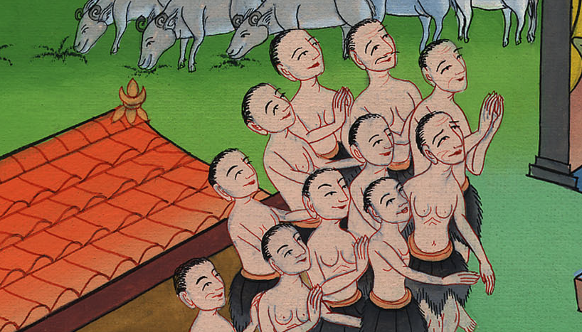
Genesis 42:13

Slide 23
14Joseph said to them, “It is like I told you, saying, ‘You are spies!’ 15By this you shall be tested. By the life of Pharaoh, you shall not go out from here, unless your youngest brother comes here.

Slide 24
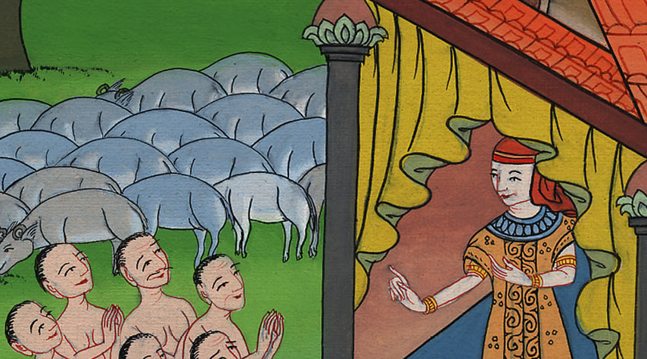
Genesis 42:14

Slide 25
19If you are honest men, then let one of your brothers be bound in your prison; but you go, carry grain for the famine of your houses.

Slide 26
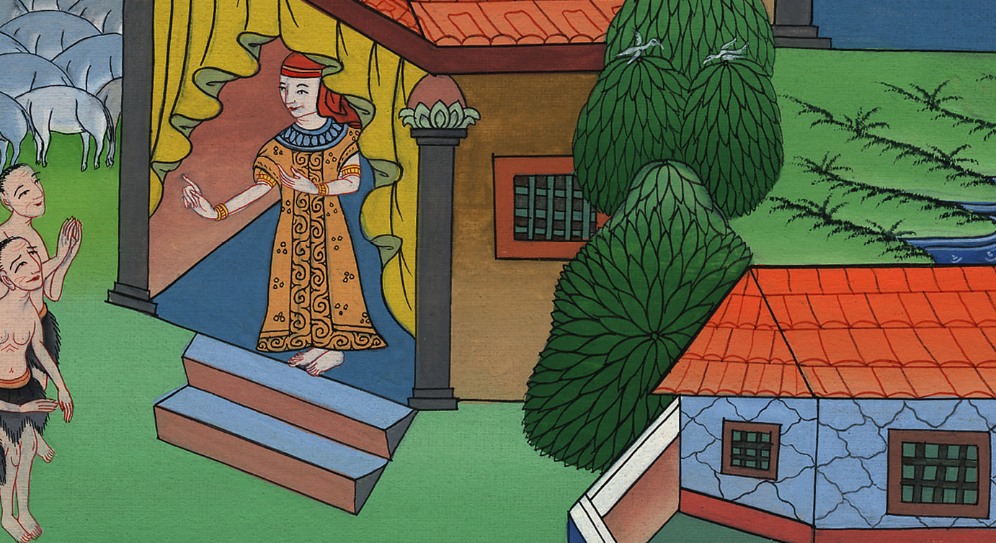
Genesis 42:19

Slide 27
20Bring your youngest brother to me; so will your words be verified, and you won’t die.”

Slide 28
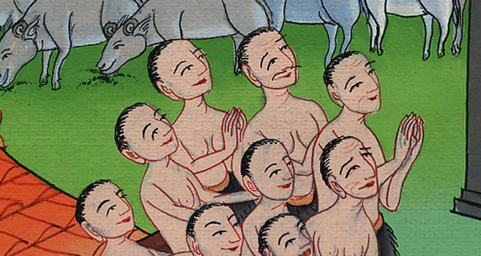
Genesis 42:20

Slide 29
25Then Joseph gave a command to fill their bags with grain, and to restore each man’s money into his sack, and to give them food for the way. So it was done to them.

Slide 30
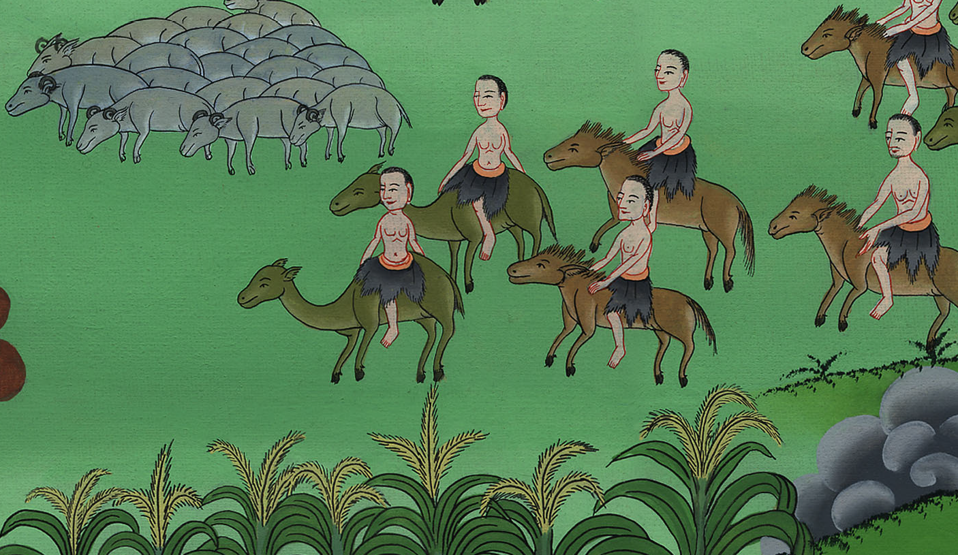
Genesis 42:25

Slide 31
26They loaded their donkeys with their grain, and departed from there.

Slide 32
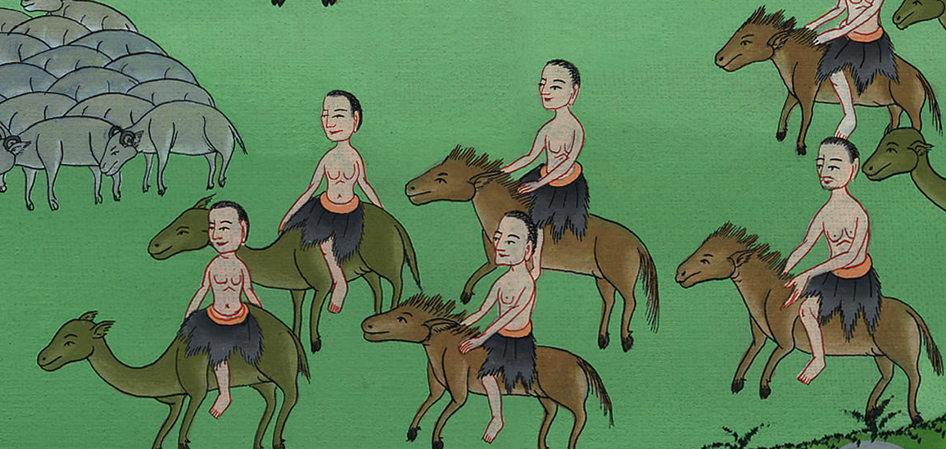
Genesis 42:26

