Slide 1
7-7
This work is licensed under a Creative Commons Attribution-ShareAlike 4.0 International License.
Please add this statement to all the videos you create.
English Bible quotes are from the World English Bible US, which is in the public domain.

Slide 2
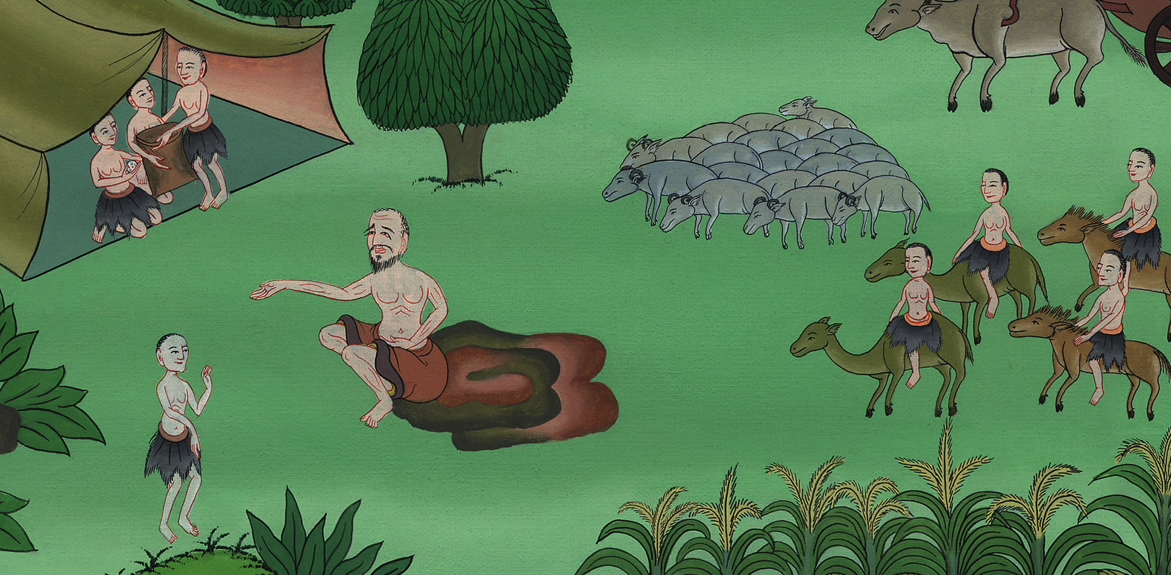
07-7
Brothers return home
Genesis 42:27-38
Notes:
checked

Slide 3
8) Brothers return home – Gen 42:27-38 (Left 2nd from Bottom)
Notes:
Final Check

Slide 4
Brothers return home
Genesis 42:27-38

Slide 5
25Then Joseph gave a command to fill their bags with grain, and to restore each man’s money into his sack, and to give them food for the way. So it was done to them.
26They loaded their donkeys with their grain, and departed from there.

Slide 6
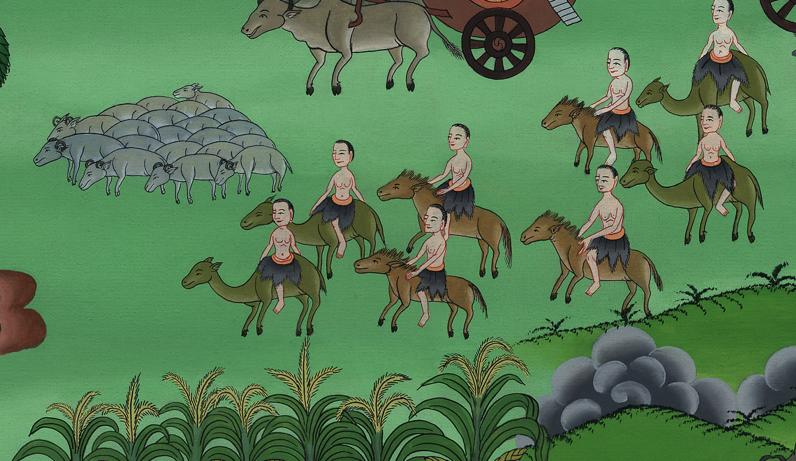
Genesis 42:25,26

Slide 7
27As one of them opened his sack to give his donkey food in the lodging place, he saw his money. Behold, it was in the mouth of his sack.

Slide 8
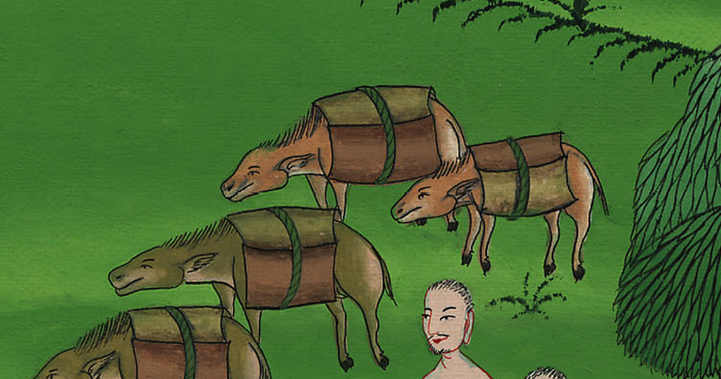
Genesis 42:27

Slide 9
28He said to his brothers, “My money is restored! Behold, it is in my sack!” Their hearts failed them, and they turned trembling to one another, saying, “What is this that God has done to us?”

Slide 10
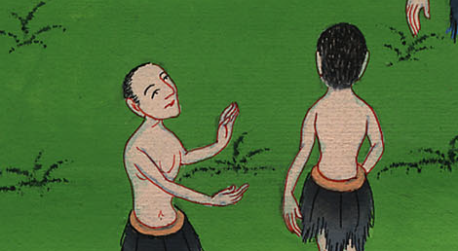
Genesis 42:28

Slide 11
29They came to Jacob their father, to the land of Canaan, and told him all that had happened to them, saying,

Slide 12
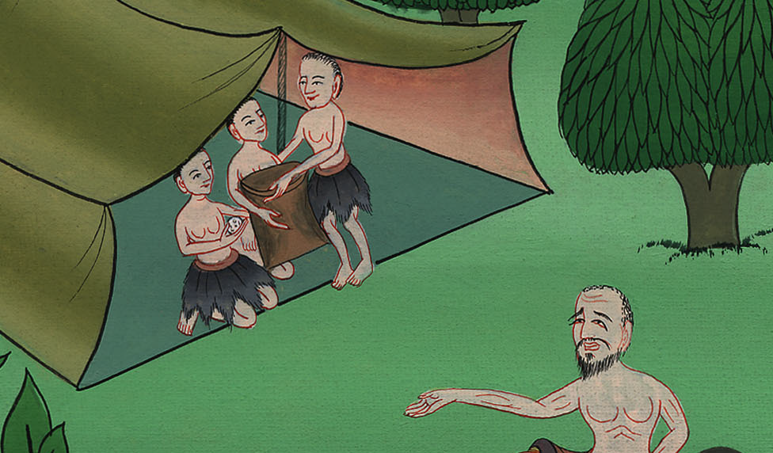
Genesis 42:29

Slide 13
30“The man, the lord of the land, spoke roughly with us, and took us for spies of the country.

Slide 14
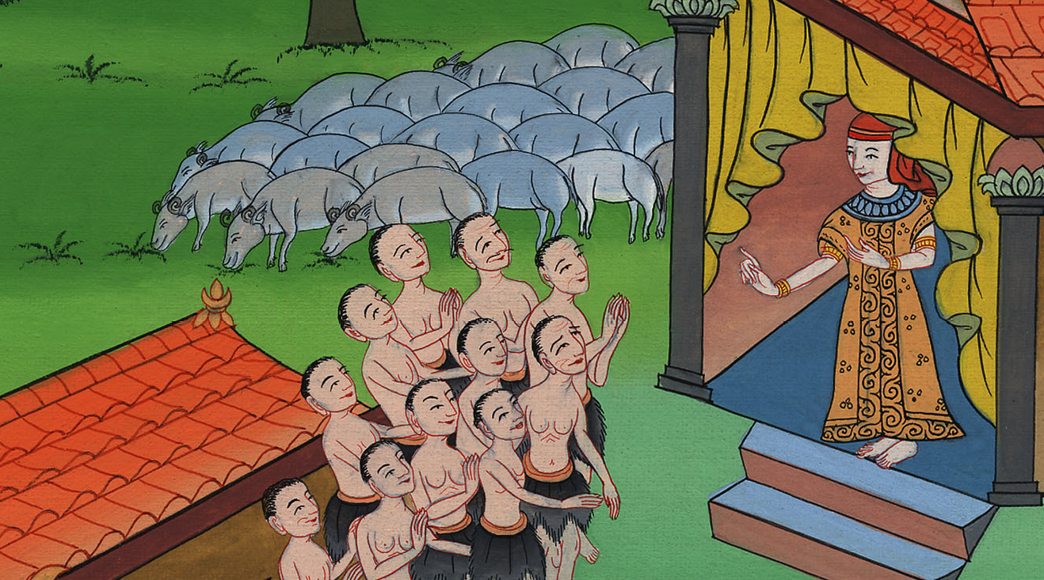
Genesis 42:30

Slide 15
31We said to him, ‘We are honest men. We are no spies.

Slide 16
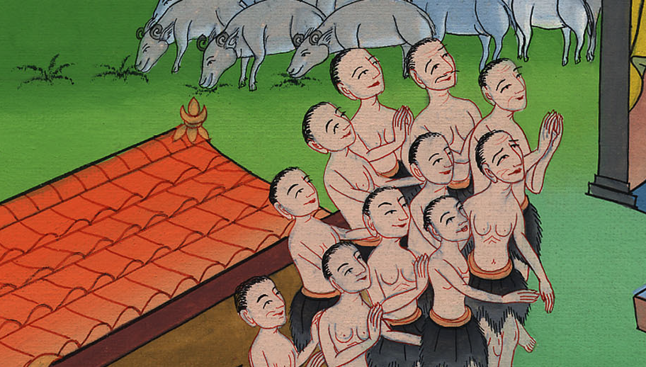
Genesis 42:31

Slide 17
32We are twelve brothers, sons of our father; one is no more, and the youngest is today with our father in the land of Canaan.’

Slide 18
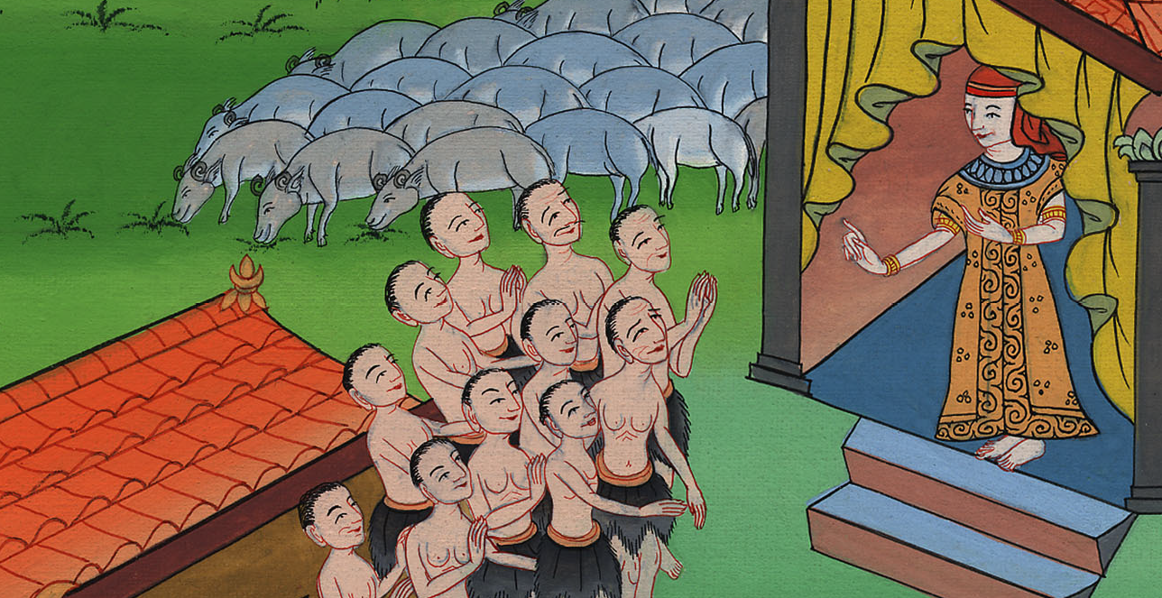
Genesis 42:32

Slide 19
33The man, the lord of the land, said to us, ‘By this I will know that you are honest men: leave one of your brothers with me, and take grain for the famine of your houses, and go your way.

Slide 20
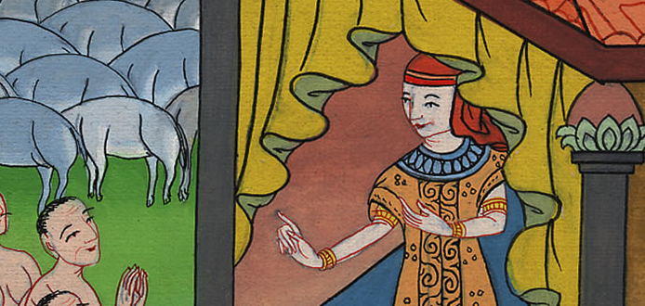
Genesis 42:33

Slide 21
34Bring your youngest brother to me. Then I will know that you are not spies, but that you are honest men. So I will deliver your brother to you, and you shall trade in the land.’”

Slide 22
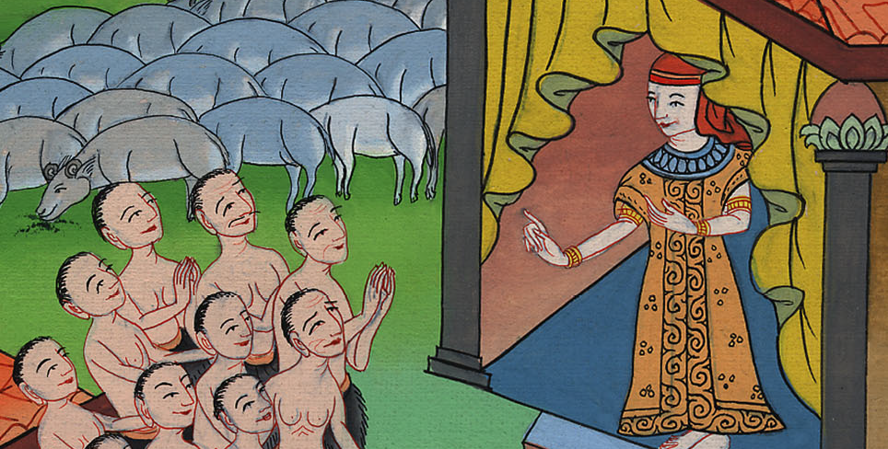
Genesis 42:34

Slide 23
35As they emptied their sacks, behold, each man’s bundle of money was in his sack. When they and their father saw their bundles of money, they were afraid.

Slide 24
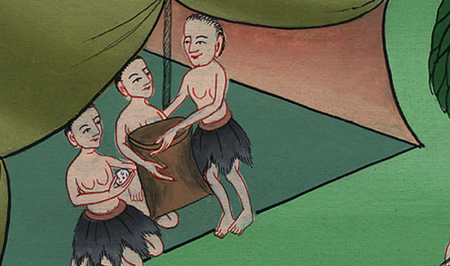
Genesis 42:35

Slide 25
36Jacob, their father, said to them, “You have bereaved me of my children! Joseph is no more, Simeon is no more, and you want to take Benjamin away. All these things are against me.”

Slide 26
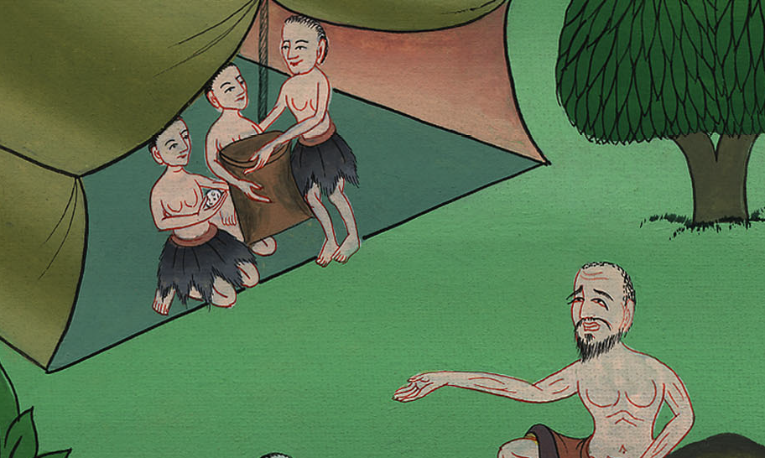
Genesis 42:36

Slide 27
37Reuben spoke to his father, saying, “Kill my two sons, if I don’t bring him to you. Entrust him to my care, and I will bring him to you again.”

Slide 28
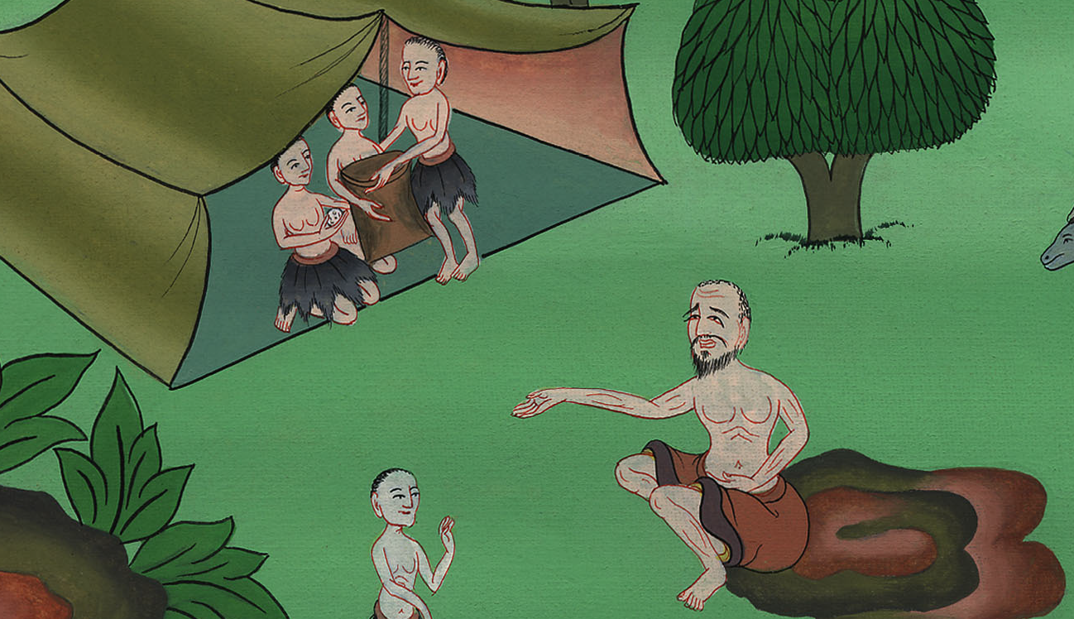
Genesis 42:37

Slide 29
38He said, “My son shall not go down with you; for his brother is dead, and he only is left. If harm happens to him along the way in which you go, then you will bring down my gray hairs with sorrow to Sheol.”

Slide 30
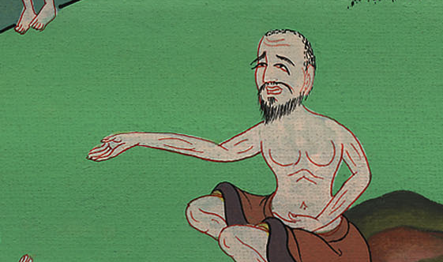
Genesis 42:38

