Slide 1
7-9
This work is licensed under a Creative Commons Attribution-ShareAlike 4.0 International License.
Please add this statement to all the videos you create.
English Bible quotes are from the World English Bible US, which is in the public domain.

Slide 2
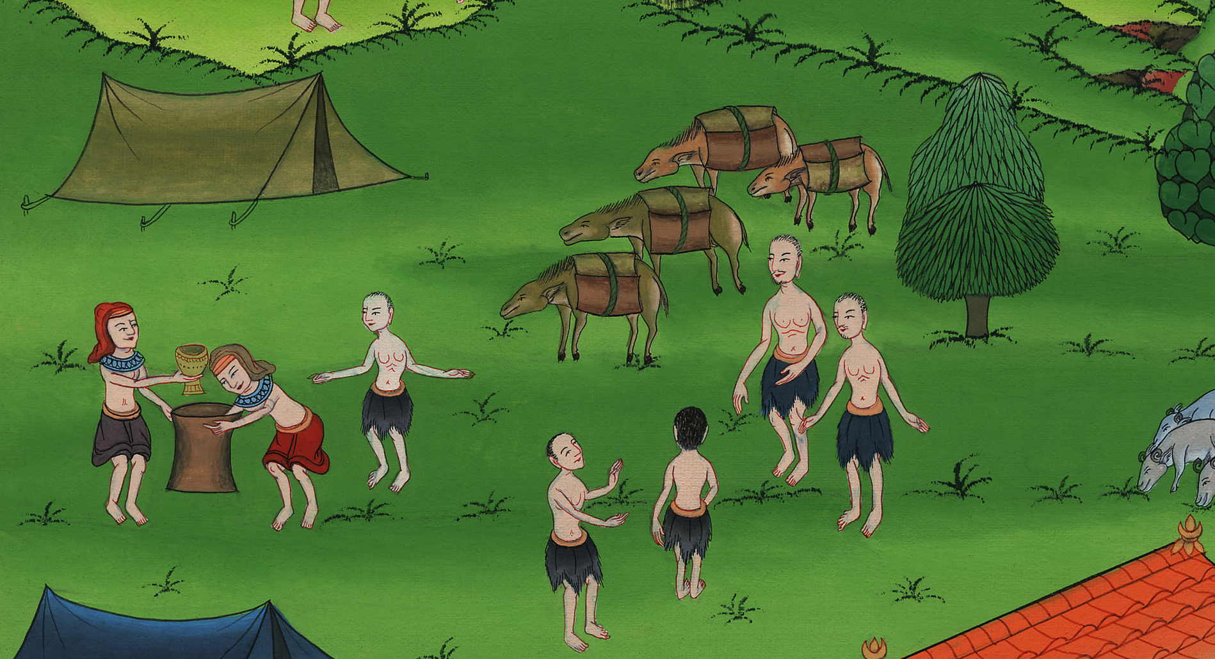
07-9
Joseph’s cup in Benjamin’s bag
Genesis 44:1-13
Notes:
checked

Slide 3
10) Joseph’s cup in Benjamin’s bag – Gen 44:1-13 (Left 4th from Bottom)
Notes:
Check

Slide 4
Joseph’s cup in Benjamin’s bag
Genesis 44:1-13

Slide 5
1He commanded the steward of his house, saying, “Fill the men’s sacks with food, as much as they can carry, and put each man’s money in his sack’s mouth.

Slide 6
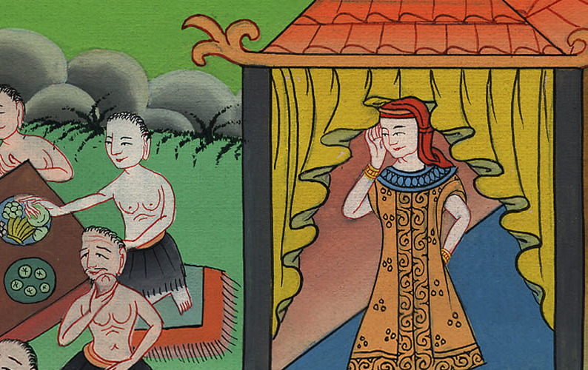
Genesis 44:1

Slide 7
2Put my cup, the silver cup, in the sack’s mouth of the youngest, with his grain money.” He did according to the word that Joseph had spoken.

Slide 8
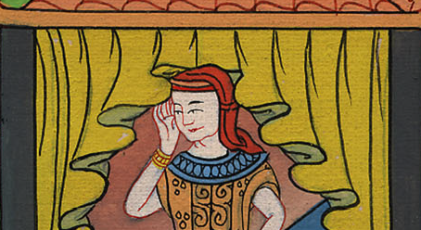
Genesis 44:2

Slide 9
3As soon as the morning was light, the men were sent away, they and their donkeys.

Slide 10
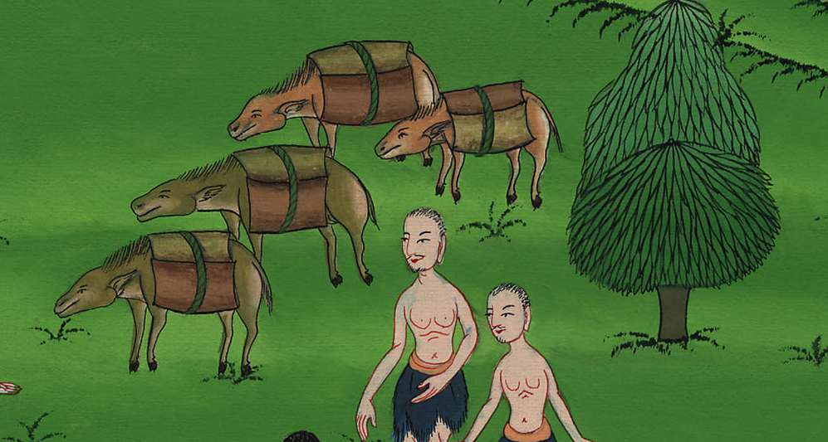
Genesis 44:3

Slide 11
4When they had gone out of the city, and were not yet far off, Joseph said to his steward, “Up, follow after the men. When you overtake them, ask them, ‘Why have you rewarded evil for good?

Slide 12
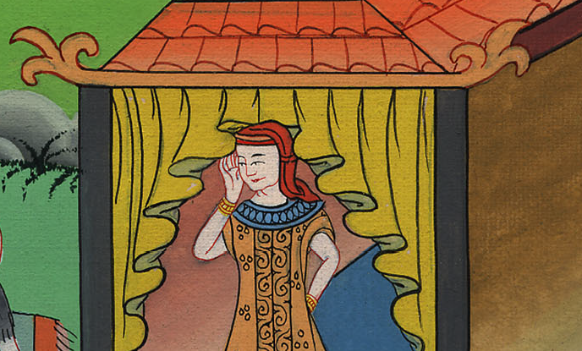
Genesis 44:4

Slide 13
5Isn’t this that from which my lord drinks, and by which he indeed divines? You have done evil in so doing.’”

Slide 14
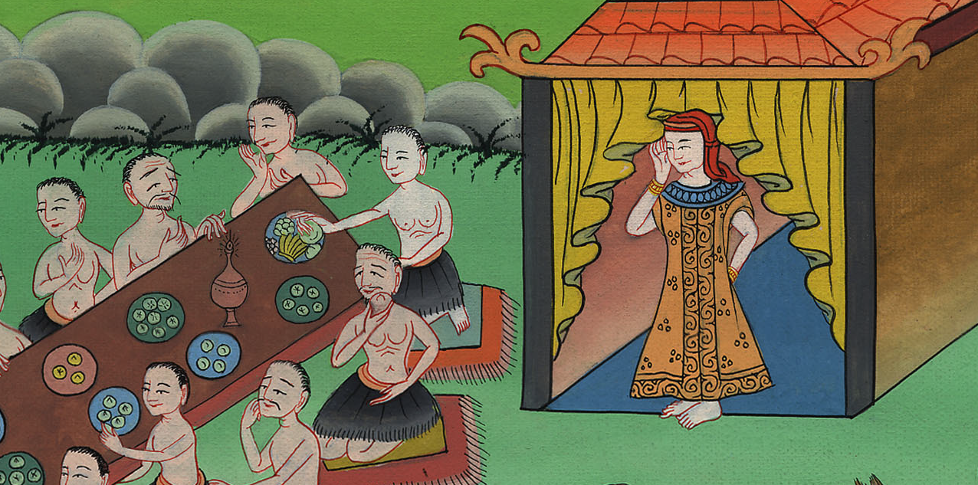
Genesis 44:5

Slide 15
6He overtook them, and he spoke these words to them.

Slide 16
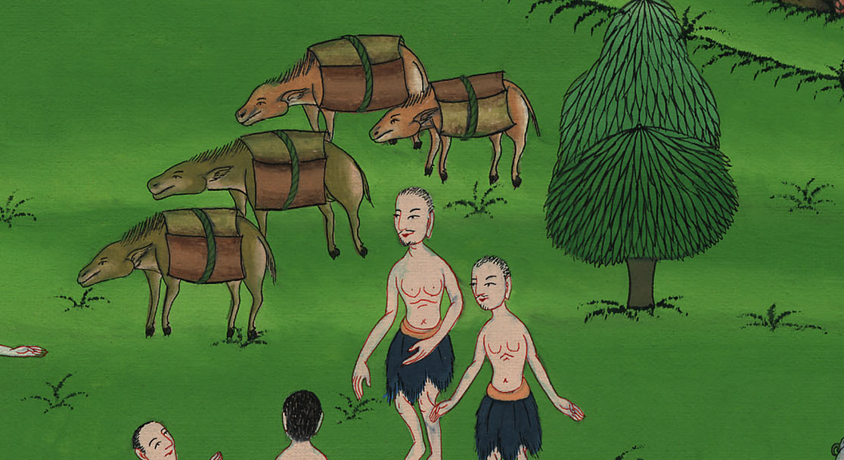
Genesis 44:6

Slide 17
7They said to him, “Why does my lord speak such words as these? Far be it from your servants that they should do such a thing!

Slide 18
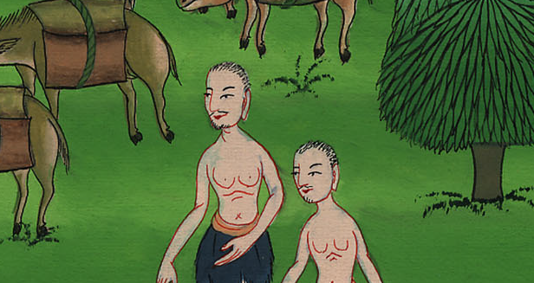
Genesis 44:7

Slide 19
9With whomever of your servants it is found, let him die, and we also will be my lord’s slaves.”

Slide 20
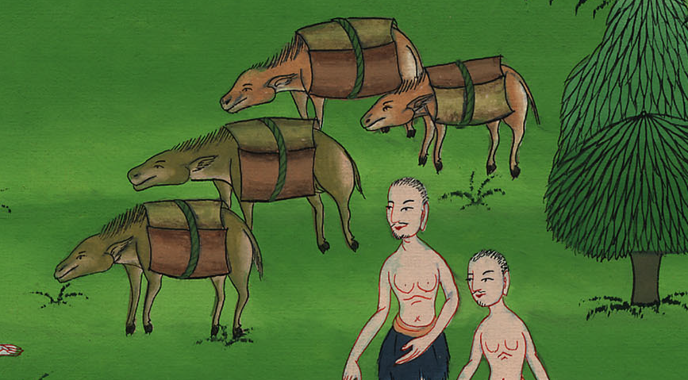
Genesis 44:9

Slide 21
10He said, “Now also let it be according to your words. He with whom it is found will be my slave; and you will be blameless.”

Slide 22
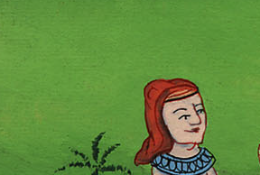
Genesis 44:10

Slide 23
11Then they hurried, and each man took his sack down to the ground, and each man opened his sack.

Slide 24
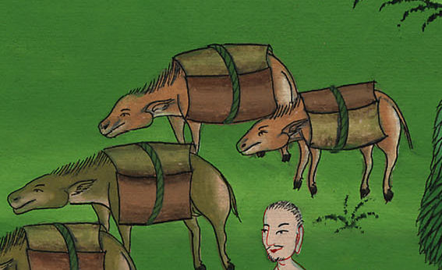
Genesis 44:11

Slide 25
12He searched, beginning with the oldest, and ending at the youngest. The cup was found in Benjamin’s sack.

Slide 26
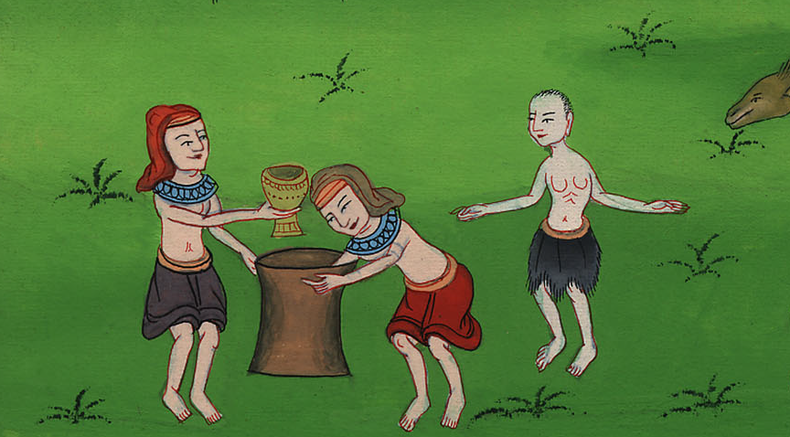
Genesis 44:12

Slide 27
13Then they tore their clothes, and each man loaded his donkey, and returned to the city.

Slide 28
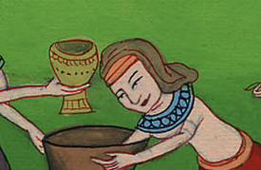
Genesis 44:13

