Slide 1
8-1
This work is licensed under a Creative Commons Attribution 4.0-ShareAlike International License.
Please add this statement to all the videos you create.
English Bible quotes are from the World English Bible US, which is in the public domain.
Notes:
checked

Slide 2
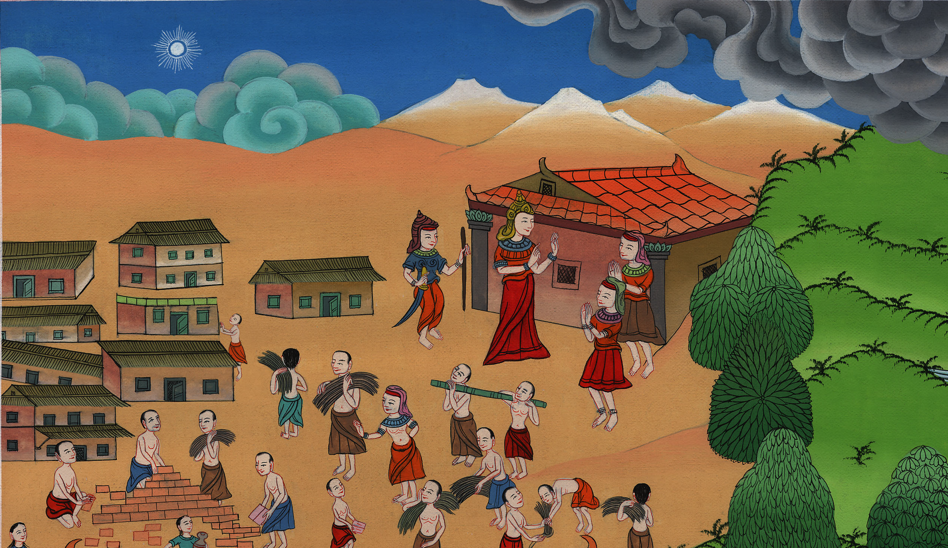
Hebrews forced into hard labor – Exodus 1:1-14

Slide 3
Hebrews forced into hard labor – Exodus 1:1-14
Notes:
First draft

Slide 4
Hebrews forced into hard labor – Exodus 1:1-14

Slide 5
1Now these are the names of the sons of Israel, who came into Egypt (every man and his household came with Jacob):

Slide 6
Exodus 1:1

Slide 7
2Reuben, Simeon, Levi, and Judah,

Slide 8
Exodus 1:2

Slide 9
3Issachar, Zebulun, and Benjamin,

Slide 10
Exodus 1:3

Slide 11
4Dan and Naphtali, Gad and Asher.

Slide 12
Exodus 1:4

Slide 13
5All the souls who came out of Jacob’s body were seventy souls, and Joseph was in Egypt already.

Slide 14
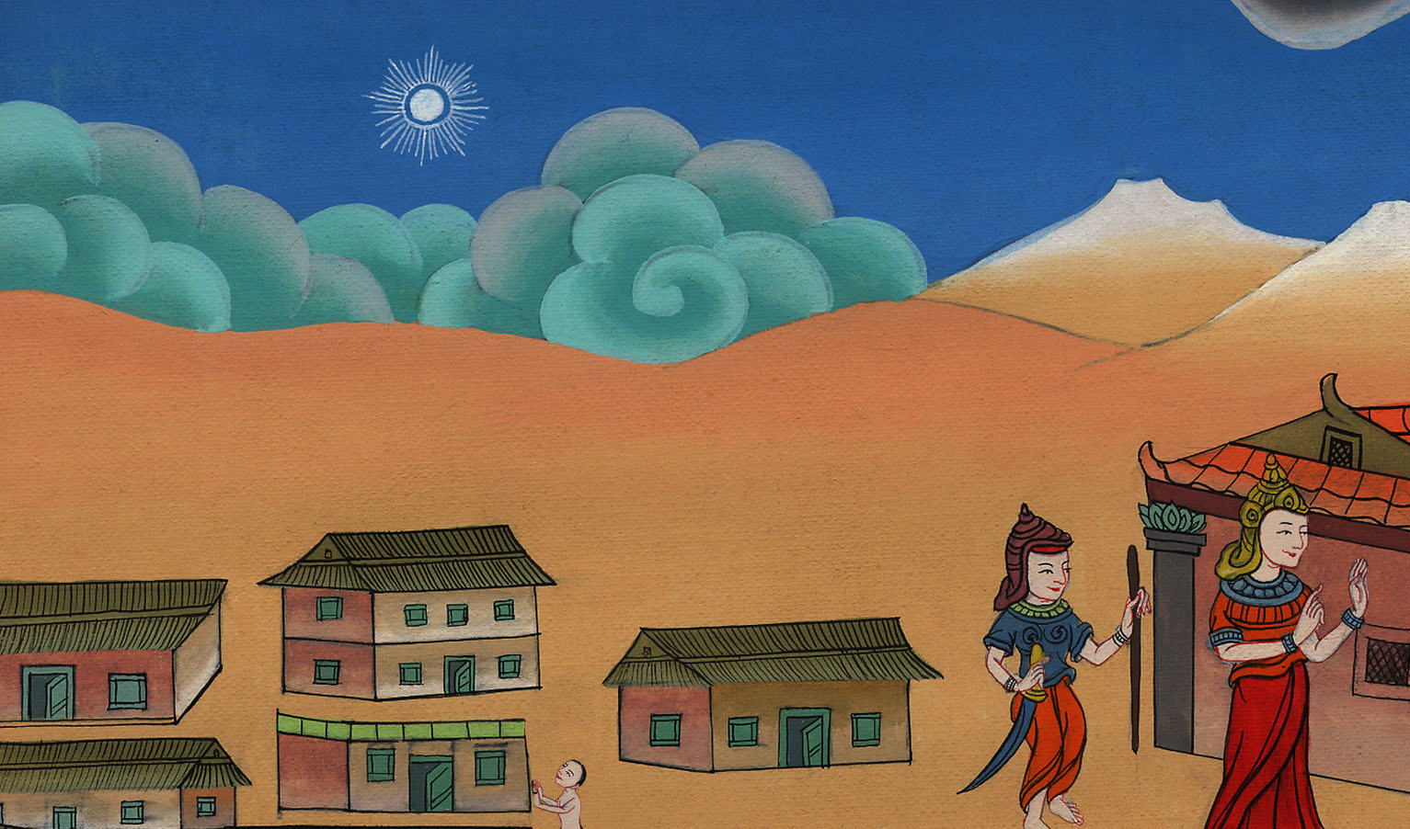
Exodus 1:5

Slide 15
6Joseph died, as did all his brothers, and all that generation.

Slide 16
Exodus 1:6

Slide 17
7The children of Israel were fruitful, and increased abundantly, and multiplied, and grew exceedingly mighty; and the land was filled with them.

Slide 18
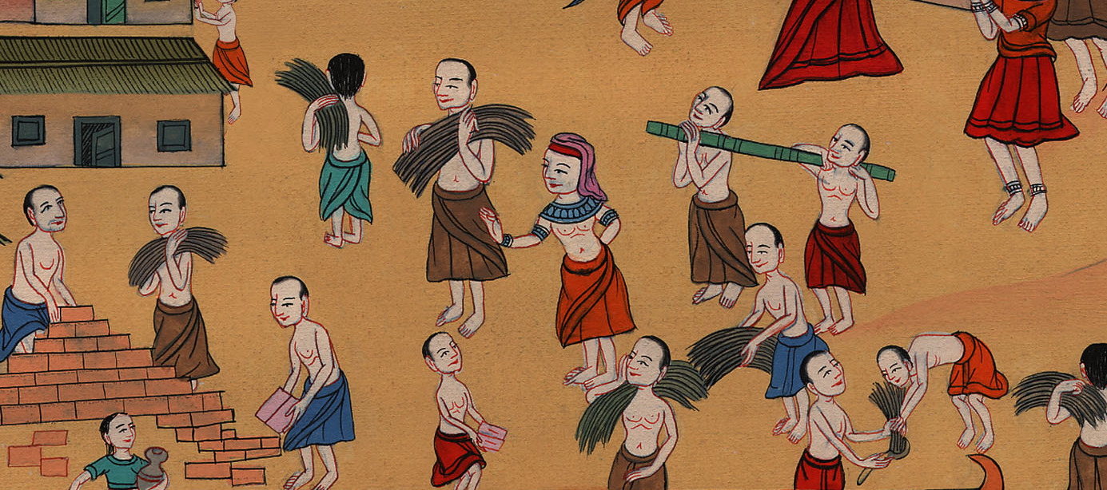
Exodus 1:7

Slide 19
8Now there arose a new king over Egypt, who didn’t know Joseph.

Slide 20
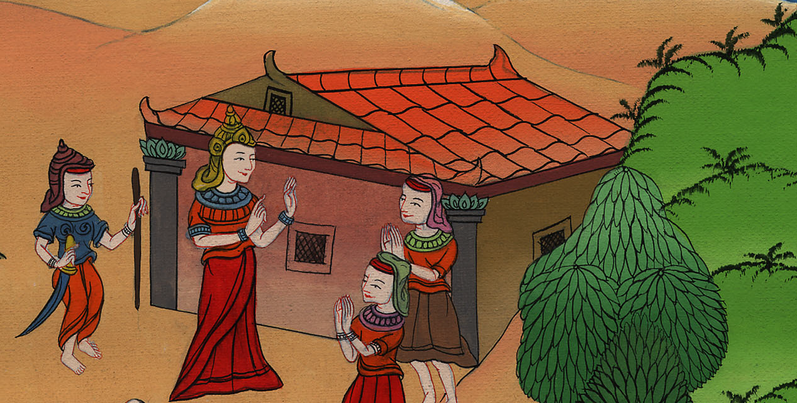
Exodus 1:8

Slide 21
9He said to his people, “Behold, the people of the children of Israel are more and mightier than we.

Slide 22
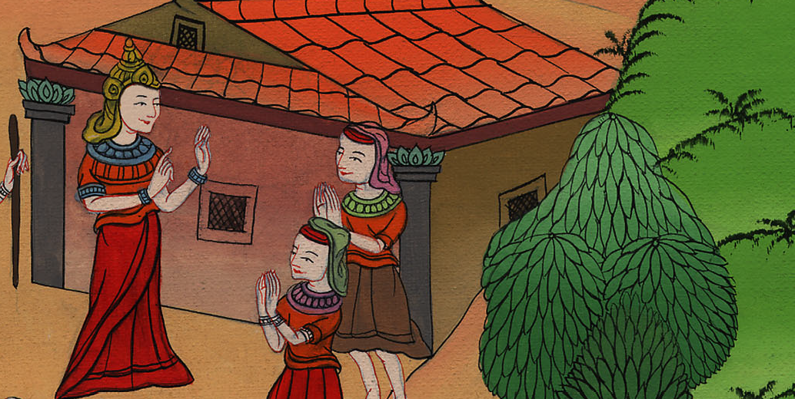
Exodus 1:9

Slide 23
10Come, let’s deal wisely with them, lest they multiply, and it happen that when any war breaks out, they also join themselves to our enemies and fight against us, and escape out of the land.”

Slide 24
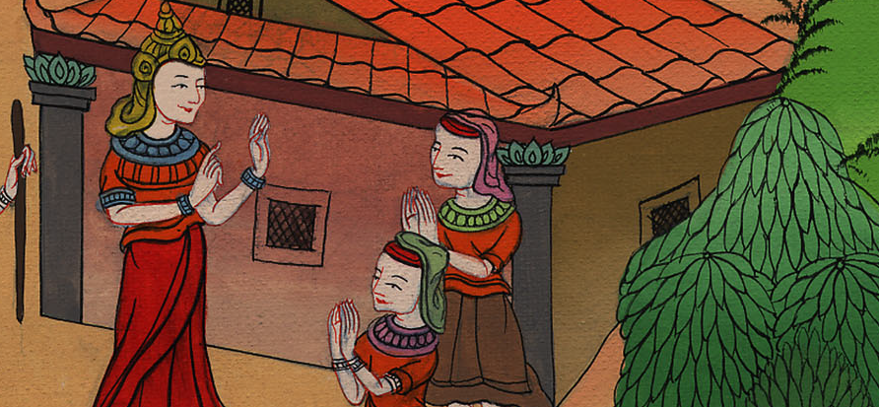
Exodus 1:10

Slide 25
11Therefore they set taskmasters over them to afflict them with their burdens. They built storage cities for Pharaoh: Pithom and Raamses.

Slide 26
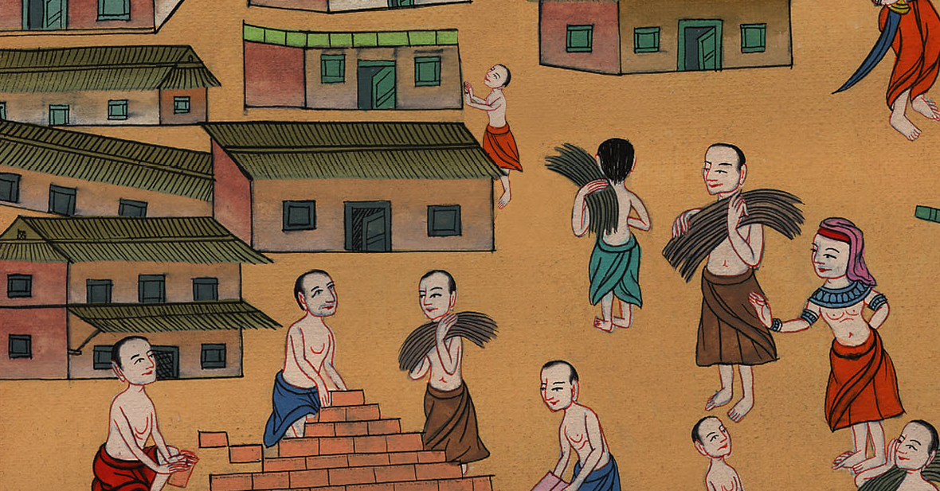
Exodus 1:11

Slide 27
12But the more they afflicted them, the more they multiplied and the more they spread out. They started to dread the children of Israel.

Slide 28
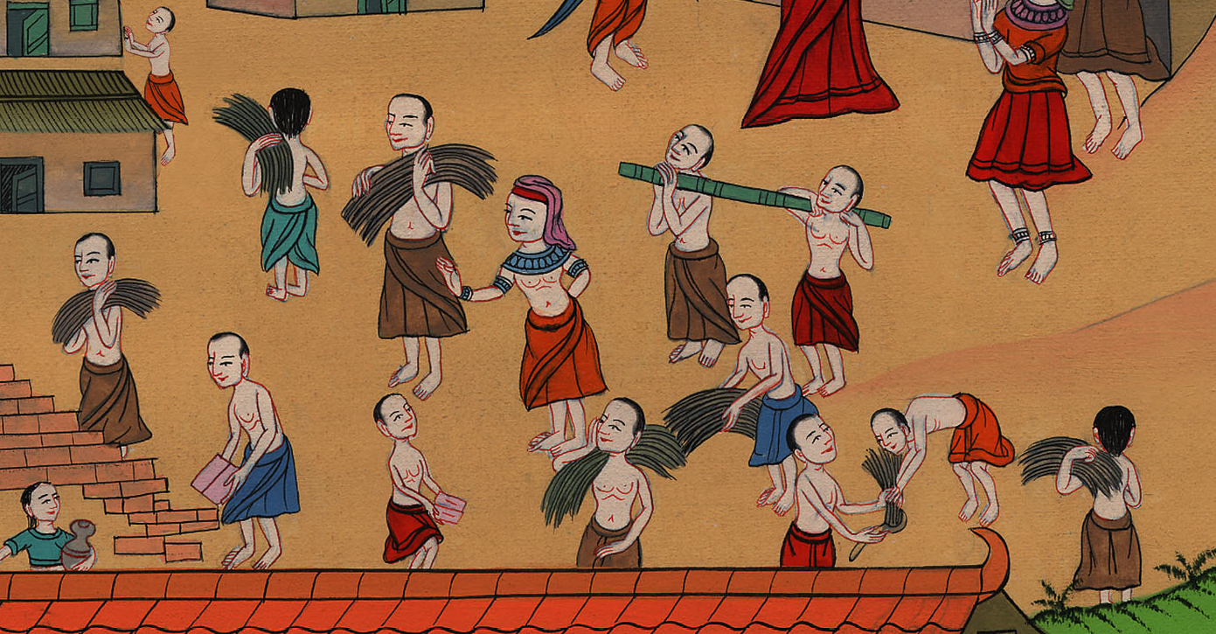
Exodus 1:12

Slide 29
13The Egyptians ruthlessly made the children of Israel serve,

Slide 30
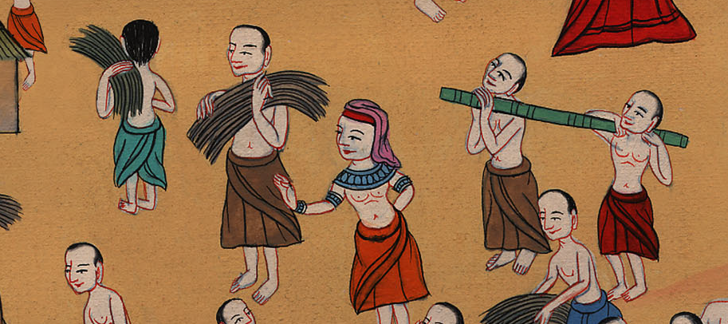
Exodus 1:13

Slide 31
14and they made their lives bitter with hard service in mortar and in brick, and in all kinds of service in the field, all their service, in which they ruthlessly made them serve.

Slide 32
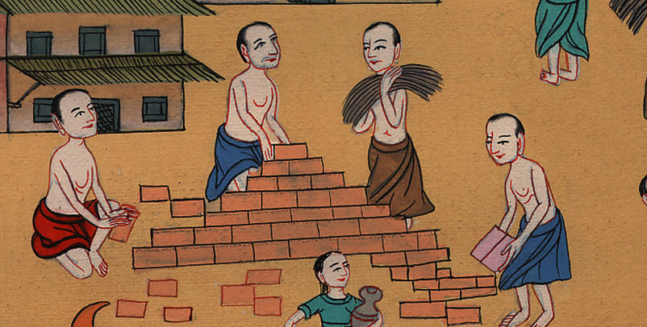
Exodus 1:14

