Slide 1
8-2
This work is licensed under a Creative Commons Attribution-ShareAlike 4.0 International License.
Please add this statement to all the videos you create.
English Bible quotes are from the World English Bible US, which is in the public domain.
Notes:
checked

Slide 2
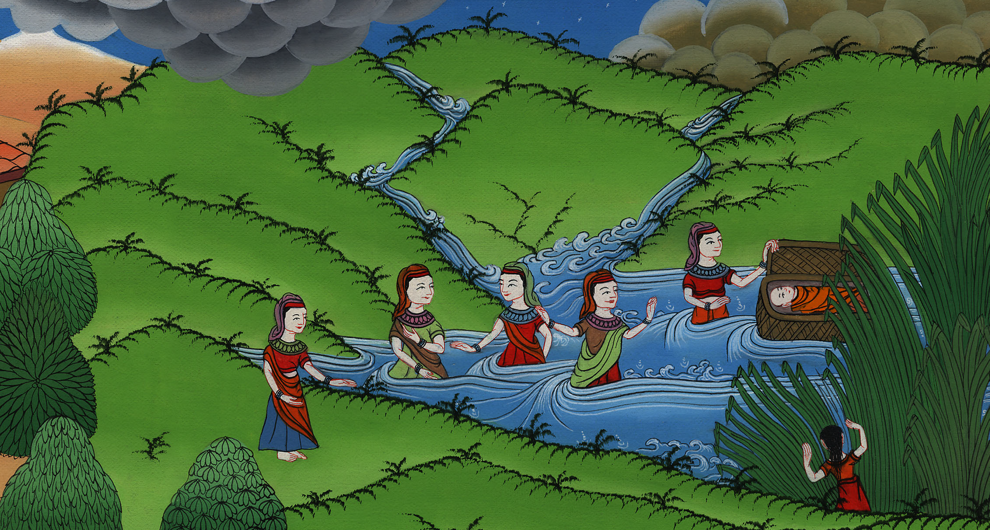
Baby Moses – Exodus 1:15 -2:10

Slide 3
Baby Moses – Exodus 1:15 – 2:10
Notes:
First draft

Slide 4
Baby Moses – Exodus 1:15 -2:10

Slide 5
15The king of Egypt spoke to the Hebrew midwives, of whom the name of the one was Shiphrah, and the name of the other Puah,

Slide 6
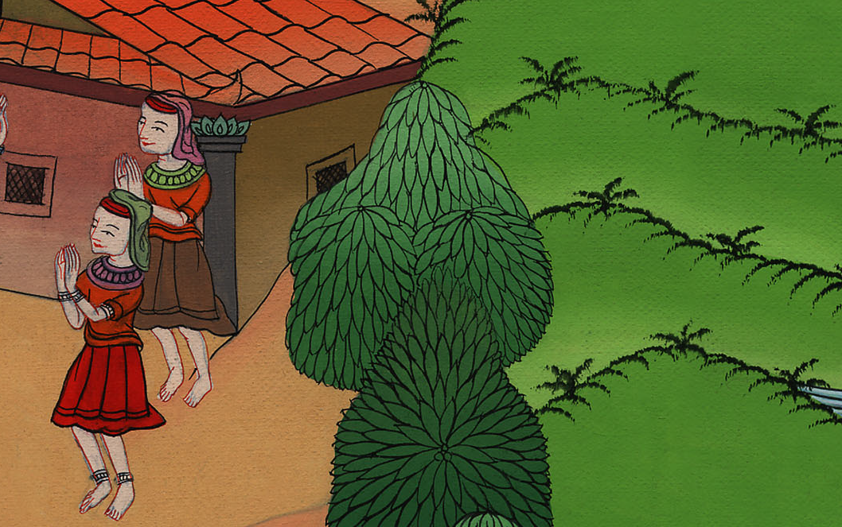
Exodus 1:15

Slide 7
16and he said, “When you perform the duty of a midwife to the Hebrew women, and see them on the birth stool, if it is a son, then you shall kill him; but if it is a daughter, then she shall live.”

Slide 8
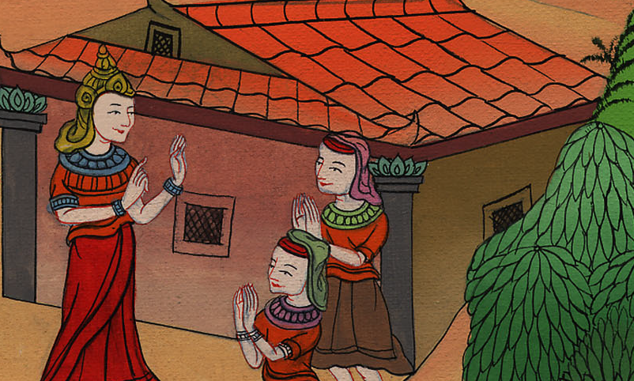
Exodus 1:16

Slide 9
17But the midwives feared God, and didn’t do what the king of Egypt commanded them, but saved the baby boys alive.

Slide 10
Exodus 1:17

Slide 11
18The king of Egypt called for the midwives, and said to them, “Why have you done this thing and saved the boys alive?”

Slide 12
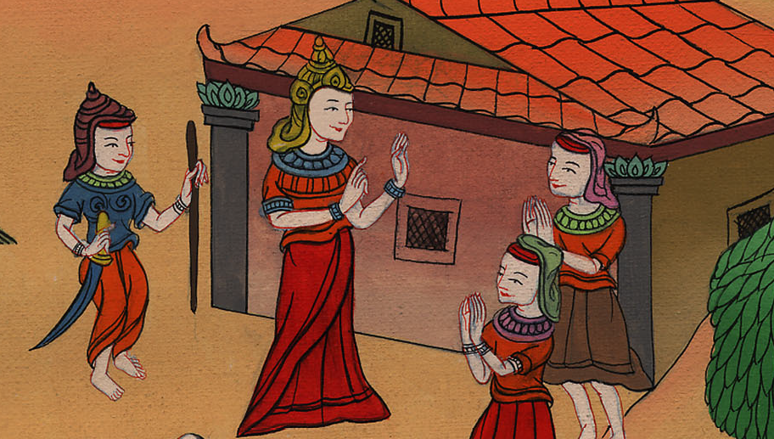
Exodus 1:18

Slide 13
19The midwives said to Pharaoh, “Because the Hebrew women aren’t like the Egyptian women; for they are vigorous and give birth before the midwife comes to them.”

Slide 14
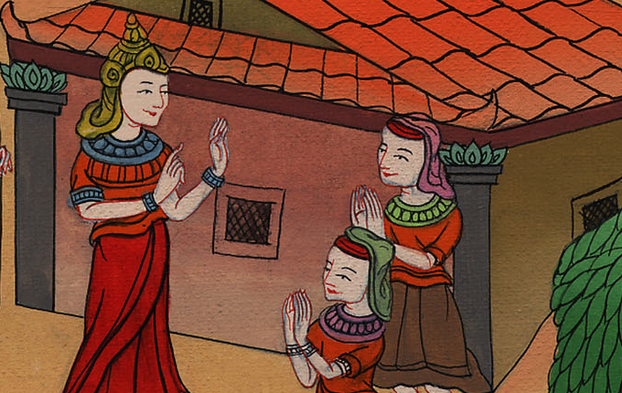
Exodus 1:19

Slide 15
20God dealt well with the midwives, and the people multiplied, and grew very mighty.

Slide 16
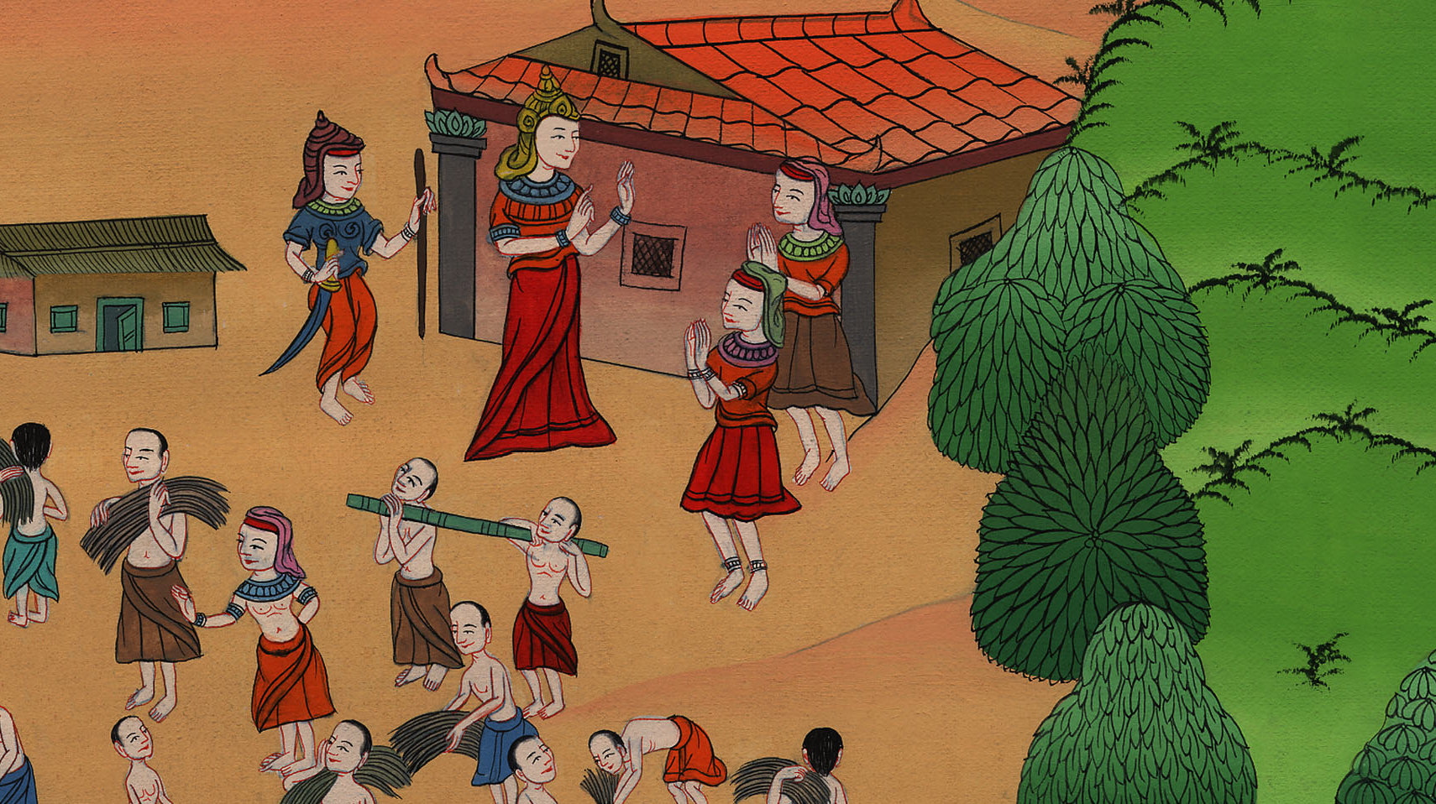
Exodus 1:20

Slide 17
22Pharaoh commanded all his people, saying, “You shall cast every son who is born into the river, and every daughter you shall save alive.”

Slide 18
Exodus 1:22

Slide 19
1A man of the house of Levi went and took a daughter of Levi as his wife.

Slide 20
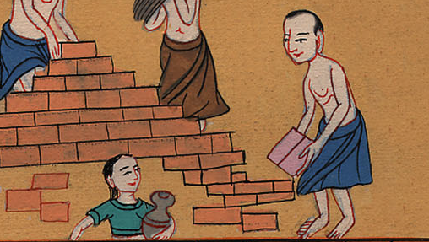
Exodus 2:1

Slide 21
2The woman conceived and bore a son. When she saw that he was a fine child, she hid him three months.

Slide 22
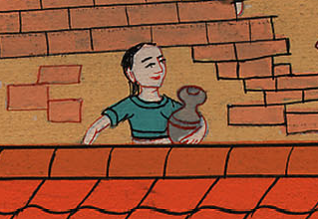
Exodus 2:2

Slide 23
3When she could no longer hide him, she took a papyrus basket for him, and coated it with tar and with pitch. She put the child in it, and laid it in the reeds by the river’s bank.

Slide 24
Exodus 2:3

Slide 25
4His sister stood far off, to see what would be done to him.

Slide 26
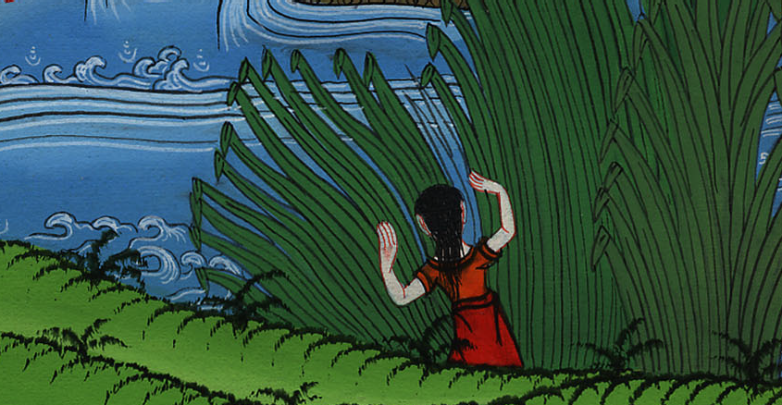
Exodus 2:4

Slide 27
5Pharaoh’s daughter came down to bathe at the river. Her maidens walked along by the riverside. She saw the basket among the reeds, and sent her servant to get it.

Slide 28
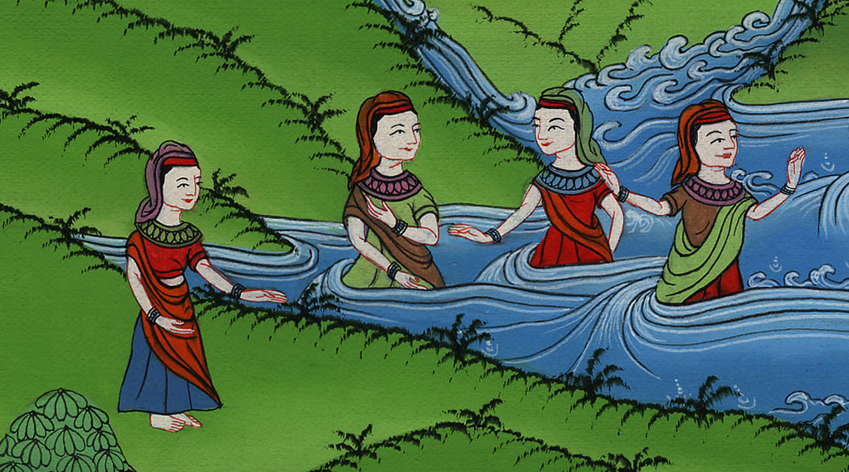
Exodus 2:5

Slide 29
6She opened it, and saw the child, and behold, the baby cried. She had compassion on him, and said, “This is one of the Hebrews’ children.”

Slide 30
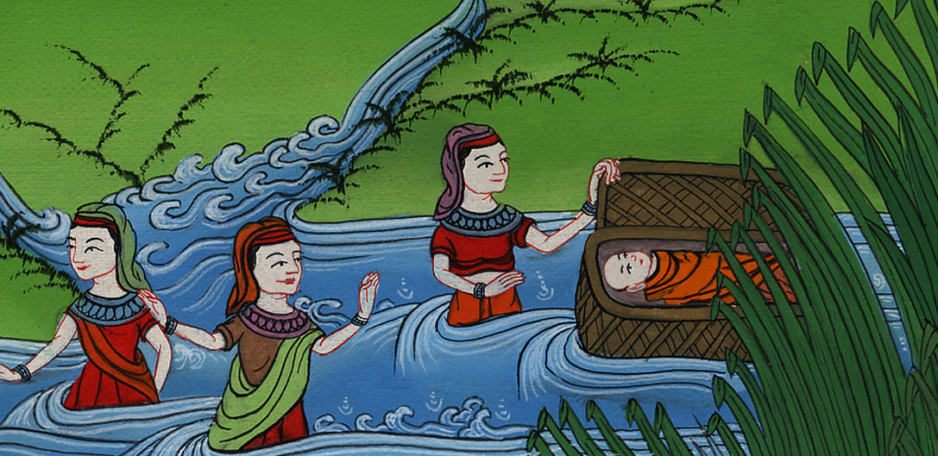
Exodus 2:6

Slide 31
7Then his sister said to Pharaoh’s daughter, “Should I go and call a nurse for you from the Hebrew women, that she may nurse the child for you?”

Slide 32
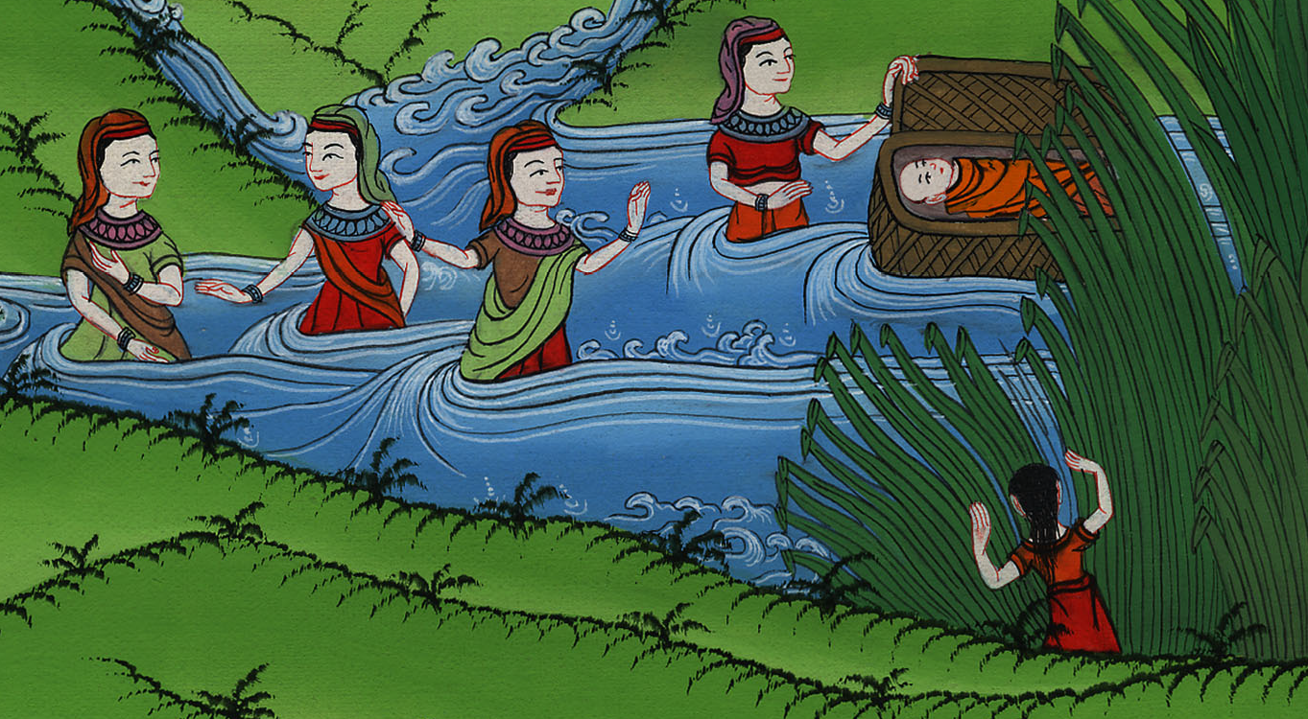
Exodus 2:7

Slide 33
8Pharaoh’s daughter said to her, “Go.”
The young woman went and called the child’s mother.

Slide 34
Exodus 2:8

Slide 35
9Pharaoh’s daughter said to her, “Take this child away, and nurse him for me, and I will give you your wages.”
The woman took the child, and nursed it.

Slide 36
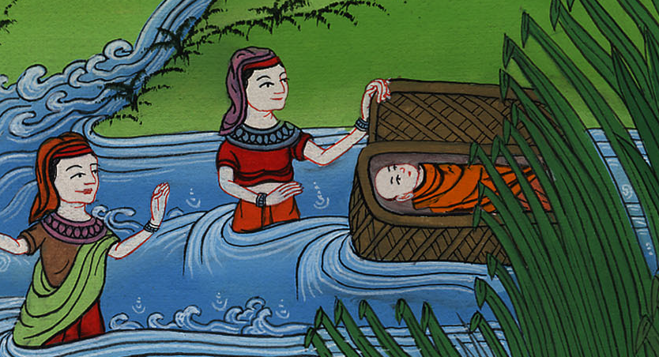
Exodus 2:9

Slide 37
10The child grew, and she brought him to Pharaoh’s daughter, and he became her son. She named him Moses, and said, “Because I drew him out of the water.”

Slide 38
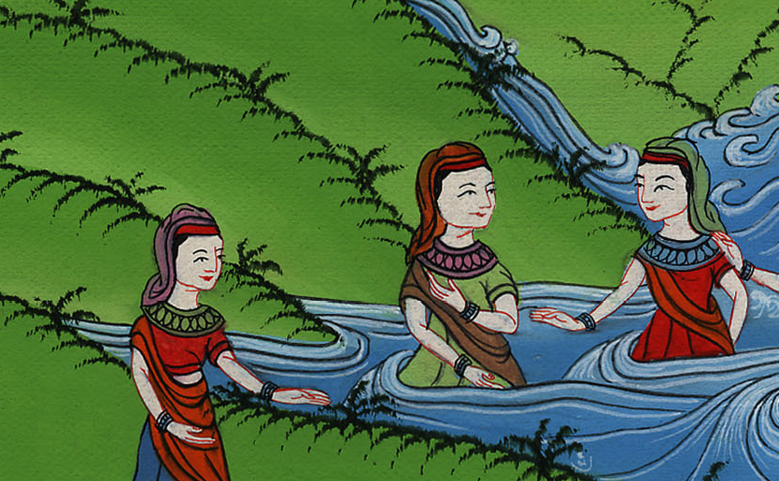
Exodus 2:10

