Slide 1
08-3
This work is licensed under a Creative Commons Attribution 4.0--ShareAlike International License.
Please add this statement to all the videos you create.
English Bible quotes are from the World English Bible US, which is in the public domain.
Notes:
checked

Slide 2
Moses kills an Egyptian – Exodus 2:11-15

Slide 3
Moses kills an Egyptian – Exodus 2:11-15
Notes:
First draft

Slide 4
Moses kills an Egyptian – Exodus 2:11-15

Slide 5
11In those days, when Moses had grown up, he went out to his brothers and saw their burdens. He saw an Egyptian striking a Hebrew, one of his brothers.

Slide 6
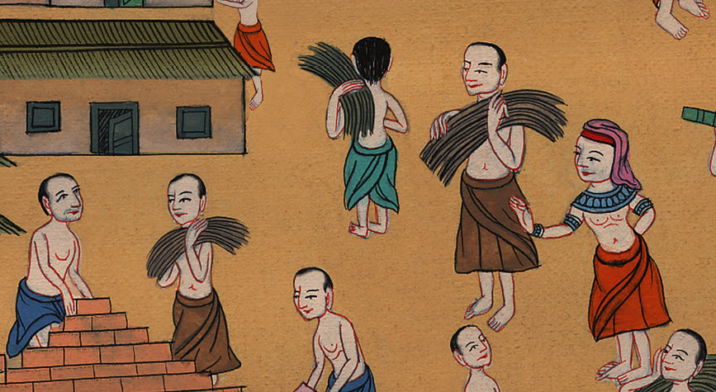
Exodus 2:11

Slide 7
12He looked this way and that way, and when he saw that there was no one, he killed the Egyptian, and hid him in the sand.

Slide 8
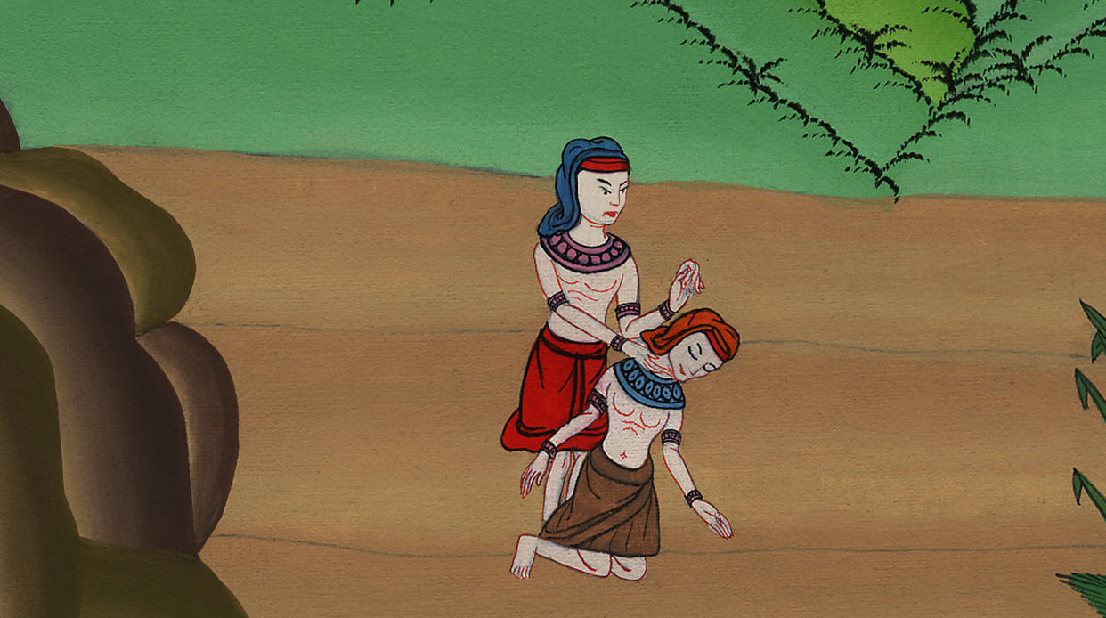
Exodus 2:12

Slide 9
13He went out the second day, and behold, two men of the Hebrews were fighting with each other. He said to him who did the wrong, “Why do you strike your fellow?”

Slide 10
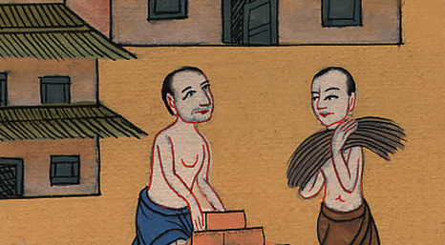
Exodus 2:13

Slide 11
14He said, “Who made you a prince and a judge over us? Do you plan to kill me, as you killed the Egyptian?”
Moses was afraid, and said, “Surely this thing is known.”

Slide 12
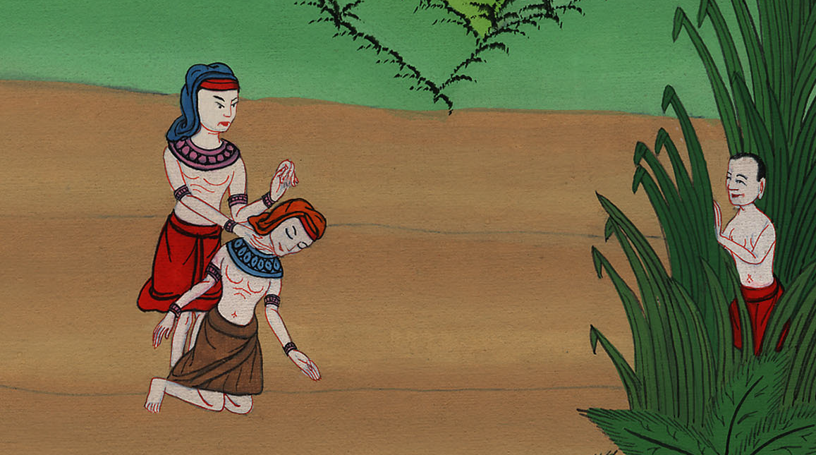
Exodus 2:14

Slide 13
15Now when Pharaoh heard this thing, he sought to kill Moses. But Moses fled from the face of Pharaoh, and lived in the land of Midian, and he sat down by a well.

Slide 14
Exodus 2:15

