Slide 1
08-4
This work is licensed under a Creative Commons Attribution 4.0-ShareAlike International License.
Please add this statement to all the videos you create.
English Bible quotes are from the World English Bible US, which is in the public domain.
Notes:
checked

Slide 2
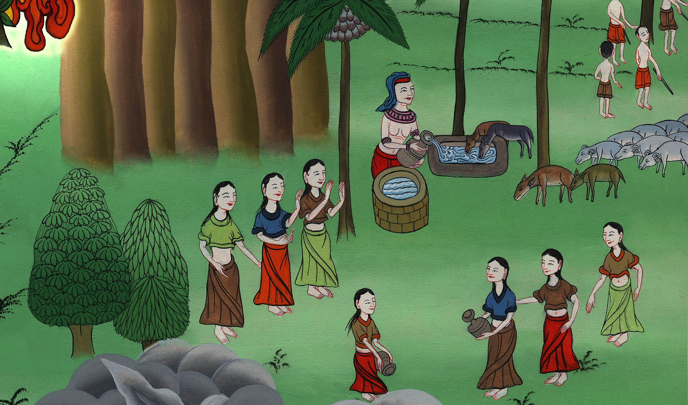
Moses lives with Jethro – Exodus 2:15-22

Slide 3
Moses lives with Jethro – Exodus 2:15-22
Notes:
First draft

Slide 4
Moses lives with Jethro – Exodus 2:15-22

Slide 5
15Now when Pharaoh heard this thing, he sought to kill Moses. But Moses fled from the face of Pharaoh, and lived in the land of Midian, and he sat down by a well.

Slide 6
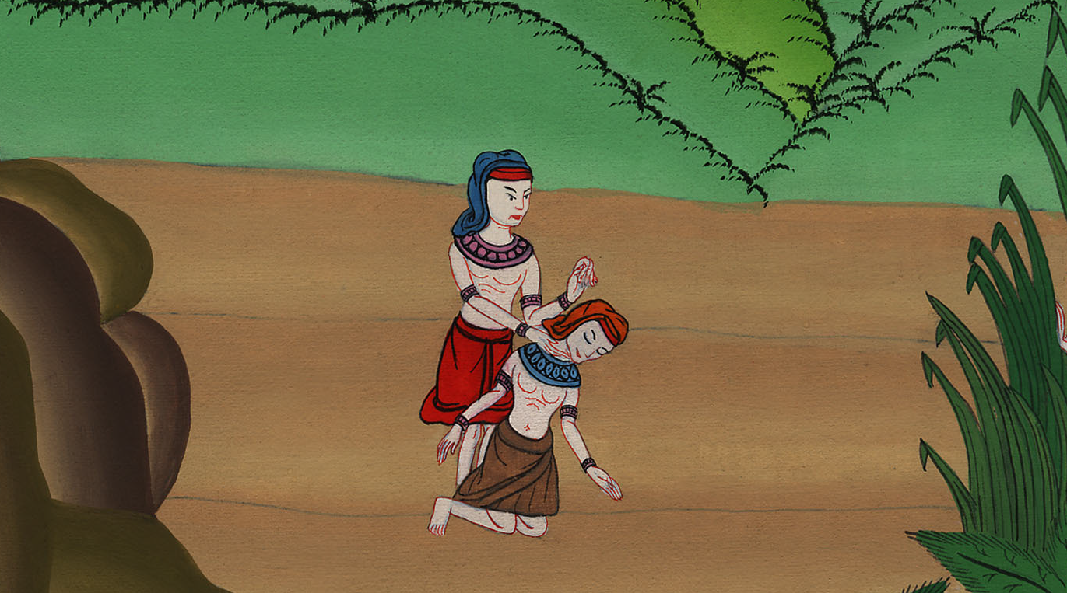
Exodus 2:15

Slide 7
16Now the priest of Midian had seven daughters. They came and drew water, and filled the troughs to water their father’s flock.

Slide 8
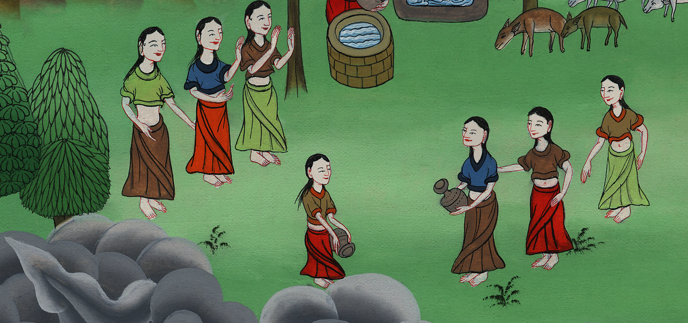
Exodus 2:16

Slide 9
17The shepherds came and drove them away; but Moses stood up and helped them, and watered their flock.

Slide 10
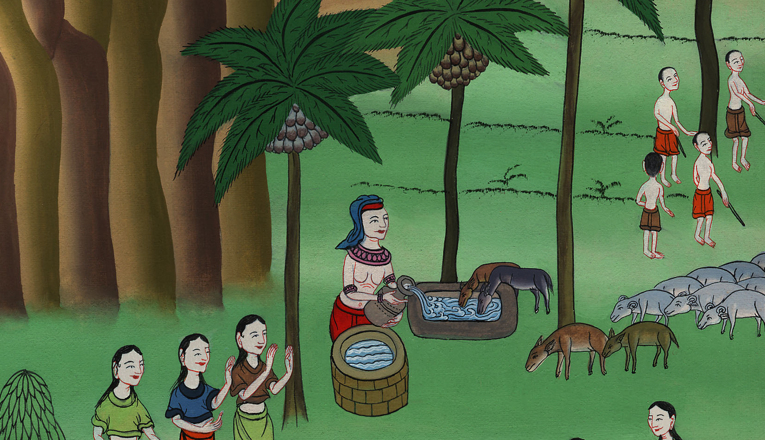
Exodus 2:17

Slide 11
18When they came to Reuel, their father, he said, “How is it that you have returned so early today?”

Slide 12
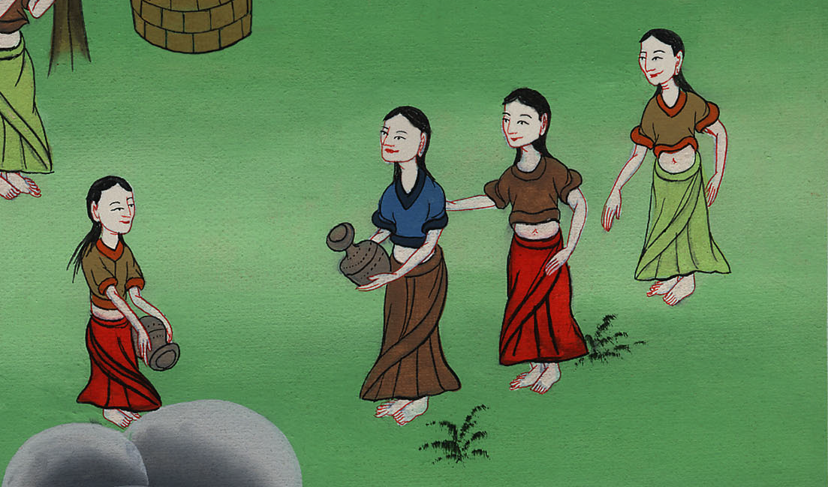
Exodus 2:18

Slide 13
19They said, “An Egyptian delivered us out of the hand of the shepherds, and moreover he drew water for us, and watered the flock.”

Slide 14
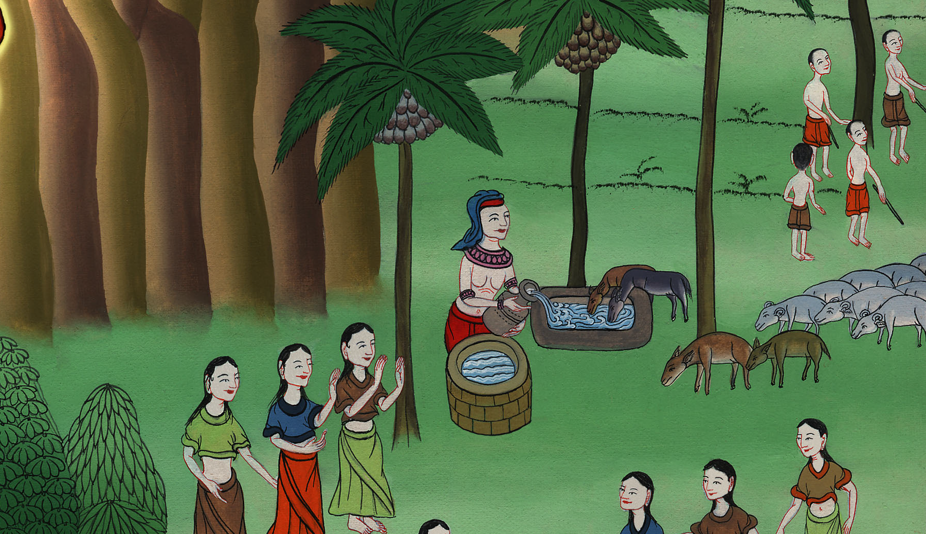
Exodus 2:19

Slide 15
20He said to his daughters, “Where is he? Why is it that you have left the man? Call him, that he may eat bread.”

Slide 16
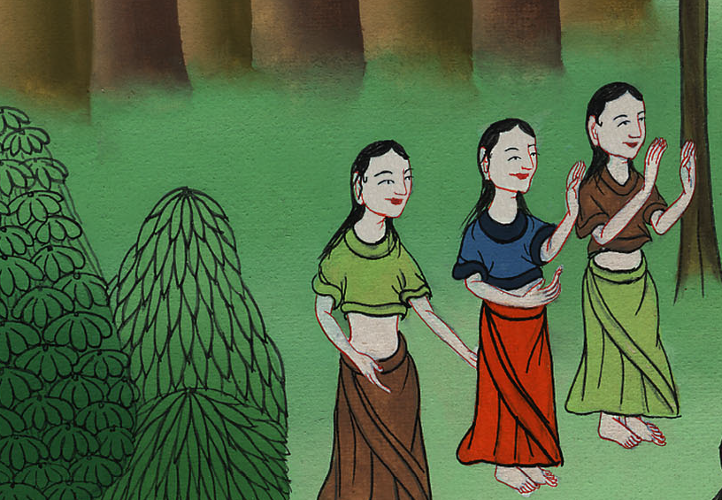
Exodus 2:20

Slide 17
21Moses was content to dwell with the man. He gave Moses Zipporah, his daughter.

Slide 18
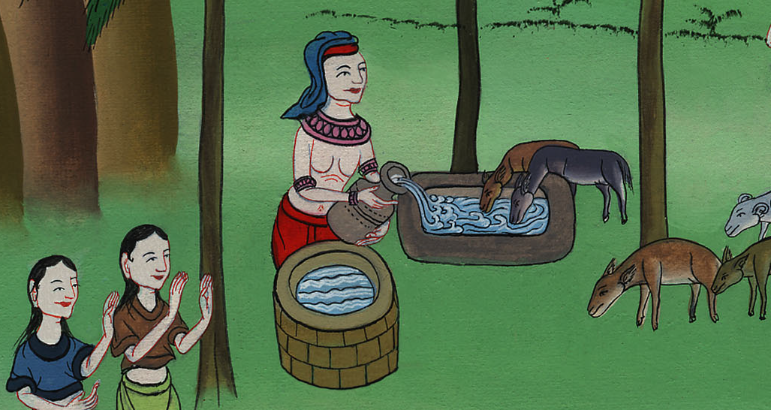
Exodus 2:21

Slide 19
22She bore a son, and he named him Gershom, for he said, “I have lived as a foreigner in a foreign land.”

Slide 20
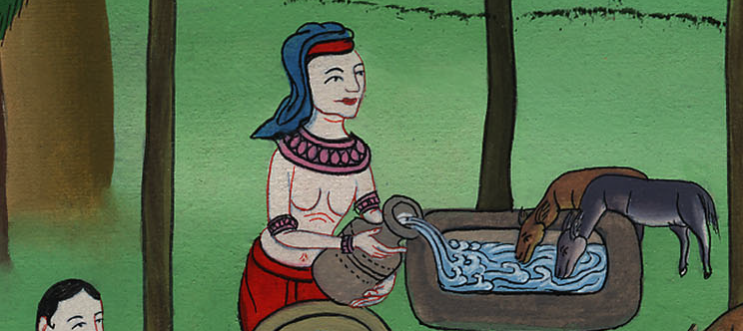
Exodus 2:22

Slide 21
23In the course of those many days, the king of Egypt died, and the children of Israel sighed because of the bondage, and they cried, and their cry came up to God because of the bondage.

Slide 22
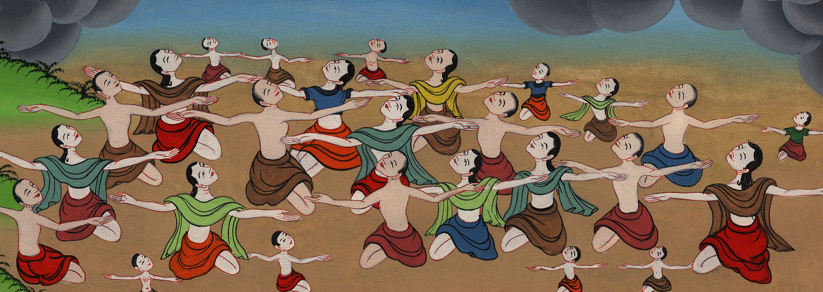
Exodus 2:23

Slide 23
24God heard their groaning, and God remembered his covenant with Abraham, with Isaac, and with Jacob.

Slide 24
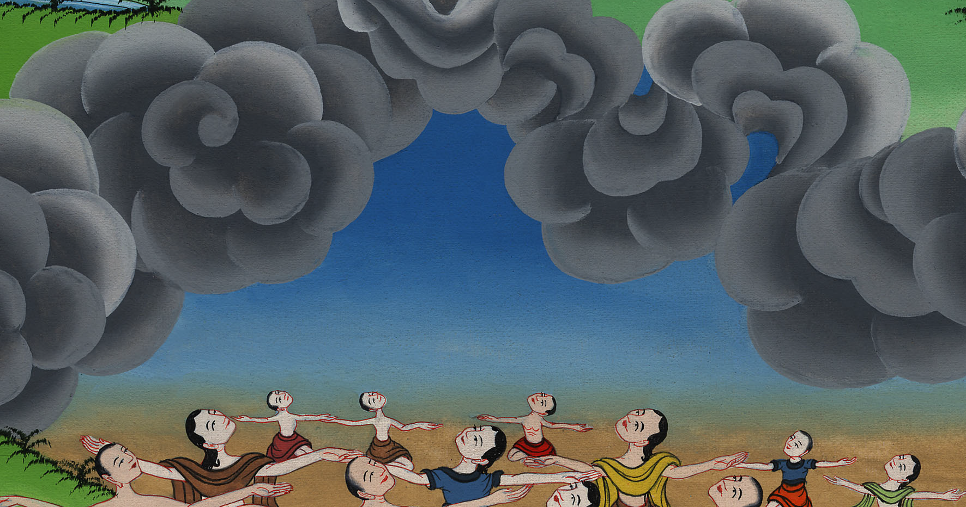
Exodus 2:24

Slide 25
25God saw the children of Israel, and God understood.

Slide 26
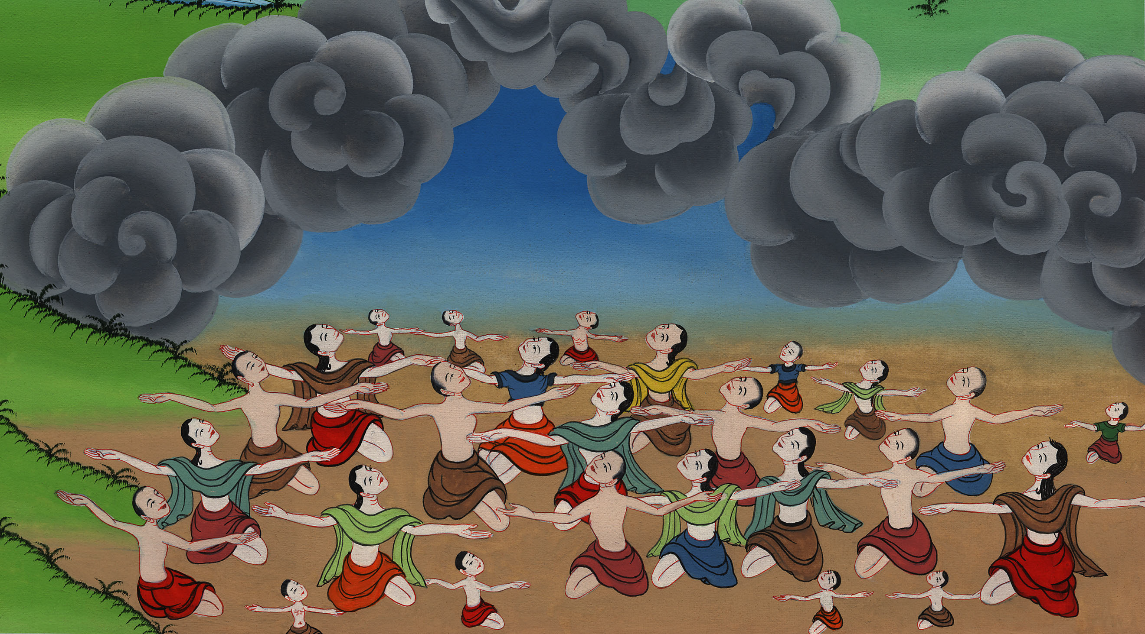
Exodus 2:25

