Slide 1
08-5
This work is licensed under a Creative Commons Attribution 4.0-ShareAlike International License.
Please add this statement to all the videos you create.
English Bible quotes are from the World English Bible US, which is in the public domain.
Notes:
checked

Slide 2
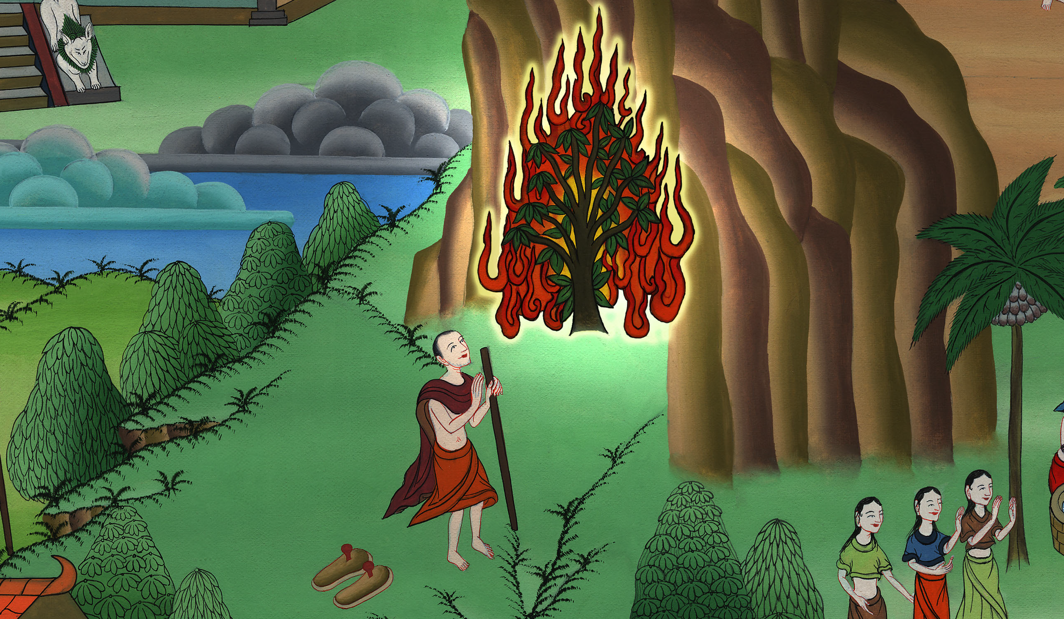
Burning Bush – Exodus 3:1 – 4:17

Slide 3
Burning Bush – Exodus 3:1 – 4:17
Notes:
First draft

Slide 4
Burning Bush – Exodus 3:1 – 4:17

Slide 5
1Now Moses was keeping the flock of Jethro, his father-in-law, the priest of Midian, and he led the flock to the back of the wilderness, and came to God’s mountain, to Horeb.

Slide 6
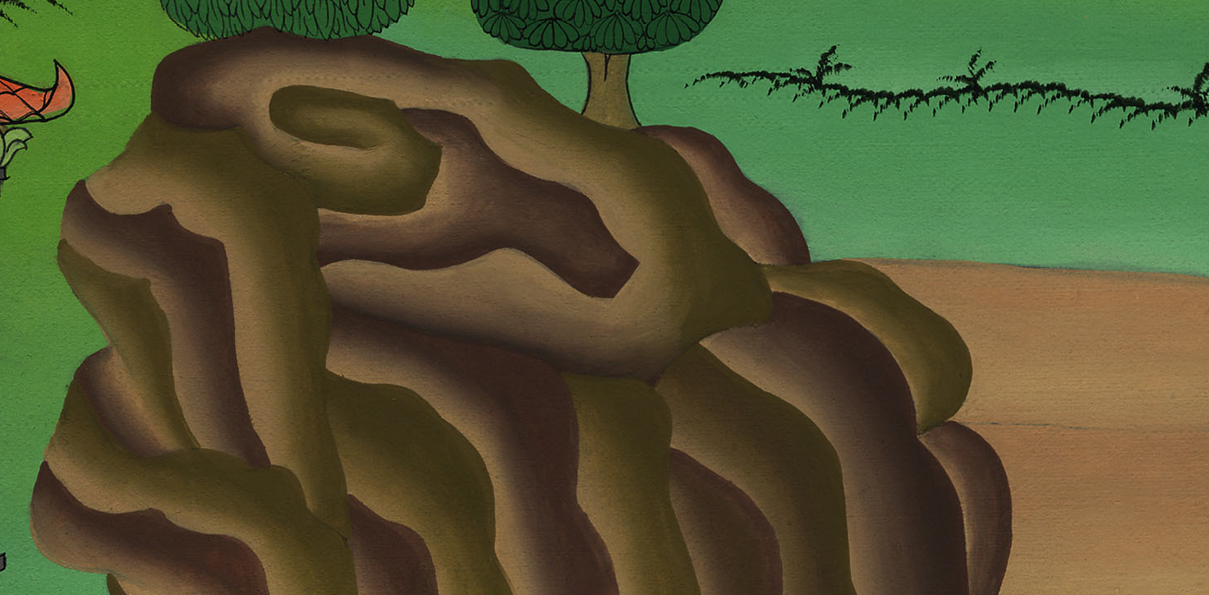
Exodus 3:1

Slide 7
2Yahweh’s angel appeared to him in a flame of fire out of the middle of a bush. He looked, and behold, the bush burned with fire, and the bush was not consumed.

Slide 8
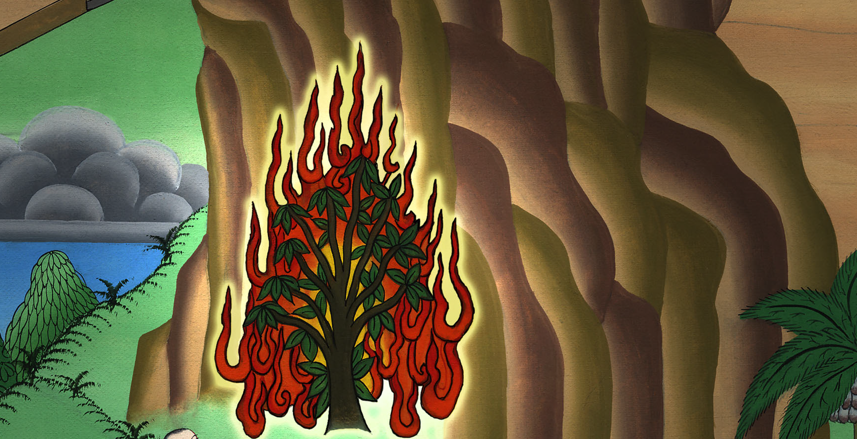
Exodus 3:2

Slide 9
3Moses said, “I will go now, and see this great sight, why the bush is not burned.”

Slide 10
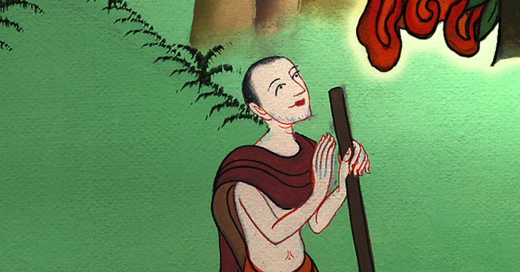
Exodus 3:3

Slide 11
4When Yahweh saw that he came over to see, God called to him out of the middle of the bush, and said, “Moses! Moses!”
He said, “Here I am.”

Slide 12
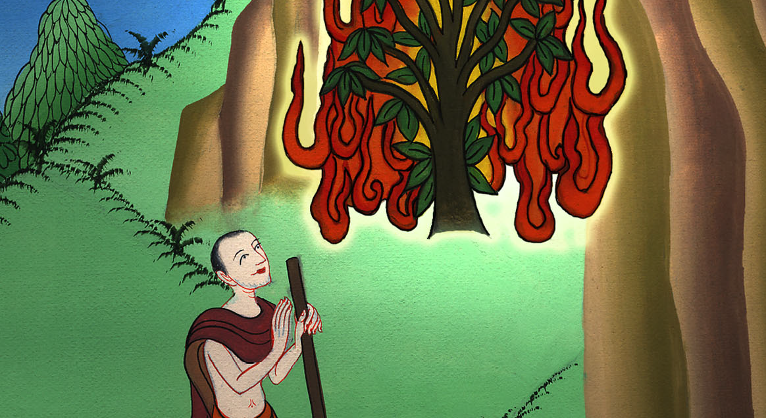
Exodus 3:4

Slide 13
5He said, “Don’t come close. Take off your sandals, for the place you are standing on is holy ground.”

Slide 14
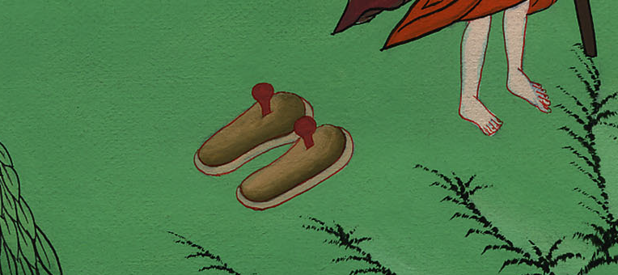
Exodus 3:5

Slide 15
6Moreover he said, “I am the God of your father, the God of Abraham, the God of Isaac, and the God of Jacob.”
Moses hid his face because he was afraid to look at God.

Slide 16
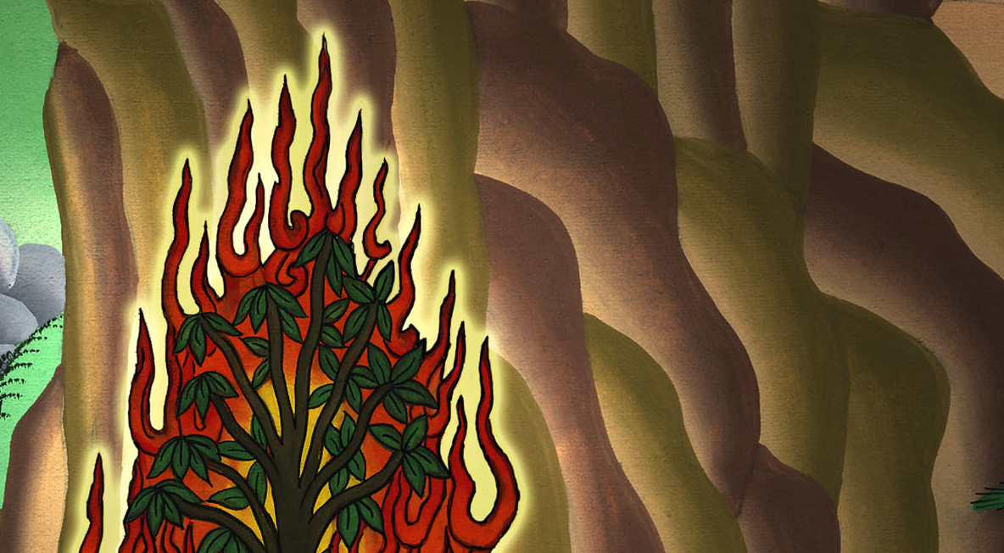
Exodus 3:6

Slide 17
7Yahweh said, “I have surely seen the affliction of my people who are in Egypt, and have heard their cry because of their taskmasters, for I know their sorrows.

Slide 18
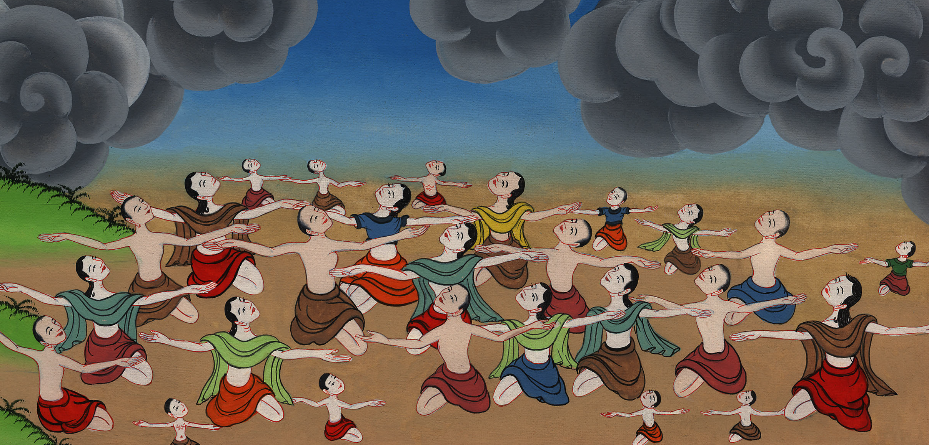
Exodus 3:7

Slide 19
8I have come down to deliver them out of the hand of the Egyptians, and to bring them up out of that land to a good and large land, to a land flowing with milk and honey;….

Slide 20
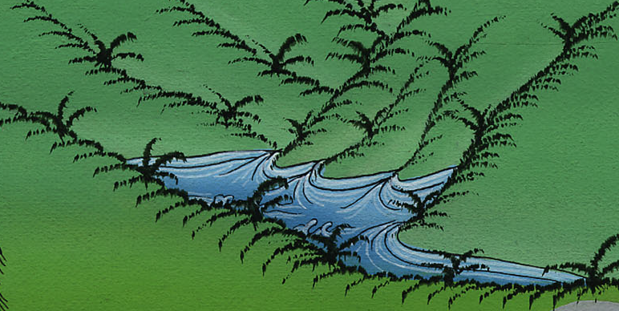
Exodus 3:8

Slide 21
10Come now therefore, and I will send you to Pharaoh, that you may bring my people, the children of Israel, out of Egypt.”

Slide 22
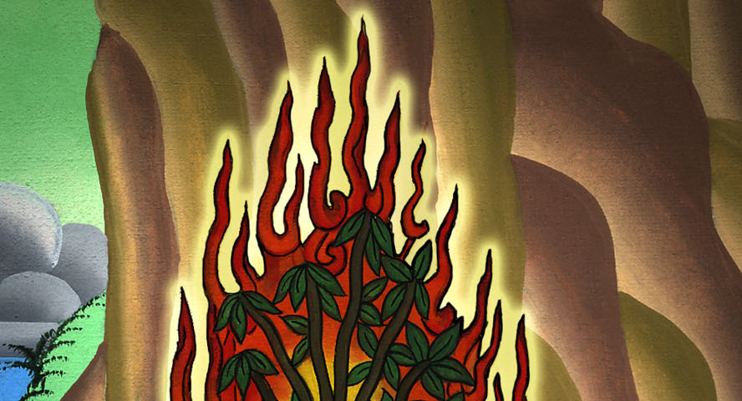
Exodus 3:10

Slide 23
11Moses said to God, “Who am I, that I should go to Pharaoh, and that I should bring the children of Israel out of Egypt?”

Slide 24
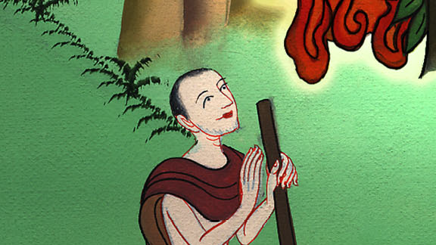
Exodus 3:11

Slide 25
12He said, “Certainly I will be with you. This will be the token to you, that I have sent you: when you have brought the people out of Egypt, you shall serve God on this mountain.”

Slide 26
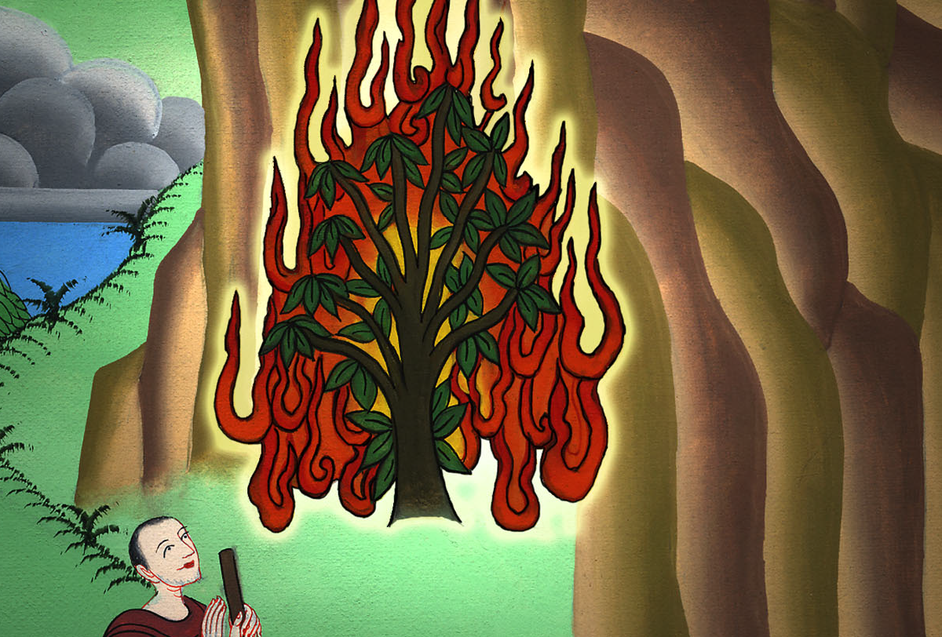
Exodus 3:12

Slide 27
18…You shall come, you and the elders of Israel, to the king of Egypt, and you shall tell him, ‘Yahweh, the God of the Hebrews, has met with us. Now please let us go three days’ journey into the wilderness, that we may sacrifice to Yahweh, our God.’

Slide 28
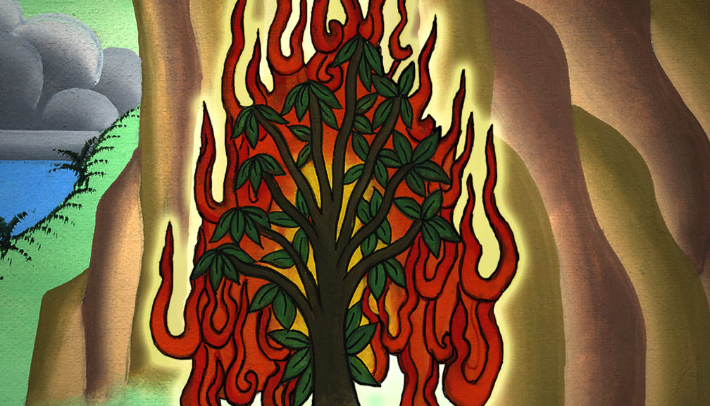
Exodus 3:18

