Slide 1
08-6
This work is licensed under a Creative Commons Attribution-ShareAlike 4.0 International License.
Please add this statement to all the videos you create.
English Bible quotes are from the World English Bible US, which is in the public domain.

Slide 2
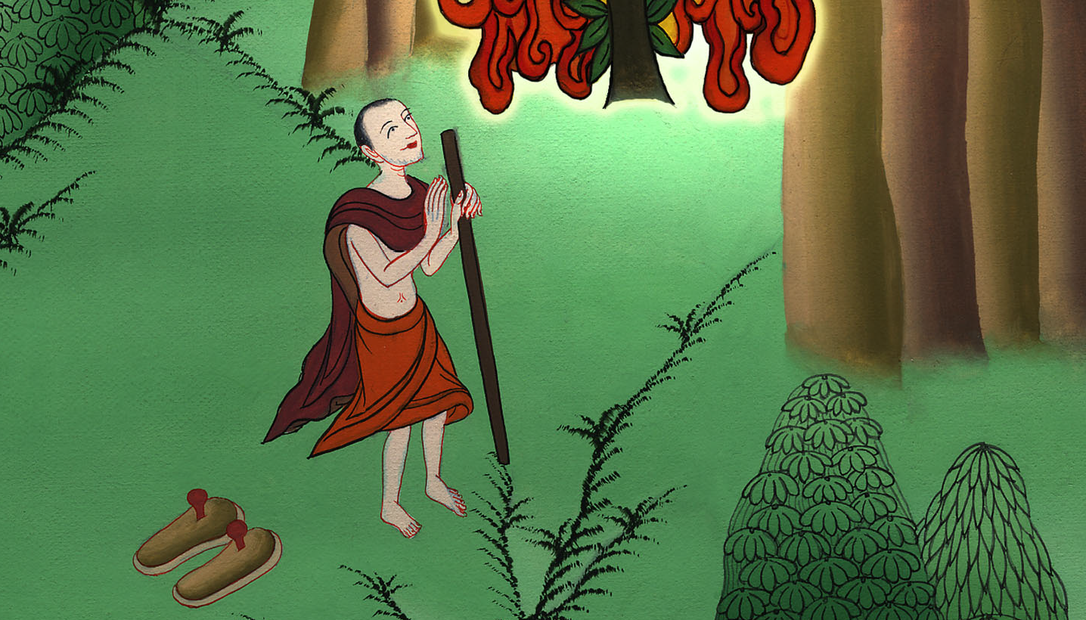
Signs for Moses
to Do –
Exodus 3, 4

Slide 3
Signs for Moses to Do - Exodus 3, 4

Slide 4
Signs for Moses
to Do –
Exodus 3, 4

Slide 5
18…You shall come, you and the elders of Israel, to the king of Egypt, and you shall tell him, ‘Yahweh, the God of the Hebrews, has met with us. Now please let us go three days’ journey into the wilderness, that we may sacrifice to Yahweh, our God.’

Slide 6
Exodus 3:18

Slide 7
19I know that the king of Egypt won’t give you permission to go, no, not by a mighty hand.

Slide 8
Exodus 3:19

Slide 9
20I will reach out my hand and strike Egypt with all my wonders which I will do among them, and after that he will let you go.

Slide 10
Exodus 3:20

Slide 11
2Yahweh said to him, “What is that in your hand?”
He said, “A rod.”

Slide 12
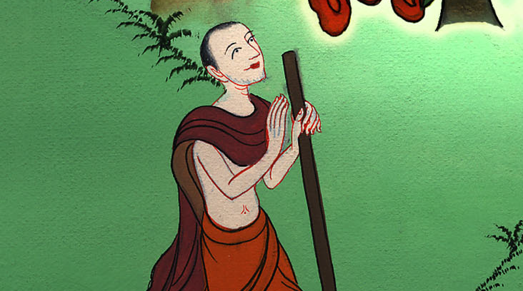
Exodus 4:2

Slide 13
3He said, “Throw it on the ground.”
He threw it on the ground, and it became a snake; and Moses ran away from it.

Slide 14
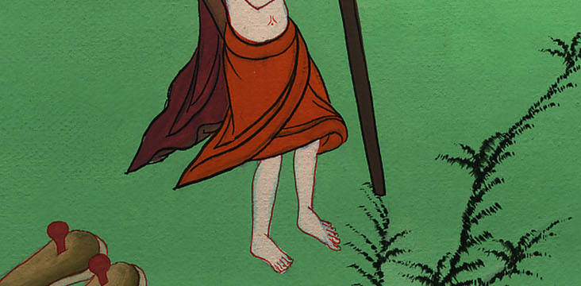
Exodus 4:3

Slide 15
4Yahweh said to Moses, “Stretch out your hand, and take it by the tail.”
He stretched out his hand, and took hold of it, and it became a rod in his hand.

Slide 16
Exodus 4:4

Slide 17
5“This is so that they may believe that Yahweh, the God of their fathers, the God of Abraham, the God of Isaac, and the God of Jacob, has appeared to you.”

Slide 18
Exodus 4:5

Slide 19
6Yahweh said furthermore to him, “Now put your hand inside your cloak.”
He put his hand inside his cloak, and when he took it out, behold, his hand was leprous, as white as snow.

Slide 20
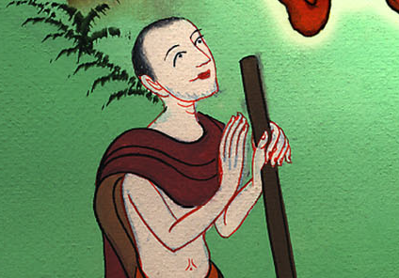
Exodus 4:6

Slide 21
7He said, “Put your hand inside your cloak again.”
He put his hand inside his cloak again, and when he took it out of his cloak, behold, it had turned again as his other flesh.

Slide 22
Exodus 4:7

Slide 23
9It will happen, if they will not believe even these two signs or listen to your voice, that you shall take of the water of the river, and pour it on the dry land. The water which you take out of the river will become blood on the dry land.”

Slide 24
Exodus 4:9

Slide 25
10Moses said to Yahweh, “O Lord, I am not eloquent, neither before now, nor since you have spoken to your servant; for I am slow of speech, and of a slow tongue.”

Slide 26
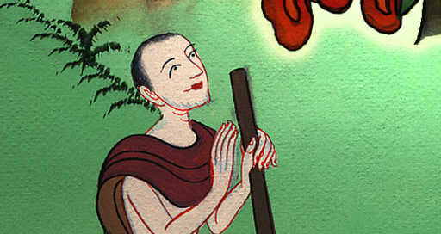
Exodus 4:10

Slide 27
11Yahweh said to him, “Who made man’s mouth? Or who makes one mute, or deaf, or seeing, or blind? Isn’t it I, Yahweh?

Slide 28
Exodus 4:11

Slide 29
12Now therefore go, and I will be with your mouth, and teach you what you shall speak.”
13Moses said, “Oh, Lord, please send someone else.”

Slide 30
Exodus 4:12

Slide 31
14Yahweh’s anger burned against Moses, and he said, “What about Aaron, your brother, the Levite? I know that he can speak well.…

Slide 32
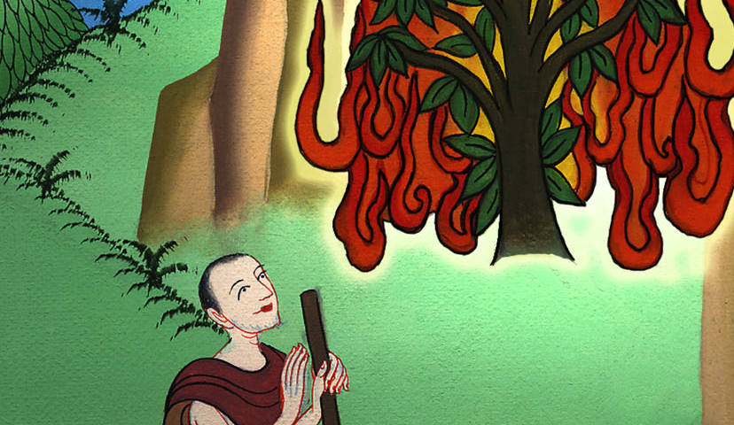
Exodus 4:14

Slide 33
15You shall speak to him, and put the words in his mouth. I will be with your mouth, and with his mouth, and will teach you what you shall do.

Slide 34
Exodus 4:15

Slide 35
17You shall take this rod in your hand, with which you shall do the signs.”

