Slide 1
08-7
This work is licensed under a Creative Commons Attribution-ShareAlike 4.0 International License.
Please add this statement to all the videos you create.
English Bible quotes are from the World English Bible US, which is in the public domain.
Notes:
checked

Slide 2
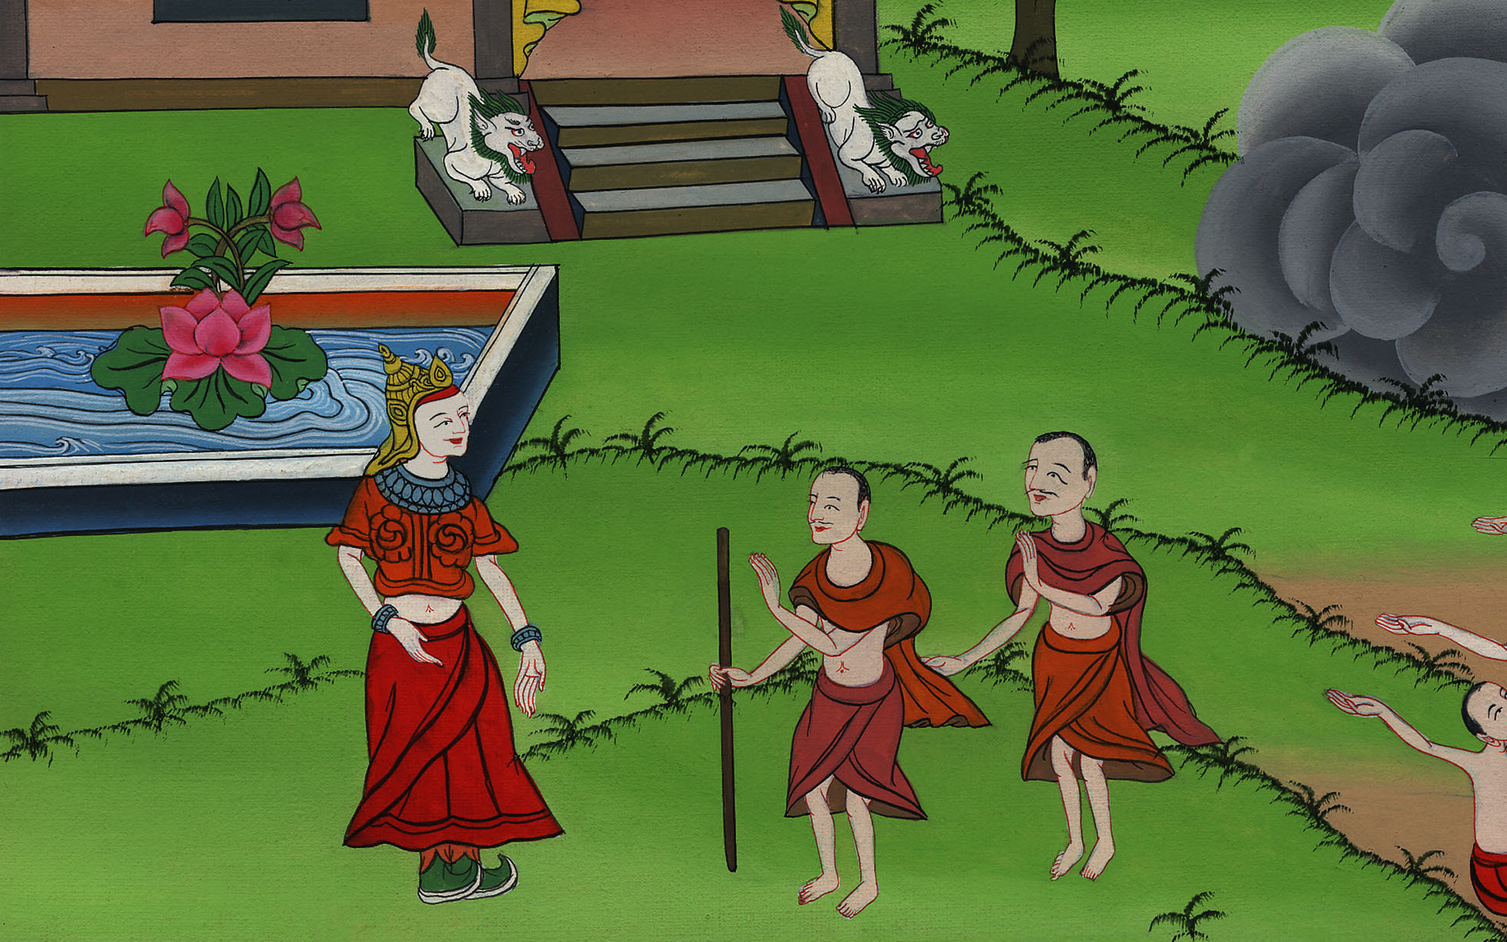
Moses and Aaron meet Pharaoh – Exodus 4:18 – 5:11

Slide 3
Moses and Aaron meet Pharaoh – Exodus 4:18 – 5:11
Notes:
First draft

Slide 4
Moses and Aaron meet Pharaoh – Exodus 4:18 – 5:11

Slide 5
18Moses went and returned to Jethro his father-in-law, and said to him, “Please let me go and return to my brothers who are in Egypt, and see whether they are still alive.”
Jethro said to Moses, “Go in peace.”

Slide 6
Exodus 4:18

Slide 7
20Moses took his wife and his sons, and set them on a donkey, and he returned to the land of Egypt. Moses took God’s rod in his hand.

Slide 8
Exodus 4:20

Slide 9
21Yahweh said to Moses, “When you go back into Egypt, see that you do before Pharaoh all the wonders which I have put in your hand, but I will harden his heart and he will not let the people go.

Slide 10
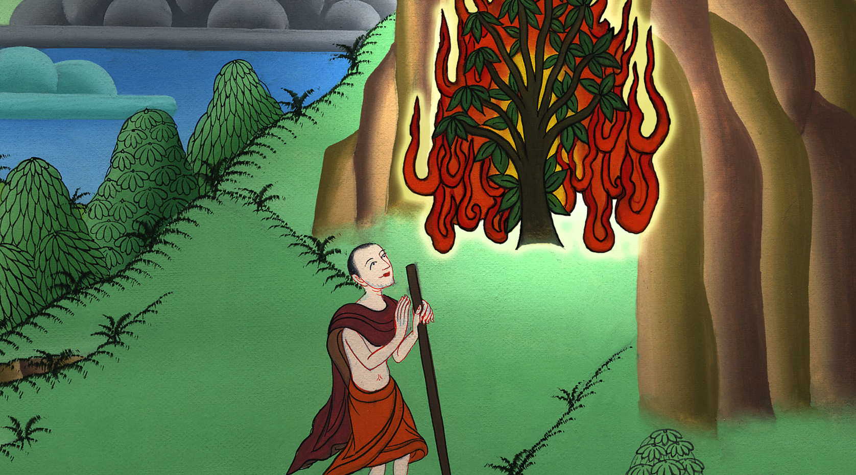
Exodus 4:21

Slide 11
22You shall tell Pharaoh, ‘Yahweh says, Israel is my son, my firstborn, 23and I have said to you, “Let my son go, that he may serve me;” and you have refused to let him go. Behold, I will kill your firstborn son.’”

Slide 12
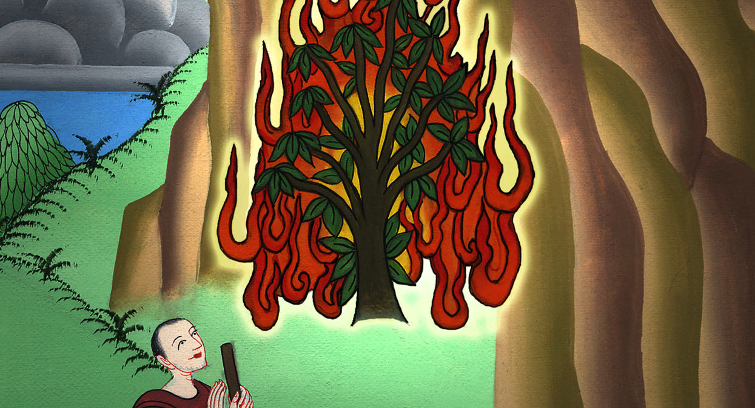
Exodus 4:22

Slide 13
27Yahweh said to Aaron, “Go into the wilderness to meet Moses.”
He went, and met him on God’s mountain, and kissed him.

Slide 14
Exodus 4:27

Slide 15
28Moses told Aaron all Yahweh’s words with which he had sent him, and all the signs with which he had instructed him.

Slide 16
Exodus 4:28

Slide 17
29Moses and Aaron went and gathered together all the elders of the children of Israel.

Slide 18
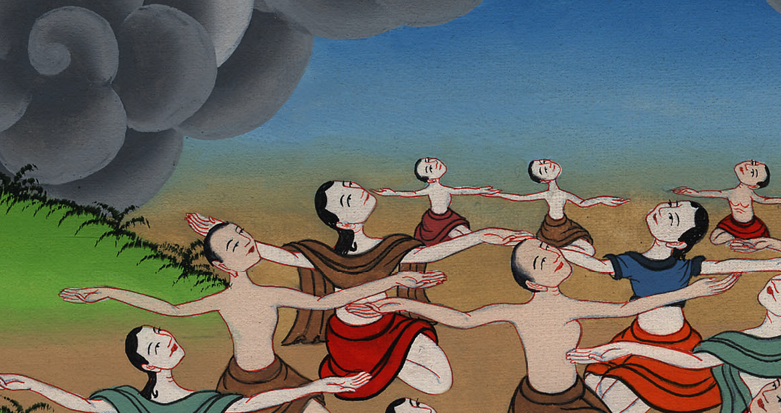
Exodus 4:29

Slide 19
30Aaron spoke all the words which Yahweh had spoken to Moses, and did the signs in the sight of the people.

Slide 20
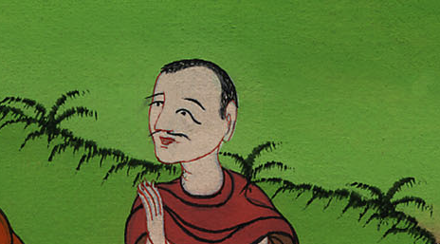
Exodus 4:30

Slide 21
31The people believed, and when they heard that Yahweh had visited the children of Israel, and that he had seen their affliction, then they bowed their heads and worshiped.

Slide 22
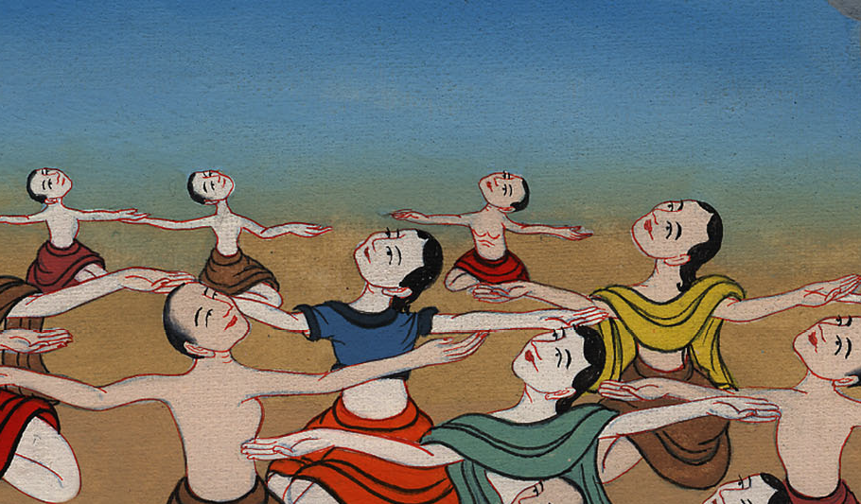
Exodus 4:31

Slide 23
1Afterward Moses and Aaron came, and said to Pharaoh, “This is what Yahweh, the God of Israel, says, ‘Let my people go, that they may hold a feast to me in the wilderness.’”

Slide 24
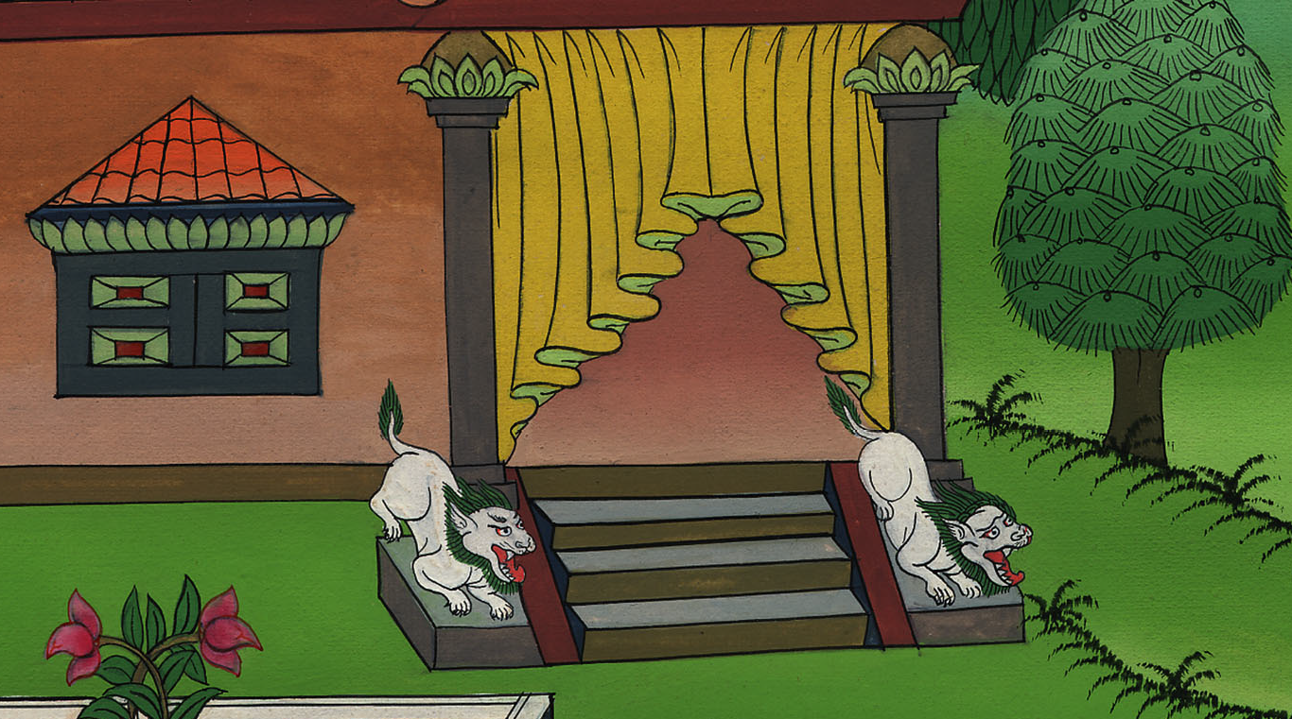
Exodus 5:1

Slide 25
2Pharaoh said, “Who is Yahweh, that I should listen to his voice to let Israel go? I don’t know Yahweh, and moreover I will not let Israel go.”

Slide 26
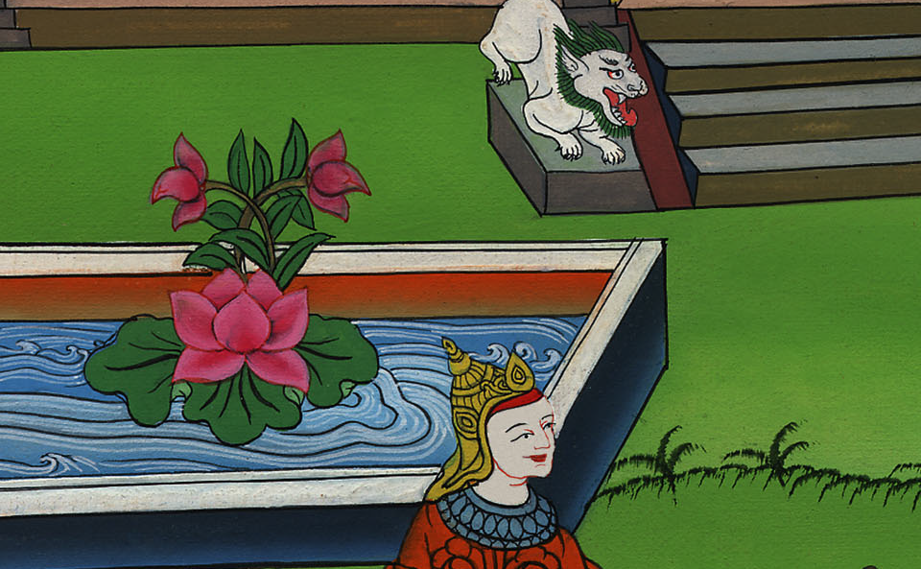
Exodus 5:2

Slide 27
3They said, “The God of the Hebrews has met with us. Please let us go three days’ journey into the wilderness, and sacrifice to Yahweh, our God, lest he fall on us with pestilence, or with the sword.”

Slide 28
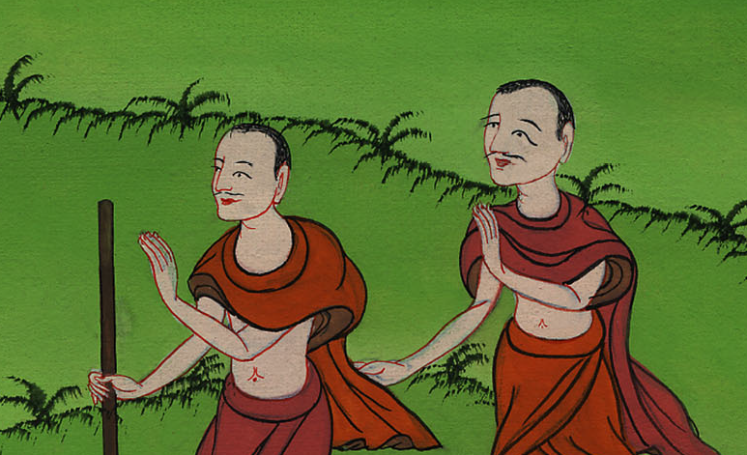
Exodus 5:3

Slide 29
4The king of Egypt said to them, “Why do you, Moses and Aaron, take the people from their work? Get back to your burdens!”

Slide 30
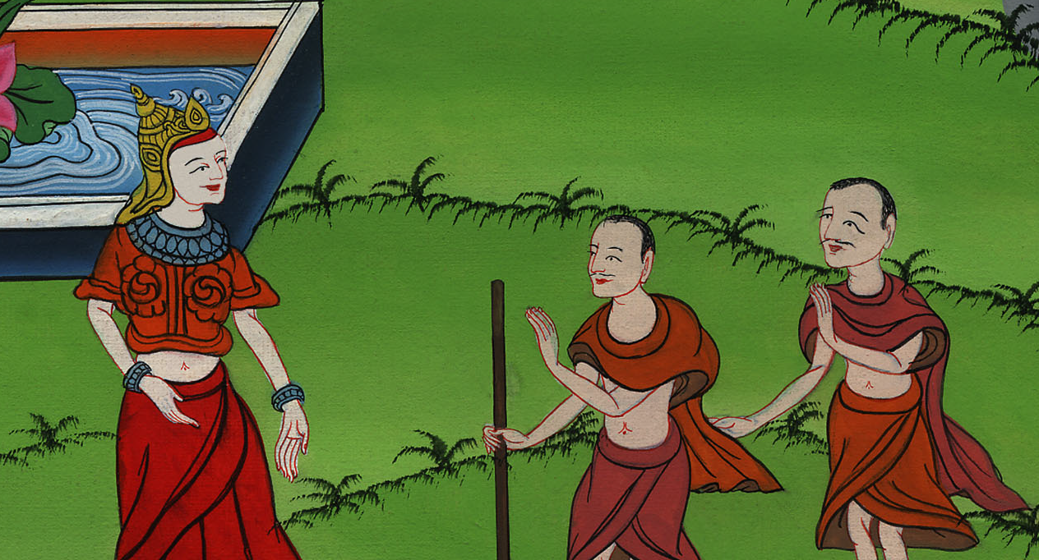
Exodus 5:4

Slide 31
6The same day Pharaoh commanded the taskmasters of the people and their officers, saying,

Slide 32
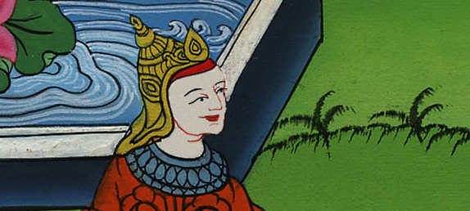
Exodus 5:6

Slide 33
7“You shall no longer give the people straw to make brick, as before. Let them go and gather straw for themselves.

Slide 34
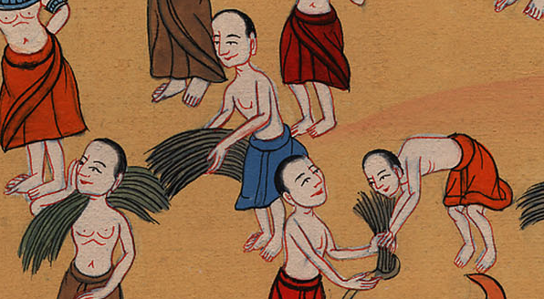
Exodus 5:7

Slide 35
8You shall require from them the number of the bricks which they made before. You shall not diminish anything of it, for they are idle. Therefore they cry, saying, ‘Let’s go and sacrifice to our God.’

Slide 36
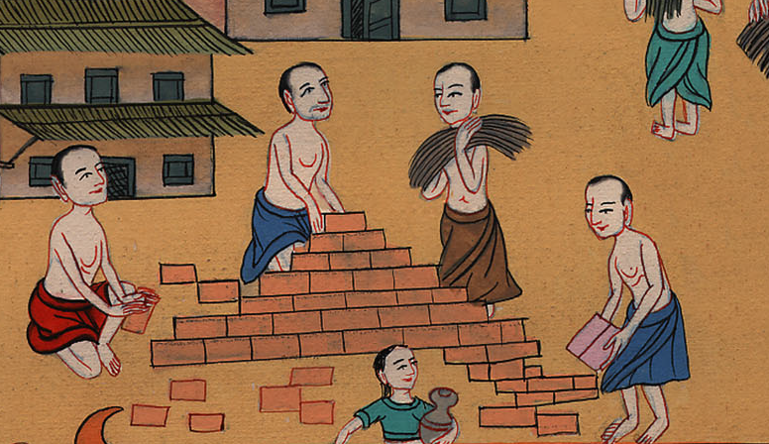
Exodus 5:8

