Slide 1
08-8
This work is licensed under a Creative Commons Attribution-ShareAlike 4.0 International License.
Please add this statement to all the videos you create.
English Bible quotes are from the World English Bible US, which is in the public domain.
Notes:
Checked. Vs7 nb

Slide 2
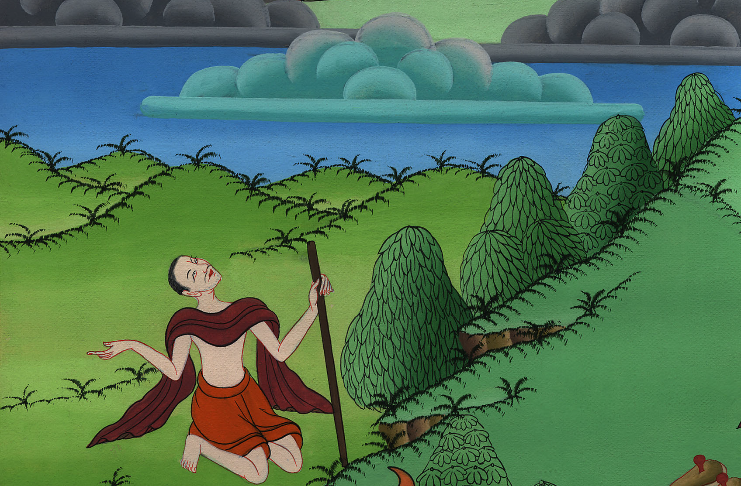
Moses questions God – Exodus 5:12 – 6:30

Slide 3
Moses questions God – Exodus 5:12 – 6:30
Notes:
First draft

Slide 4
Moses questions God – Exodus 5:10 – 6:30

Slide 5
10The taskmasters of the people went out with their officers, and they spoke to the people, saying, “This is what Pharaoh says: ‘I will not give you straw.

Slide 6
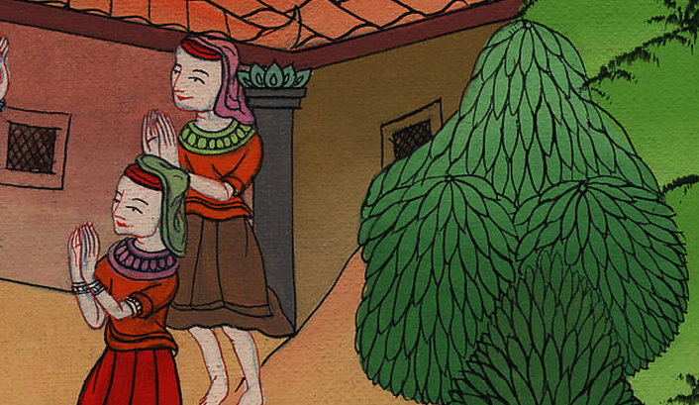
Exodus 5:10

Slide 7
12So the people were scattered abroad throughout all the land of Egypt to gather stubble for straw.

Slide 8
Exodus 5:12

Slide 9
13The taskmasters were urgent saying, “Fulfill your work quota daily, as when there was straw!”

Slide 10
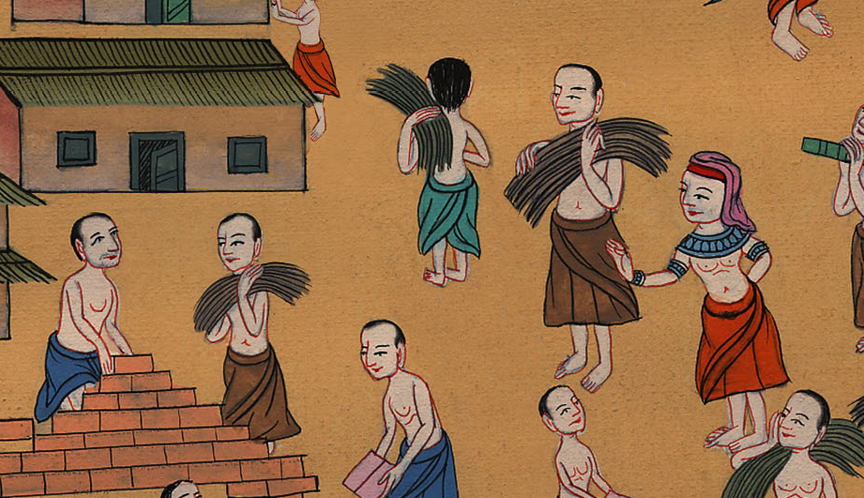
Exodus 5:13

Slide 11
14The officers of the children of Israel, whom Pharaoh’s taskmasters had set over them, were beaten, and were asked, “Why haven’t you fulfilled your quota both yesterday and today, in making brick as before?”

Slide 12
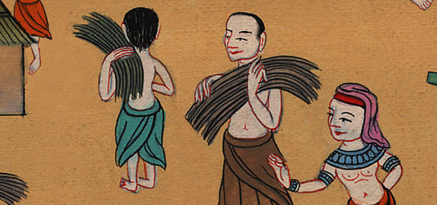
Exodus 5:14

Slide 13
22Moses returned to Yahweh, and said, “Lord, why have you brought trouble on this people? Why is it that you have sent me?

Slide 14
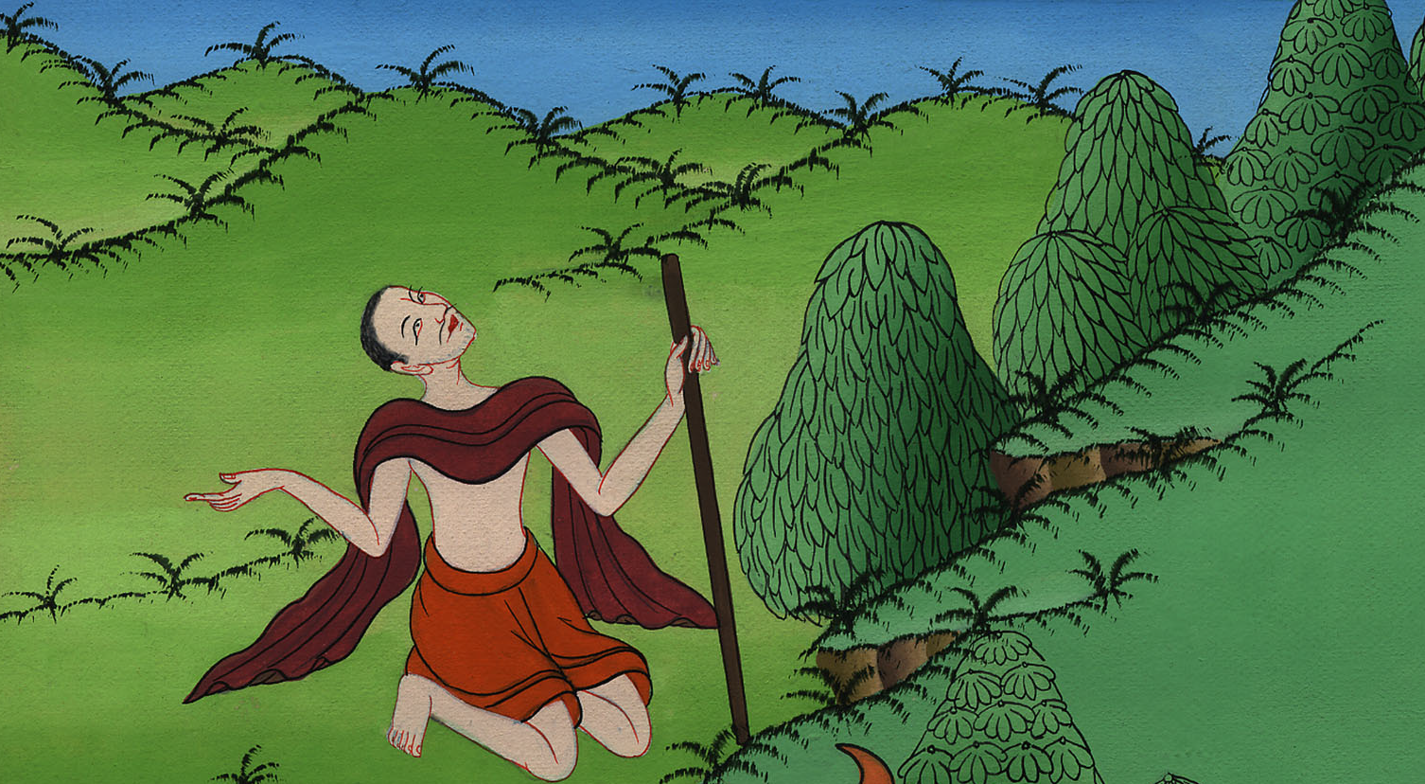
Exodus 5:22

Slide 15
1Yahweh said to Moses, “Now you shall see what I will do to Pharaoh, for by a strong hand he shall let them go, and by a strong hand he shall drive them out of his land.”

Slide 16
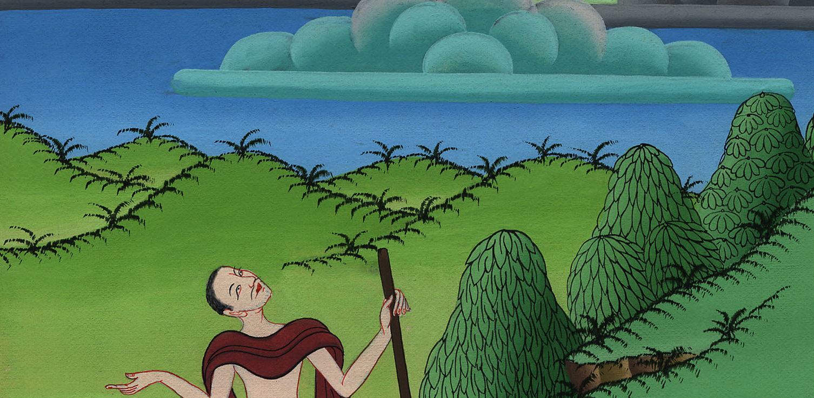
Exodus 6:1

Slide 17
2God spoke to Moses, and said to him, “I am Yahweh. 3I appeared to Abraham, to Isaac, and to Jacob, as God Almighty; but by my name Yahweh I was not known to them.

Slide 18
Exodus 6:2,3

Slide 19
4I have also established my covenant with them, to give them the land of Canaan, the land of their travels, in which they lived as aliens.

Slide 20
Exodus 6:4

Slide 21
6Therefore tell the children of Israel, ‘I am Yahweh, and I will bring you out from under the burdens of the Egyptians, and I will rid you out of their bondage, and I will redeem you with an outstretched arm, and with great judgments.

Slide 22
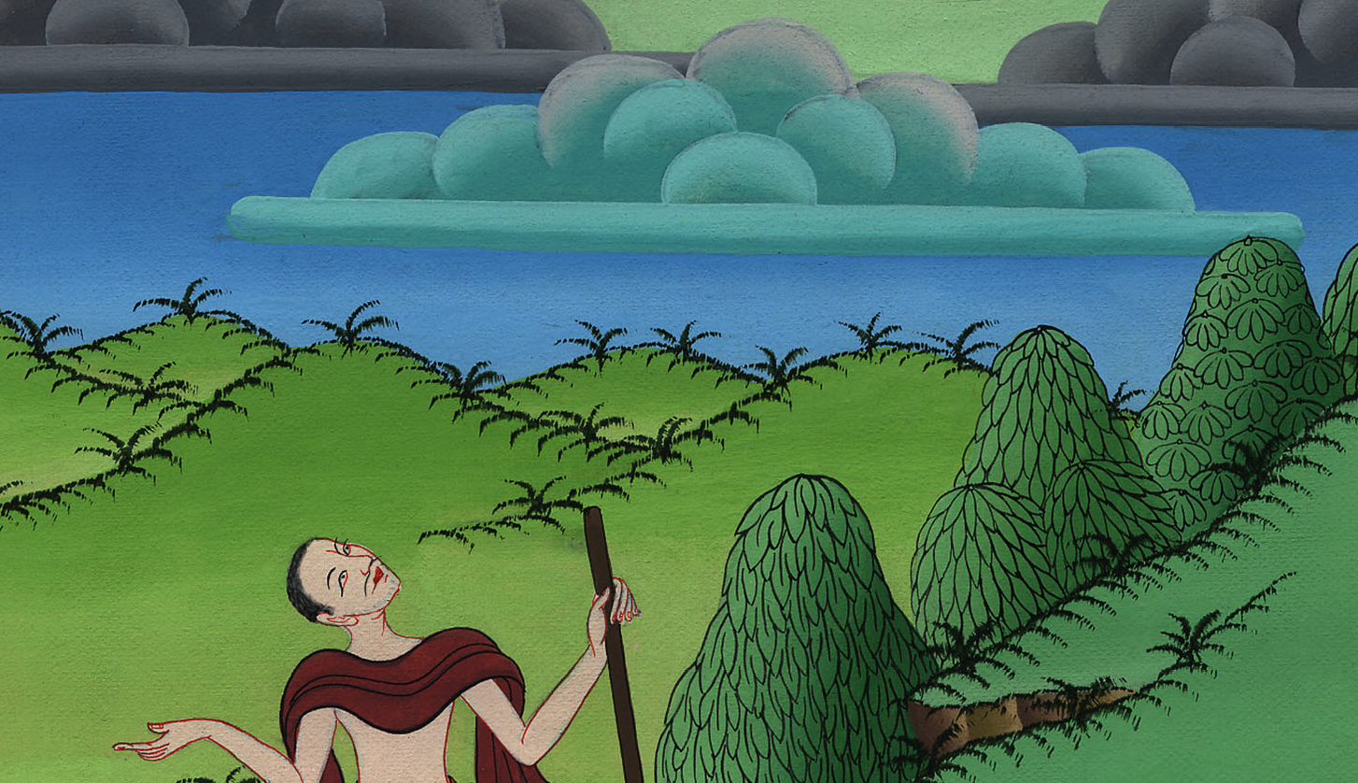
Exodus 6:6

Slide 23
7I will take you to myself for a people. I will be your God; and you shall know that I am Yahweh your God, who brings you out from under the burdens of the Egyptians.

Slide 24
Exodus 6:7

Slide 25
9Moses spoke so to the children of Israel, but they didn’t listen to Moses for anguish of spirit, and for cruel bondage.

Slide 26
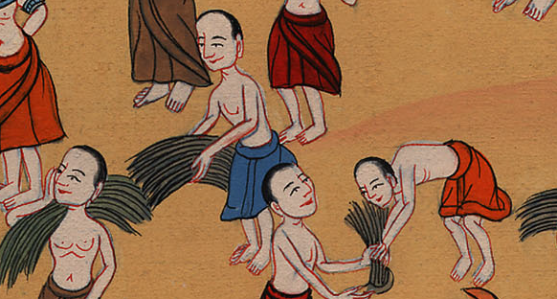
Exodus 6:9

Slide 27
10Yahweh spoke to Moses, saying, 11“Go in, speak to Pharaoh king of Egypt, that he let the children of Israel go out of his land.”

Slide 28
Exodus 6:10

