Slide 1
09-1
This work is licensed under a Creative Commons Attribution-ShareAlike 4.0 International License.
Please add this statement to all the videos you create.
English Bible quotes are from the World English Bible US, which is in the public domain.
Notes:
checked

Slide 2
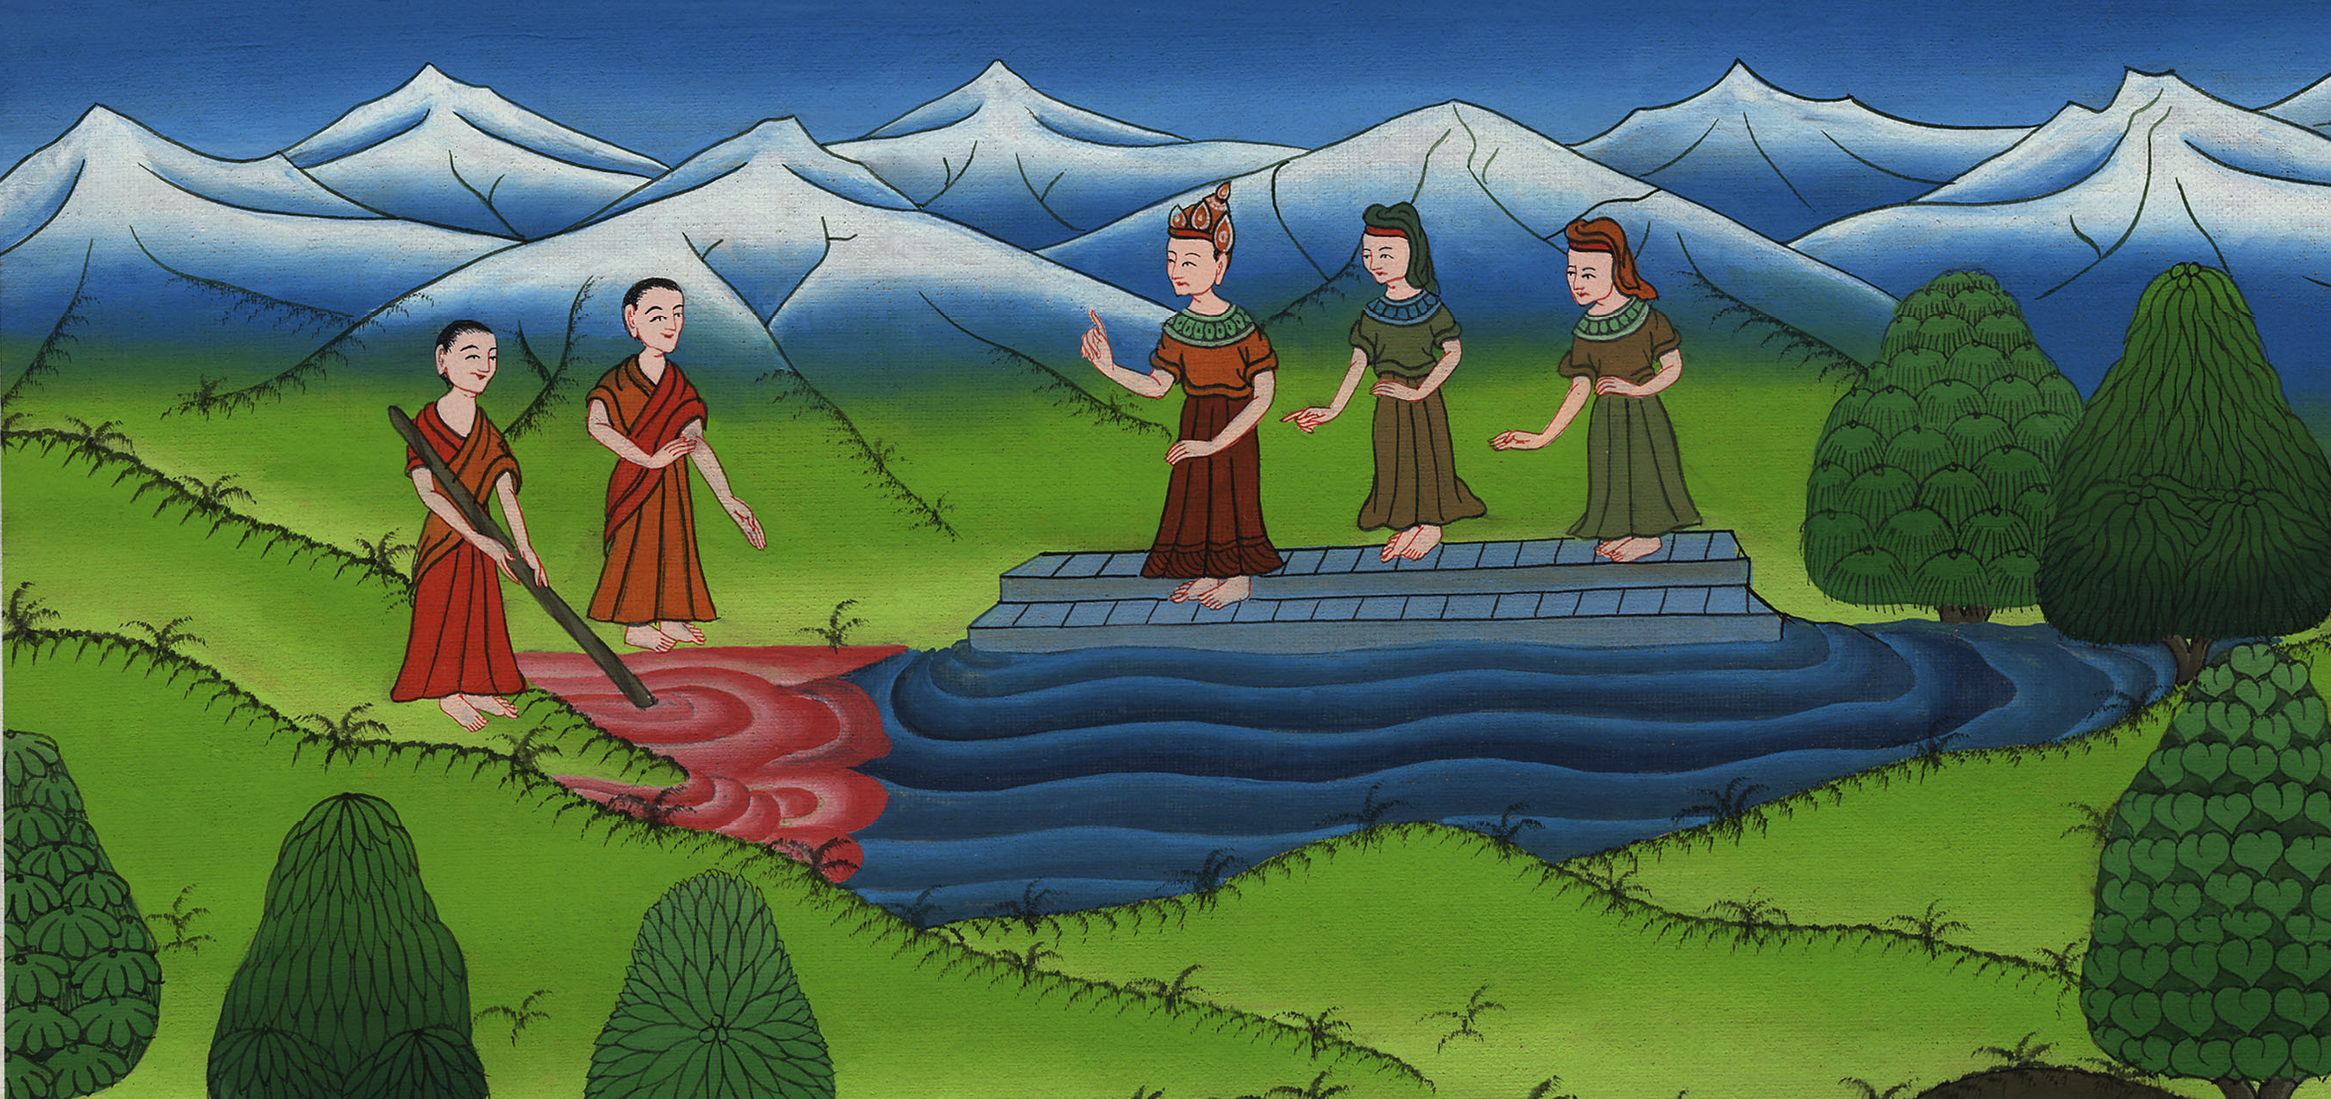
Water to Blood – Exodus 7:14-25

Slide 3
Water to Blood – Exodus 7:14-25
Notes:
First draft

Slide 4
Water to Blood – Exodus 7:14-25

Slide 5
14Yahweh said to Moses, “Pharaoh’s heart is stubborn. He refuses to let the people go.

Slide 6
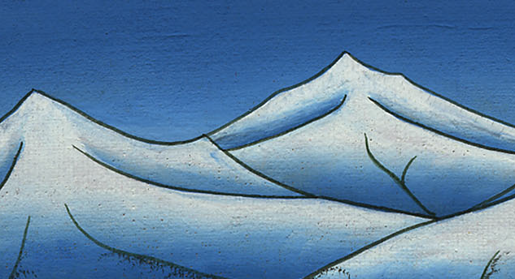
Exodus 7:14

Slide 7
15Go to Pharaoh in the morning. Behold, he is going out to the water. You shall stand by the river’s bank to meet him. You shall take the rod which was turned to a serpent in your hand.

Slide 8
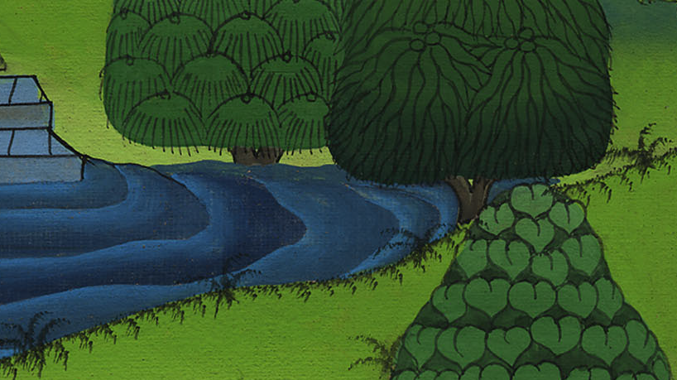
Exodus 7:15

Slide 9
16You shall tell him, ‘Yahweh, the God of the Hebrews, has sent me to you, saying, “Let my people go, that they may serve me in the wilderness. Behold, until now you haven’t listened.”

Slide 10
Exodus 7:16

Slide 11
17Yahweh says, “In this you shall know that I am Yahweh. Behold: I will strike with the rod that is in my hand on the waters which are in the river, and they shall be turned to blood.

Slide 12
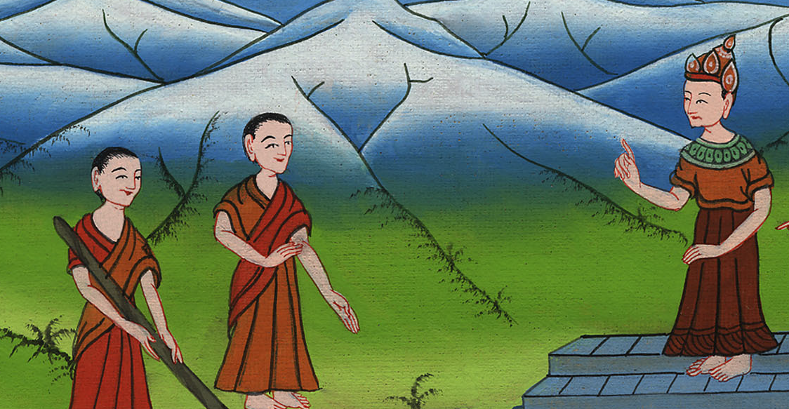
Exodus 7:17

Slide 13
18The fish that are in the river will die and the river will become foul. The Egyptians will loathe to drink water from the river.”’”

Slide 14
Exodus 7:18

Slide 15
19Yahweh said to Moses, “Tell Aaron, ‘Take your rod, and stretch out your hand over the waters of Egypt, over their rivers, over their streams, and over their pools, and over all their ponds of water, that they may become blood. There will be blood throughout all the land of Egypt, both in vessels of wood and in vessels of stone.’”

Slide 16
Exodus 7:19

Slide 17
20Moses and Aaron did so, as Yahweh commanded; and he lifted up the rod, and struck the waters that were in the river, in the sight of Pharaoh, and in the sight of his servants; and all the waters that were in the river were turned to blood.

Slide 18
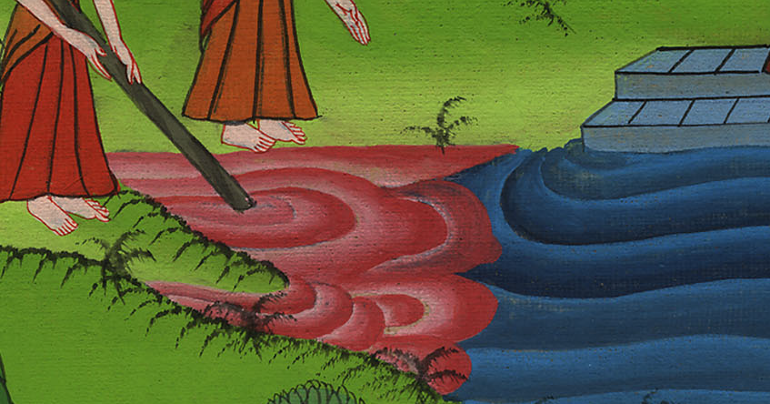
Exodus 7:20

Slide 19
21The fish that were in the river died. The river became foul. The Egyptians couldn’t drink water from the river. The blood was throughout all the land of Egypt.

Slide 20
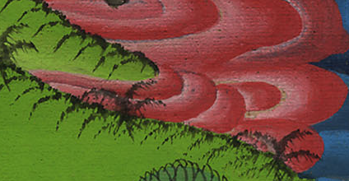
Exodus 7:21

Slide 21
22The magicians of Egypt did the same thing with their enchantments. So Pharaoh’s heart was hardened, and he didn’t listen to them, as Yahweh had spoken.

Slide 22
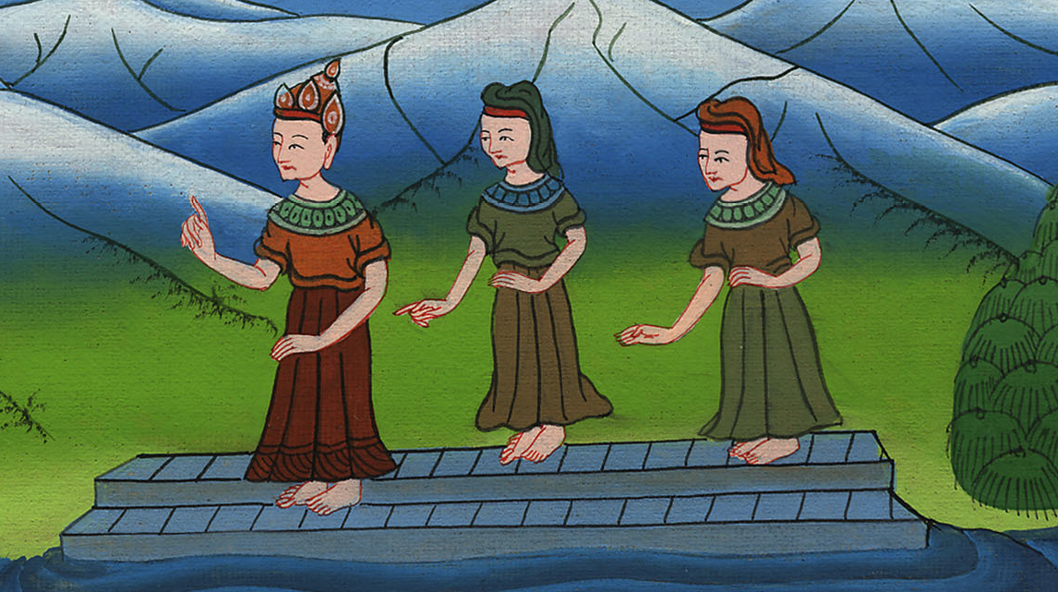
Exodus 7:22

Slide 23
23Pharaoh turned and went into his house, and he didn’t even take this to heart.

Slide 24
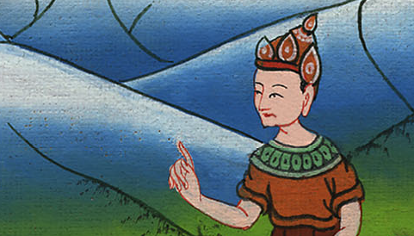
Exodus 7:23

