Slide 1
09-10
This work is licensed under a Creative Commons Attribution-ShareAlike 4.0 International License.
Please add this statement to all the videos you create.
English Bible quotes are from the World English Bible US, which is in the public domain.

Slide 2
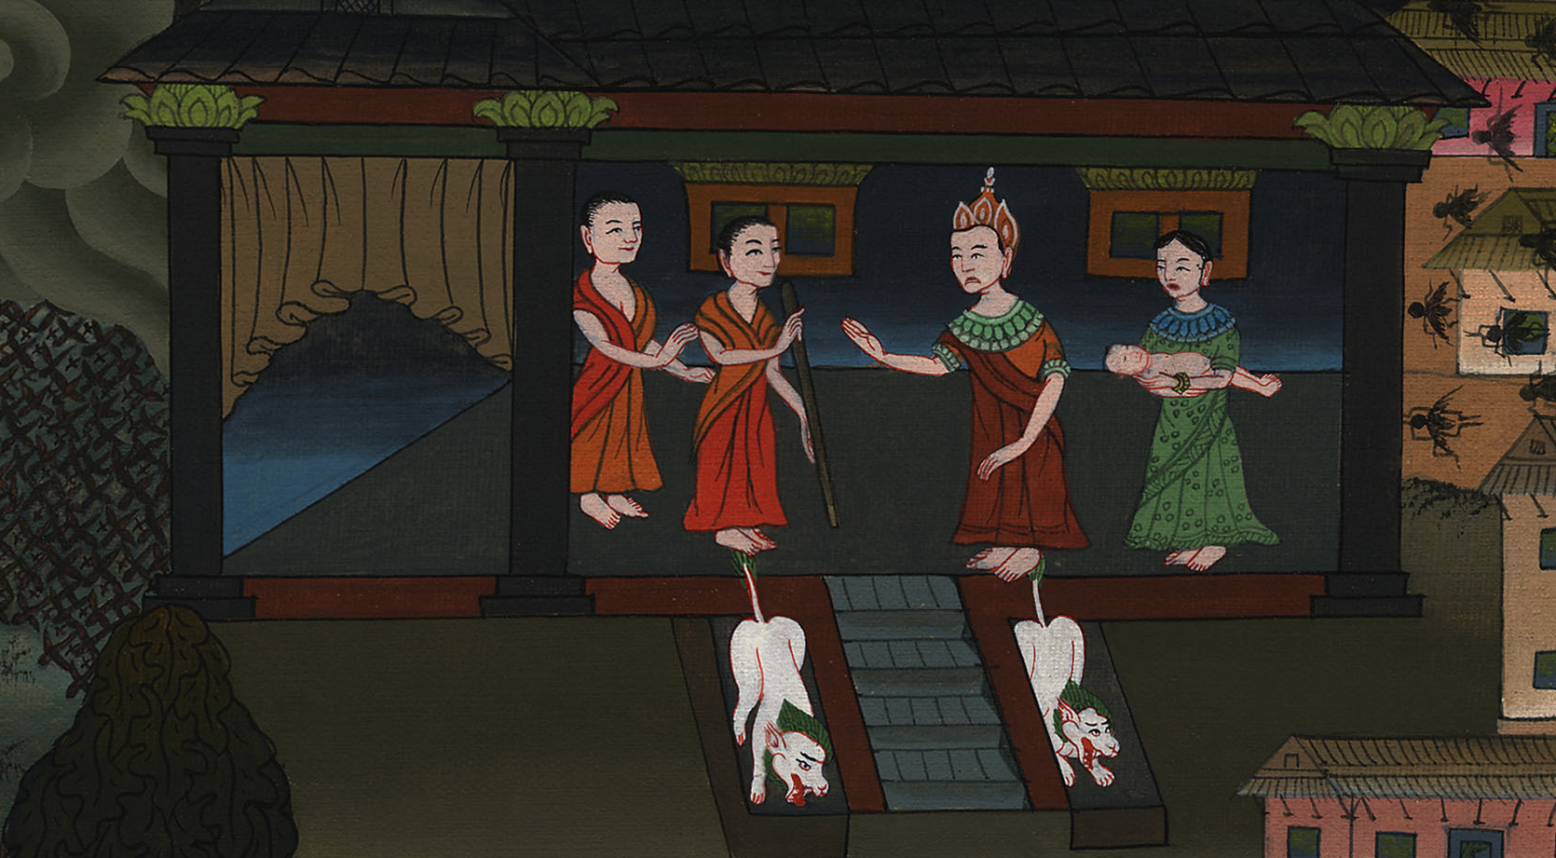
Death of eldest son announced – Exodus 11:1-10

Slide 3
Death of eldest son announced – Exodus 11:1-10
Notes:
First draft

Slide 4
Death of eldest son announced – Exodus 11:1-10

Slide 5
1Yahweh said to Moses, “I will bring yet one more plague on Pharaoh, and on Egypt; afterwards he will let you go. When he lets you go, he will surely thrust you out altogether.

Slide 6
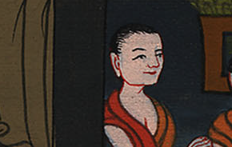
Exodus 11:1

Slide 7
2Speak now in the ears of the people, and let every man ask of his neighbor, and every woman of her neighbor, jewels of silver, and jewels of gold.”

Slide 8
Exodus 11:2

Slide 9
3Yahweh gave the people favor in the sight of the Egyptians. Moreover, the man Moses was very great in the land of Egypt, in the sight of Pharaoh’s servants, and in the sight of the people.

Slide 10
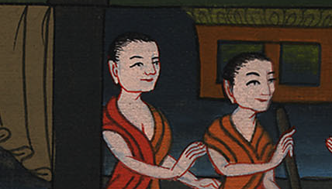
Exodus 11:3

Slide 11
4Moses said, “This is what Yahweh says: ‘About midnight I will go out into the middle of Egypt,

Slide 12
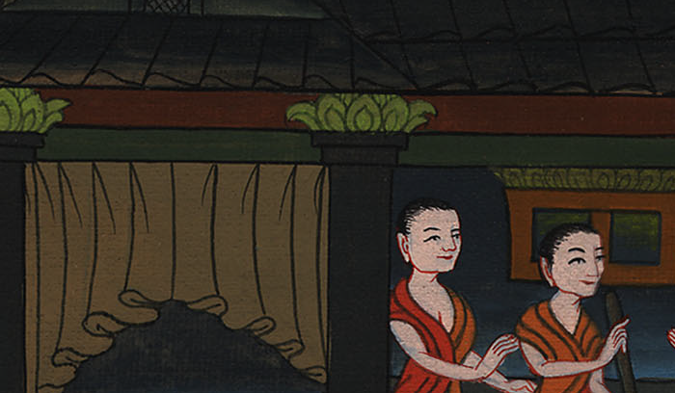
Exodus 11:4

Slide 13
5and all the firstborn in the land of Egypt shall die, from the firstborn of Pharaoh who sits on his throne, even to the firstborn of the female servant who is behind the mill, and all the firstborn of livestock.

Slide 14
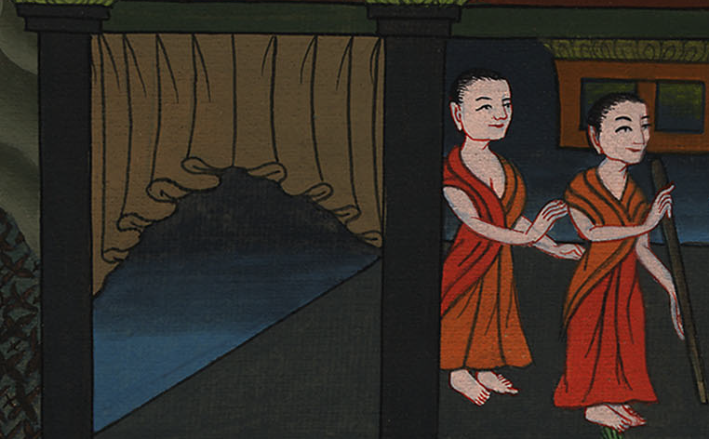
Exodus 11:5

Slide 15
6There will be a great cry throughout all the land of Egypt, such as there has not been, nor will be any more.

Slide 16
Exodus 11:6

Slide 17
7But against any of the children of Israel a dog won’t even bark or move its tongue, against man or animal, that you may know that Yahweh makes a distinction between the Egyptians and Israel.

Slide 18
Exodus 11:7

Slide 19
8All these servants of yours will come down to me, and bow down themselves to me, saying, “Get out, with all the people who follow you;” and after that I will go out.’” He went out from Pharaoh in hot anger.

Slide 20
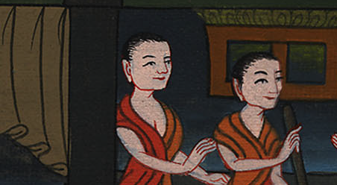
Exodus 11:8

Slide 21
9Yahweh said to Moses, “Pharaoh won’t listen to you, that my wonders may be multiplied in the land of Egypt.”

Slide 22
Exodus 11:9

Slide 23
10Moses and Aaron did all these wonders before Pharaoh, but Yahweh hardened Pharaoh’s heart, and he didn’t let the children of Israel go out of his land.

Slide 24
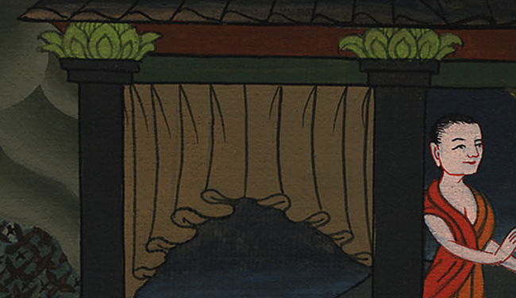
Exodus 11:10

