Slide 1
09-11
This work is licensed under a Creative Commons Attribution-ShareAlike 4.0 International License.
Please add this statement to all the videos you create.
English Bible quotes are from the World English Bible US, which is in the public domain.

Slide 2
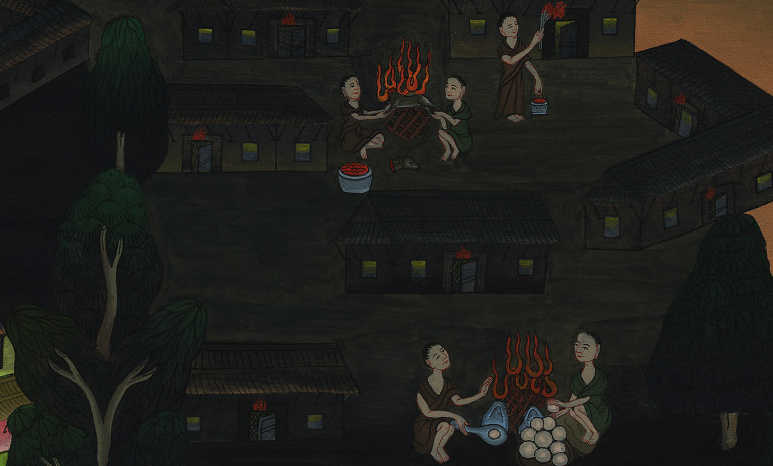
Passover – Exodus 12:1-36

Slide 3
Passover – Exodus 12:1-36
Notes:
First draft

Slide 4
Passover – Exodus 12:1-36

Slide 5
1Yahweh spoke to Moses and Aaron in the land of Egypt, saying,

Slide 6
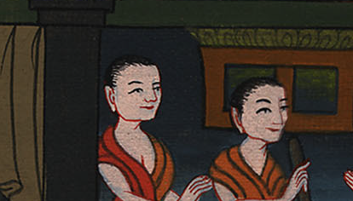
Exodus 12:1

Slide 7
2“This month shall be to you the beginning of months. It shall be the first month of the year to you.

Slide 8
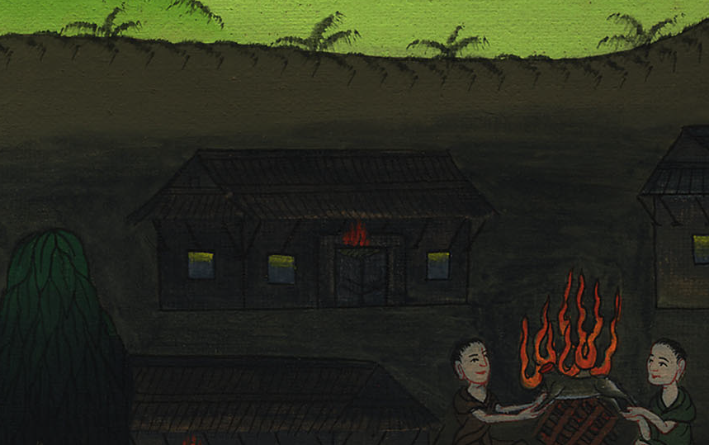
Exodus 12:2

Slide 9
3Speak to all the congregation of Israel, saying, ‘On the tenth day of this month, they shall take to them every man a lamb, according to their fathers’ houses, a lamb for a household;

Slide 10
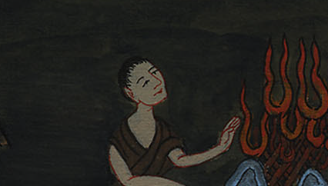
Exodus 12:3

Slide 11
6You shall keep it until the fourteenth day of the same month; and the whole assembly of the congregation of Israel shall kill it at evening.

Slide 12
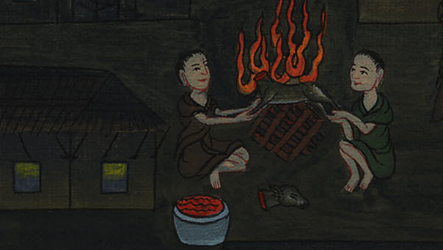
Exodus 12:6

Slide 13
7They shall take some of the blood, and put it on the two door posts and on the lintel, on the houses in which they shall eat it.

Slide 14
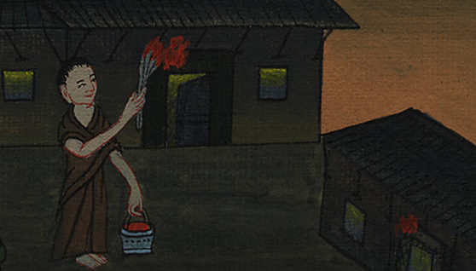
Exodus 12:7

Slide 15
8They shall eat the meat in that night, roasted with fire, with unleavened bread. They shall eat it with bitter herbs.

Slide 16
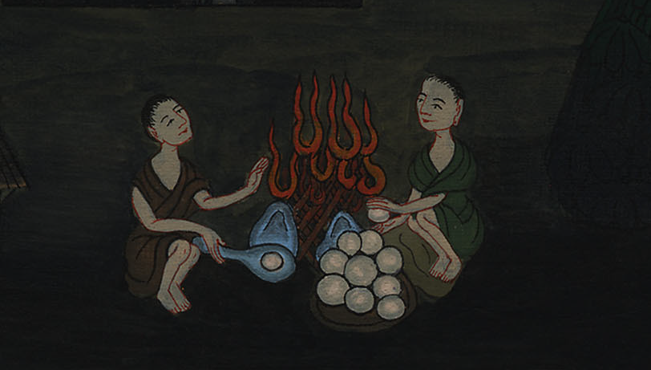
Exodus 12:8

Slide 17
10You shall let nothing of it remain until the morning; but that which remains of it until the morning you shall burn with fire.

Slide 18
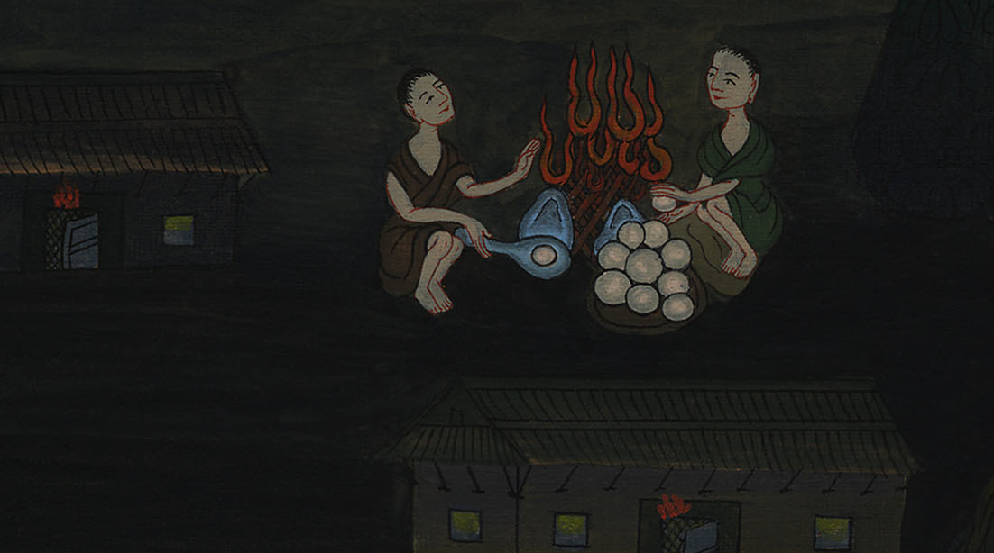
Exodus 12:10

Slide 19
11This is how you shall eat it: with your belt on your waist, your sandals on your feet, and your staff in your hand; and you shall eat it in haste: it is Yahweh’s Passover.

Slide 20
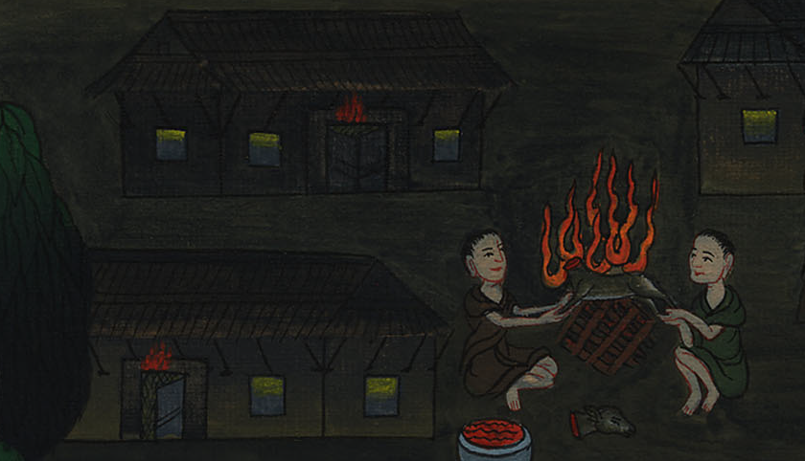
Exodus 12:11

Slide 21
12For I will go through the land of Egypt in that night, and will strike all the firstborn in the land of Egypt, both man and animal. I will execute judgments against all the gods of Egypt. I am Yahweh.

Slide 22
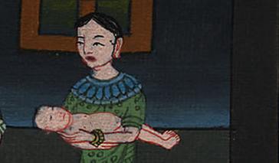
Exodus 12:12

Slide 23
13The blood shall be to you for a token on the houses where you are. When I see the blood, I will pass over you, and no plague will be on you to destroy you when I strike the land of Egypt.

Slide 24
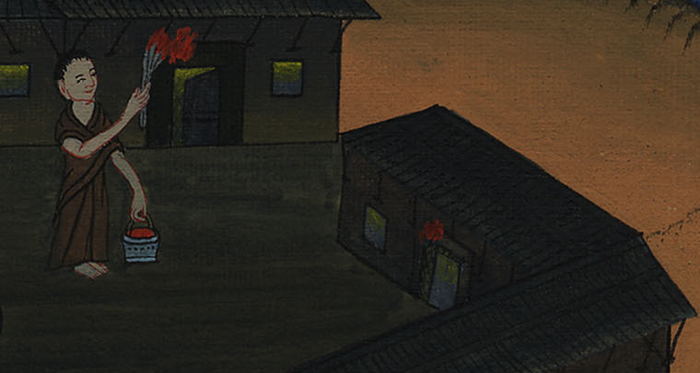
Exodus 12:13

Slide 25
28The children of Israel went and did so; as Yahweh had commanded Moses and Aaron, so they did.

Slide 26
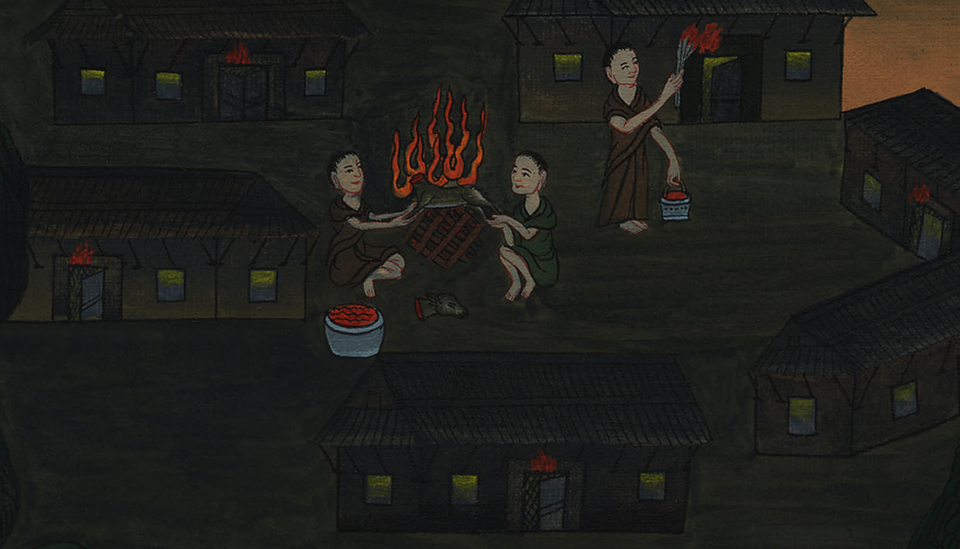
Exodus 12:28

Slide 27
29At midnight, Yahweh struck all the firstborn in the land of Egypt, from the firstborn of Pharaoh who sat on his throne to the firstborn of the captive who was in the dungeon, and all the firstborn of livestock.

Slide 28
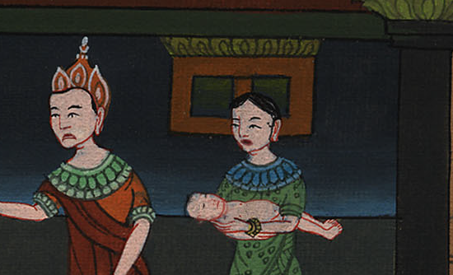
Exodus 12:29

Slide 29
30Pharaoh rose up in the night, he, and all his servants, and all the Egyptians; and there was a great cry in Egypt, for there was not a house where there was not one dead.

Slide 30
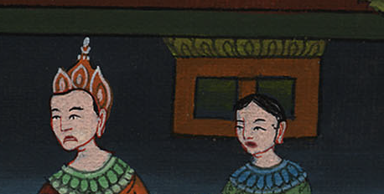
Exodus 12:30

Slide 31
31He called for Moses and Aaron by night, and said, “Rise up, get out from among my people, both you and the children of Israel; and go, serve Yahweh, as you have said!

Slide 32
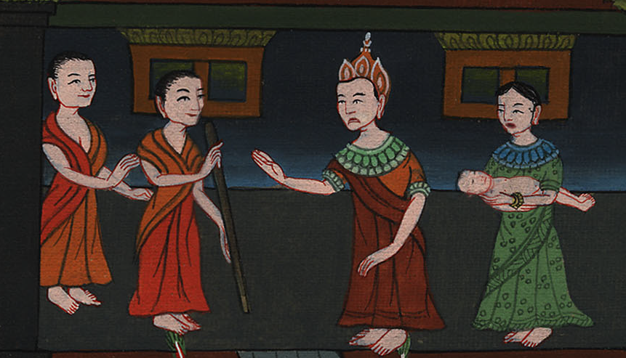
Exodus 12:31

Slide 33
32Take both your flocks and your herds, as you have said, and be gone; and bless me also!”

Slide 34
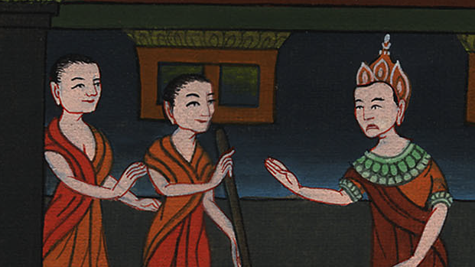
Exodus 12:32

Slide 35
33The Egyptians were urgent with the people, to send them out of the land in haste, for they said, “We are all dead men.”

Slide 36
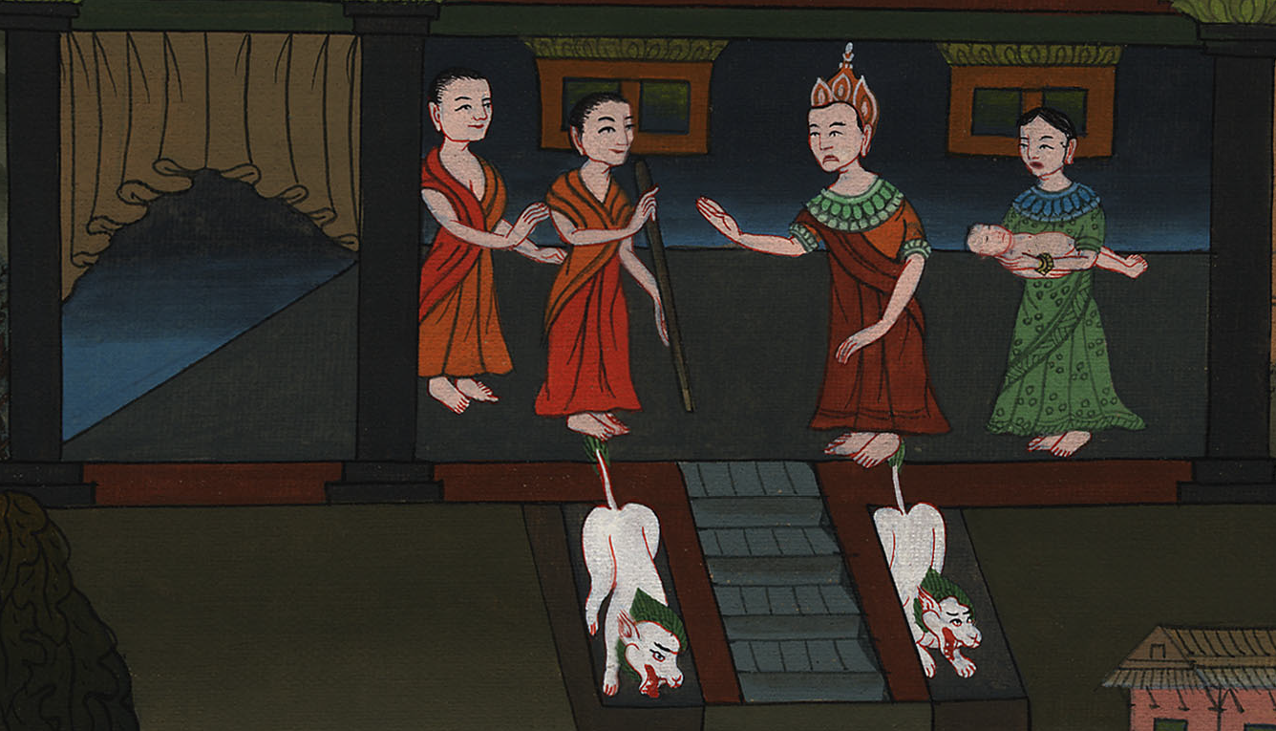
Exodus 12:33

Slide 37
35The children of Israel did according to the word of Moses; and they asked of the Egyptians jewels of silver, and jewels of gold, and clothing.

Slide 38
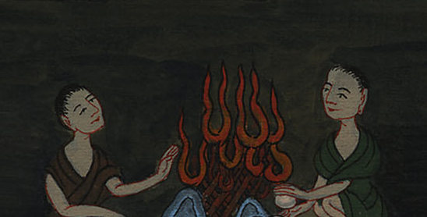
Exodus 12:35

Slide 39
36Yahweh gave the people favor in the sight of the Egyptians, so that they let them have what they asked. They plundered the Egyptians.

Slide 40
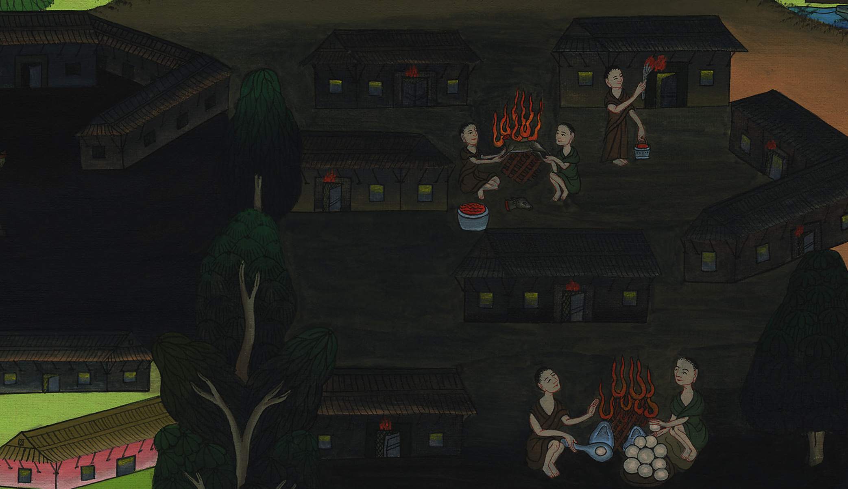
Exodus 12:36

