Slide 1
09-2
This work is licensed under a Creative Commons Attribution-ShareAlike 4.0 International License.
Please add this statement to all the videos you create.
English Bible quotes are from the World English Bible US, which is in the public domain.

Slide 2
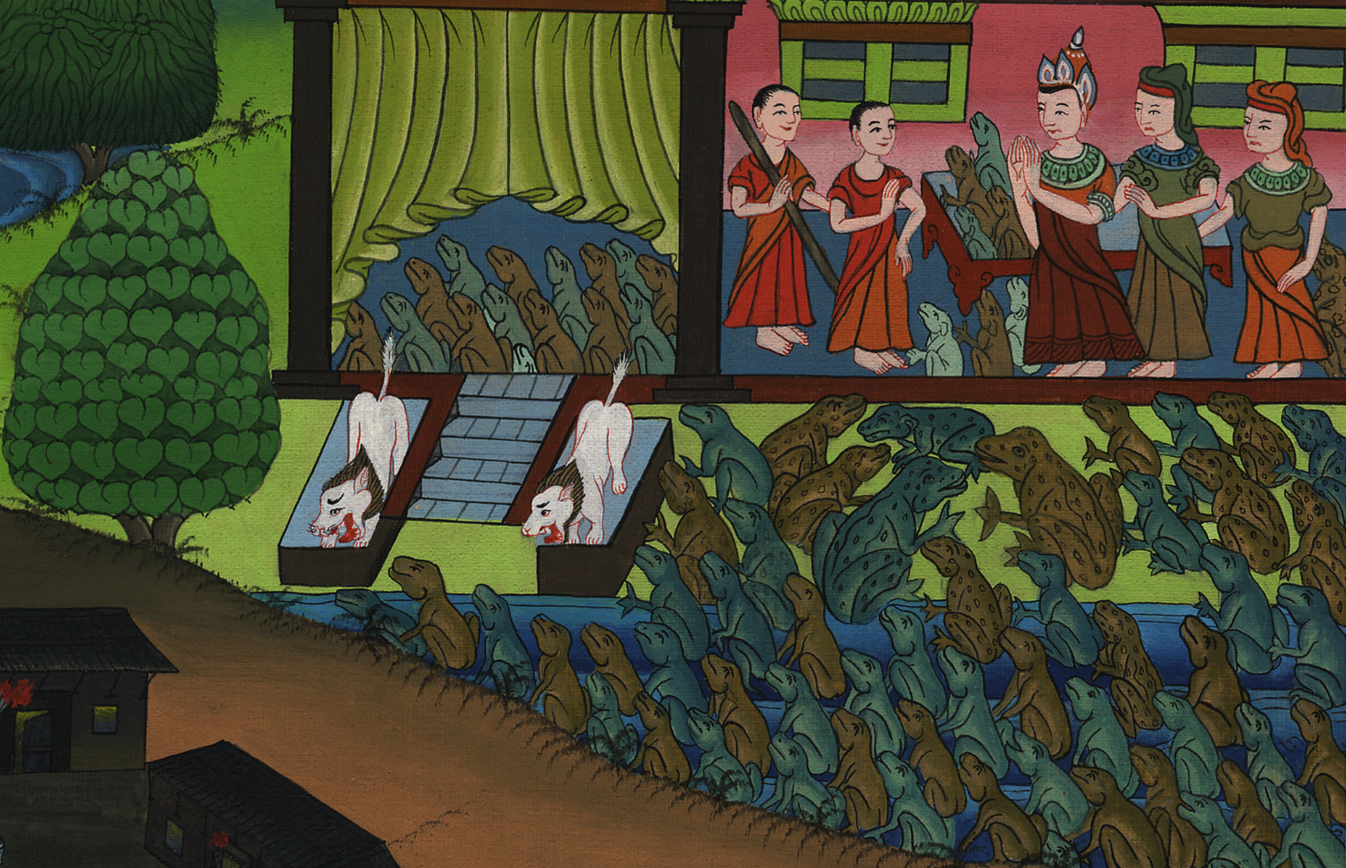
Frogs –
Exodus 8:1-15

Slide 3
Frogs – Exodus 8:1-15
Notes:
First draft

Slide 4
Frogs –
Exodus 8:1-15

Slide 5
སྡེབ་ཐོན 7:
1Yahweh spoke to Moses, “Go in to Pharaoh, and tell him, ‘This is what Yahweh says, “Let my people go, that they may serve me.

Slide 6
Exodus 8:1

Slide 7
2If you refuse to let them go, behold, I will plague all your borders with frogs.

Slide 8
Exodus 8:2

Slide 9
3The river will swarm with frogs, which will go up and come into your house, and into your bedroom, and on your bed, and into the house of your servants, and on your people, and into your ovens, and into your kneading troughs.

Slide 10
Exodus 8:3

Slide 11
4The frogs shall come up both on you, and on your people, and on all your servants.”’”

Slide 12
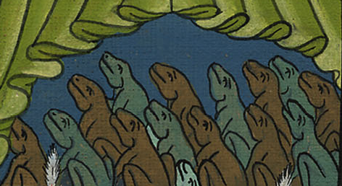
Exodus 8:4

Slide 13
5Yahweh said to Moses, “Tell Aaron, ‘Stretch out your hand with your rod over the rivers, over the streams, and over the pools, and cause frogs to come up on the land of Egypt.’”

Slide 14
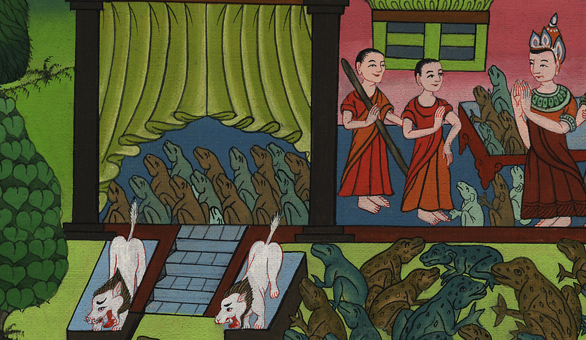
Exodus 8:5

Slide 15
6Aaron stretched out his hand over the waters of Egypt; and the frogs came up, and covered the land of Egypt.

Slide 16
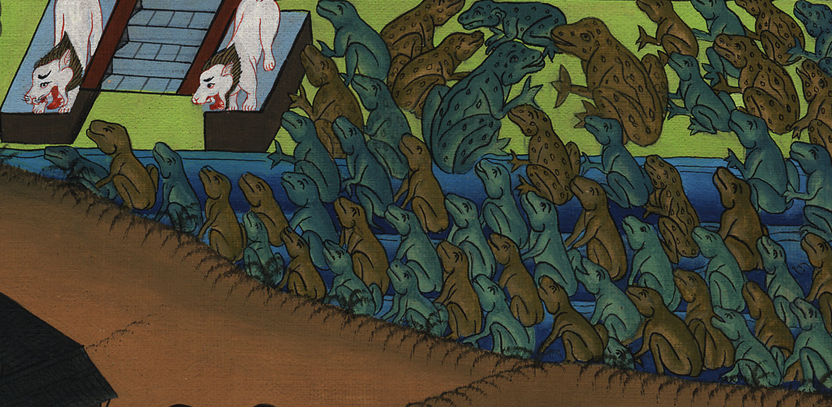
Exodus 8:6

Slide 17
7The magicians did the same thing with their enchantments, and brought up frogs on the land of Egypt.

Slide 18
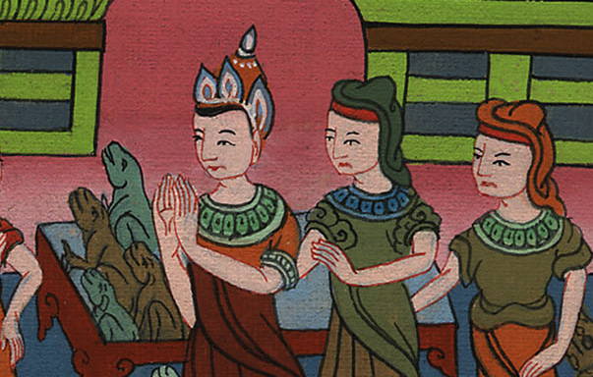
Exodus 8:7

Slide 19
8Then Pharaoh called for Moses and Aaron, and said, “Entreat Yahweh, that he take away the frogs from me and from my people; and I will let the people go, that they may sacrifice to Yahweh.”

Slide 20
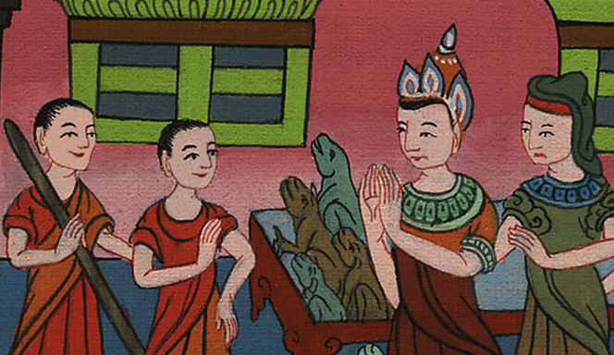
Exodus 8:8

Slide 21
12Moses and Aaron went out from Pharaoh, and Moses cried to Yahweh concerning the frogs which he had brought on Pharaoh.

Slide 22
Exodus 8:12

Slide 23
13Yahweh did according to the word of Moses, and the frogs died out of the houses, out of the courts, and out of the fields.

Slide 24
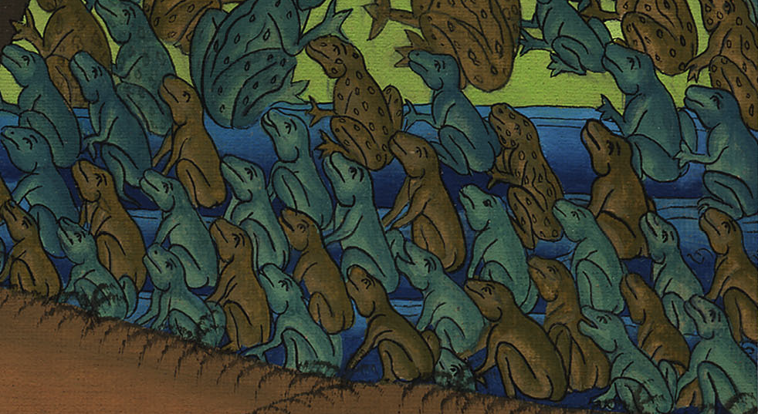
Exodus 8:13

Slide 25
14They gathered them together in heaps, and the land stank.

Slide 26
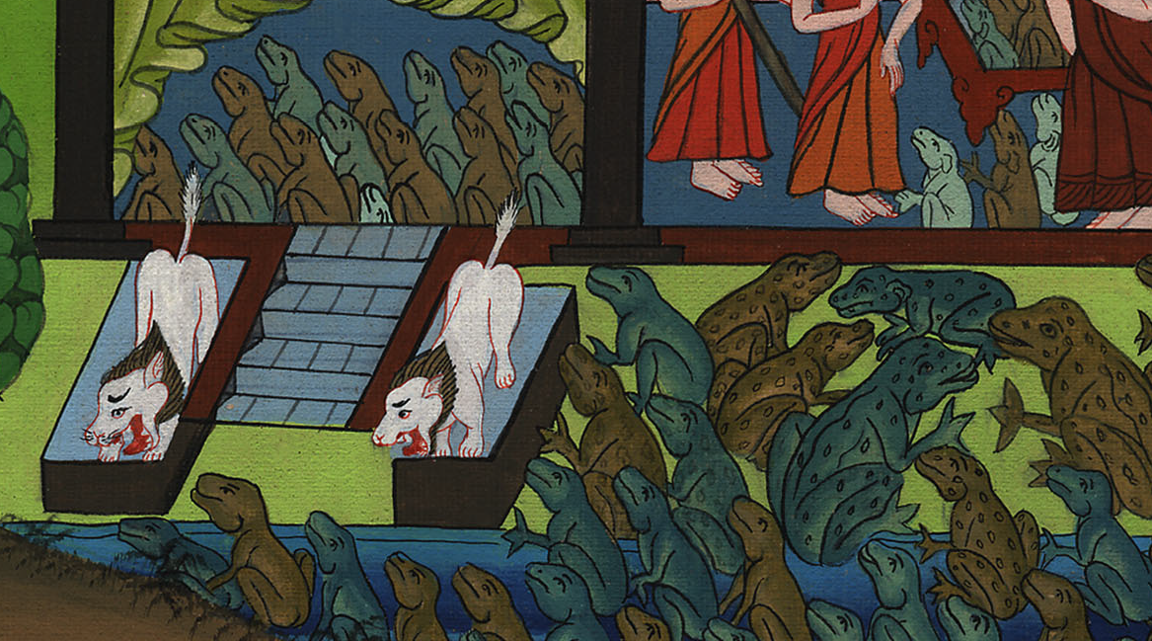
Exodus 8:14

Slide 27
15But when Pharaoh saw that there was a respite, he hardened his heart, and didn’t listen to them, as Yahweh had spoken.

Slide 28
Exodus 8:15

