Slide 1
09-3
This work is licensed under a Creative Commons Attribution-ShareAlike 4.0 International License.
Please add this statement to all the videos you create.
English Bible quotes are from the World English Bible US, which is in the public domain.

Slide 2
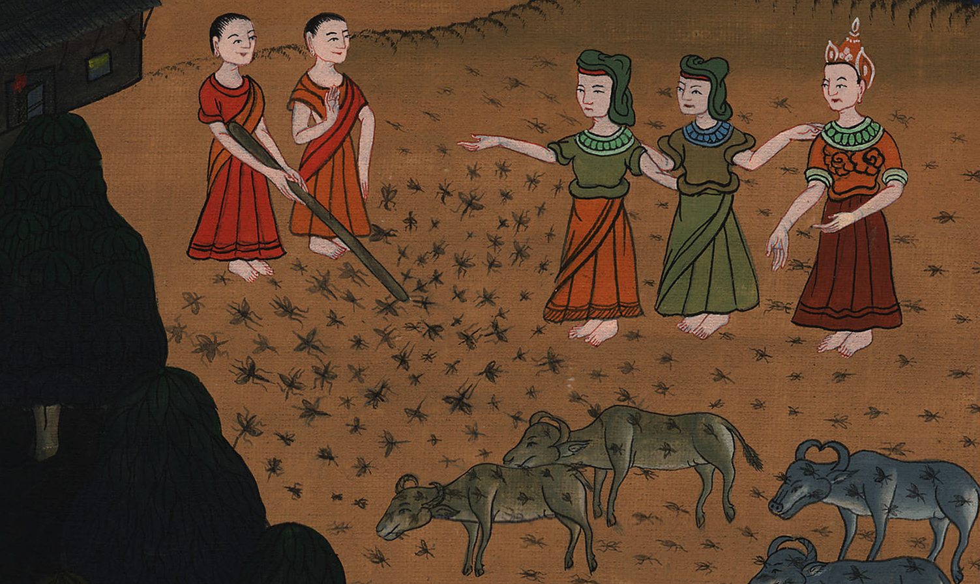
Gnats –
Exodus 8:16-19

Slide 3
Gnats – Exodus 8:16-19
Notes:
First draft

Slide 4
Gnats –
Exodus 8:16-19

Slide 5
16Yahweh said to Moses, “Tell Aaron, ‘Stretch out your rod, and strike the dust of the earth, that it may become lice throughout all the land of Egypt.’”

Slide 6
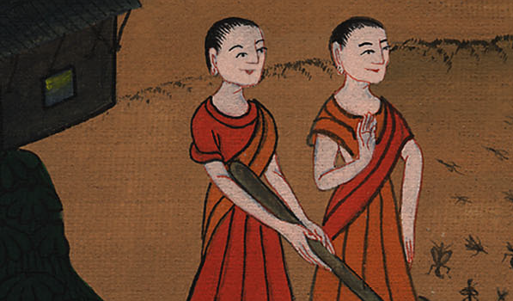
Exodus 8:16

Slide 7
17They did so; and Aaron stretched out his hand with his rod, and struck the dust of the earth, and there were lice on man, and on animal; all the dust of the earth became lice throughout all the land of Egypt.

Slide 8
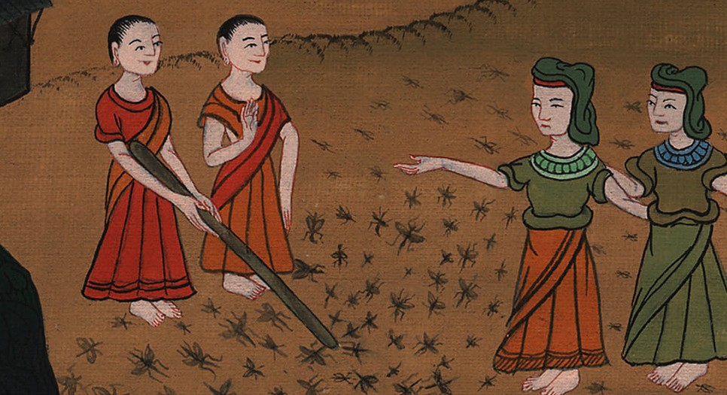
Exodus 8:17

Slide 9
18The magicians tried with their enchantments to produce lice, but they couldn’t. There were lice on man, and on animal.

Slide 10
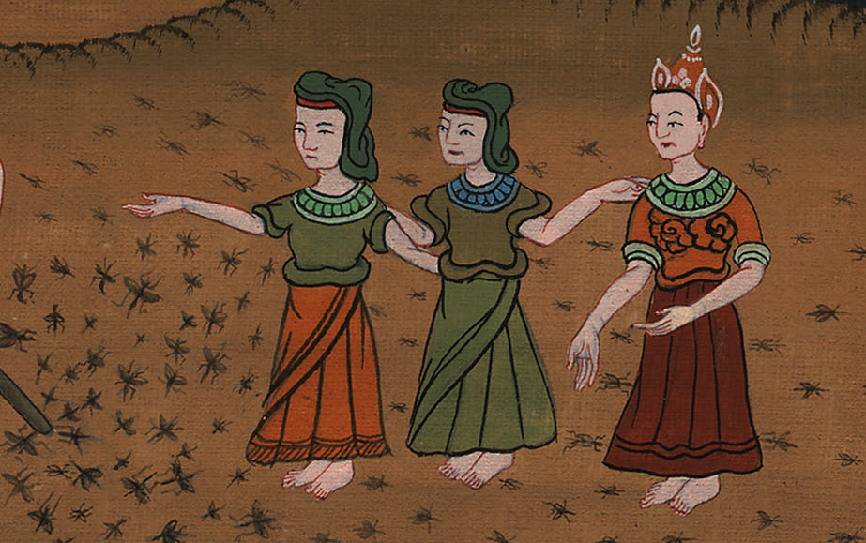
Exodus 8:18

Slide 11
19Then the magicians said to Pharaoh, “This is God’s finger;” but Pharaoh’s heart was hardened, and he didn’t listen to them, as Yahweh had spoken.

Slide 12
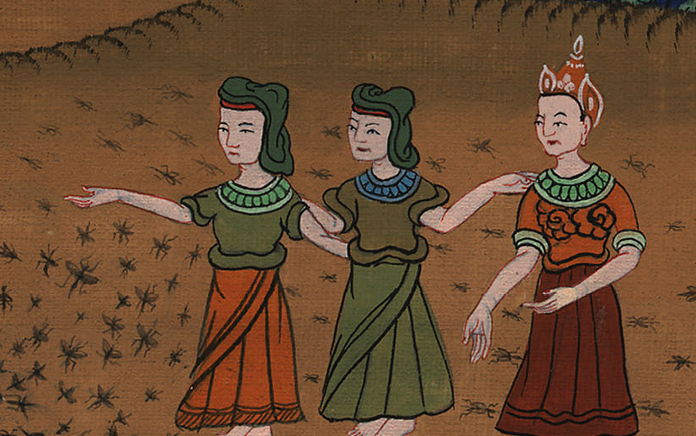
Exodus 8:19

