Slide 1
09-4
This work is licensed under a Creative Commons Attribution-ShareAlike 4.0 International License.
Please add this statement to all the videos you create.
English Bible quotes are from the World English Bible US, which is in the public domain.

Slide 2
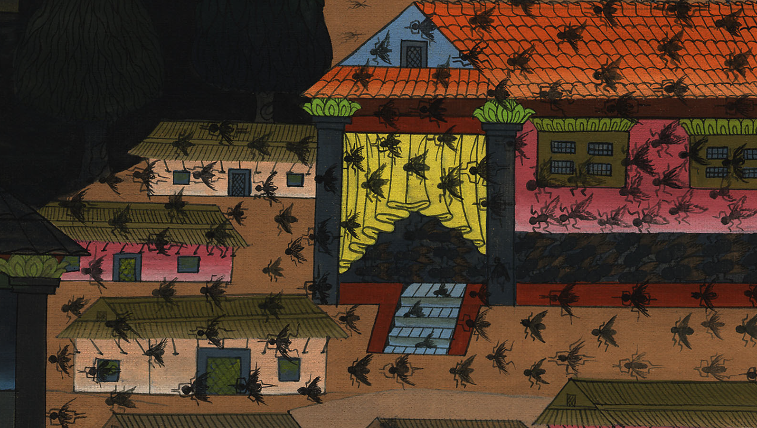
Flies –
Exodus 8:20-32

Slide 3
Flies – Exodus 8:20-32
Notes:
First draft

Slide 4
Flies –
Exodus 8:20-32

Slide 5
20Yahweh said to Moses, “Rise up early in the morning, and stand before Pharaoh; behold, he comes out to the water; and tell him, ‘This is what Yahweh says, “Let my people go, that they may serve me.

Slide 6
Exodus 8:20

Slide 7
21Else, if you will not let my people go, behold, I will send swarms of flies on you, and on your servants, and on your people, and into your houses. The houses of the Egyptians shall be full of swarms of flies, and also the ground they are on.

Slide 8
Exodus 8:21

Slide 9
22I will set apart in that day the land of Goshen, in which my people dwell, that no swarms of flies shall be there, to the end you may know that I am Yahweh on the earth.

Slide 10
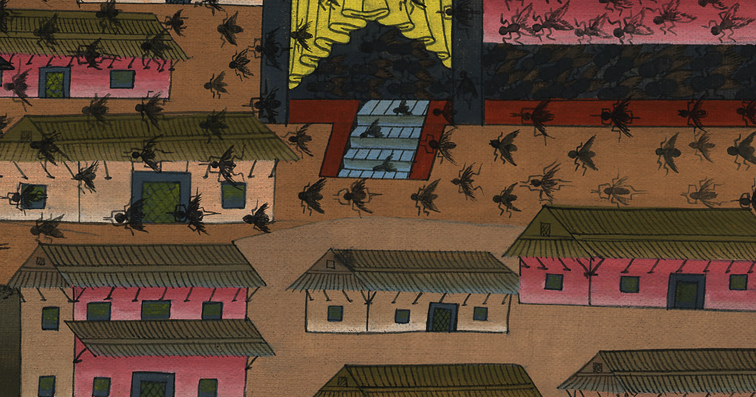
Exodus 8:22

Slide 11
23I will put a division between my people and your people. This sign shall happen by tomorrow.”’”

Slide 12
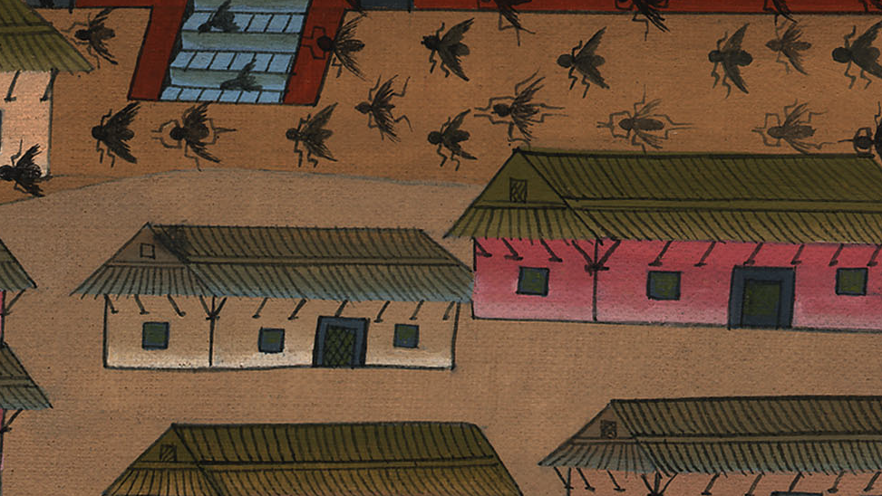
Exodus 8:23

Slide 13
24Yahweh did so; and there came grievous swarms of flies into the house of Pharaoh, and into his servants’ houses. In all the land of Egypt the land was corrupted by reason of the swarms of flies.

Slide 14
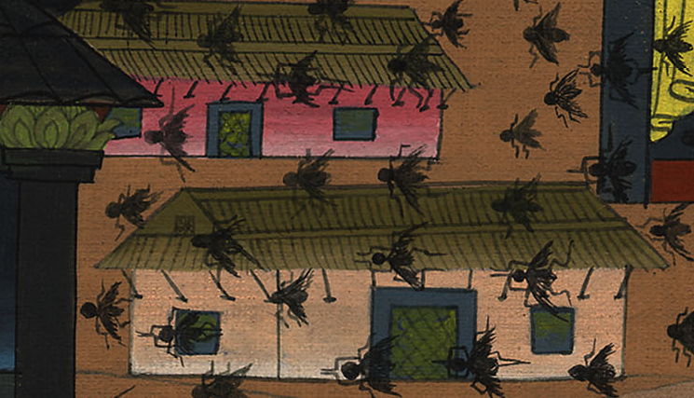
Exodus 8:24

Slide 15
25Pharaoh called for Moses and for Aaron, and said, “Go, sacrifice to your God in the land!”

Slide 16
Exodus 8:25

Slide 17
26Moses said, “It isn’t appropriate to do so; for we shall sacrifice the abomination of the Egyptians to Yahweh our God. Behold, if we sacrifice the abomination of the Egyptians before their eyes, won’t they stone us?

Slide 18
Exodus 8:26

Slide 19
27We will go three days’ journey into the wilderness, and sacrifice to Yahweh our God, as he shall command us.”

Slide 20
Exodus 8:27

Slide 21
28Pharaoh said, “I will let you go, that you may sacrifice to Yahweh your God in the wilderness, only you shall not go very far away. Pray for me.”

Slide 22
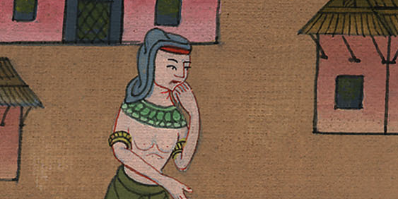
Exodus 8:28

Slide 23
29Moses said, “Behold, I am going out from you. I will pray to Yahweh that the swarms of flies may depart from Pharaoh, from his servants, and from his people, tomorrow; only don’t let Pharaoh deal deceitfully any more in not letting the people go to sacrifice to Yahweh.”

Slide 24
Exodus 8:29

Slide 25
30Moses went out from Pharaoh, and prayed to Yahweh.

Slide 26
Exodus 8:30

Slide 27
31Yahweh did according to the word of Moses, and he removed the swarms of flies from Pharaoh, from his servants, and from his people. There remained not one.

Slide 28
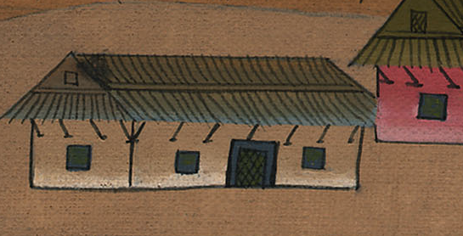
Exodus 8:31

Slide 29
32Pharaoh hardened his heart this time also, and he didn’t let the people go.

Slide 30
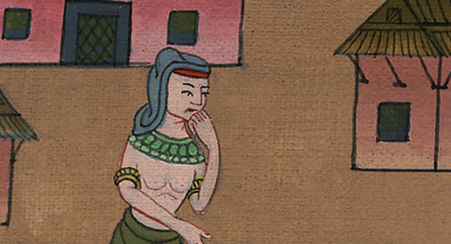
Exodus 8:32

