Slide 1
09-5
This work is licensed under a Creative Commons Attribution-ShareAlike 4.0 International License.
Please add this statement to all the videos you create.
English Bible quotes are from the World English Bible US, which is in the public domain.

Slide 2
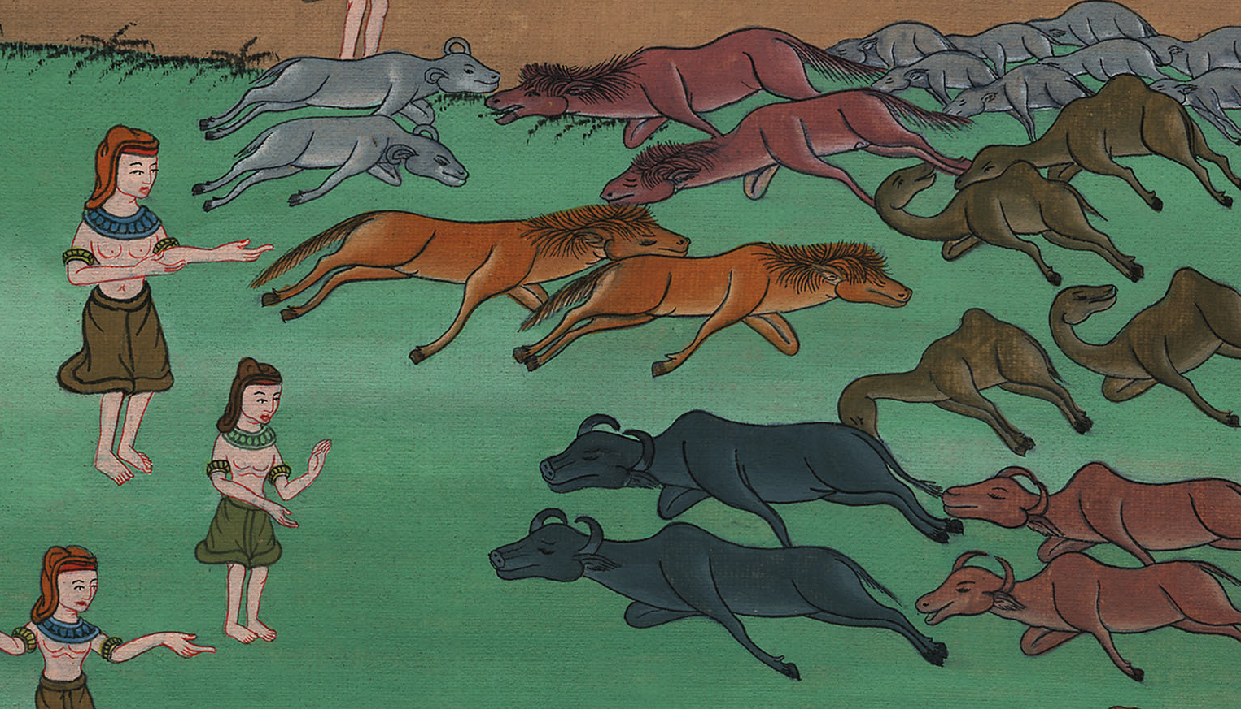
Dead Livestock – Exodus 9:1-7

Slide 3
Dead Livestock – Exodus 9:1-7
Notes:
First draft

Slide 4
Dead Livestock – Exodus 9:1-7

Slide 5
1Then Yahweh said to Moses, “Go in to Pharaoh, and tell him, ‘This is what Yahweh, the God of the Hebrews, says: “Let my people go, that they may serve me.

Slide 6
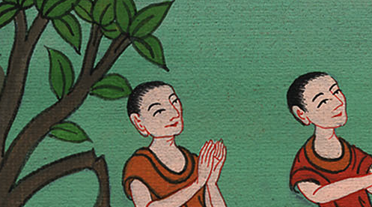
Exodus 9:1

Slide 7
2For if you refuse to let them go, and hold them still,

Slide 8
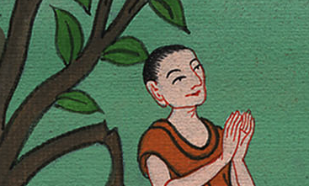
Exodus 9:2

Slide 9
3behold, Yahweh’s hand is on your livestock which are in the field, on the horses, on the donkeys, on the camels, on the herds, and on the flocks with a very grievous pestilence.

Slide 10
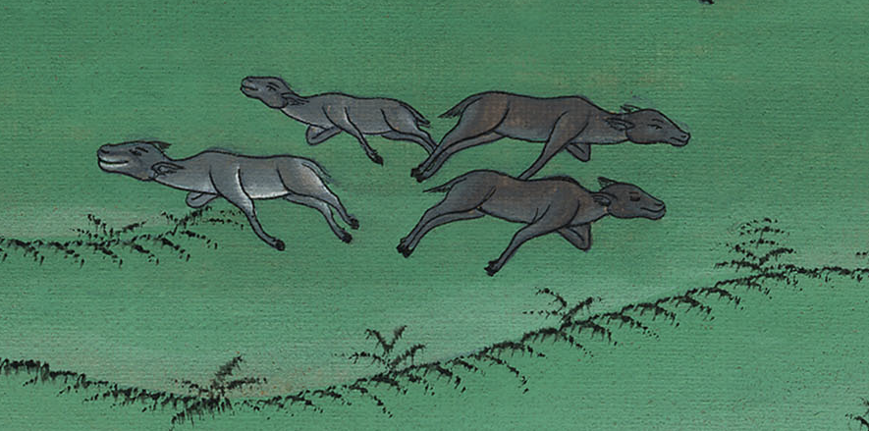
Exodus 9:3

Slide 11
4Yahweh will make a distinction between the livestock of Israel and the livestock of Egypt; and nothing shall die of all that belongs to the children of Israel.”’”

Slide 12
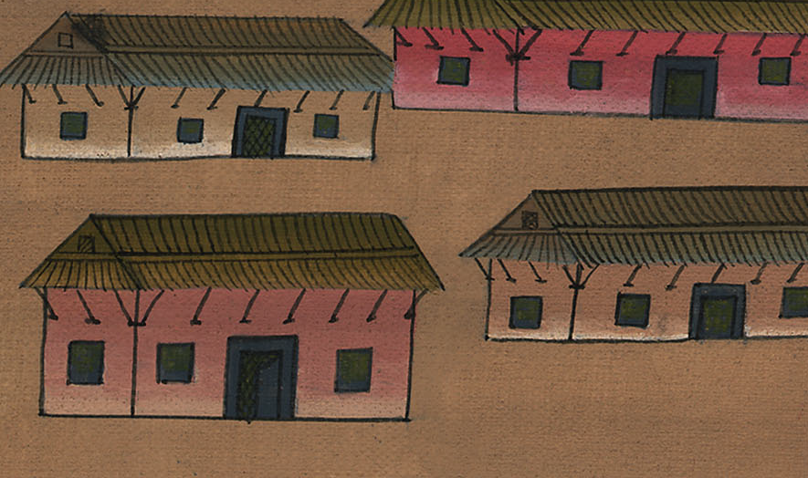
Exodus 9:4

Slide 13
6Yahweh did that thing on the next day; and all the livestock of Egypt died, but of the livestock of the children of Israel, not one died.

Slide 14
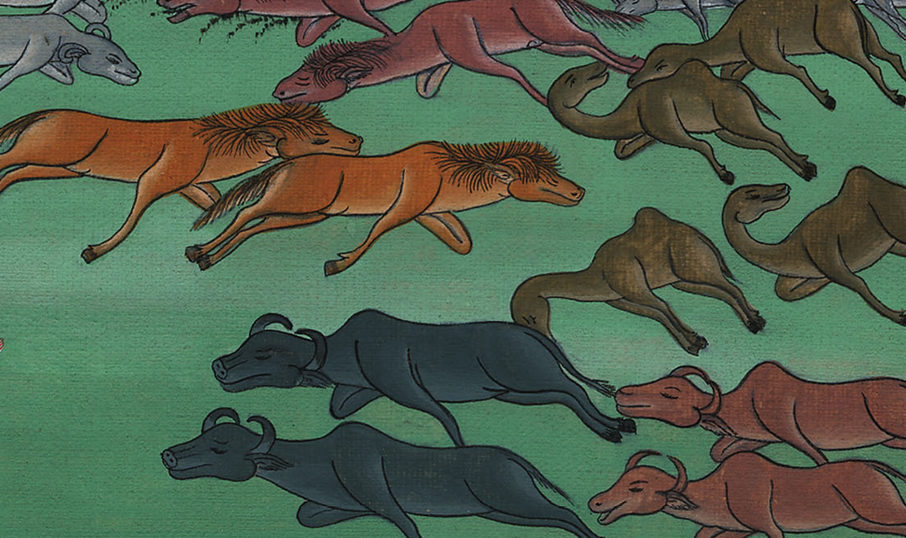
Exodus 9:6

Slide 15
7Pharaoh sent, and, behold, there was not so much as one of the livestock of the Israelites dead. But the heart of Pharaoh was stubborn, and he didn’t let the people go.

Slide 16
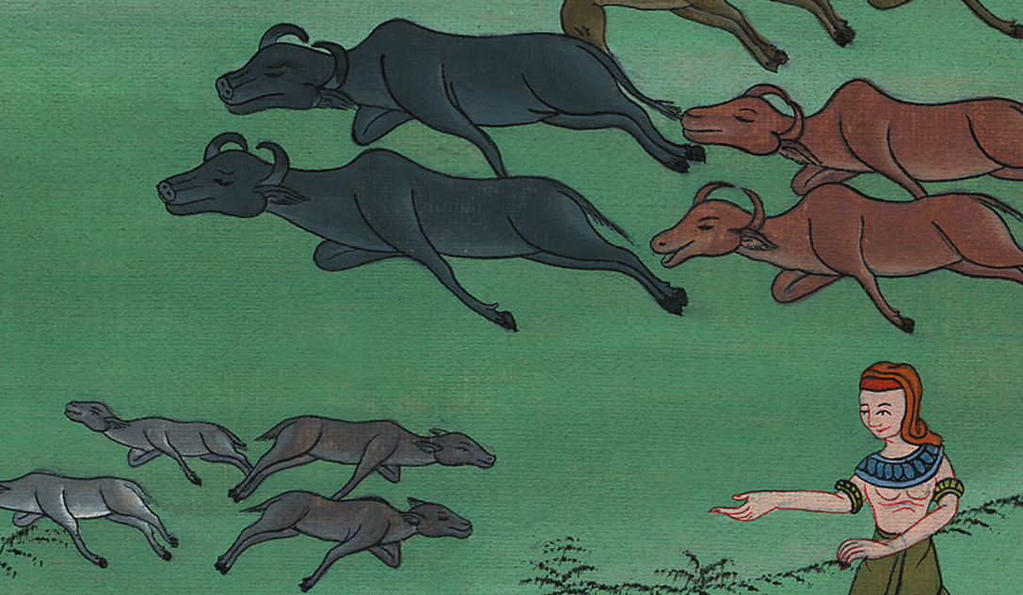
Exodus 9:7

