Slide 1
09-6
This work is licensed under a Creative Commons Attribution-ShareAlike 4.0 International License.
Please add this statement to all the videos you create.
English Bible quotes are from the World English Bible US, which is in the public domain.
Notes:
checked

Slide 2
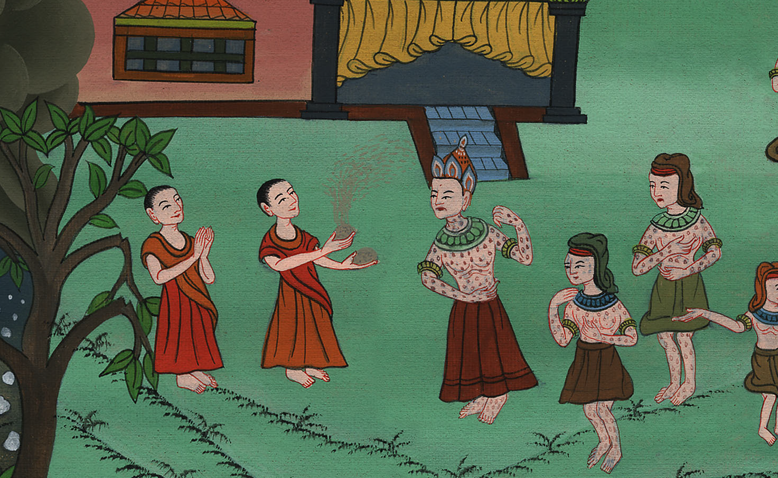
Boils –
Exodus 9:8-12

Slide 3
Boils – Exodus 9:8-12
Notes:
First draft

Slide 4
Boils –
Exodus 9:8-12

Slide 5
8Yahweh said to Moses and to Aaron, “Take handfuls of ashes of the furnace, and let Moses sprinkle it toward the sky in the sight of Pharaoh.

Slide 6
Exodus 9:8

Slide 7
9It shall become small dust over all the land of Egypt, and shall be boils and blisters breaking out on man and on animal, throughout all the land of Egypt.”

Slide 8
Exodus 9:9

Slide 9
10They took ashes of the furnace, and stood before Pharaoh; and Moses sprinkled it up toward the sky; and it became boils and blisters breaking out on man and on animal.

Slide 10
Exodus 9:10

Slide 11
11The magicians couldn’t stand before Moses because of the boils; for the boils were on the magicians and on all the Egyptians.

Slide 12
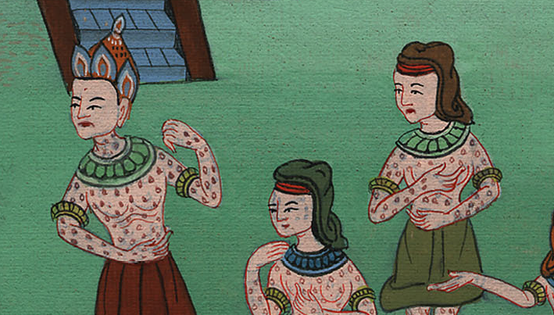
Exodus 9:11

Slide 13
12Yahweh hardened the heart of Pharaoh, and he didn’t listen to them, as Yahweh had spoken to Moses.

Slide 14
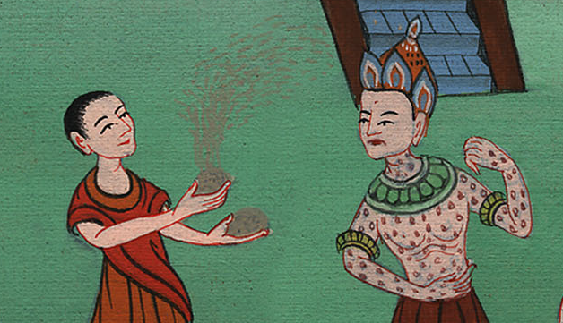
Exodus 9:12

