Slide 1
09-7
This work is licensed under a Creative Commons Attribution-ShareAlike 4.0 International License.
Please add this statement to all the videos you create.
English Bible quotes are from the World English Bible US, which is in the public domain.
Notes:
checked

Slide 2
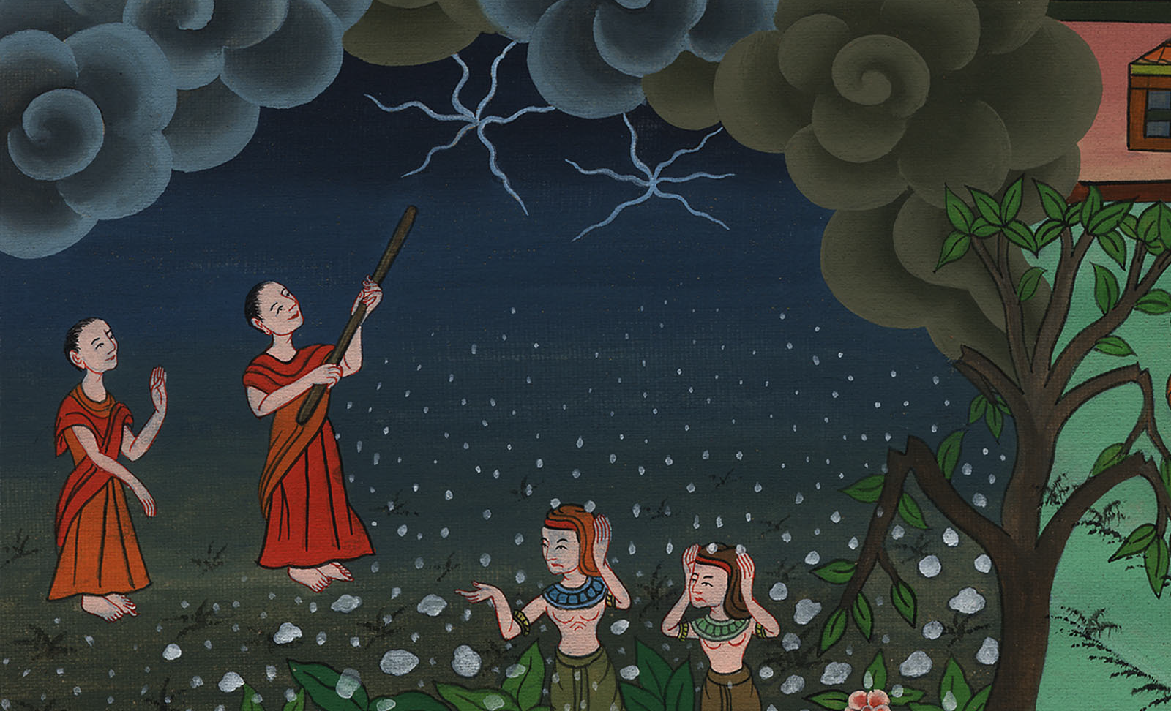
Hail –
Exodus 9:13-35

Slide 3
Hail – Exodus 9:13-35
Notes:
First draft

Slide 4
Hail –
Exodus 9:13-35

Slide 5
13Yahweh said to Moses, “Rise up early in the morning, and stand before Pharaoh, and tell him, ‘This is what Yahweh, the God of the Hebrews, says: “Let my people go, that they may serve me.

Slide 6
Exodus 9:13

Slide 7
14For this time I will send all my plagues against your heart, against your officials, and against your people; that you may know that there is no one like me in all the earth.

Slide 8
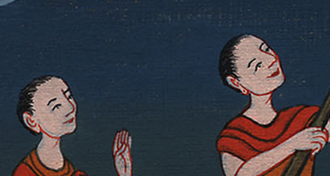
Exodus 9:14

Slide 9
15For now I would have stretched out my hand, and struck you and your people with pestilence, and you would have been cut off from the earth;

Slide 10
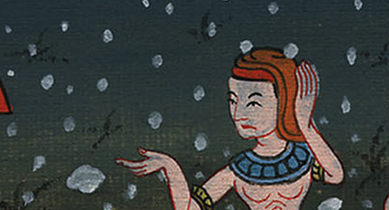
Exodus 9:15

Slide 11
16but indeed for this cause I have made you stand: to show you my power, and that my name may be declared throughout all the earth,

Slide 12
Exodus 9:16

Slide 13
17because you still exalt yourself against my people, that you won’t let them go.

Slide 14
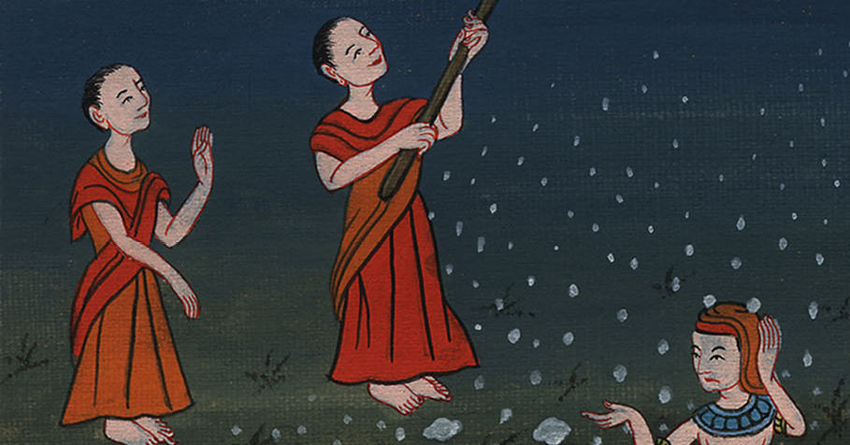
Exodus 9:17

Slide 15
18Behold, tomorrow about this time I will cause it to rain a very grievous hail, such as has not been in Egypt since the day it was founded even until now.

Slide 16
Exodus 9:18

Slide 17
19Now therefore command that all of your livestock and all that you have in the field be brought into shelter. The hail will come down on every man and animal that is found in the field, and isn’t brought home, and they will die.”’”

Slide 18
Exodus 9:19

Slide 19
20Those who feared Yahweh’s word among the servants of Pharaoh made their servants and their livestock flee into the houses.

Slide 20
Exodus 9:20

Slide 21
21Whoever didn’t respect Yahweh’s word left his servants and his livestock in the field.

Slide 22
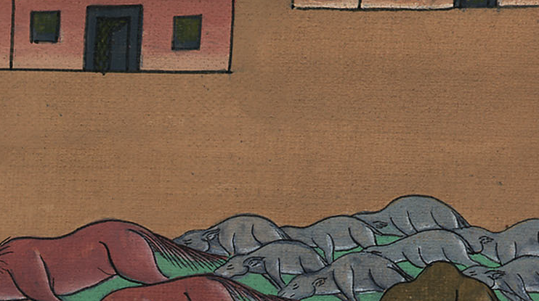
Exodus 9:21

Slide 23
22Yahweh said to Moses, “Stretch out your hand toward the sky, that there may be hail in all the land of Egypt, on man, and on animal, and on every herb of the field, throughout the land of Egypt.”

Slide 24
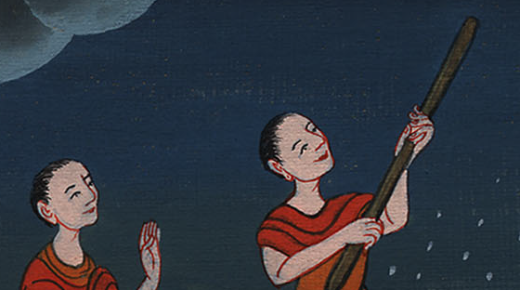
Exodus 9:22

Slide 25
23Moses stretched out his rod toward the heavens, and Yahweh sent thunder and hail; and lightning flashed down to the earth. Yahweh rained hail on the land of Egypt.

Slide 26
Exodus 9:23

Slide 27
24So there was very severe hail, and lightning mixed with the hail, such as had not been in all the land of Egypt since it became a nation.

Slide 28
Exodus 9:24

Slide 29
25The hail struck throughout all the land of Egypt all that was in the field, both man and animal; and the hail struck every herb of the field, and broke every tree of the field.

Slide 30
Exodus 9:25

Slide 31
26Only in the land of Goshen, where the children of Israel were, there was no hail.

Slide 32
Exodus 9:26

Slide 33
27Pharaoh sent and called for Moses and Aaron, and said to them, “I have sinned this time. Yahweh is righteous, and I and my people are wicked.

Slide 34
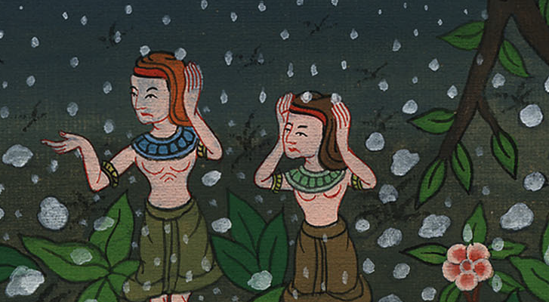
Exodus 9:27

Slide 35
28Pray to Yahweh; for there has been enough of mighty thunderings and hail. I will let you go, and you shall stay no longer.”

Slide 36
Exodus 9:28

Slide 37
29Moses said to him, “As soon as I have gone out of the city, I will spread out my hands to Yahweh. The thunders shall cease, and there will not be any more hail; that you may know that the earth is Yahweh’s.

Slide 38
Exodus 9:29

Slide 39
30But as for you and your servants, I know that you don’t yet fear Yahweh God.”

Slide 40
Exodus 9:30

Slide 41
33Moses went out of the city from Pharaoh, and spread out his hands to Yahweh; and the thunders and hail ceased, and the rain was not poured on the earth.

Slide 42
Exodus 9:33

Slide 43
34When Pharaoh saw that the rain and the hail and the thunders had ceased, he sinned yet more, and hardened his heart, he and his servants.

Slide 44
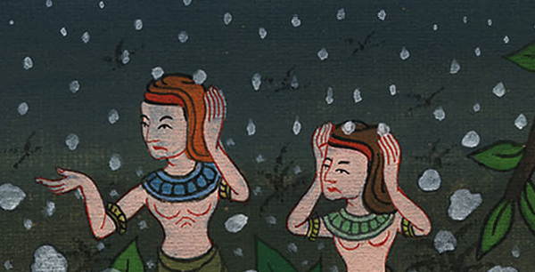
Exodus 9:34

Slide 45
35The heart of Pharaoh was hardened, and he didn’t let the children of Israel go, just as Yahweh had spoken through Moses.

Slide 46
Exodus 9:35

