Slide 1
09-8
This work is licensed under a Creative Commons Attribution-ShareAlike 4.0 International License.
Please add this statement to all the videos you create.
English Bible quotes are from the World English Bible US, which is in the public domain.
Notes:
checked

Slide 2
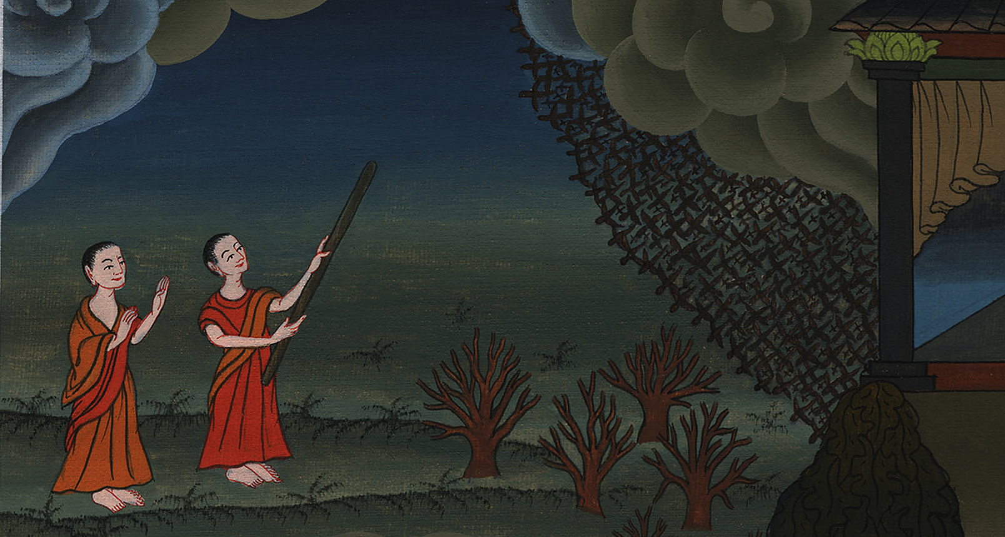
Locusts – Exodus 10:1-20

Slide 3
Locusts – Exodus 10:1-20
Notes:
First draft

Slide 4
Locusts – Exodus 10:1-20

Slide 5
1Yahweh said to Moses, “Go in to Pharaoh, for I have hardened his heart and the heart of his servants, that I may show these my signs among them;

Slide 6
Exodus 10:1

Slide 7
3Moses and Aaron went in to Pharaoh, and said to him, “This is what Yahweh, the God of the Hebrews, says: ‘How long will you refuse to humble yourself before me? Let my people go, that they may serve me.

Slide 8
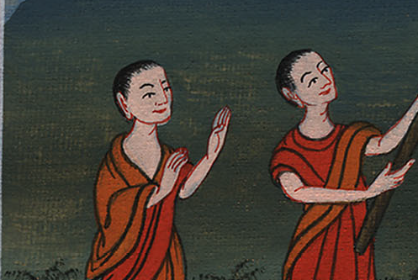
Exodus 10:3

Slide 9
4Or else, if you refuse to let my people go, behold, tomorrow I will bring locusts into your country,

Slide 10
Exodus 10:4

Slide 11
5and they shall cover the surface of the earth, so that one won’t be able to see the earth. They shall eat the residue of that which has escaped, which remains to you from the hail, and shall eat every tree which grows for you out of the field.

Slide 12
Exodus 10:5

Slide 13
6Your houses shall be filled, and the houses of all your servants, and the houses of all the Egyptians, as neither your fathers nor your fathers’ fathers have seen, since the day that they were on the earth to this day.’” He turned, and went out from Pharaoh.

Slide 14
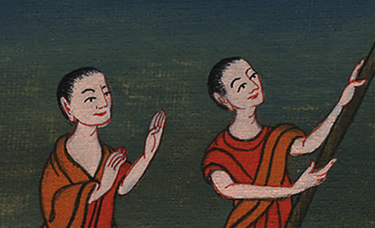
Exodus 10:6

Slide 15
7Pharaoh’s servants said to him, “How long will this man be a snare to us? Let the men go, that they may serve Yahweh, their God. Don’t you yet know that Egypt is destroyed?”

Slide 16
Exodus 10:7

Slide 17
8Moses and Aaron were brought again to Pharaoh, and he said to them, “Go, serve Yahweh your God; but who are those who will go?”

Slide 18
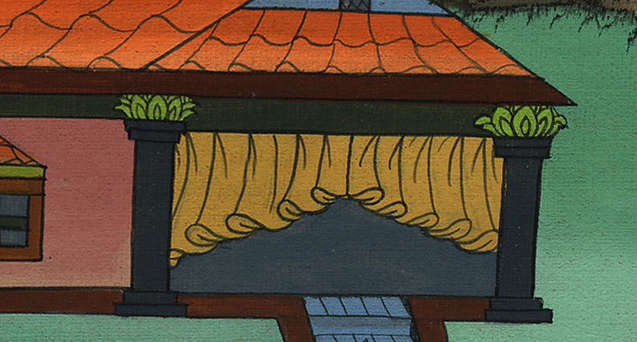
Exodus 10:8

Slide 19
9Moses said, “We will go with our young and with our old. We will go with our sons and with our daughters, with our flocks and with our herds; for we must hold a feast to Yahweh.”

Slide 20
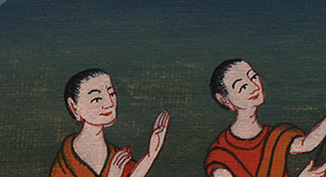
Exodus 10:9

Slide 21
10He said to them, “Yahweh be with you if I let you go with your little ones! See, evil is clearly before your faces.

Slide 22
Exodus 10:10

Slide 23
11Not so! Go now you who are men, and serve Yahweh; for that is what you desire!” Then they were driven out from Pharaoh’s presence.

Slide 24
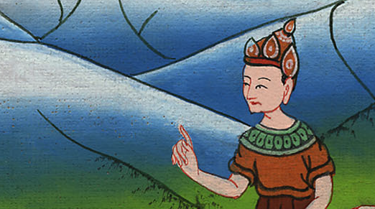
Exodus 10:11

Slide 25
12Yahweh said to Moses, “Stretch out your hand over the land of Egypt for the locusts, that they may come up on the land of Egypt, and eat every herb of the land, even all that the hail has left.”

Slide 26
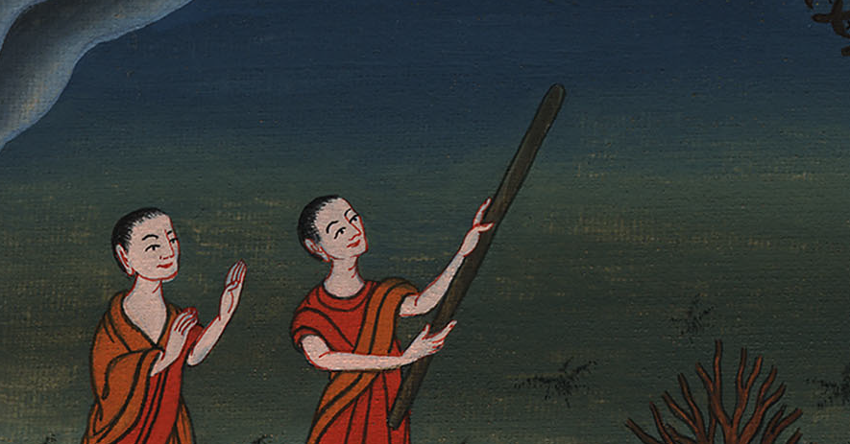
Exodus 10:12

Slide 27
13Moses stretched out his rod over the land of Egypt, and Yahweh brought an east wind on the land all that day, and all night; and when it was morning, the east wind brought the locusts.

Slide 28
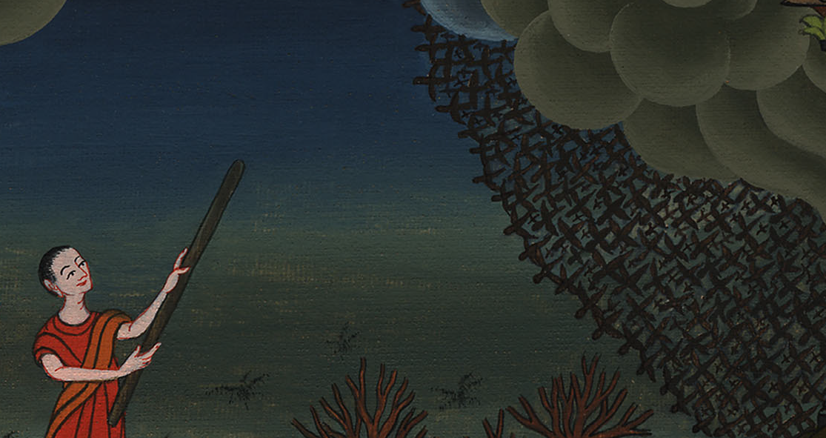
Exodus 10:13

Slide 29
14The locusts went up over all the land of Egypt, and rested in all the borders of Egypt. They were very grievous. Before them there were no such locusts as they, nor will there ever be again.

Slide 30
Exodus 10:14

Slide 31
15For they covered the surface of the whole earth, so that the land was darkened, and they ate every herb of the land, and all the fruit of the trees which the hail had left. There remained nothing green, either tree or herb of the field, through all the land of Egypt.

Slide 32
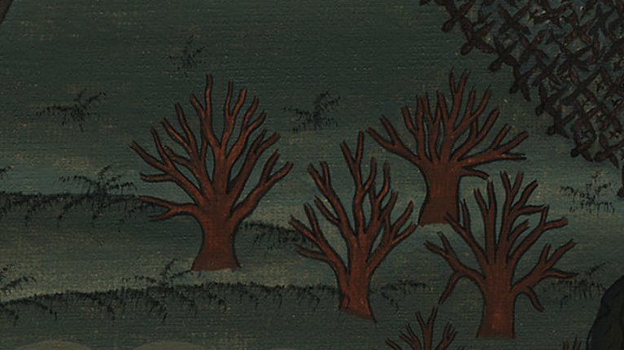
Exodus 10:15

Slide 33
16Then Pharaoh called for Moses and Aaron in haste, and he said, “I have sinned against Yahweh your God, and against you.

Slide 34
Exodus 10:16

Slide 35
17Now therefore please forgive my sin again, and pray to Yahweh your God, that he may also take away from me this death.”

Slide 36
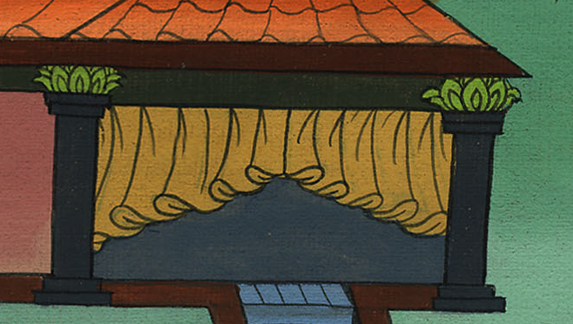
Exodus 10:17

Slide 37
18Moses went out from Pharaoh, and prayed to Yahweh.

Slide 38
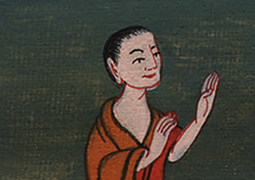
Exodus 10:18

Slide 39
19Yahweh sent an exceedingly strong west wind, which took up the locusts, and drove them into the Red Sea. There remained not one locust in all the borders of Egypt.
19གཙོ་བོ་དཀོན་མཆོག་གིས་ཤར་ཕྱོགས་ནས་ཡོང་བའི་རླུང་འཚུབ་ལ་ནུབ་ཕྱོགས་ཀྱི་རླུང་འཚུབ་སྟོབས་ལྡན་ལ་གྱུར་ནས་དེས་ཆ་ག་འབུ་རྣམས་འཁྱེར་ནས་རྒྱ་མཚོ་དམར་པོར་དབྱུགས་སོ། ཨི་ཇིབ་ནང་ཆ་ག་འབུ་གཅིག་ཀྱང་མ་ལུས་སོ།

Slide 40
Exodus 10:19

Slide 41
20But Yahweh hardened Pharaoh’s heart, and he didn’t let the children of Israel go.
20འོན་ཀྱང་གཙོ་བོ་དཀོན་མཆོག་གིས་རྒྱལ་པོའི་སེམས་གྱོང་པོར་མཛད་པར་བརྟེན། ཁོས་ཨིསི་རཱཨེལ་པ་རྣམས་ལ་འགྲོ་རུ་མ་བཅུག་གོ།

Slide 42
Exodus 10:20

