Slide 1
09-9
This work is licensed under a Creative Commons Attribution-ShareAlike 4.0 International License.
Please add this statement to all the videos you create.
English Bible quotes are from the World English Bible US, which is in the public domain.
Notes:
checked

Slide 2
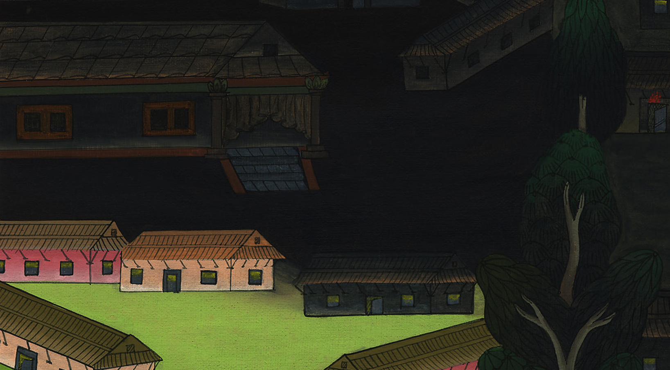
Darkness – Exodus 10:21-29

Slide 3
Darkness – Exodus 10:21-29
Notes:
First draft

Slide 4
Darkness – Exodus 10:21-29

Slide 5
21Yahweh said to Moses, “Stretch out your hand toward the sky, that there may be darkness over the land of Egypt, even darkness which may be felt.”

Slide 6
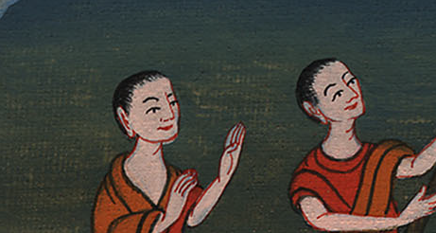
Exodus 10:21

Slide 7
22Moses stretched out his hand toward the sky, and there was a thick darkness in all the land of Egypt for three days.

Slide 8
Exodus 10:22

Slide 9
23They didn’t see one another, and nobody rose from his place for three days; but all the children of Israel had light in their dwellings.

Slide 10
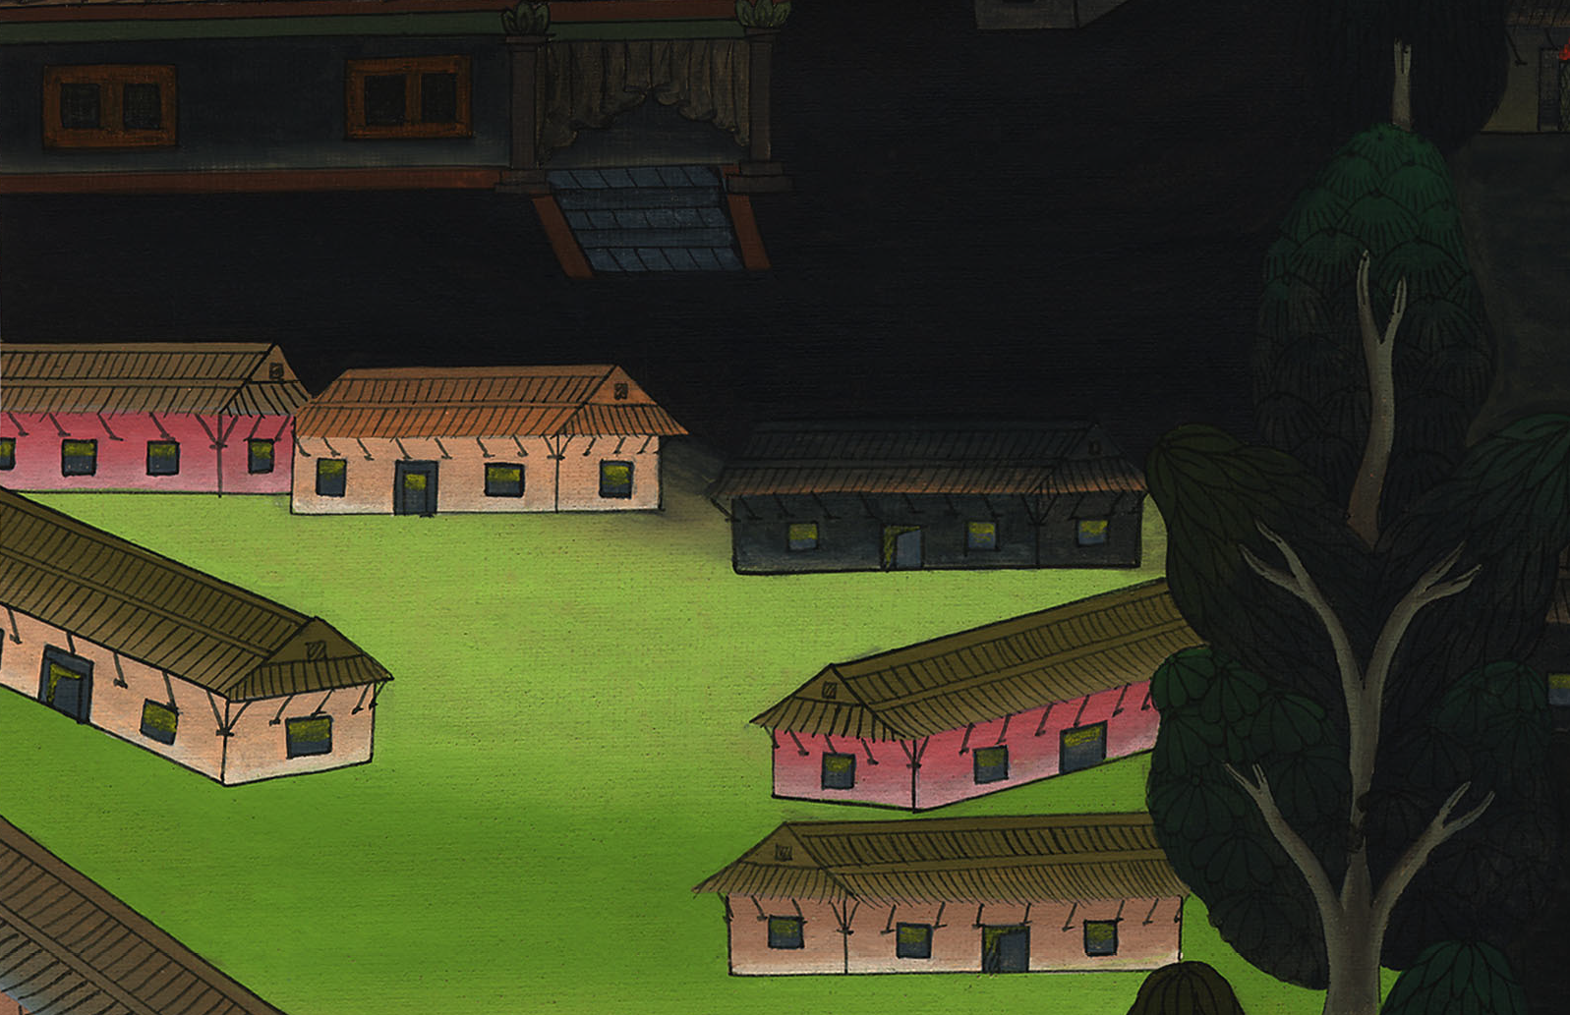
Exodus 10:23

Slide 11
24Pharaoh called to Moses, and said, “Go, serve Yahweh. Only let your flocks and your herds stay behind. Let your little ones also go with you.”

Slide 12
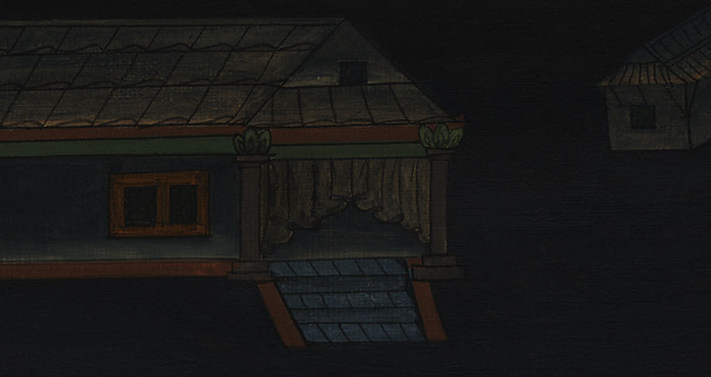
Exodus 10:24

Slide 13
25Moses said, “You must also give into our hand sacrifices and burnt offerings, that we may sacrifice to Yahweh our God.

Slide 14
Exodus 10:25

Slide 15
26Our livestock also shall go with us. Not a hoof shall be left behind, for of it we must take to serve Yahweh our God; and we don’t know with what we must serve Yahweh, until we come there.”

Slide 16
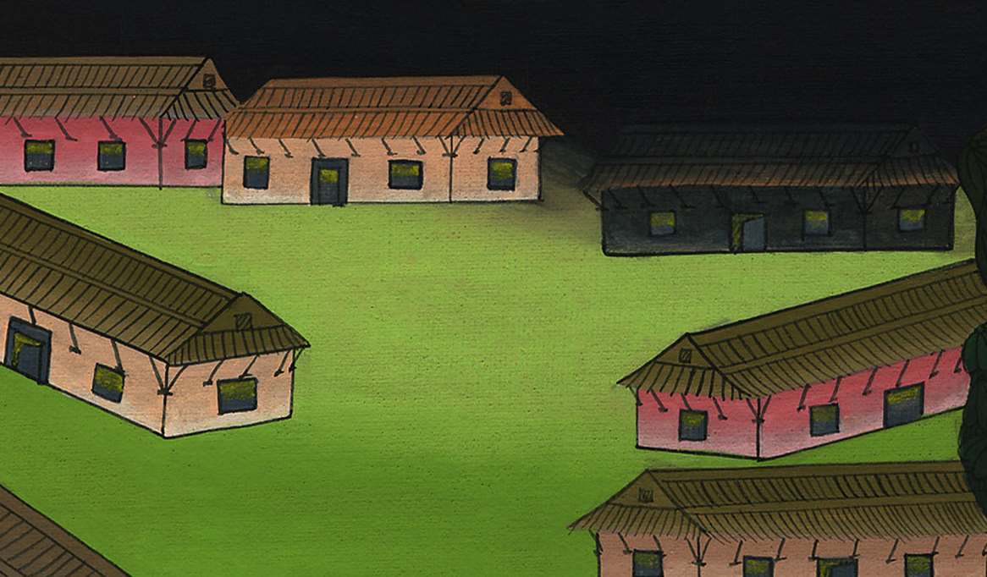
Exodus 10:26

Slide 17
27But Yahweh hardened Pharaoh’s heart, and he wouldn’t let them go.

Slide 18
Exodus 10:27

Slide 19
28Pharaoh said to him, “Get away from me! Be careful to see my face no more; for in the day you see my face you shall die!”

Slide 20
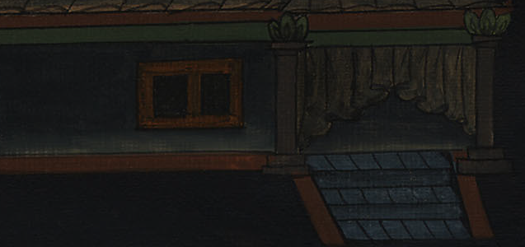
Exodus 10:28

Slide 21
29Moses said, “You have spoken well. I will see your face again no more.”

Slide 22
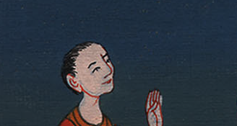
Exodus 10:29

