Slide 1
10-1
This work is licensed under a Creative Commons Attribution-Sharealike 4.0 International License.
Please add this statement to all the videos you create.
English Bible quotes are from the World English Bible US, which is in the public domain.

Slide 2
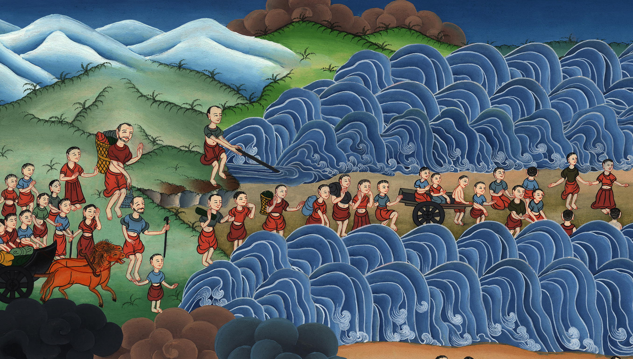
Crossing the Red Sea – Exodus 12:37 – 14:31

Slide 3
1 Samuel
1) Crossing the Red Sea – Exodus 12:37 – 14:31 (Top)
Notes:
First recording
10 The Exodus – Part 1 – Ex 12-34
1) Crossing the Red Sea – Ex 12:37 – 15:21 (Top)
2) Bitter water made sweet – Ex 15:22-27 (Right 2nd)
3) Quail – Ex 16:1-13a (Right 3rd)
4) Manna – Ex 16:13b-36 (Right Botom)
5) Water from a stone – Ex 17:1-7 (Left Bottom)
6) Fighting Amalek – Ex 17:8-16 (Left Center)
7) Mount Sinai – Ex 19 – 20 & 32-34 (Center)

Slide 4
Crossing the Red Sea – Exodus 12:37 – 14:31

Slide 5
1 Samuel
Exodus12: 37The children of Israel traveled from Rameses to Succoth, about six hundred thousand on foot who were men, in addition to children. 38A mixed multitude went up also with them, with flocks, herds, and even very much livestock.

Slide 6
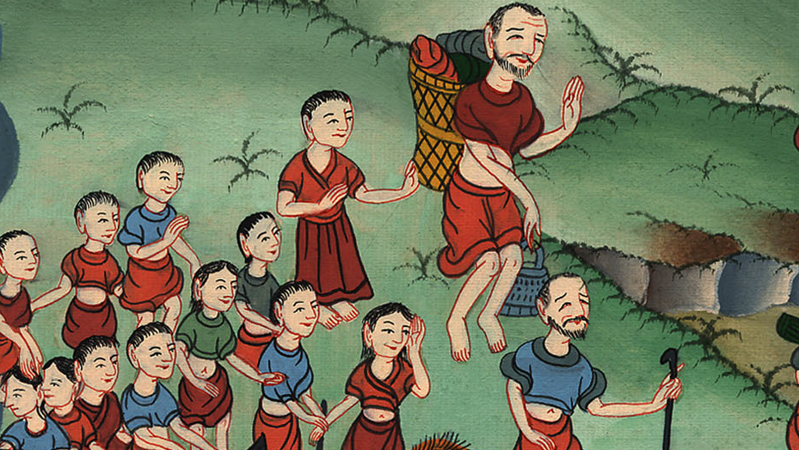
Exodus 12:37

Slide 7
1 Samuel
40Now the time that the children of Israel lived in Egypt was four hundred thirty years.

Slide 8
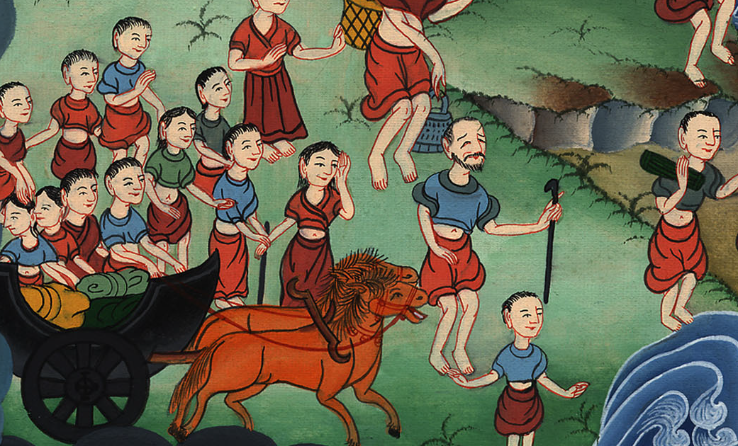
Exodus 12:40

Slide 9
1 Samuel
13:21Yahweh went before them by day in a pillar of cloud, to lead them on their way, and by night in a pillar of fire, to give them light, that they might go by day and by night:

Slide 10
Exodus 13:21

Slide 11
1 Samuel
14:5The king of Egypt was told that the people had fled; and the heart of Pharaoh and of his servants was changed toward the people, and they said, “What is this we have done, that we have let Israel go from serving us?”

Slide 12
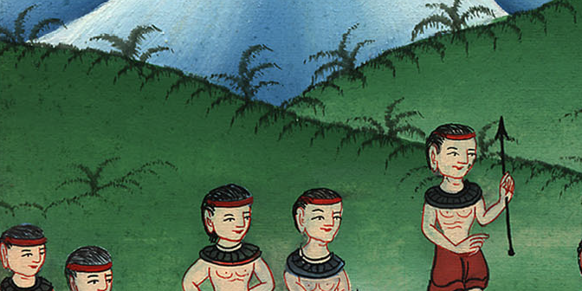
Exodus 14:5

Slide 13
1 Samuel
8Yahweh hardened the heart of Pharaoh king of Egypt, and he pursued the children of Israel; for the children of Israel went out with a high hand.

Slide 14
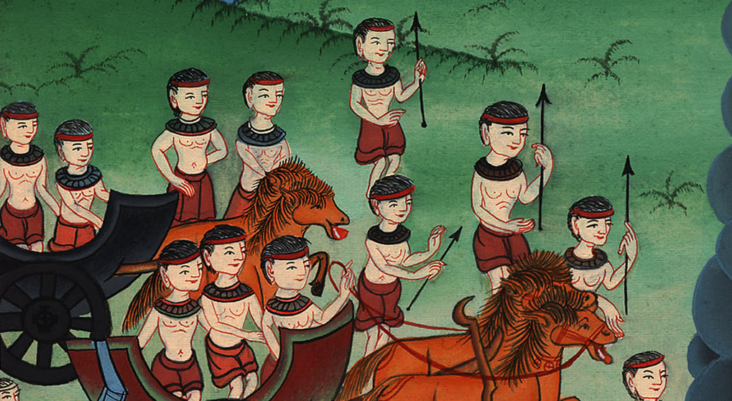
Exodus 14:8

Slide 15
1 Samuel
9The Egyptians pursued them. All the horses and chariots of Pharaoh, his horsemen, and his army overtook them encamping by the sea,

Slide 16
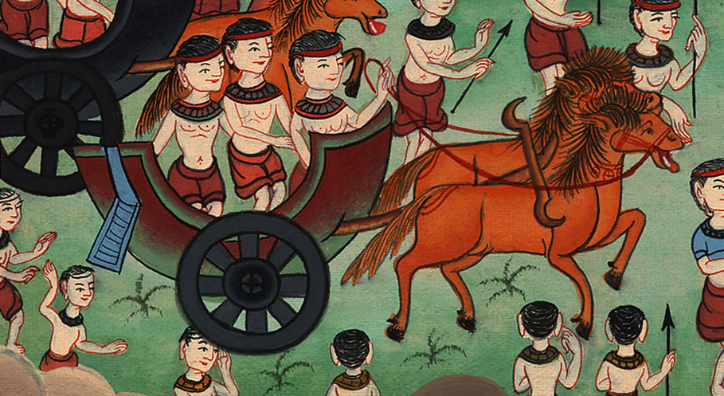
Exodus 14:9

Slide 17
1 Samuel
10When Pharaoh came near, the children of Israel lifted up their eyes, and behold, the Egyptians were marching after them; and they were very afraid. The children of Israel cried out to Yahweh.

Slide 18
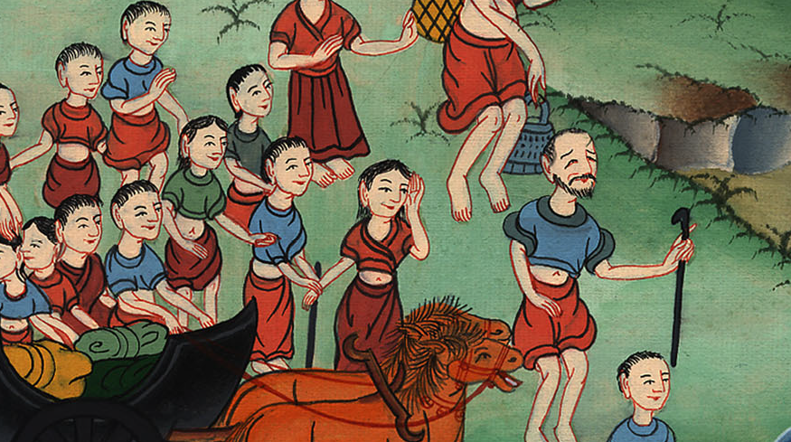
Exodus 14:10

Slide 19
1 Samuel
11They said to Moses, “Because there were no graves in Egypt, have you taken us away to die in the wilderness? Why have you treated us this way, to bring us out of Egypt?

Slide 20
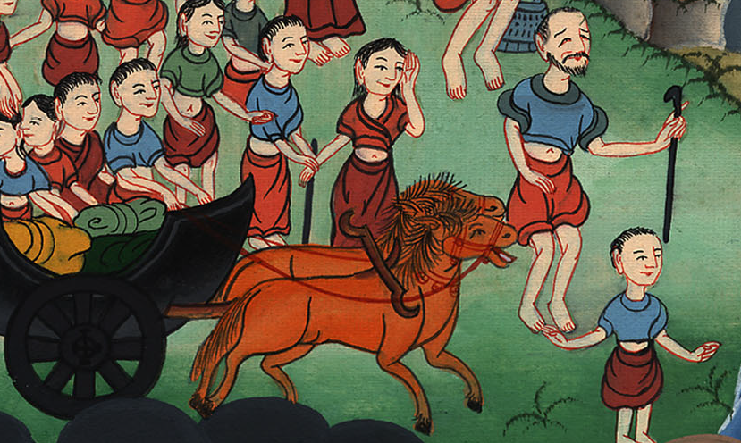
Exodus 14:11

Slide 21
1 Samuel
13Moses said to the people, “Don’t be afraid. Stand still, and see the salvation of Yahweh, which he will work for you today; for you will never again see the Egyptians whom you have seen today.

Slide 22
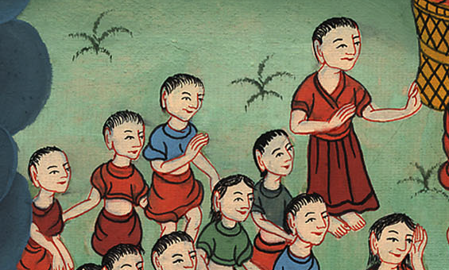
Exodus 14:13

Slide 23
1 Samuel
14Yahweh will fight for you, and you shall be still.”

Slide 24
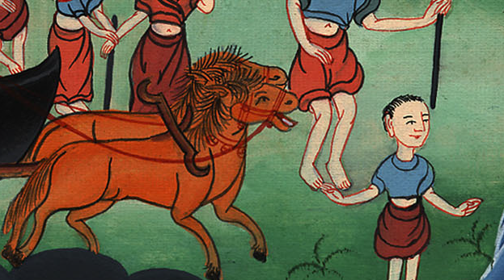
Exodus 14:14

Slide 25
1 Samuel
15Yahweh said to Moses, “Why do you cry to me? Speak to the children of Israel, that they go forward.

Slide 26
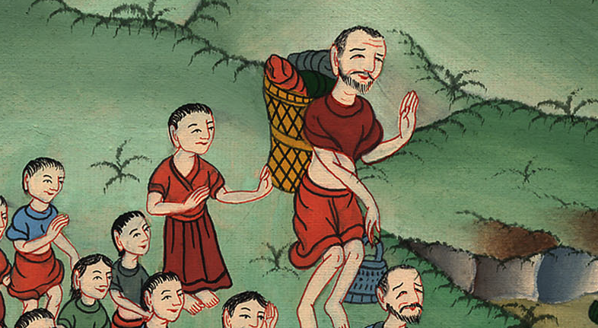
Exodus 14:15

Slide 27
1 Samuel
16Lift up your rod, and stretch out your hand over the sea and divide it. Then the children of Israel shall go into the middle of the sea on dry ground.

Slide 28
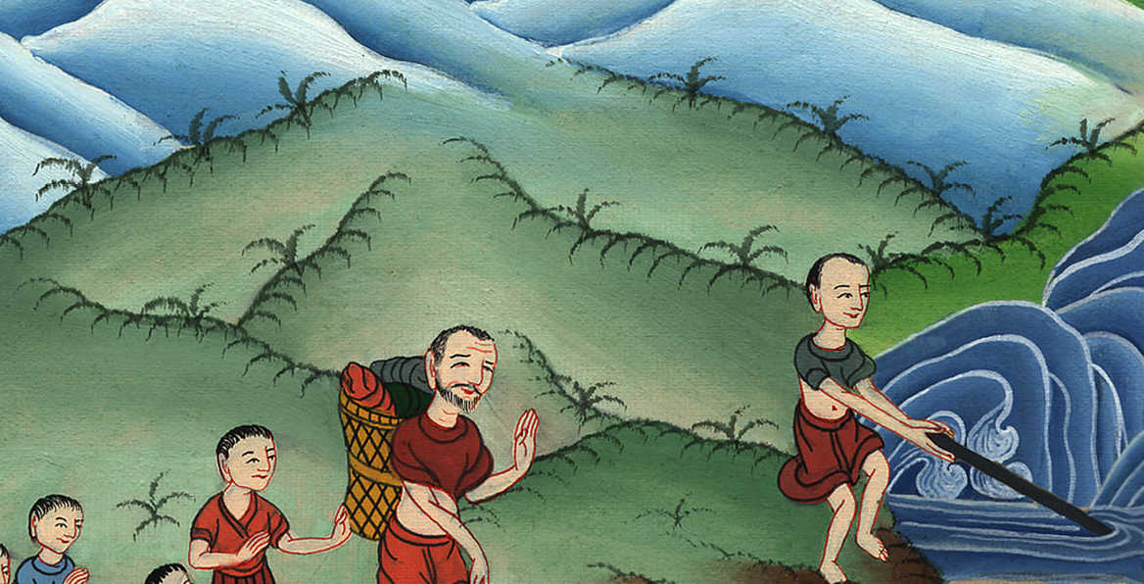
Exodus 14:16

Slide 29
1 Samuel
21Moses stretched out his hand over the sea, and Yahweh caused the sea to go back by a strong east wind all night, and made the sea dry land, and the waters were divided.

Slide 30
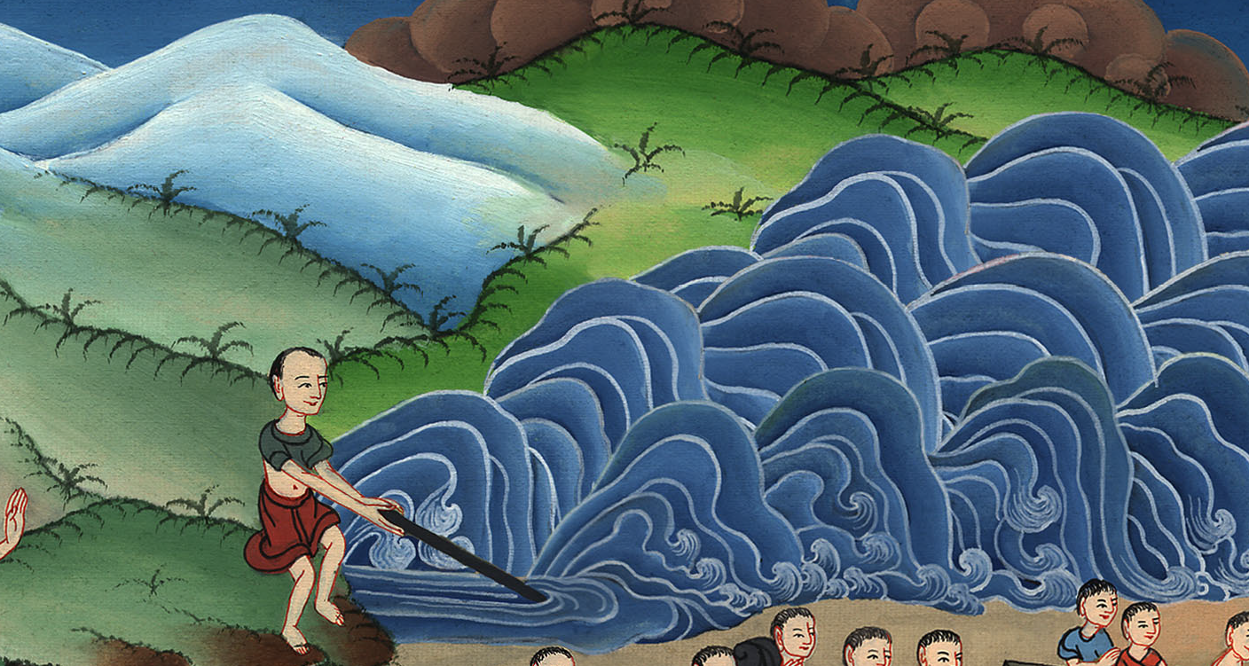
Exodus 14:21

Slide 31
1 Samuel
22The children of Israel went into the middle of the sea on the dry ground; and the waters were a wall to them on their right hand and on their left.

Slide 32
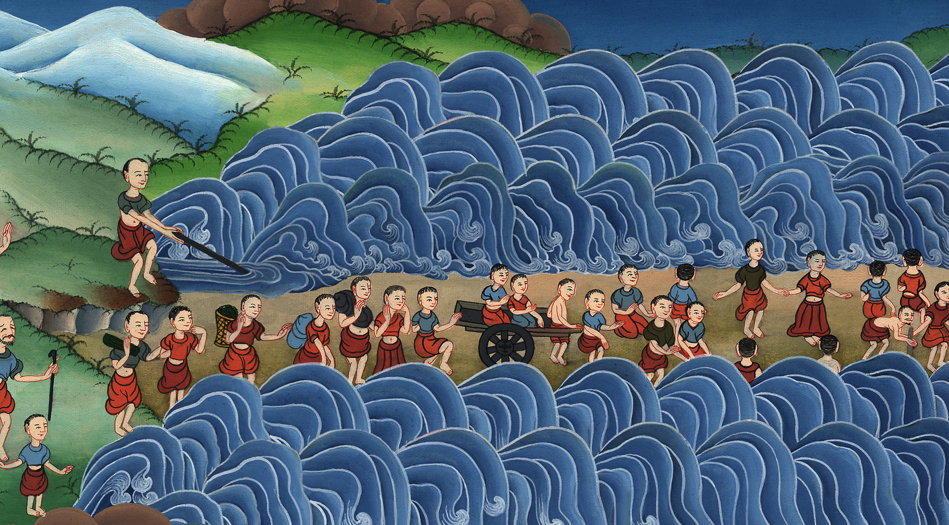
Exodus 14:22

Slide 33
1 Samuel
23The Egyptians pursued, and went in after them into the middle of the sea: all of Pharaoh’s horses, his chariots, and his horsemen.

Slide 34
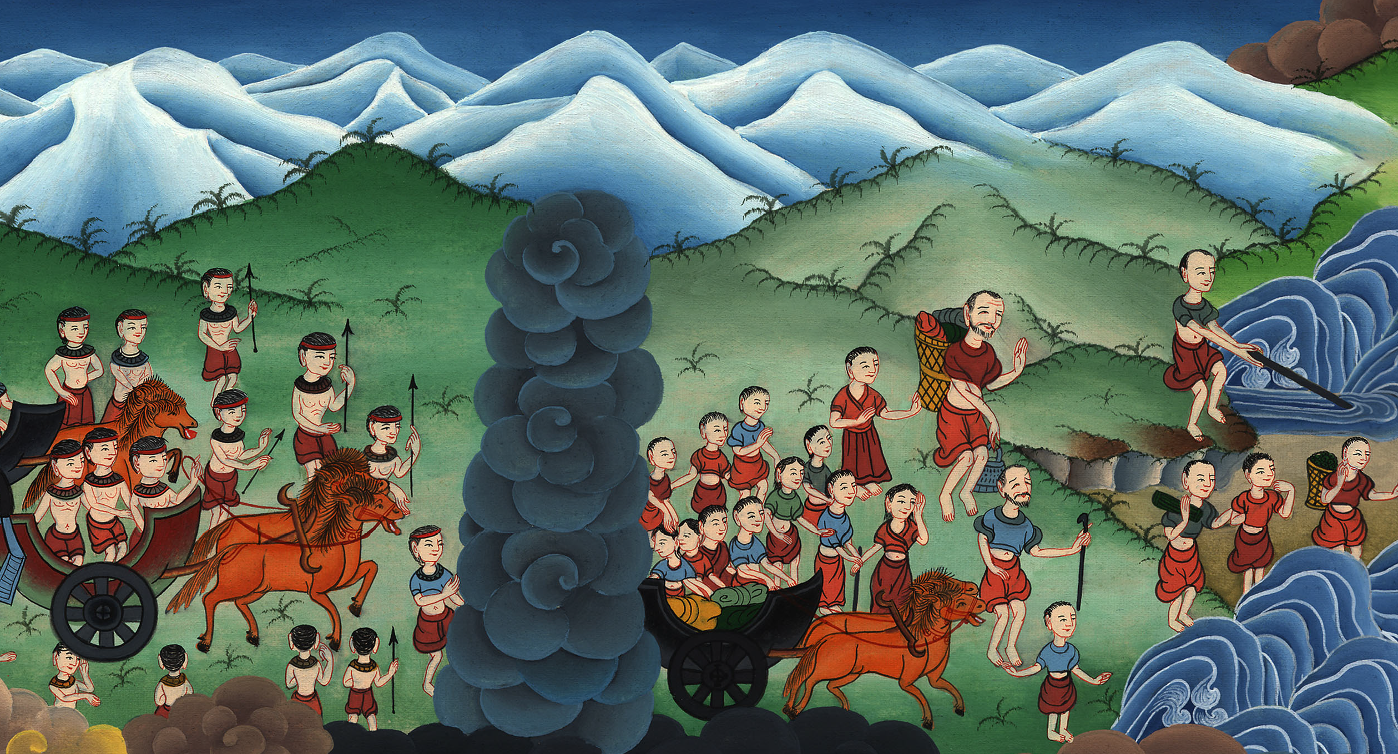
Exodus 14:23

Slide 35
1 Samuel
24In the morning watch, Yahweh looked out on the Egyptian army through the pillar of fire and of cloud, and confused the Egyptian army.

Slide 36
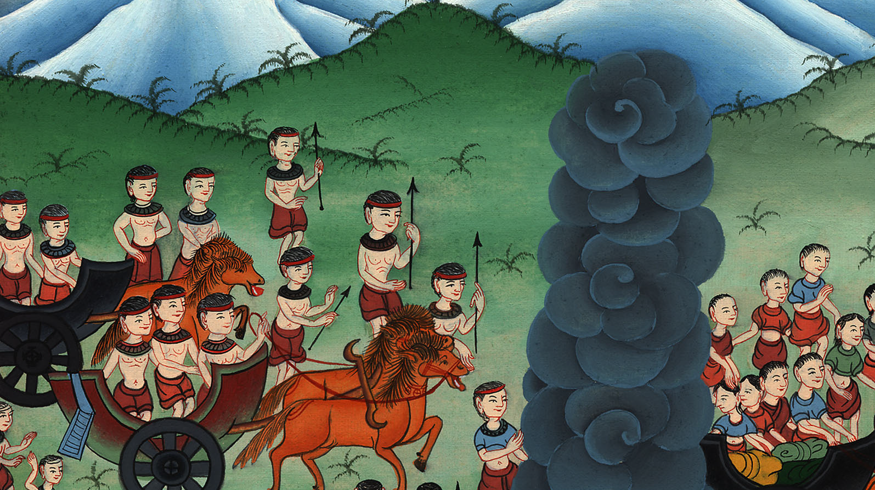
Exodus 14:24

Slide 37
1 Samuel
25He took off their chariot wheels, and they drove them heavily; so that the Egyptians said, “Let’s flee from the face of Israel, for Yahweh fights for them against the Egyptians!”

Slide 38
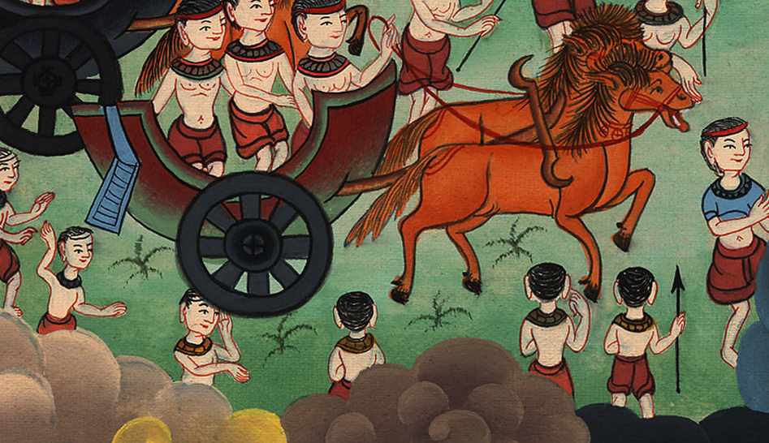
Exodus 14:25

Slide 39
1 Samuel
26Yahweh said to Moses, “Stretch out your hand over the sea, that the waters may come again on the Egyptians, on their chariots, and on their horsemen.”

Slide 40
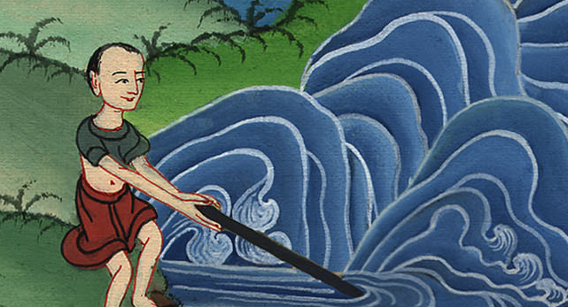
Exodus 14:26

Slide 41
1 Samuel
27Moses stretched out his hand over the sea, and the sea returned to its strength when the morning appeared; and the Egyptians fled against it. Yahweh overthrew the Egyptians in the middle of the sea.

Slide 42
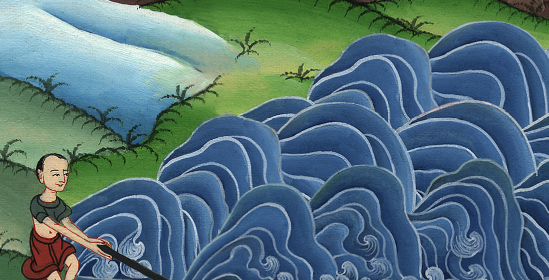
Exodus 14:27

Slide 43
1 Samuel
28The waters returned, and covered the chariots and the horsemen, even all Pharaoh’s army that went in after them into the sea. There remained not so much as one of them.

Slide 44
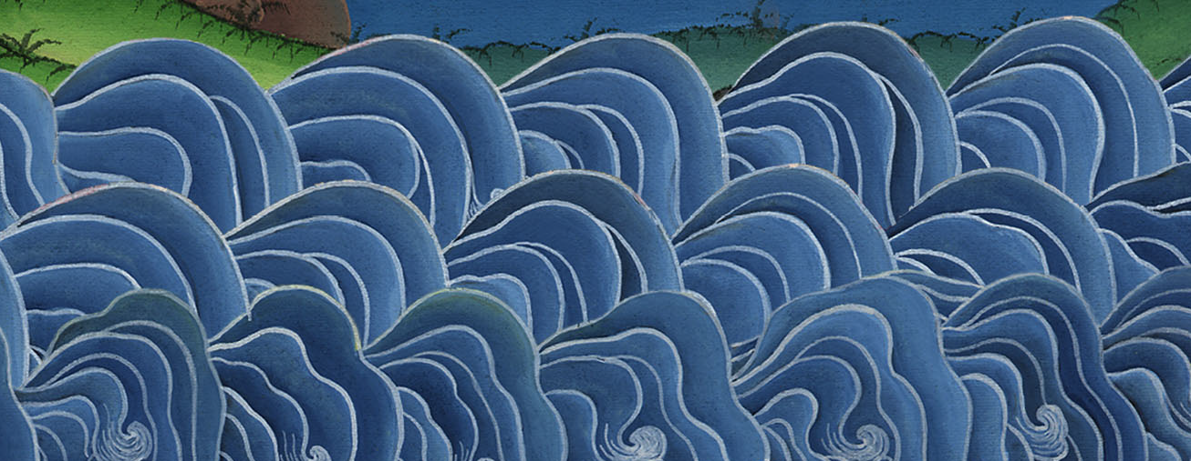
Exodus 14:28

Slide 45
1 Samuel
29But the children of Israel walked on dry land in the middle of the sea, and the waters were a wall to them on their right hand and on their left.

Slide 46
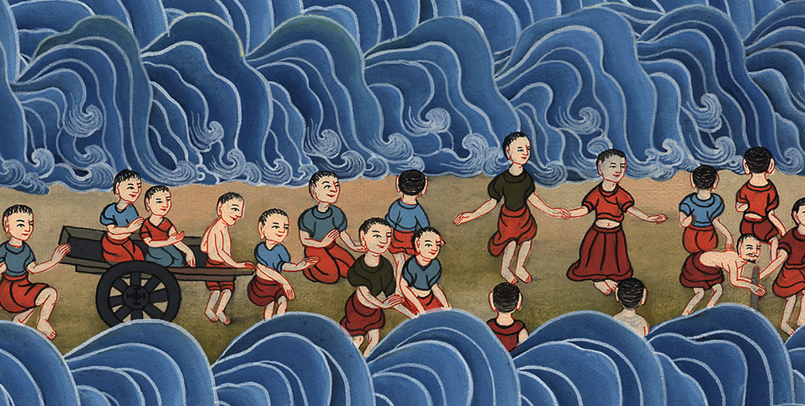
Exodus 14:29

Slide 47
1 Samuel
31Israel saw the great work which Yahweh did to the Egyptians, and the people feared Yahweh; and they believed in Yahweh and in his servant Moses.

Slide 48
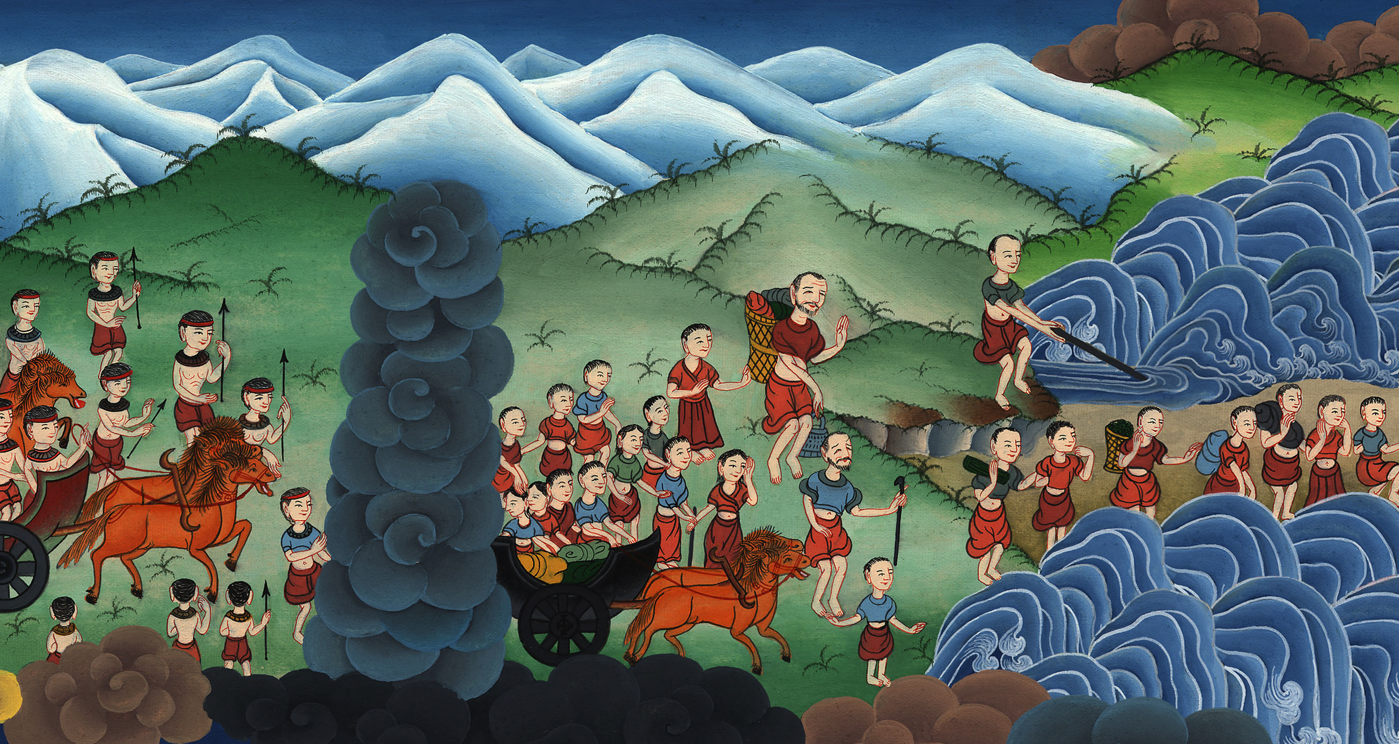
Exodus 14:31

