Slide 1
10-2
This work is licensed under a Creative Commons Attribution-ShareAlike 4.0 International License.
Please add this statement to all the videos you create.
English Bible quotes are from the World English Bible US, which is in the public domain.
Notes:
checked

Slide 2
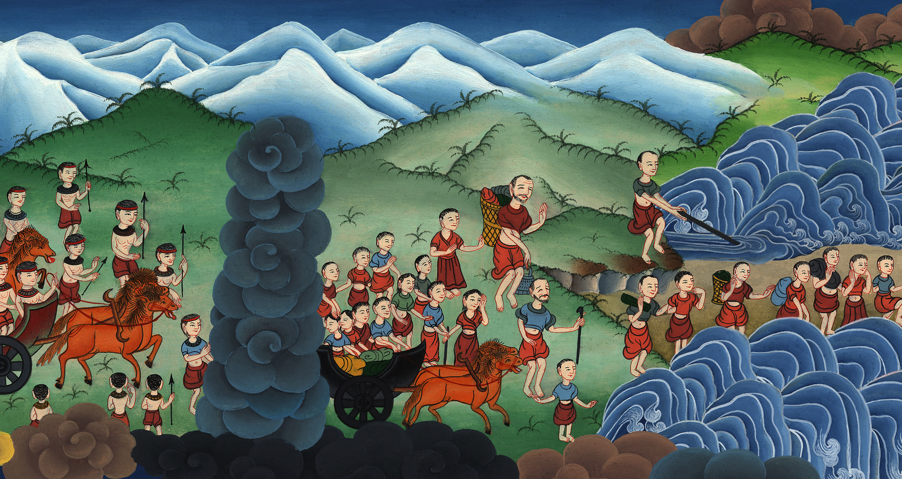
The Song of Moses and Miriam
Exodus 15:1-21

Slide 3
The Song of Moses and Miriam
Exodus 15:1-21
Notes:
First draft

Slide 4
The Song of Moses and Miriam
Exodus 15:1-21

Slide 5
Exodus15:1Then Moses and the children of Israel sang this song to Yahweh, and said,
“I will sing to Yahweh, for he has triumphed gloriously.
He has thrown the horse and his rider into the sea.

Slide 6
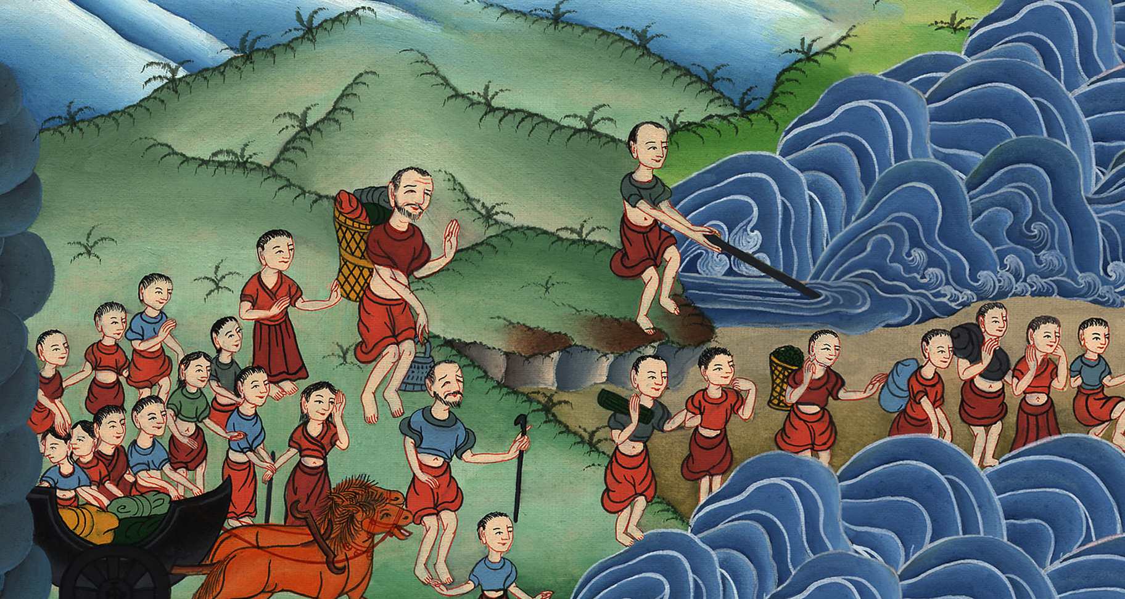
Exodus 15:1

Slide 7
2Yah is my strength and song.
He has become my salvation.
This is my God, and I will praise him;
my father’s God, and I will exalt him.

Slide 8
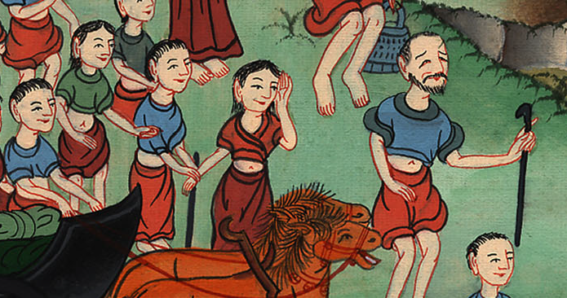
Exodus 15:2

Slide 9
3Yahweh is a man of war.
Yahweh is his name.

Slide 10
Exodus 15:3

Slide 11
4He has cast Pharaoh’s chariots and his army into the sea.
His chosen captains are sunk in the Red Sea.

Slide 12
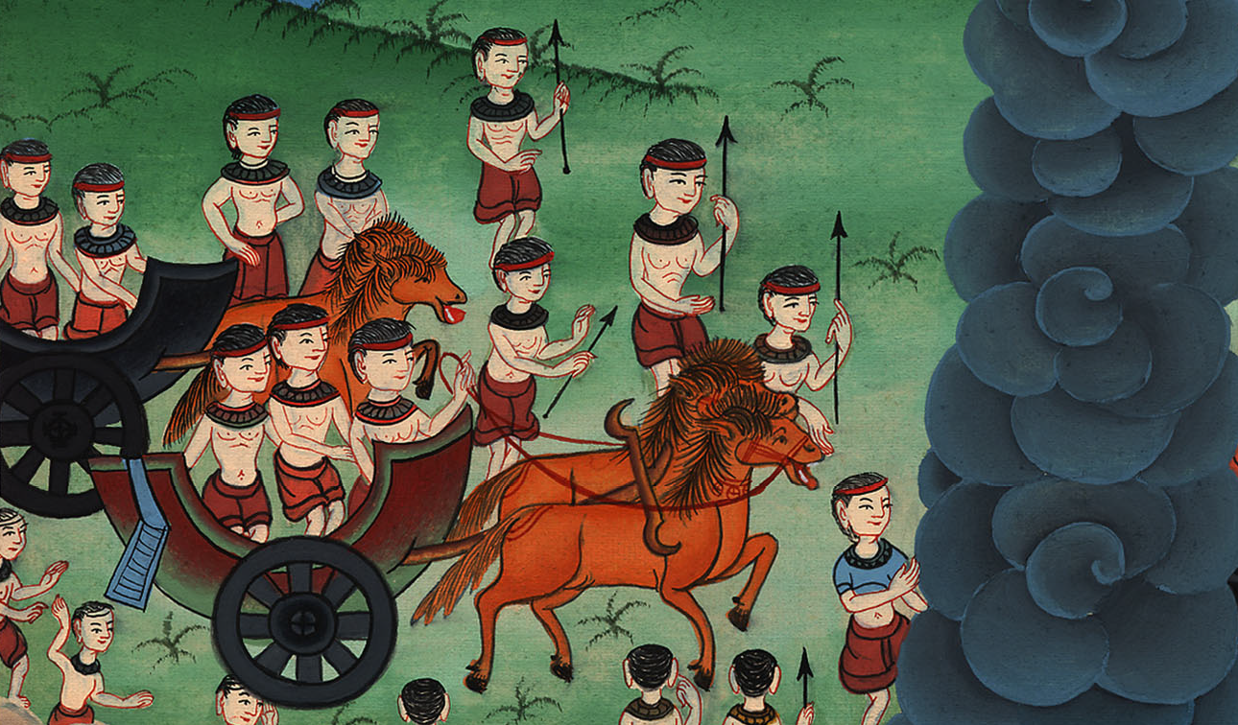
Exodus 15:4

Slide 13
5The deeps cover them.
They went down into the depths like a stone.

Slide 14
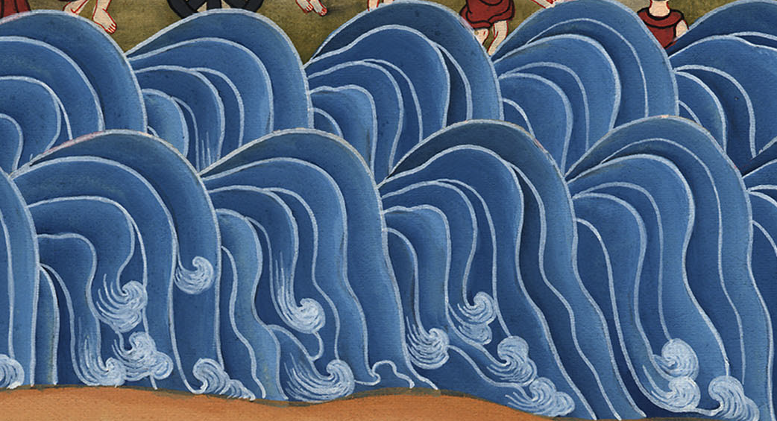
Exodus 15:5

Slide 15
6Your right hand, Yahweh, is glorious in power.
Your right hand, Yahweh, dashes the enemy in pieces.

Slide 16
Exodus 15:6

Slide 17
7In the greatness of your excellency, you overthrow those who rise up against you.
You send out your wrath. It consumes them as stubble.

Slide 18
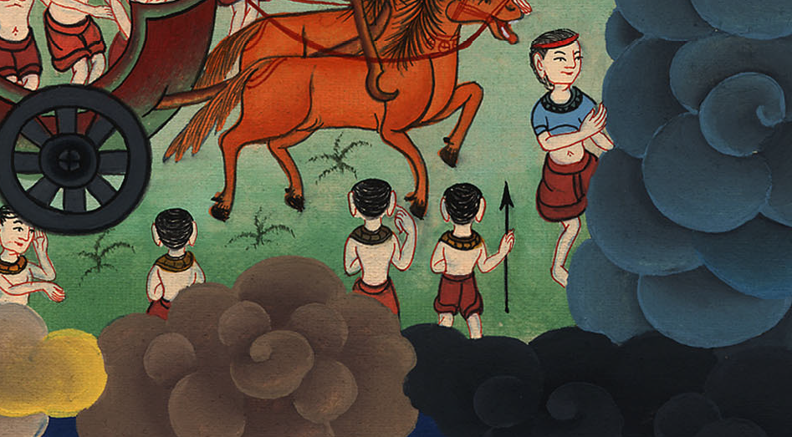
Exodus 15:7

Slide 19
8With the blast of your nostrils, the waters were piled up.
The floods stood upright as a heap.
The deeps were congealed in the heart of the sea.

Slide 20
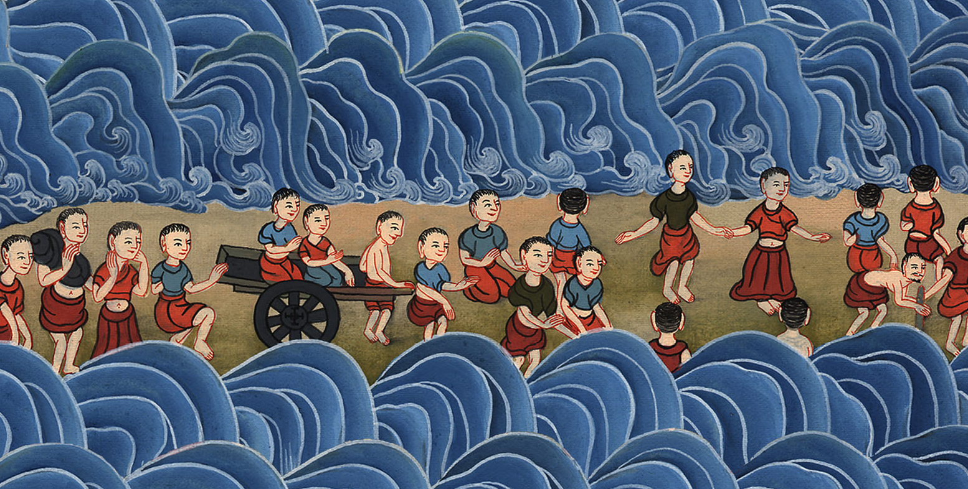
Exodus 15:8

Slide 21
9The enemy said, ‘I will pursue. I will overtake. I will divide the plunder.
My desire will be satisfied on them.
I will draw my sword. My hand will destroy them.’

Slide 22
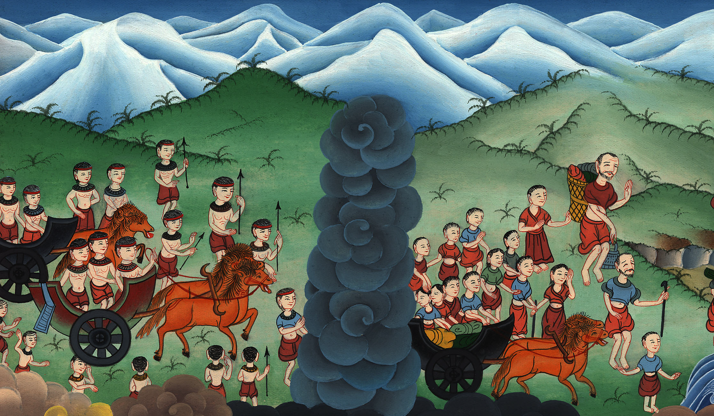
Exodus 15:9

Slide 23
10You blew with your wind.
The sea covered them.
They sank like lead in the mighty waters.

Slide 24
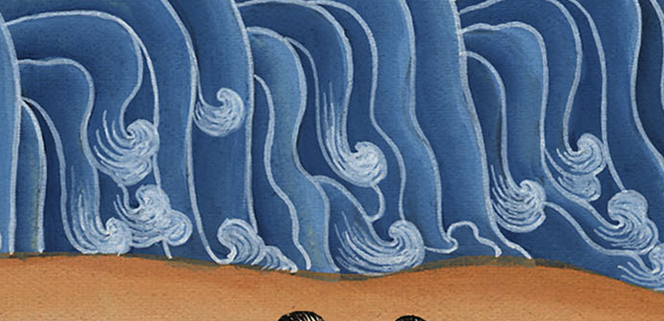
Exodus 15:10

Slide 25
11Who is like you, Yahweh, among the gods?
Who is like you, glorious in holiness,
fearful in praises, doing wonders?

Slide 26
Exodus 15:11

Slide 27
12You stretched out your right hand.
The earth swallowed them.

Slide 28
Exodus 15:12

Slide 29
13“You, in your loving kindness, have led the people that you have redeemed.
You have guided them in your strength to your holy habitation.

Slide 30
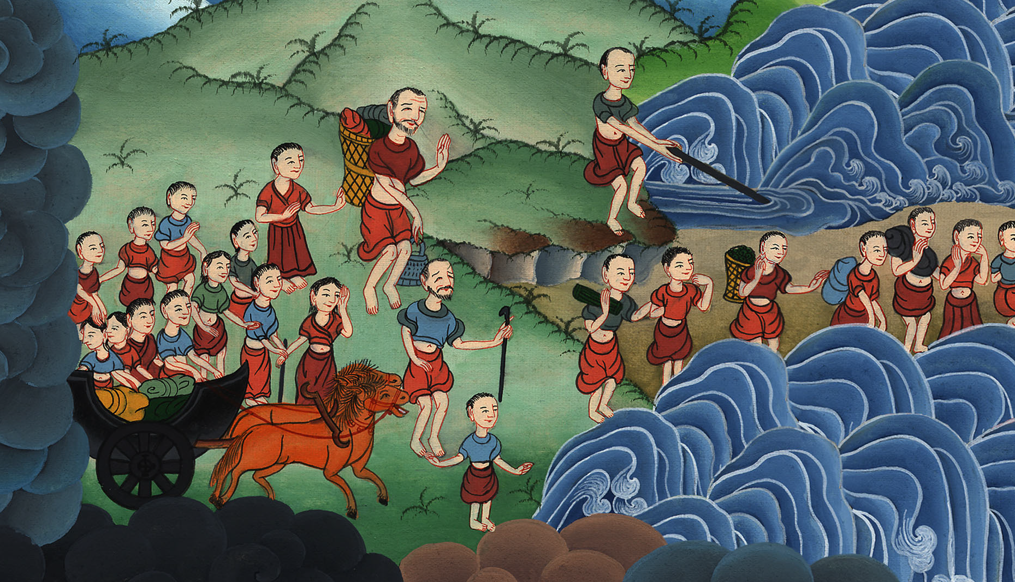
Exodus 15:13

Slide 31
14The peoples have heard.
They tremble.
Pangs have taken hold of the inhabitants of Philistia.

Slide 32
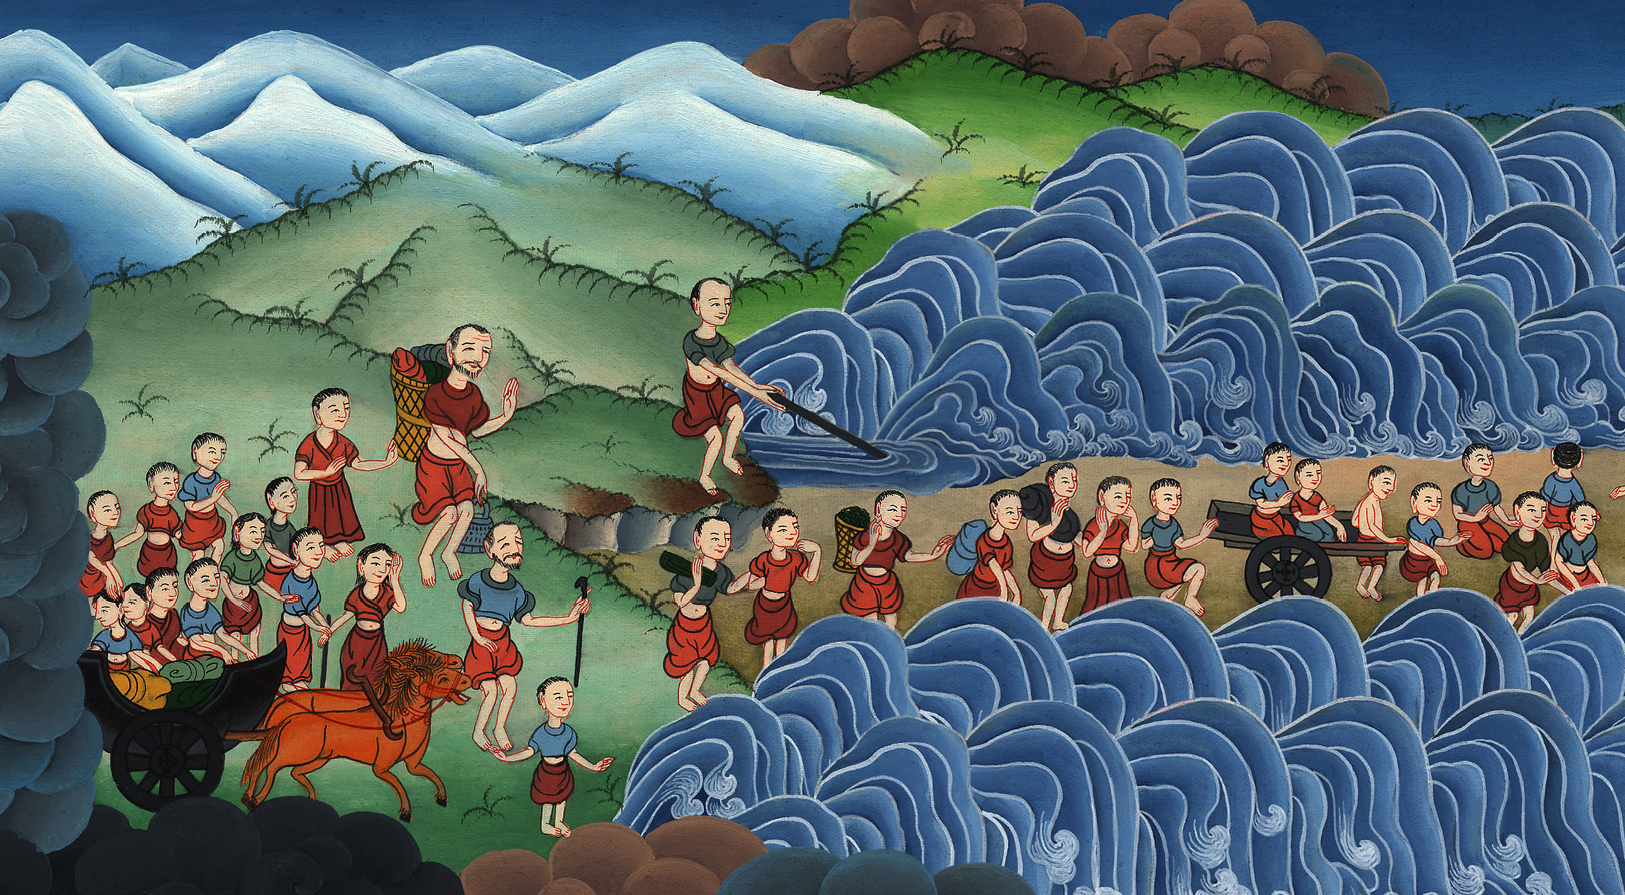
Exodus 15:14

Slide 33
15Then the chiefs of Edom were dismayed.
Trembling takes hold of the mighty men of Moab.
All the inhabitants of Canaan have melted away.

Slide 34
Exodus 15:15

Slide 35
16Terror and dread falls on them.
By the greatness of your arm they are as still as a stone,
until your people pass over, Yahweh,
until the people you have purchased pass over.

Slide 36
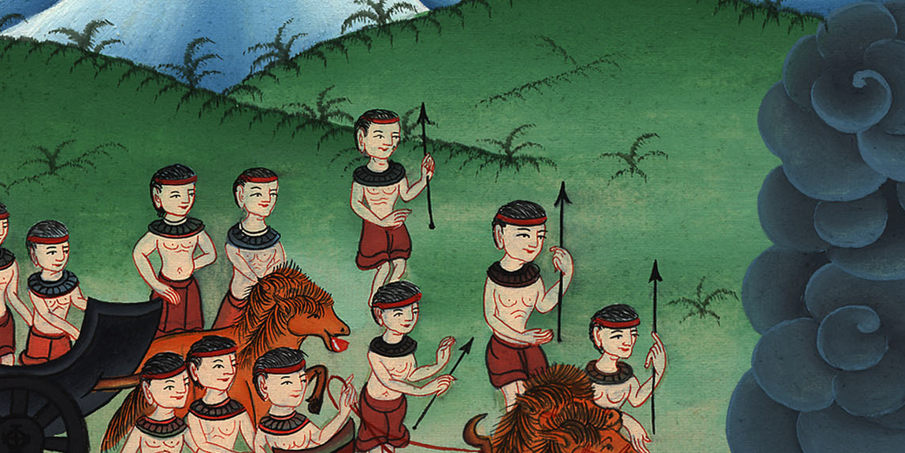
Exodus 15:16

Slide 37
17You will bring them in, and plant them in the mountain of your inheritance,
the place, Yahweh, which you have made for yourself to dwell in:
the sanctuary, Lord, which your hands have established.

Slide 38
Exodus 15:17

Slide 39
18Yahweh will reign forever and ever.”

Slide 40
Exodus 15:18

Slide 41
19For the horses of Pharaoh went in with his chariots and with his horsemen into the sea, and Yahweh brought back the waters of the sea on them; but the children of Israel walked on dry land in the middle of the sea.

Slide 42
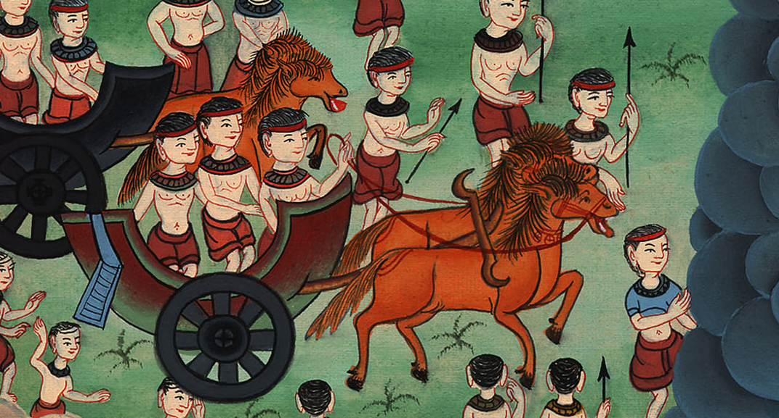
Exodus 15:19

Slide 43
20Miriam the prophetess, the sister of Aaron, took a tambourine in her hand; and all the women went out after her with tambourines and with dances.

Slide 44
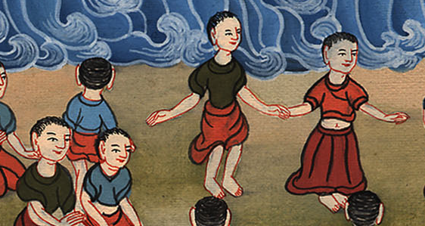
Exodus 15:20

Slide 45
21Miriam answered them,
“Sing to Yahweh, for he has triumphed gloriously.
He has thrown the horse and his rider into the sea.”

Slide 46
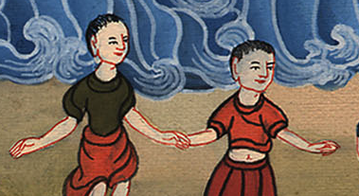
Exodus 15:21

