Slide 1
10-3
This work is licensed under a Creative Commons Attribution-ShareAlike 4.0 International License.
Please add this statement to all the videos you create.
English Bible quotes are from the World English Bible US, which is in the public domain.
Notes:
checked

Slide 2
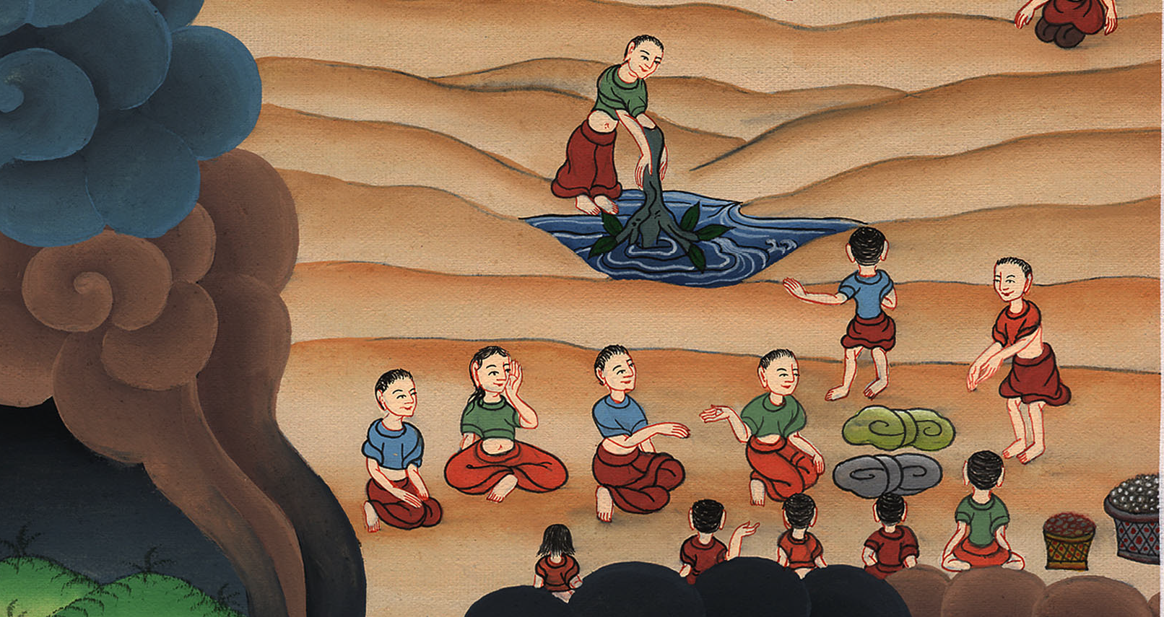
Bitter water made sweet –
Exodus 15:22-27

Slide 3
2) Bitter water made sweet – Exodus 15:22-27
Notes:
checked
2) Bitter water made sweet – Ex 15:22-27 (Right 2nd)

Slide 4
Bitter water made sweet –
Exodus 15:22-27

Slide 5
Exodus15:22Moses led Israel onward from the Red Sea, and they went out into the wilderness of Shur; and they went three days in the wilderness, and found no water.

Slide 6
Exodus 15:22

Slide 7
23When they came to Marah, they couldn’t drink from the waters of Marah, for they were bitter. Therefore its name was called Marah

Slide 8
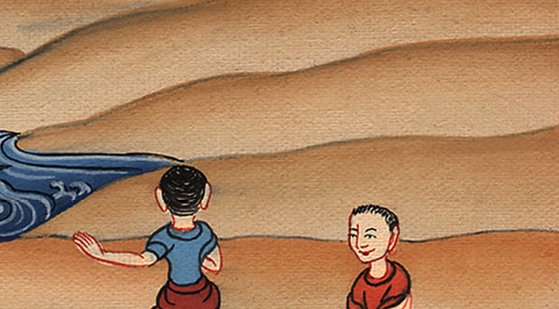
Exodus 15:23

Slide 9
24The people murmured against Moses, saying, “What shall we drink?”

Slide 10
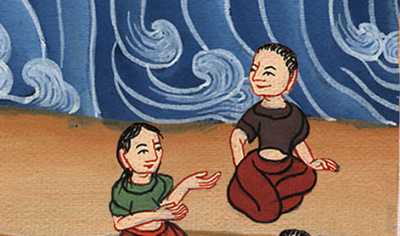
Exodus 15:24

Slide 11
25Then he cried to Yahweh. Yahweh showed him a tree, and he threw it into the waters, and the waters were made sweet.

Slide 12
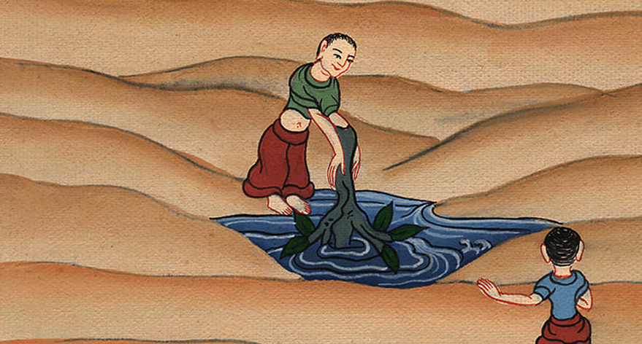
Exodus 15:25

Slide 13
There he made a statute and an ordinance for them, and there he tested them.

Slide 14
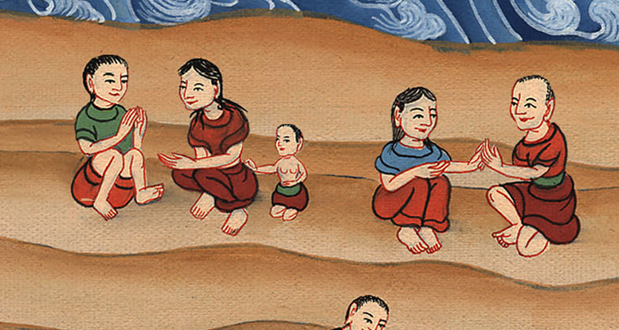
Exodus 15:25

Slide 15
26He said, “If you will diligently listen to Yahweh your God’s voice, and will do that which is right in his eyes, and will pay attention to his commandments, and keep all his statutes, I will put none of the diseases on you which I have put on the Egyptians; for I am Yahweh who heals you.”

Slide 16
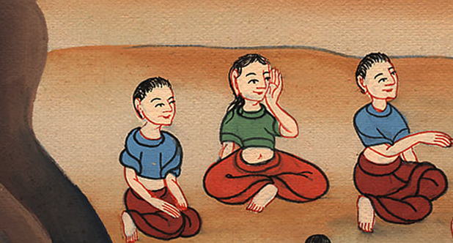
Exodus 15:26

Slide 17
27They came to Elim, where there were twelve springs of water and seventy palm trees. They encamped there by the waters.

Slide 18
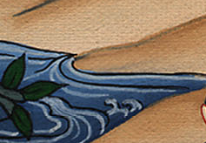
Exodus 15:27

