Slide 1
10-4
This work is licensed under a Creative Commons Attribution-ShareAlike 4.0 International License.
Please add this statement to all the videos you create.
English Bible quotes are from the World English Bible US, which is in the public domain.
Notes:
checked

Slide 2
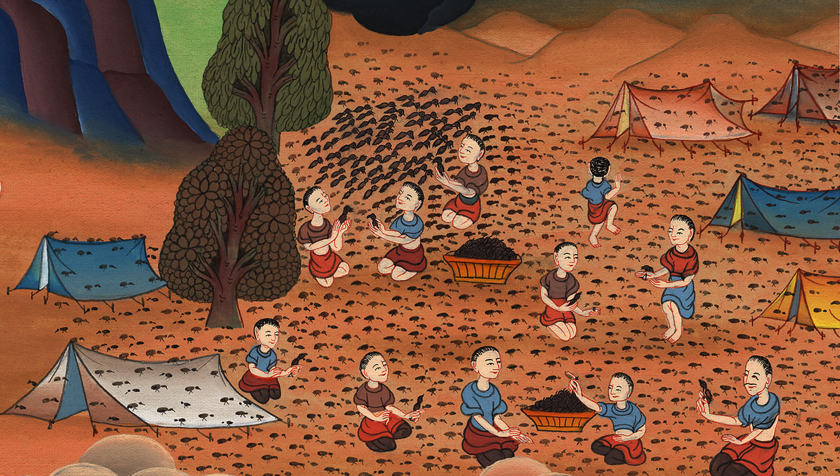
Quail –
Exodus 16:1-13a

Slide 3
3) Quail – Exodus 16:1-13a (Right 3rd)
Notes:
First draft

Slide 4
Quail –
Exodus 16:1-13a

Slide 5
Exodus16:1They took their journey from Elim, and all the congregation of the children of Israel came to the wilderness of Sin, which is between Elim and Sinai, on the fifteenth day of the second month after their departing out of the land of Egypt.

Slide 6
Exodus 16:1

Slide 7
2The whole congregation of the children of Israel murmured against Moses and against Aaron in the wilderness;

Slide 8
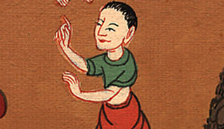
Exodus 16:2

Slide 9
3and the children of Israel said to them, “We wish that we had died by Yahweh’s hand in the land of Egypt, when we sat by the meat pots, when we ate our fill of bread, for you have brought us out into this wilderness to kill this whole assembly with hunger.”

Slide 10
Exodus 16:3

Slide 11
4Then Yahweh said to Moses, “Behold, I will rain bread from the sky for you, and the people shall go out and gather a day’s portion every day, that I may test them, whether they will walk in my law or not.

Slide 12
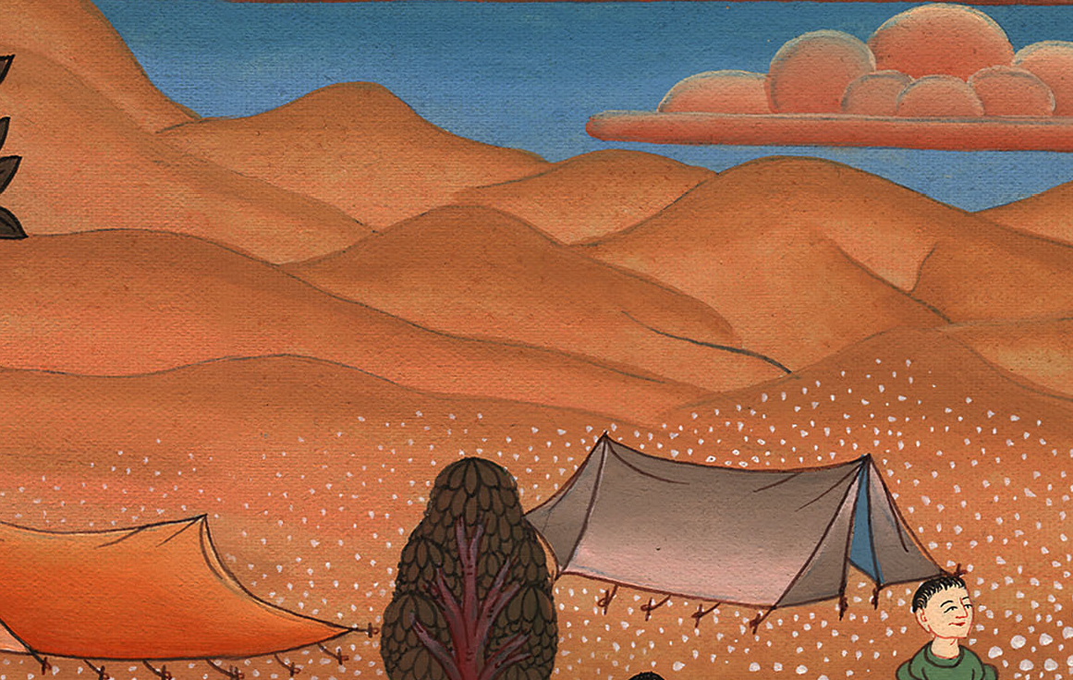
Exodus 16:4

Slide 13
5It shall come to pass on the sixth day, that they shall prepare that which they bring in, and it shall be twice as much as they gather daily.”

Slide 14
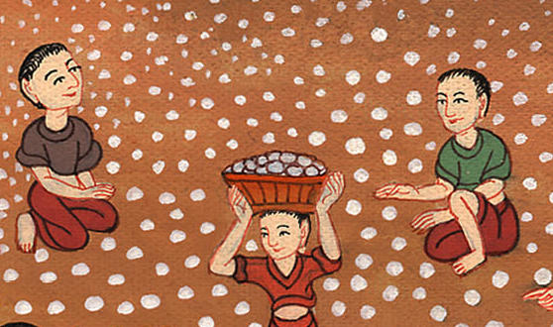
Exodus 16:5

Slide 15
10As Aaron spoke to the whole congregation of the children of Israel, they looked toward the wilderness, and behold, Yahweh’s glory appeared in the cloud.

Slide 16
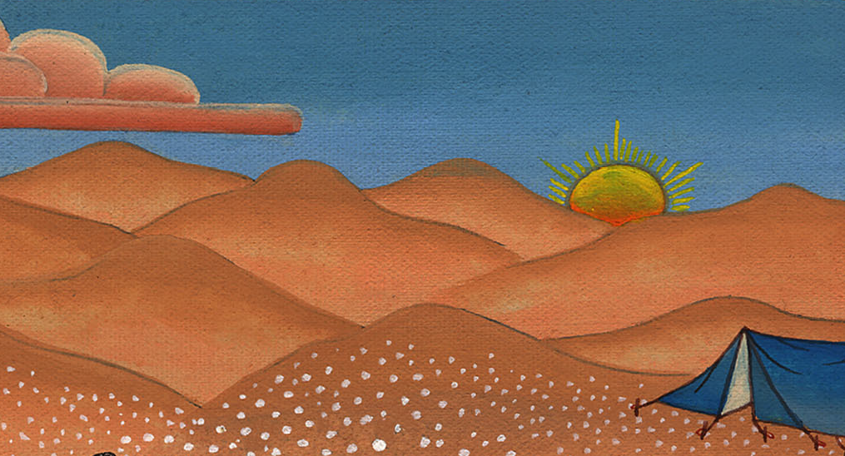
Exodus 16:10

Slide 17
11Yahweh spoke to Moses, saying, 12“I have heard the murmurings of the children of Israel. Speak to them, saying, ‘At evening you shall eat meat, and in the morning you shall be filled with bread. Then you will know that I am Yahweh your God.’”

Slide 18
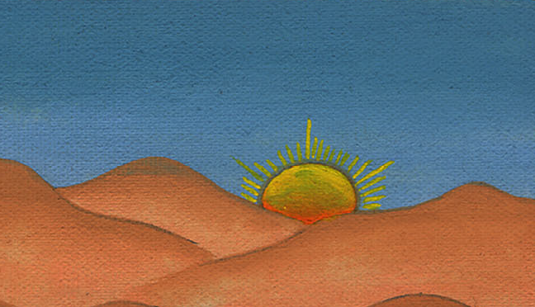
Exodus 16:11

Slide 19
13In the evening, quail came up and covered the camp; and in the morning the dew lay around the camp.

Slide 20
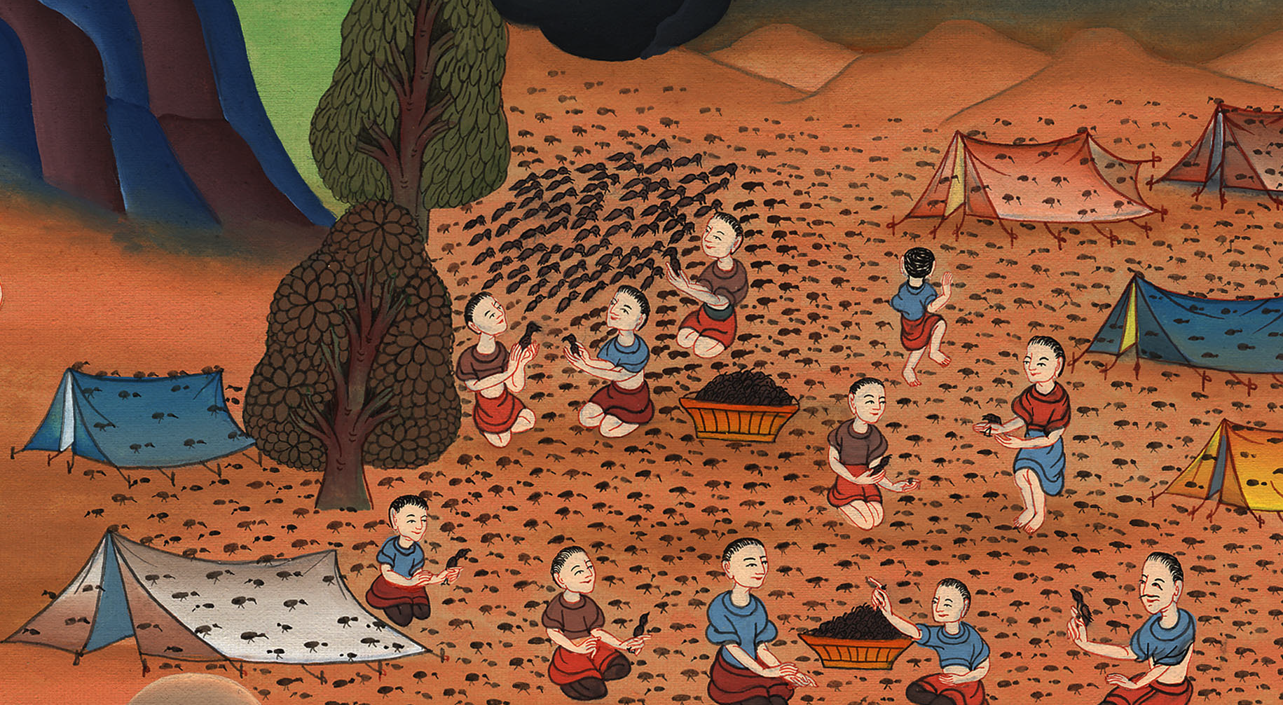
Exodus 16:13

