Slide 1
10-5
This work is licensed under a Creative Commons Attribution-ShareAlike 4.0 International License.
Please add this statement to all the videos you create.
English Bible quotes are from the World English Bible US, which is in the public domain.
Notes:
checked

Slide 2
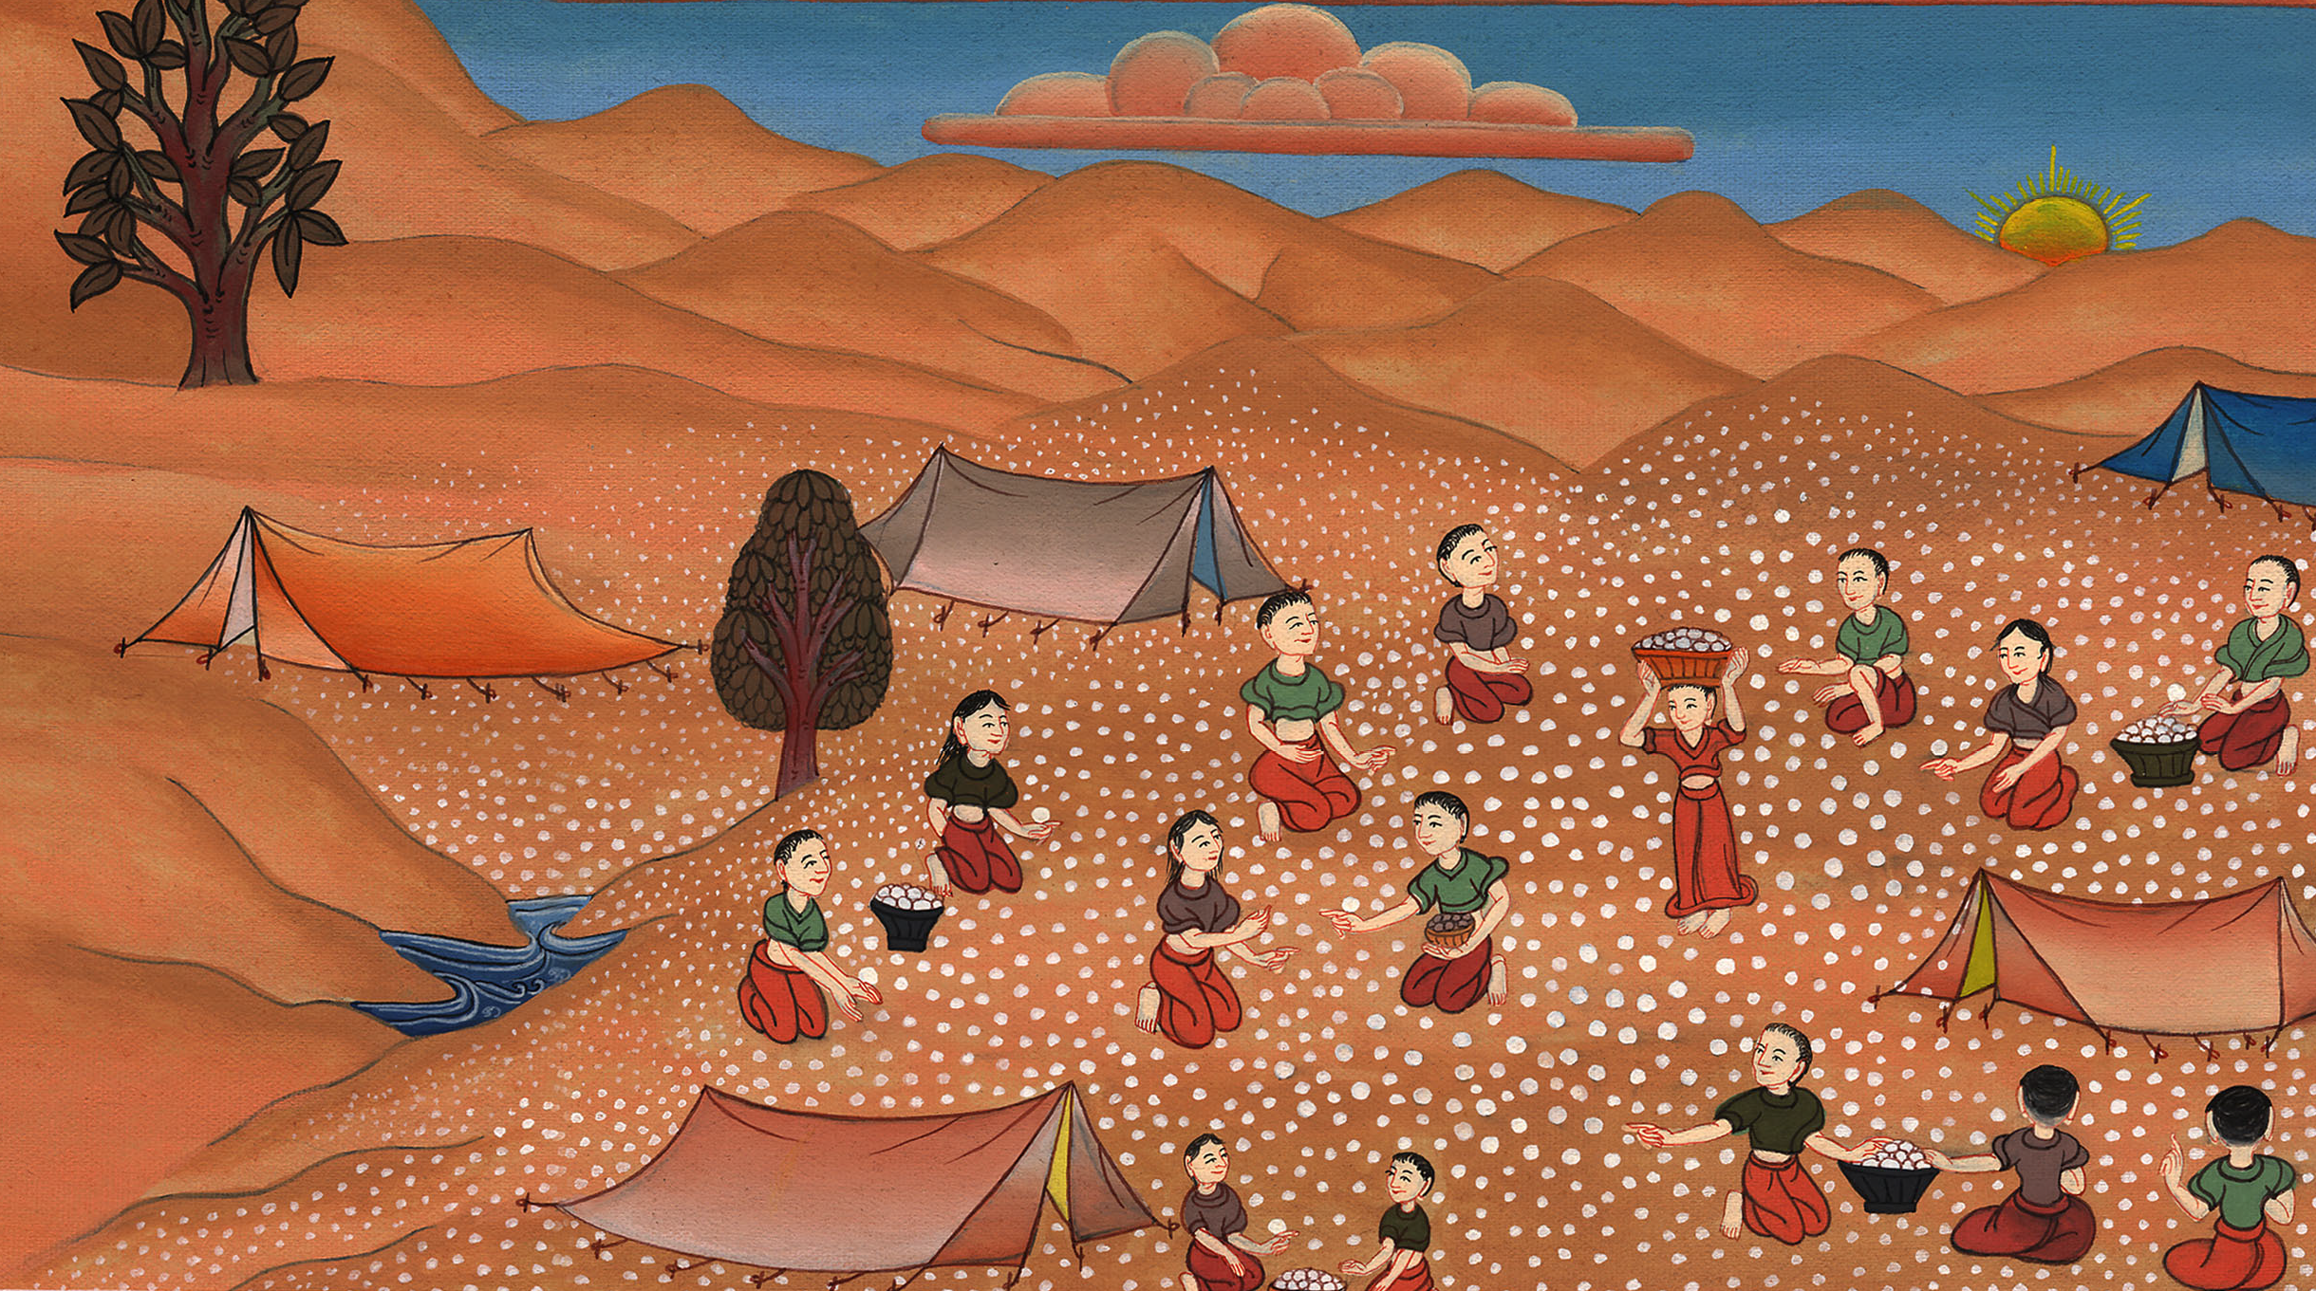
Manna –
Exodus 16:13b-36

Slide 3
Manna – Exodus 16:13b-36 (Right Bottom)
Notes:
First draft

Slide 4
Manna –
Exodus 16:13b-36

Slide 5
13In the evening, quail came up and covered the camp; and in the morning the dew lay around the camp.

Slide 6
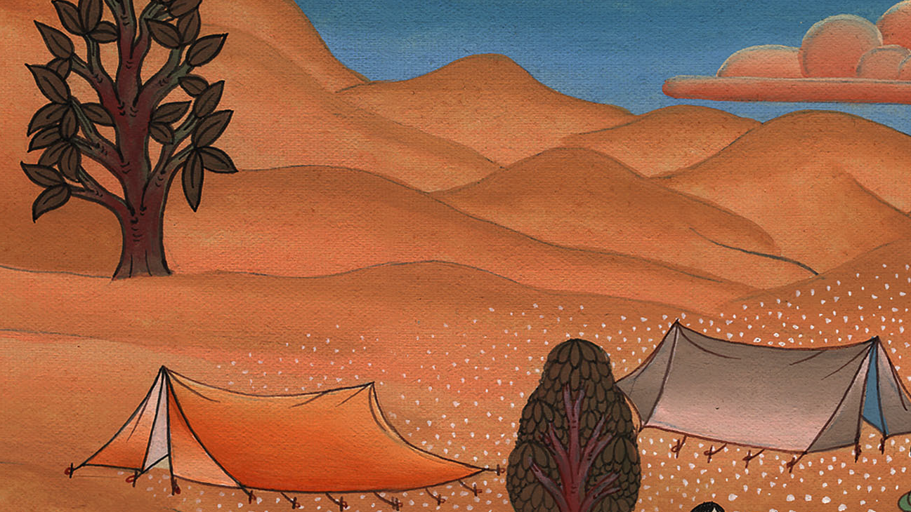
Exodus 16:13

Slide 7
14When the dew that lay had gone, behold, on the surface of the wilderness was a small round thing, small as the frost on the ground.

Slide 8
Exodus 16:14

Slide 9
15When the children of Israel saw it, they said to one another, “What is it?” For they didn’t know what it was. Moses said to them, “It is the bread which Yahweh has given you to eat.

Slide 10
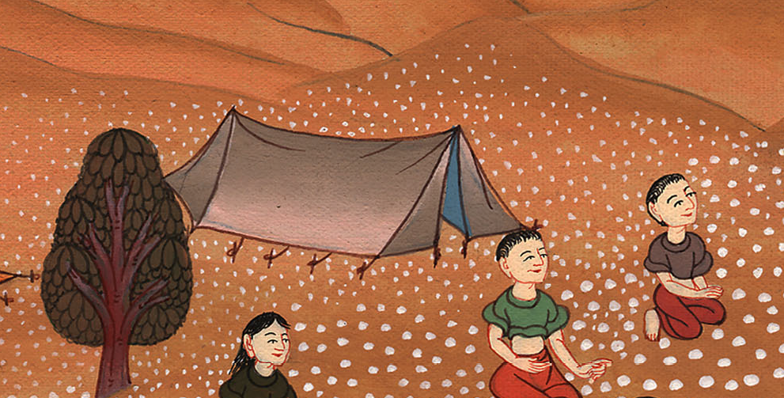
Exodus 16:15

Slide 11
16This is the thing which Yahweh has commanded: ‘Gather of it everyone according to his eating; an omer a head, according to the number of your persons, you shall take it, every man for those who are in his tent.’”

Slide 12
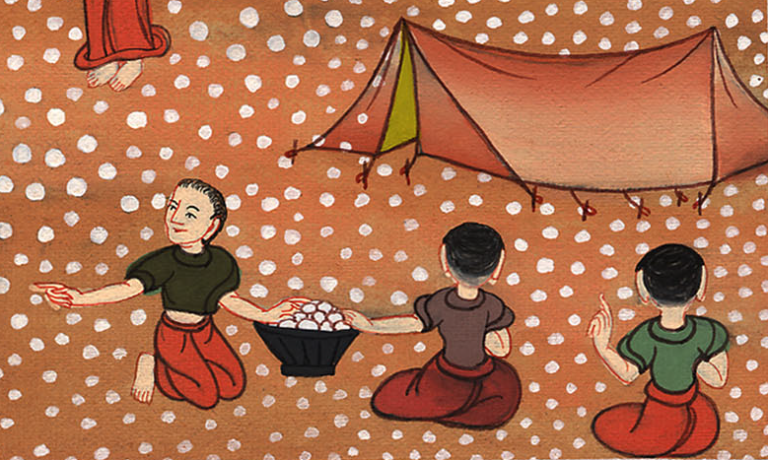
Exodus 16:16

Slide 13
17The children of Israel did so, and some gathered more, some less.

Slide 14
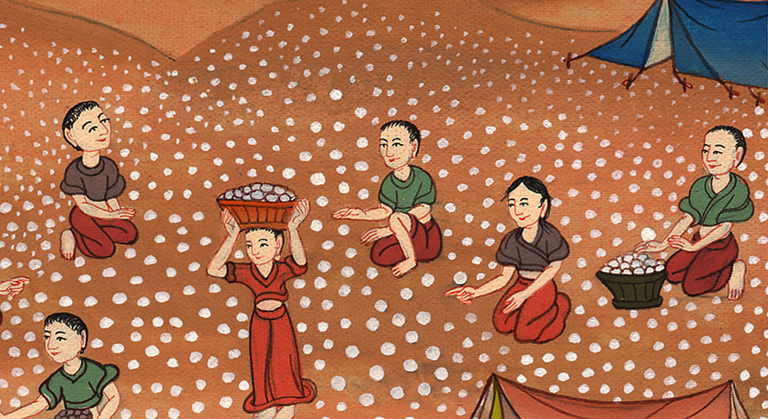
Exodus 16:17

Slide 15
18When they measured it with an omer, he who gathered much had nothing over, and he who gathered little had no lack. They each gathered according to his eating.

Slide 16
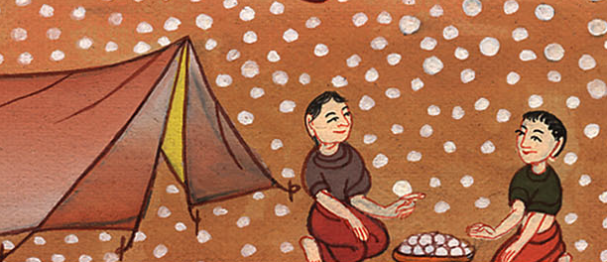
Exodus 16:18

Slide 17
19Moses said to them, “Let no one leave of it until the morning.”

Slide 18
Exodus 16:19

Slide 19
20Notwithstanding they didn’t listen to Moses, but some of them left of it until the morning, so it bred worms and became foul; and Moses was angry with them.

Slide 20
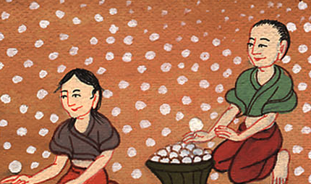
Exodus 16:20

Slide 21
21They gathered it morning by morning, everyone according to his eating. When the sun grew hot, it melted.

Slide 22
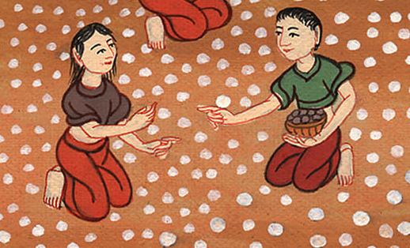
Exodus 16:21

Slide 23
22On the sixth day, they gathered twice as much bread, two omers for each one; and all the rulers of the congregation came and told Moses.

Slide 24
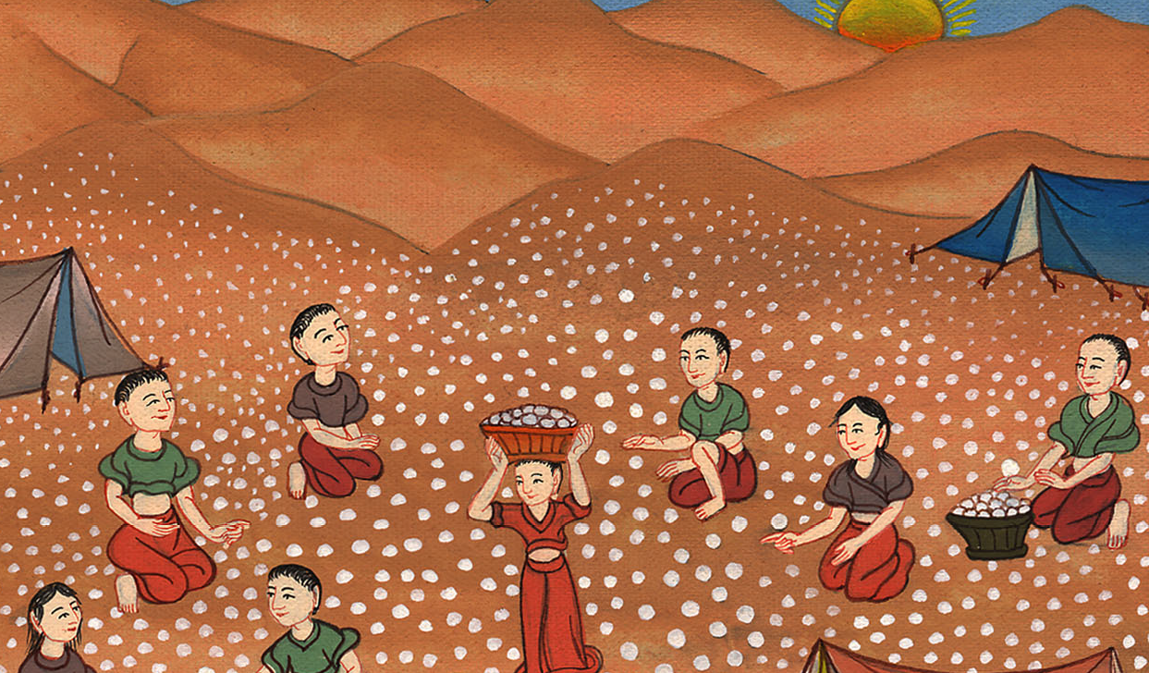
Exodus 16:22

Slide 25
23He said to them, “This is that which Yahweh has spoken, ‘Tomorrow is a solemn rest, a holy Sabbath to Yahweh. Bake that which you want to bake, and boil that which you want to boil; and all that remains over lay up for yourselves to be kept until the morning.’”

Slide 26
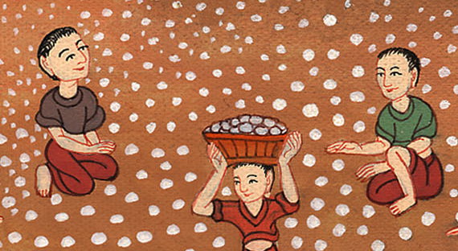
Exodus 16:23

Slide 27
24They laid it up until the morning, as Moses ordered, and it didn’t become foul, and there were no worms in it.

Slide 28
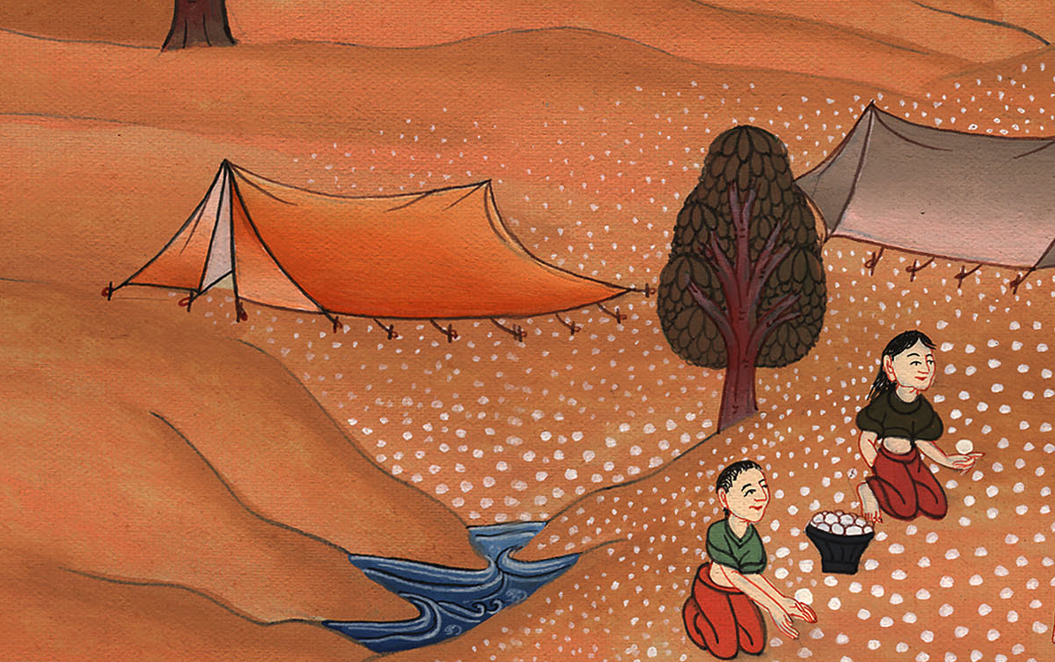
Exodus 16:24

Slide 29
25Moses said, “Eat that today, for today is a Sabbath to Yahweh. Today you shall not find it in the field.

Slide 30
Exodus 16:25

Slide 31
26Six days you shall gather it, but on the seventh day is the Sabbath. In it there shall be none.”

Slide 32
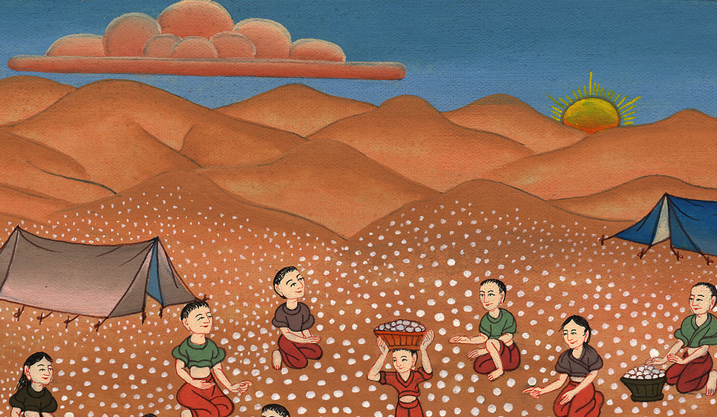
Exodus 16:26

Slide 33
30So the people rested on the seventh day.

Slide 34
Exodus 16:30

Slide 35
31The house of Israel called its name “Manna”, and it was like coriander seed, white; and its taste was like wafers with honey.

Slide 36
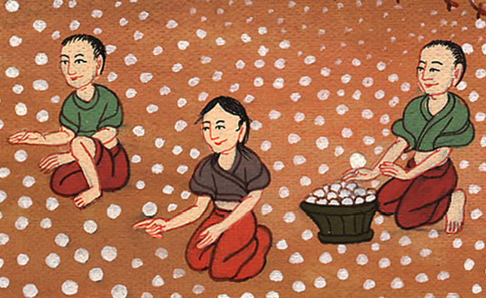
Exodus 16:31

Slide 37
35The children of Israel ate the manna forty years, until they came to an inhabited land. They ate the manna until they came to the borders of the land of Canaan.

Slide 38
Exodus 16:35

