Slide 1
10-6
This work is licensed under a Creative Commons Attribution-ShareAlike 4.0 International License.
Please add this statement to all the videos you create.
English Bible quotes are from the World English Bible US, which is in the public domain.
Notes:
checked

Slide 2
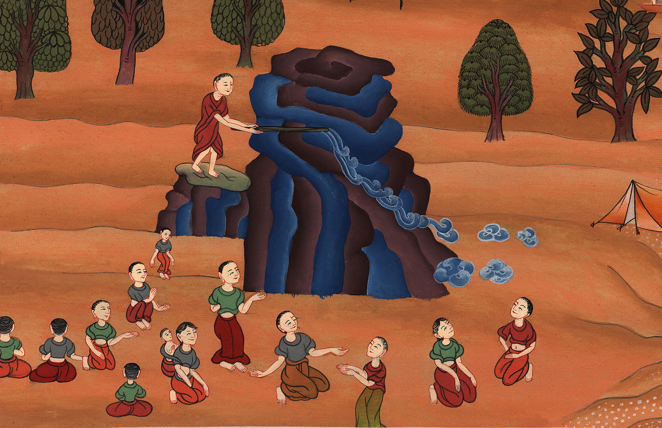
Water from a stone –
Exodus 17:1-7

Slide 3
Water from a stone – Exodus 17:1-7 (Left Bottom)
Notes:
First draft

Slide 4
Water from a stone –
Exodus 17:1-7

Slide 5
Exodus17:1All the congregation of the children of Israel traveled from the wilderness of Sin, starting according to Yahweh’s commandment, and encamped in Rephidim; but there was no water for the people to drink.

Slide 6
Exodus 17:1

Slide 7
2Therefore the people quarreled with Moses, and said, “Give us water to drink.”
Moses said to them, “Why do you quarrel with me? Why do you test Yahweh?”

Slide 8
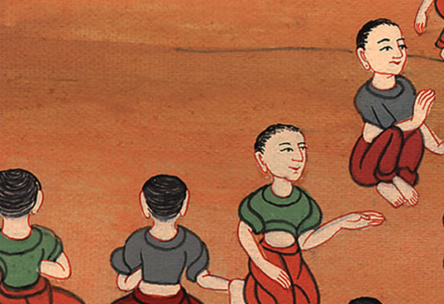
Exodus 17:2

Slide 9
3The people were thirsty for water there; so the people murmured against Moses, and said, “Why have you brought us up out of Egypt, to kill us, our children, and our livestock with thirst?”

Slide 10
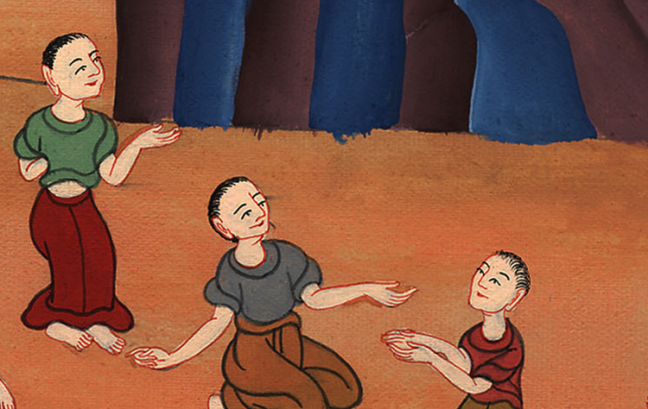
Exodus 17:3

Slide 11
4Moses cried to Yahweh, saying, “What shall I do with these people? They are almost ready to stone me.”

Slide 12
Exodus 17:4

Slide 13
5Yahweh said to Moses, “Walk on before the people, and take the elders of Israel with you, and take the rod in your hand with which you struck the Nile, and go.

Slide 14
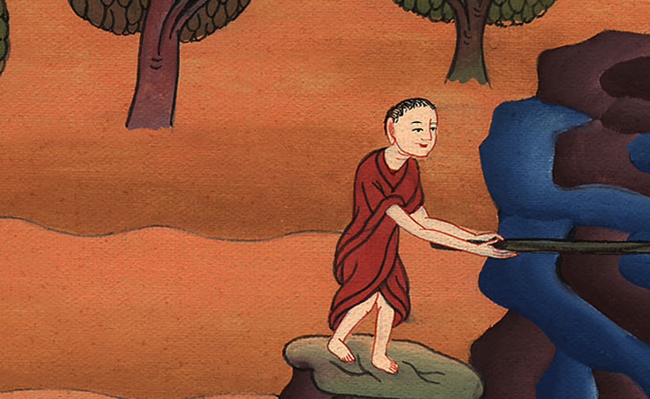
Exodus 17:5

Slide 15
6Behold, I will stand before you there on the rock in Horeb. You shall strike the rock, and water will come out of it, that the people may drink.” Moses did so in the sight of the elders of Israel.

Slide 16
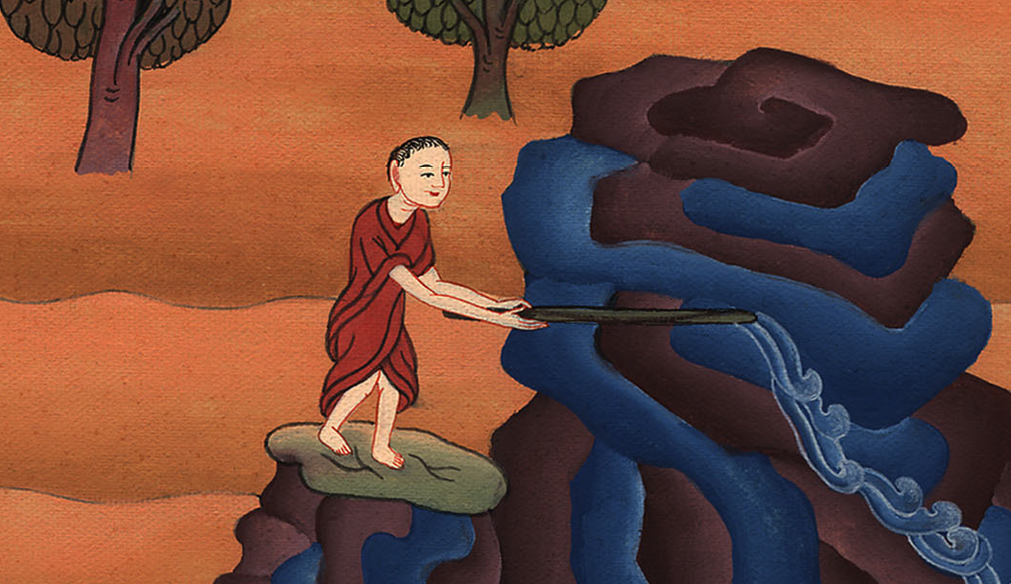
Exodus 17:6

Slide 17
It happened just as God had said

Slide 18
