Slide 1
10-7
This work is licensed under a Creative Commons Attribution-ShareAlike 4.0 International License.
Please add this statement to all the videos you create.
English Bible quotes are from the World English Bible US, which is in the public domain.
Notes:
checked

Slide 2
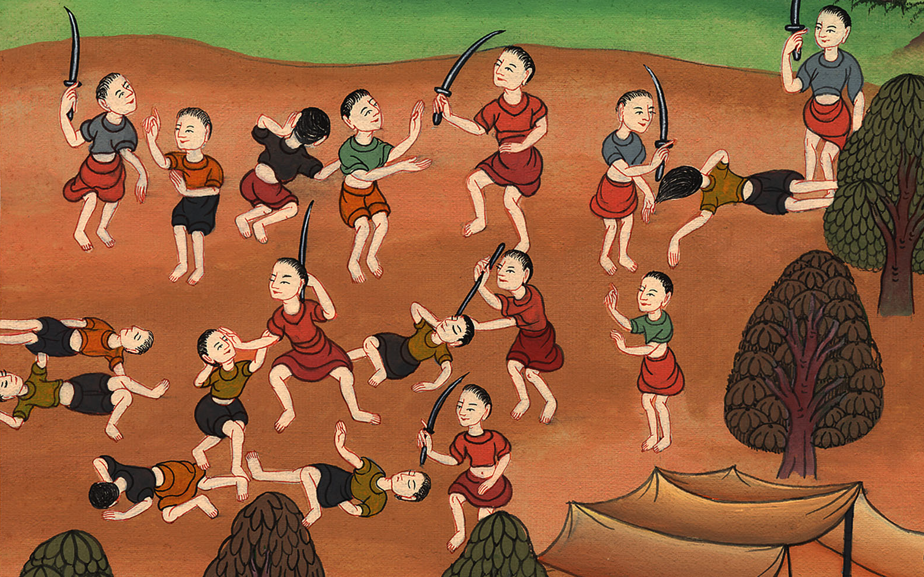
Fighting Amalek – Exodus 17:8-16

Slide 3
6) Fighting Amalek – Exodus 17:8-16 (Left Center)
Notes:
First draft

Slide 4
Fighting Amalek – Exodus 17:8-16

Slide 5
Exodus17:8Then Amalek came and fought with Israel in Rephidim.

Slide 6
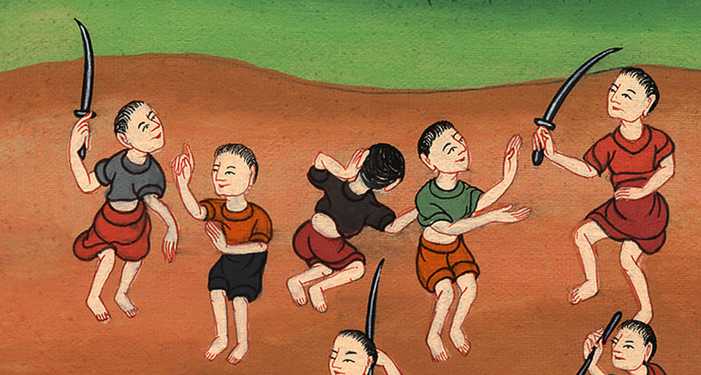
Exodus 17:8

Slide 7
9Moses said to Joshua, “Choose men for us, and go out to fight with Amalek. Tomorrow I will stand on the top of the hill with God’s rod in my hand.”

Slide 8
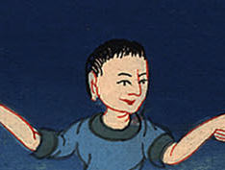
Exodus 17:9

Slide 9
10So Joshua did as Moses had told him, and fought with Amalek; and Moses, Aaron, and Hur went up to the top of the hill.

Slide 10
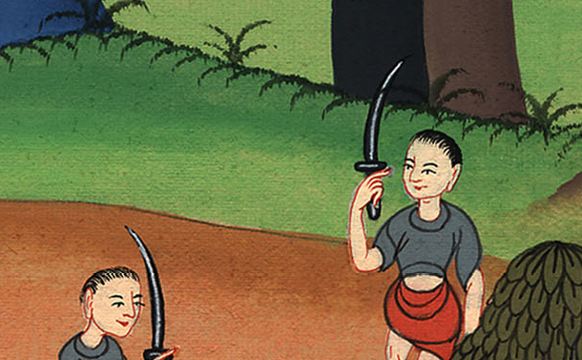
Exodus 17:10

Slide 11
11When Moses held up his hand, Israel prevailed. When he let down his hand, Amalek prevailed.

Slide 12
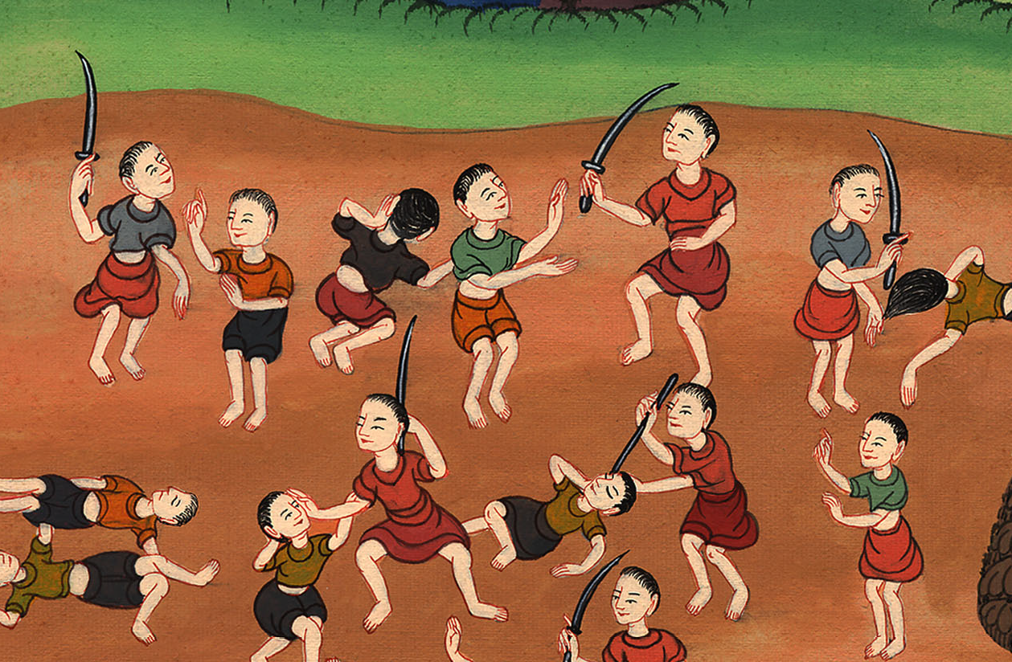
Exodus 17:11

Slide 13
12But Moses’ hands were heavy; so they took a stone, and put it under him, and he sat on it. Aaron and Hur held up his hands, the one on the one side, and the other on the other side. His hands were steady until sunset.

Slide 14
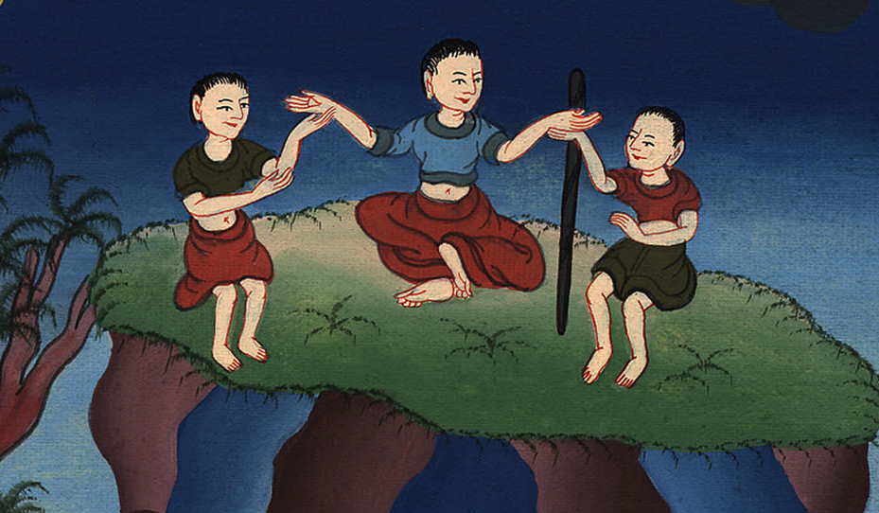
Exodus 17:12

Slide 15
13Joshua defeated Amalek and his people with the edge of the sword.

Slide 16
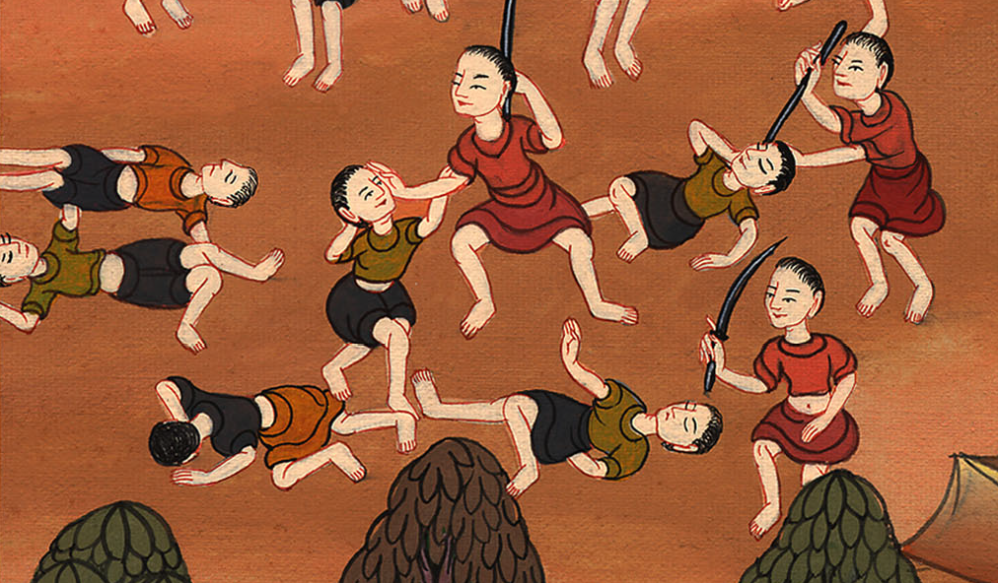
Exodus 17:13

Slide 17
14Yahweh said to Moses, “Write this for a memorial in a book, and rehearse it in the ears of Joshua: that I will utterly blot out the memory of Amalek from under the sky.”

Slide 18
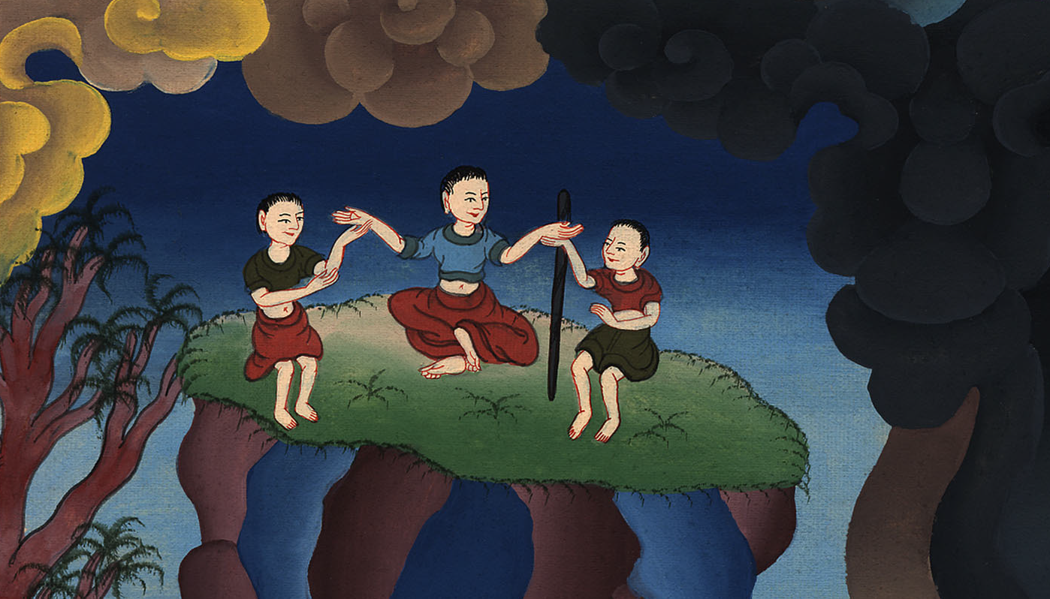
Exodus 17:14

