Slide 1
10-8
This work is licensed under a Creative Commons Attribution-ShareAlike 4.0 International License.
Please add this statement to all the videos you create.
English Bible quotes are from the World English Bible US, which is in the public domain.
Notes:
checked

Slide 2
Mount Sinai – Exodus 19 – 20 & 32-34

Slide 3
Mount Sinai – Exodus 19 – 20 & 32-34 (Center)
Notes:
First draft

Slide 4
Mount Sinai – Exodus 19 – 20 & 32-34

Slide 5
Exodus19:1In the third month after the children of Israel had gone out of the land of Egypt, on that same day they came into the wilderness of Sinai.

Slide 6
Exodus 19:1

Slide 7
3Moses went up to God, and Yahweh called to him out of the mountain, saying, “This is what you shall tell the house of Jacob, and tell the children of Israel:

Slide 8
Exodus 19:3

Slide 9
4‘You have seen what I did to the Egyptians, and how I bore you on eagles’ wings, and brought you to myself.

Slide 10
Exodus 19:4

Slide 11
5Now therefore, if you will indeed obey my voice and keep my covenant, then you shall be my own possession from among all peoples; for all the earth is mine;

Slide 12
Exodus 19:5

Slide 13
6and you shall be to me a kingdom of priests and a holy nation.’ These are the words which you shall speak to the children of Israel.”

Slide 14
Exodus 19:6

Slide 15
16On the third day, when it was morning, there were thunders and lightnings, and a thick cloud on the mountain, and the sound of an exceedingly loud trumpet; and all the people who were in the camp trembled.

Slide 16
Exodus 19:16

Slide 17
17Moses led the people out of the camp to meet God; and they stood at the lower part of the mountain.

Slide 18
Exodus 19:17

Slide 19
18All of Mount Sinai smoked, because Yahweh descended on it in fire; and its smoke ascended like the smoke of a furnace, and the whole mountain quaked greatly.

Slide 20
Exodus 19:18

Slide 21
20Yahweh came down on Mount Sinai, to the top of the mountain. Yahweh called Moses to the top of the mountain, and Moses went up.

Slide 22
Exodus 19:20

Slide 23
Exodus20:1God spoke all these words, saying, 2“I am Yahweh your God, who brought you out of the land of Egypt, out of the house of bondage.

Slide 24
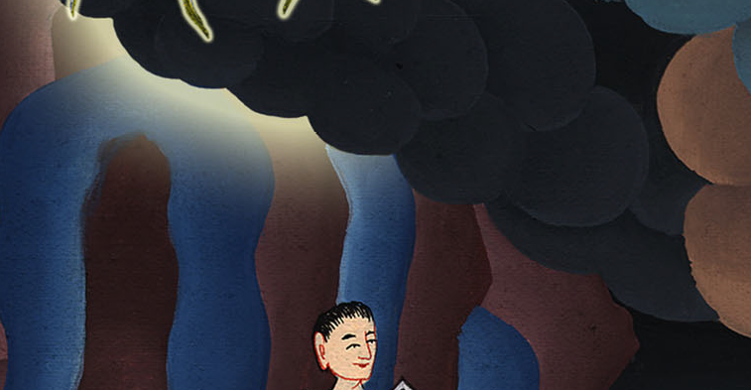
Exodus 20:1,2

Slide 25
3“You shall have no other gods before me.
4“You shall not make for yourselves an idol, nor any image of anything that is in the heavens above, or that is in the earth beneath, or that is in the water under the earth:

Slide 26
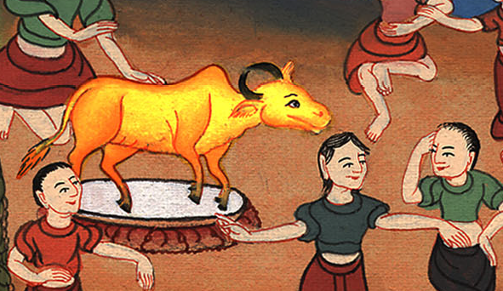
Exodus 20:3

Slide 27
5you shall not bow yourself down to them, nor serve them, for I, Yahweh your God, am a jealous God, visiting the iniquity of the fathers on the children, on the third and on the fourth generation of those who hate me,

Slide 28
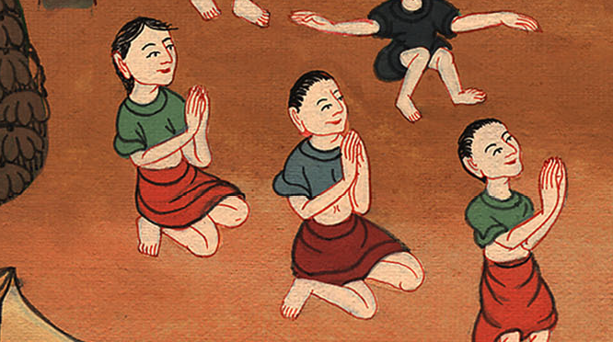
Exodus 20:5

Slide 29
6and showing loving kindness to thousands of those who love me and keep my commandments

Slide 30
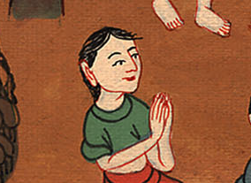
Exodus 20:6

Slide 31
7“You shall not misuse the name of Yahweh your God, for Yahweh will not hold him guiltless who misuses his name.

Slide 32
Exodus 20:7

Slide 33
8“Remember the Sabbath day, to keep it holy. 9You shall labor six days, and do all your work,

Slide 34
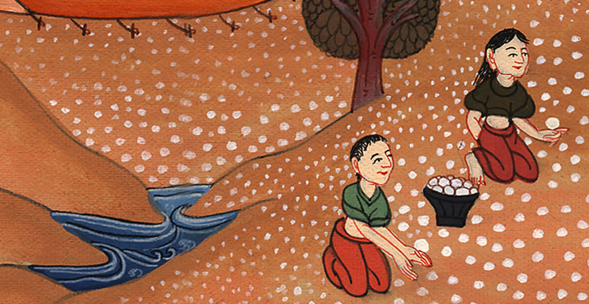
Exodus 20:8

Slide 35
10but the seventh day is a Sabbath to Yahweh your God. You shall not do any work in it, you, nor your son, nor your daughter, your male servant, nor your female servant, nor your livestock, nor your stranger who is within your gates;

Slide 36
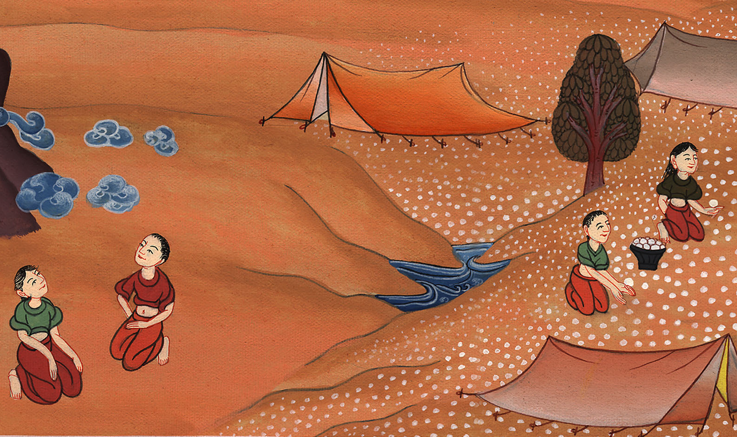
Exodus 20:10

Slide 37
11for in six days Yahweh made heaven and earth, the sea, and all that is in them, and rested the seventh day; therefore Yahweh blessed the Sabbath day, and made it holy.

Slide 38
Exodus 20:11

Slide 39
12“Honor your father and your mother, that your days may be long in the land which Yahweh your God gives you.

Slide 40
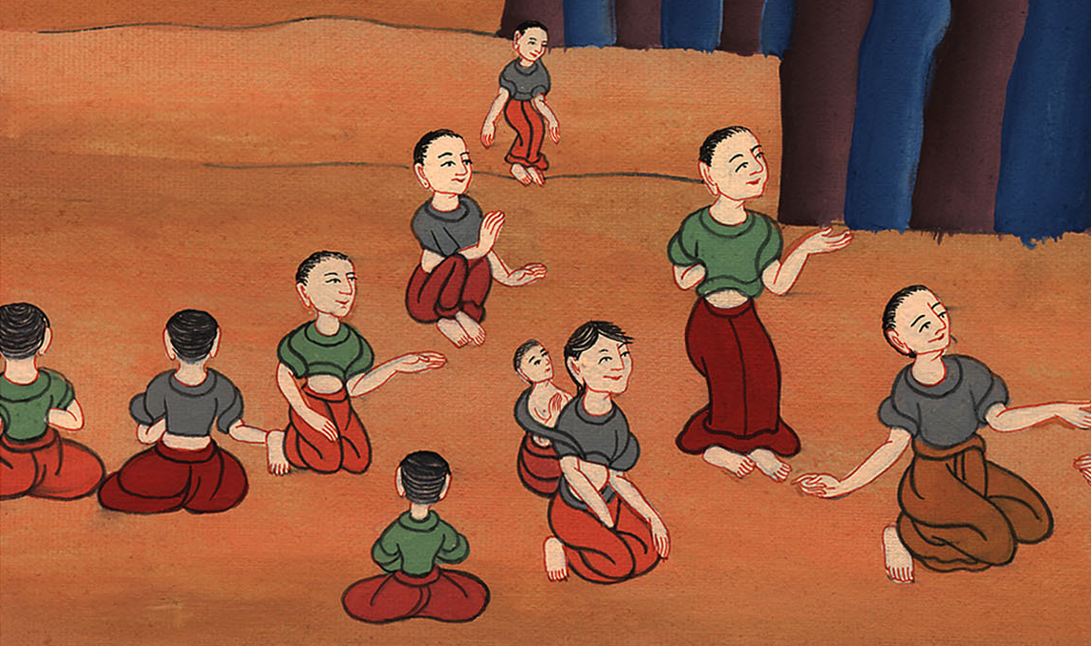
Exodus 20:12

Slide 41
13“You shall not murder.
14“You shall not commit adultery.
15“You shall not steal.
16“You shall not give false testimony against your neighbor.

Slide 42
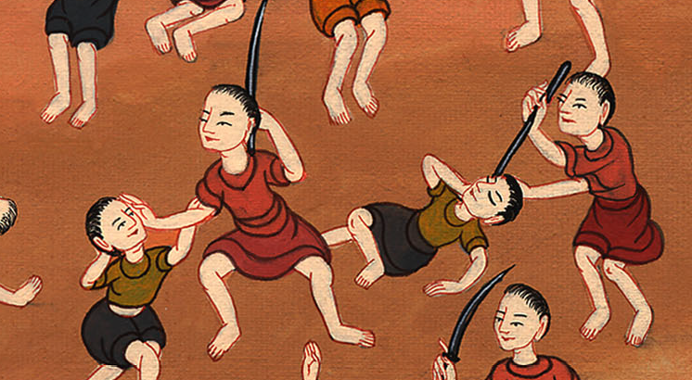
Exodus 20:13

Slide 43
17“You shall not covet your neighbor’s house. You shall not covet your neighbor’s wife, nor his male servant, nor his female servant, nor his ox, nor his donkey, nor anything that is your neighbor’s.”

Slide 44
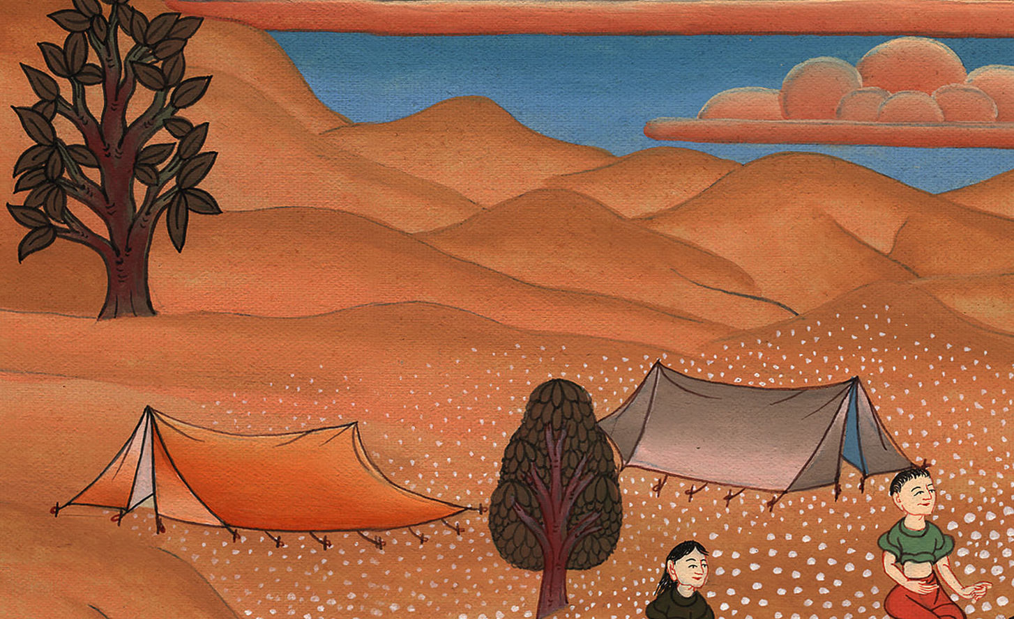
Exodus 20:17

Slide 45
18All the people perceived the thunderings, the lightnings, the sound of the trumpet, and the mountain smoking. When the people saw it, they trembled, and stayed at a distance.

Slide 46
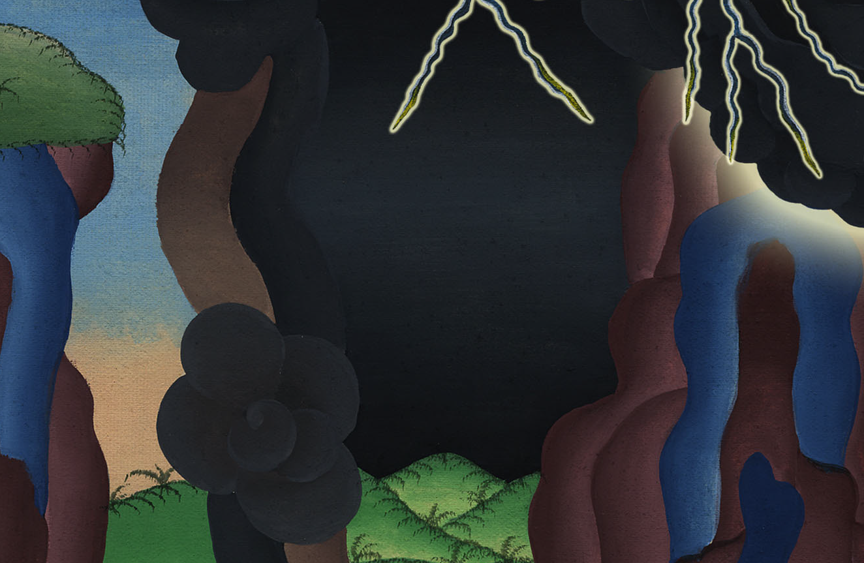
Exodus 20:18

