Slide 1
10-9
This work is licensed under a Creative Commons Attribution-ShareAlike 4.0 International License.
Please add this statement to all the videos you create.
English Bible quotes are from the World English Bible US, which is in the public domain.
Notes:
checked

Slide 2
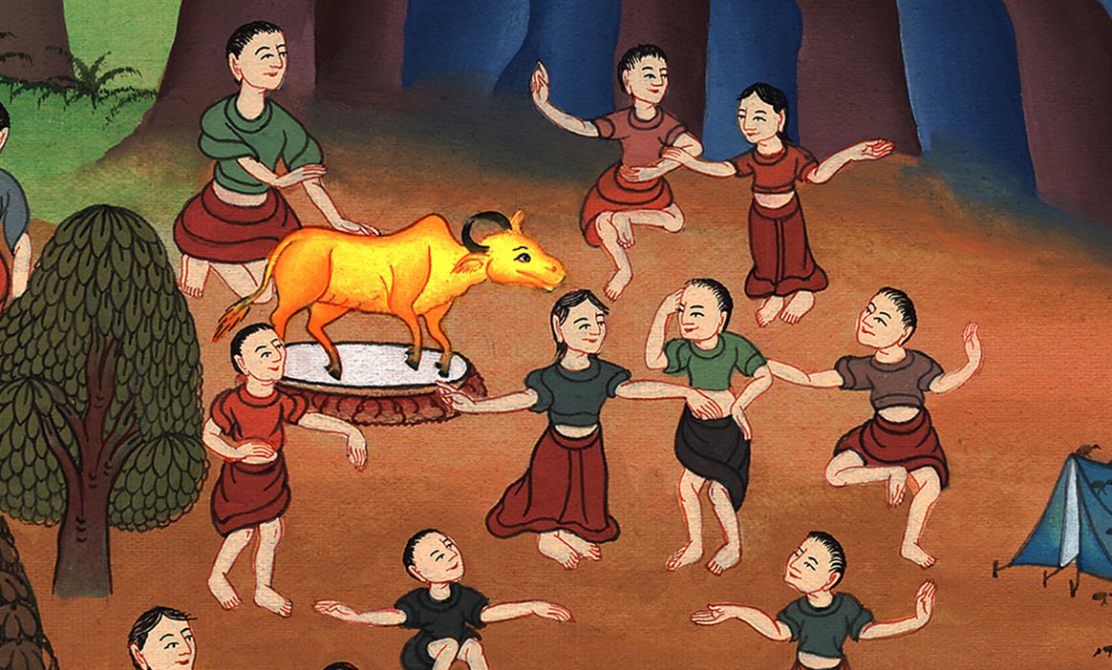
The Golden Calf – Exodus 32

Slide 3
The Golden Calf – Exodus 32
Notes:
First draft

Slide 4
The Golden Calf – Exodus 32

Slide 5
Exodus32:1When the people saw that Moses delayed coming down from the mountain, the people gathered themselves together to Aaron, and said to him, “Come, make us gods, which shall go before us; for as for this Moses, the man who brought us up out of the land of Egypt, we don’t know what has become of him.”

Slide 6
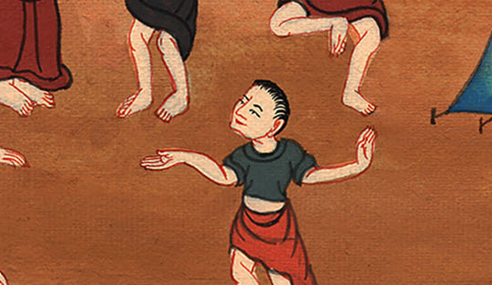
Exodus 32:1

Slide 7
2Aaron said to them, “Take off the golden rings, which are in the ears of your wives, of your sons, and of your daughters, and bring them to me.”

Slide 8
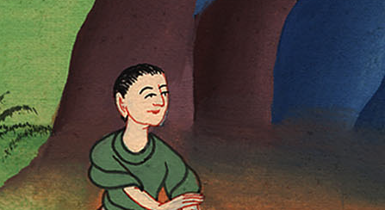
Exodus 32:2

Slide 9
4He received what they handed him, fashioned it with an engraving tool, and made it a molded calf. Then they said, “These are your gods, Israel, which brought you up out of the land of Egypt.”

Slide 10
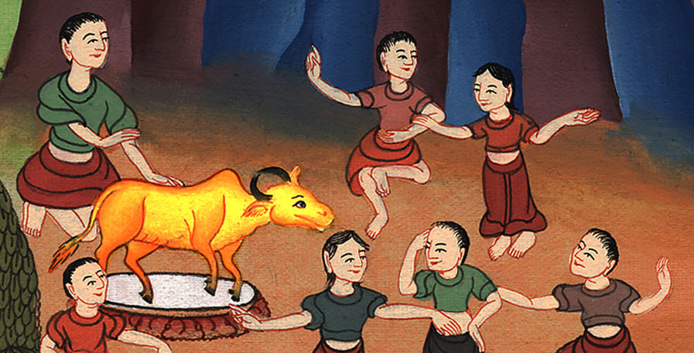
Exodus 32:4

Slide 11
6They rose up early on the next day, and offered burnt offerings, and brought peace offerings; and the people sat down to eat and to drink, and rose up to play.

Slide 12
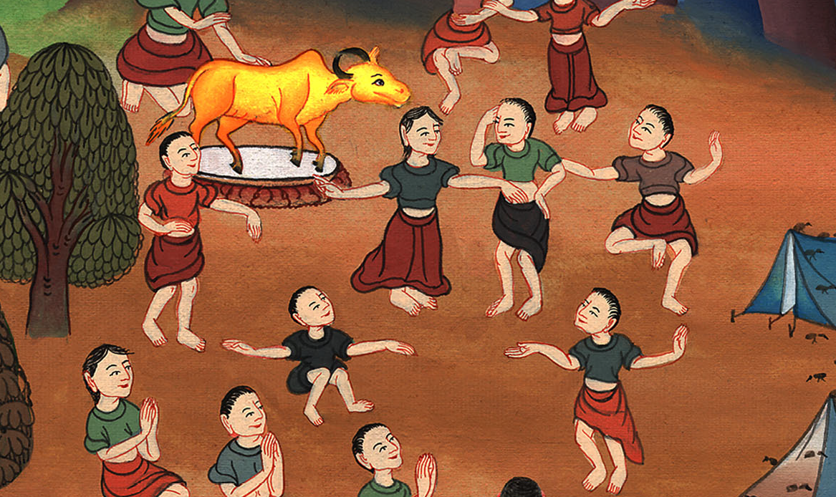
Exodus 32:6

Slide 13
7Yahweh spoke to Moses, “Go, get down; for your people, whom you brought up out of the land of Egypt, have corrupted themselves!

Slide 14
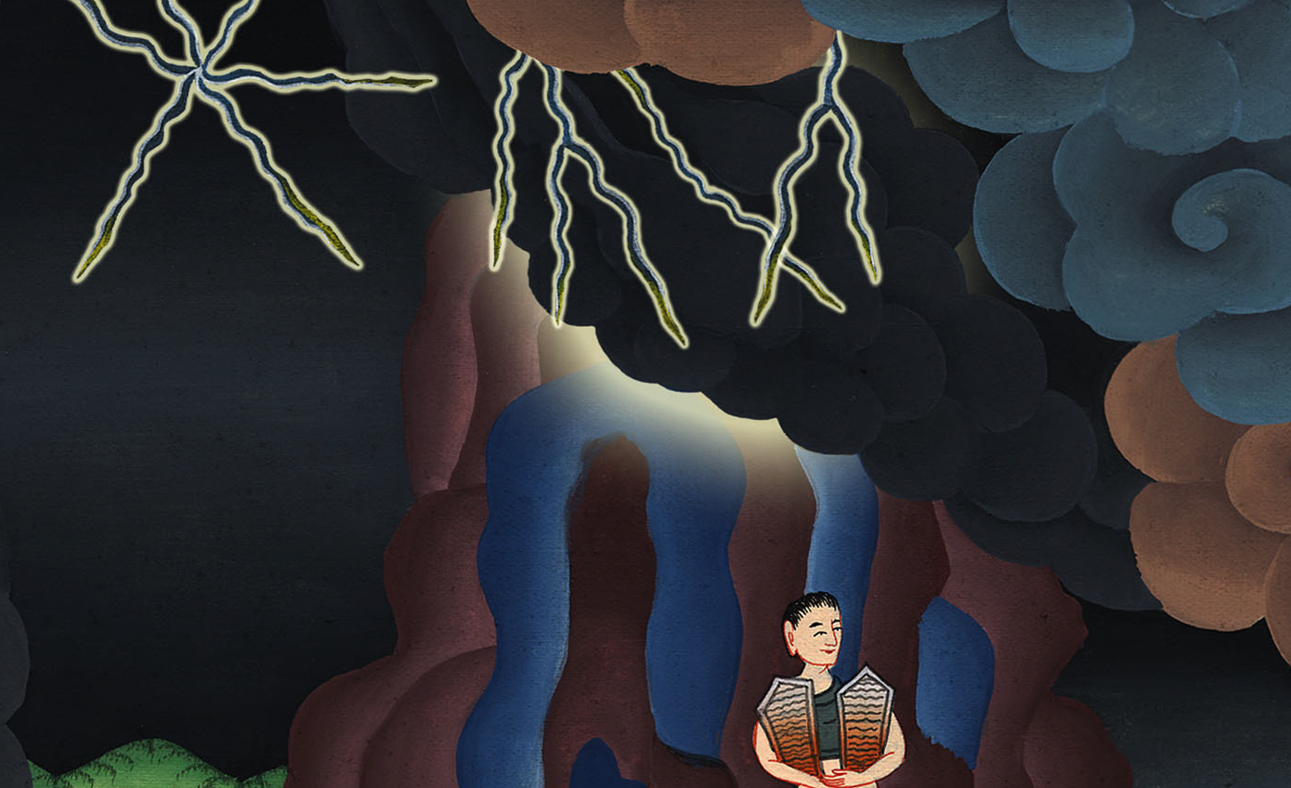
Exodus 32:7

Slide 15
15Moses turned, and went down from the mountain, with the two tablets of the covenant in his hand; tablets that were written on both their sides. They were written on one side and on the other.

Slide 16
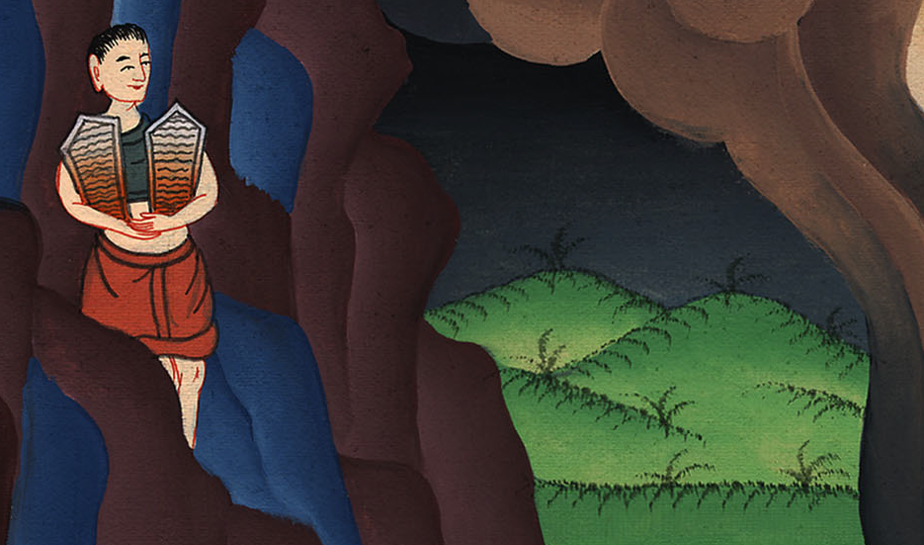
Exodus 32:15

Slide 17
16The tablets were the work of God, and the writing was the writing of God, engraved on the tablets.

Slide 18
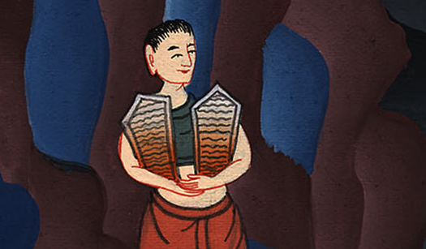
Exodus 32:16

Slide 19
19As soon as he came near to the camp, he saw the calf and the dancing. Then Moses’ anger grew hot, and he threw the tablets out of his hands, and broke them beneath the mountain.

Slide 20
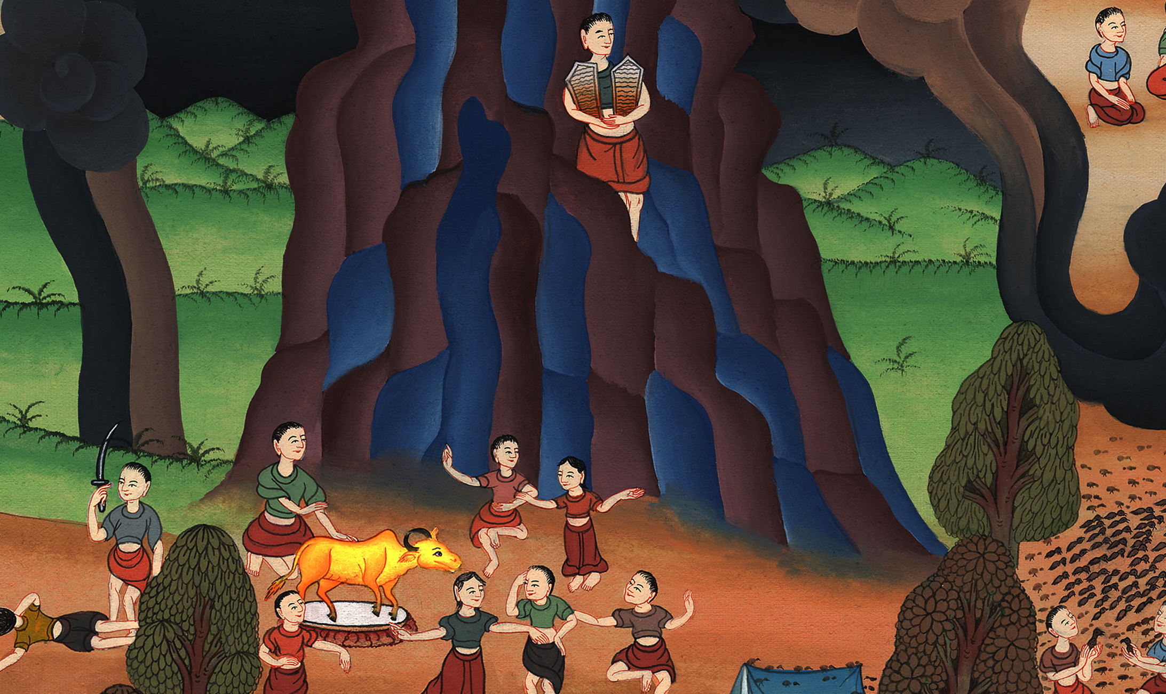
Exodus 32:19

Slide 21
20He took the calf which they had made, and burned it with fire, ground it to powder, and scattered it on the water, and made the children of Israel drink it.

Slide 22
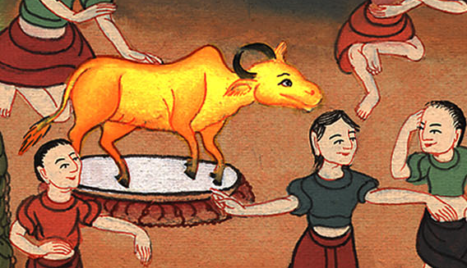
Exodus 32:20

Slide 23
26then Moses stood in the gate of the camp, and said, “Whoever is on Yahweh’s side, come to me!”
All the sons of Levi gathered themselves together to him.

Slide 24
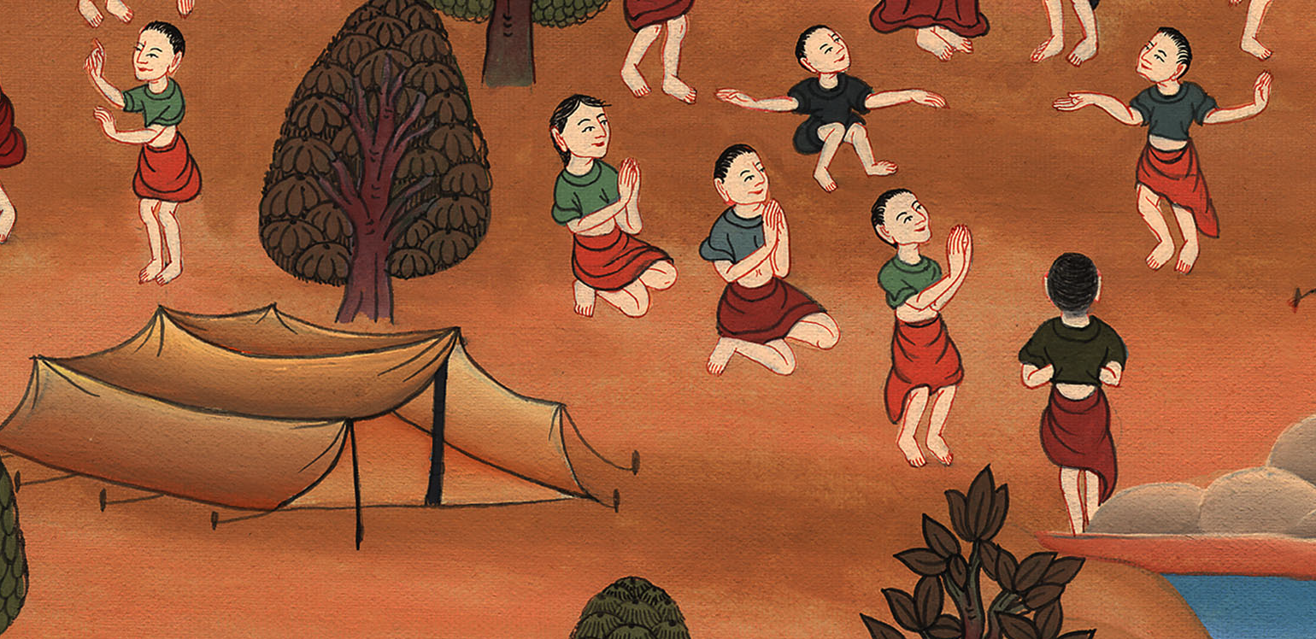
Exodus 32:26

Slide 25
27He said to them, “Yahweh, the God of Israel, says, ‘Every man put his sword on his thigh, and go back and forth from gate to gate throughout the camp, and every man kill his brother, and every man his companion, and every man his neighbor.’”

Slide 26
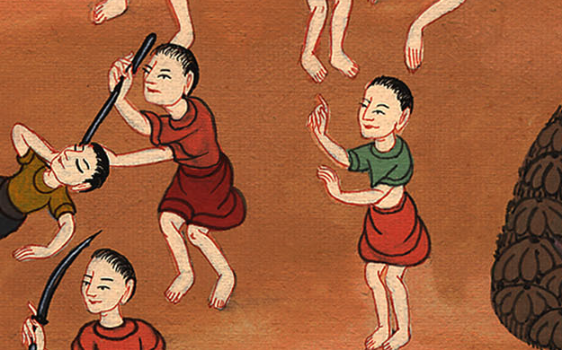
Exodus 32:27

Slide 27
29Moses said, “Consecrate yourselves today to Yahweh, for every man was against his son and against his brother, that he may give you a blessing today.”

Slide 28
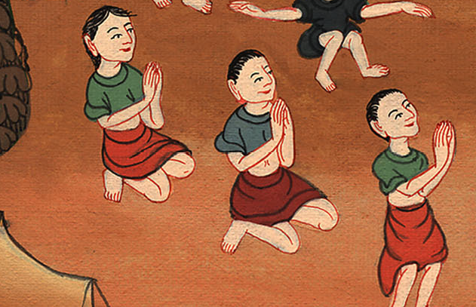
Exodus 32:29

Slide 29
30On the next day, Moses said to the people, “You have sinned a great sin. Now I will go up to Yahweh. Perhaps I shall make atonement for your sin.”

Slide 30
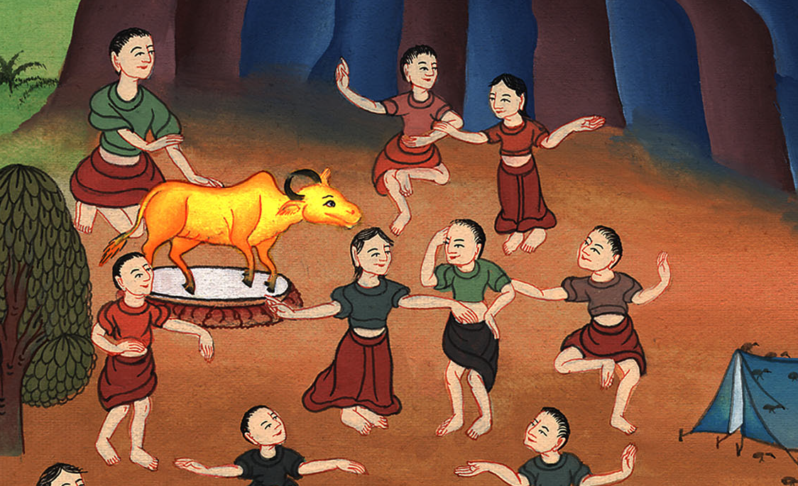
Exodus 32:30

